Slide 1
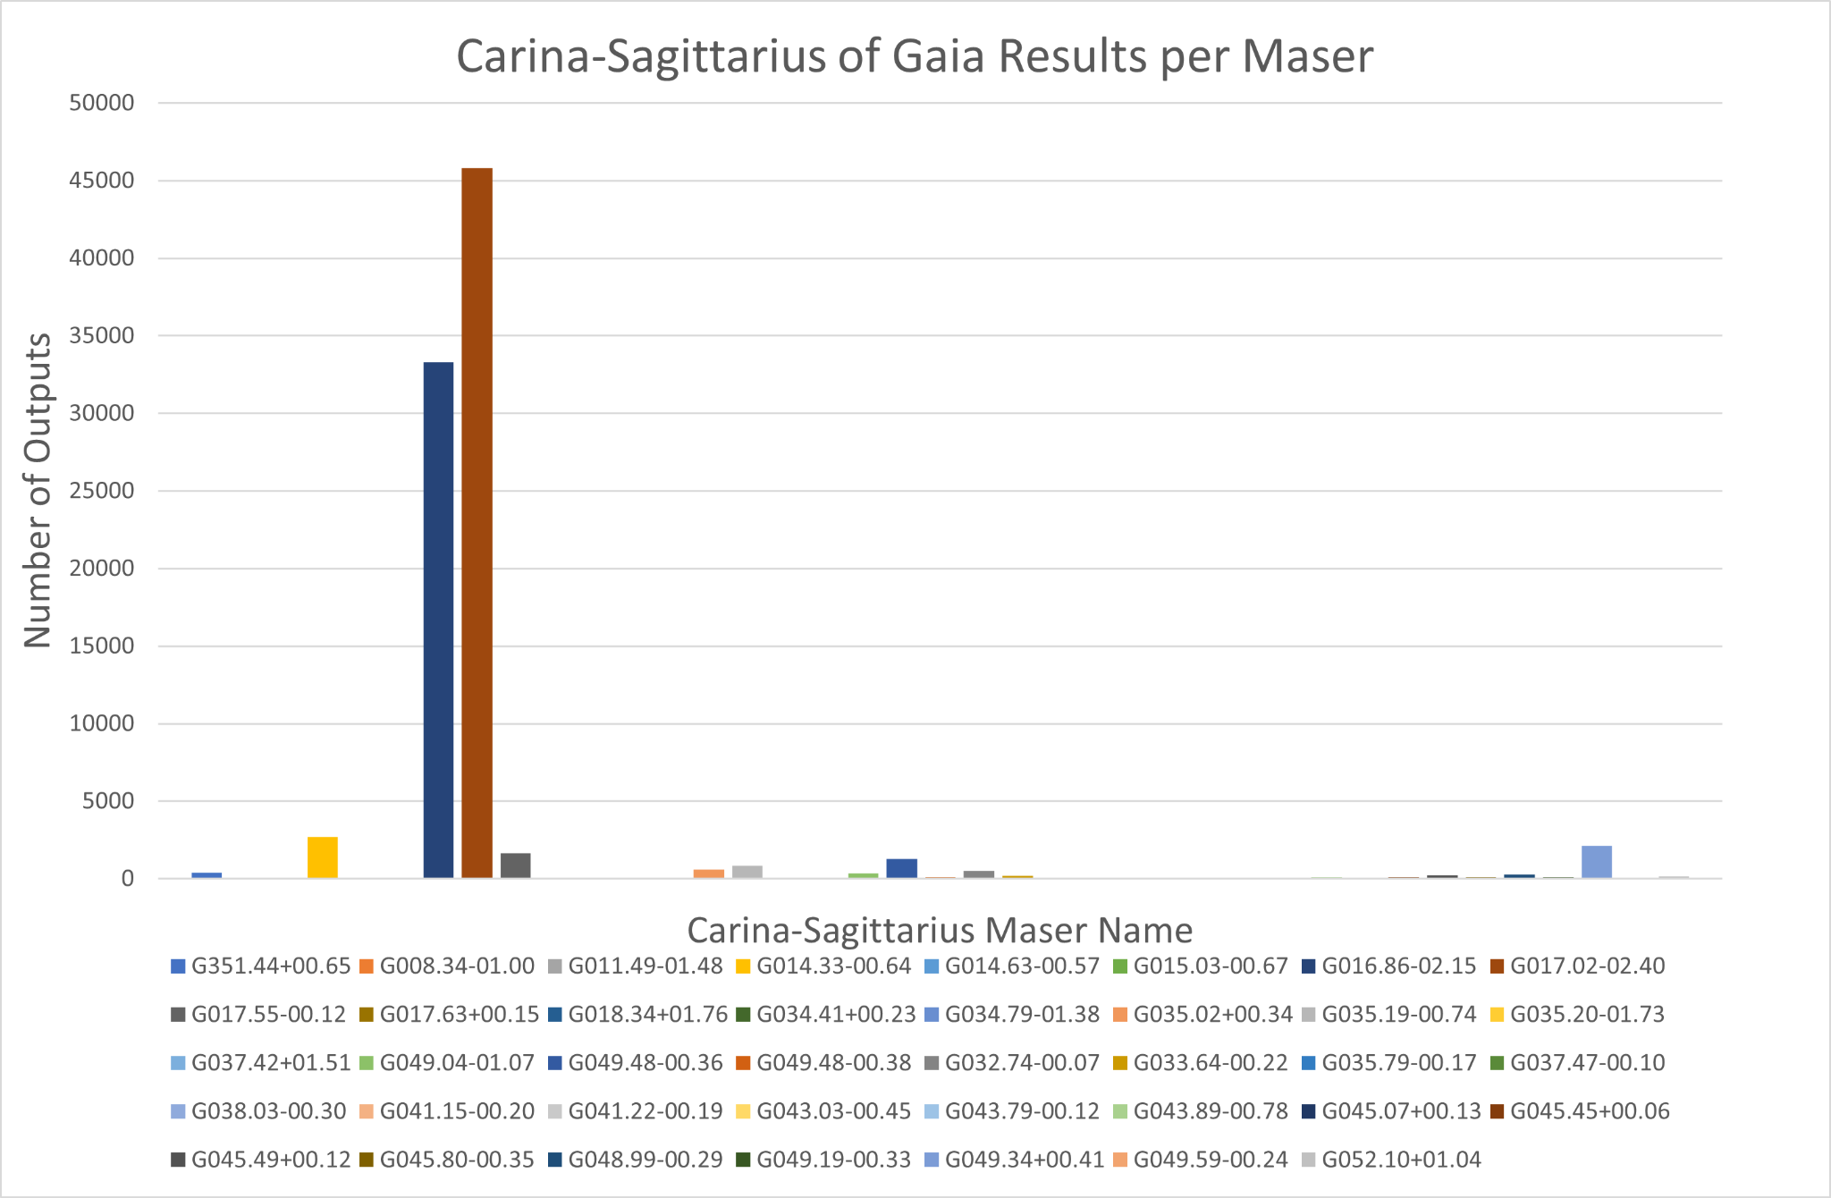
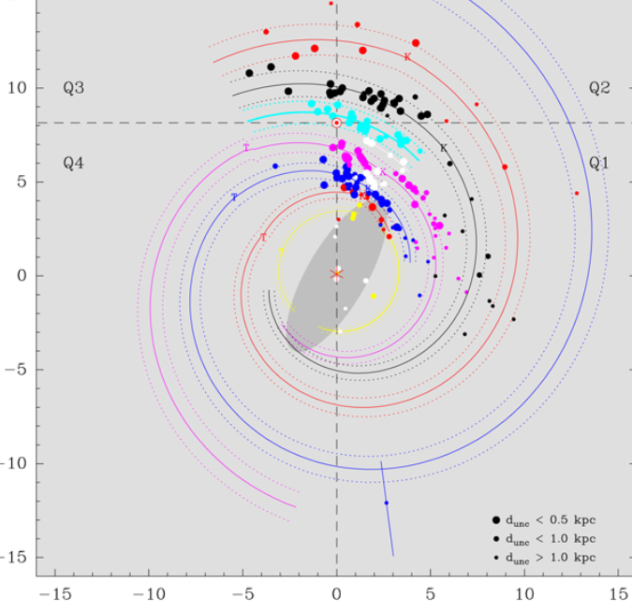
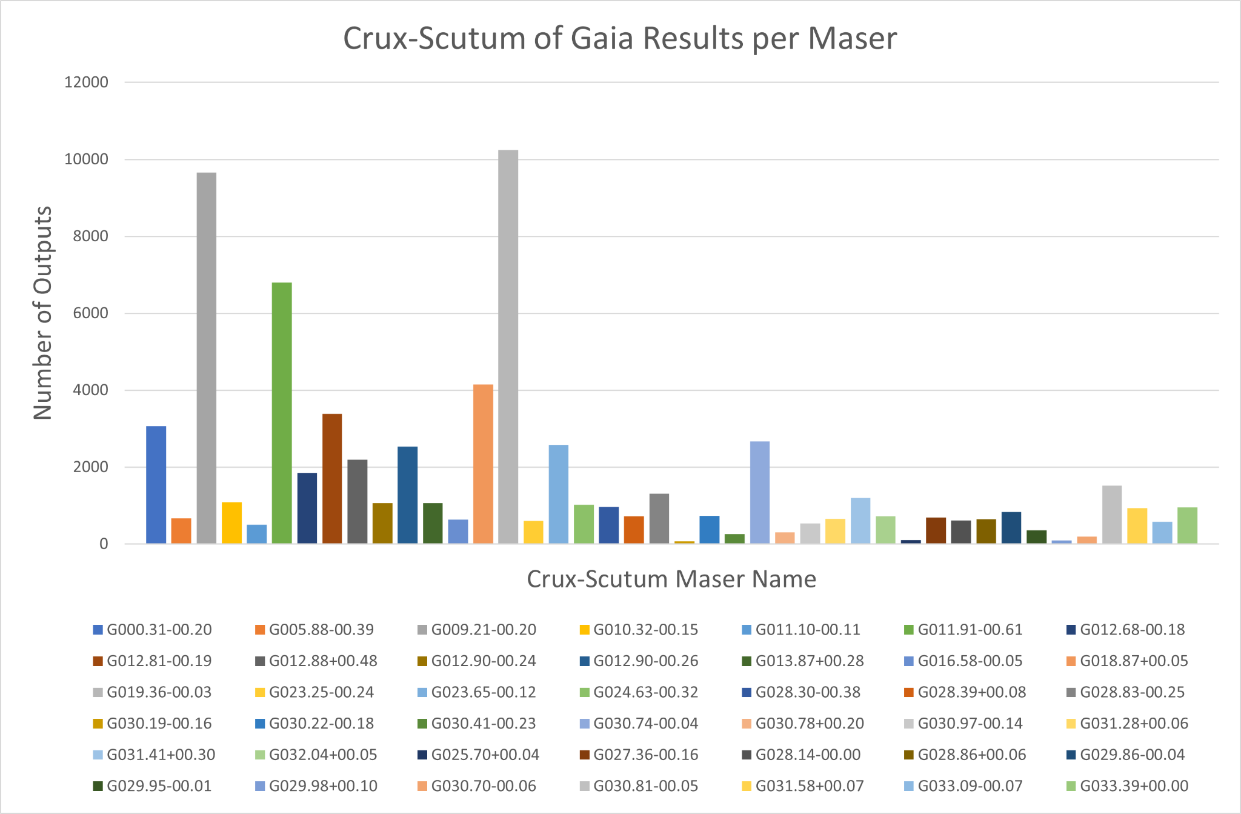
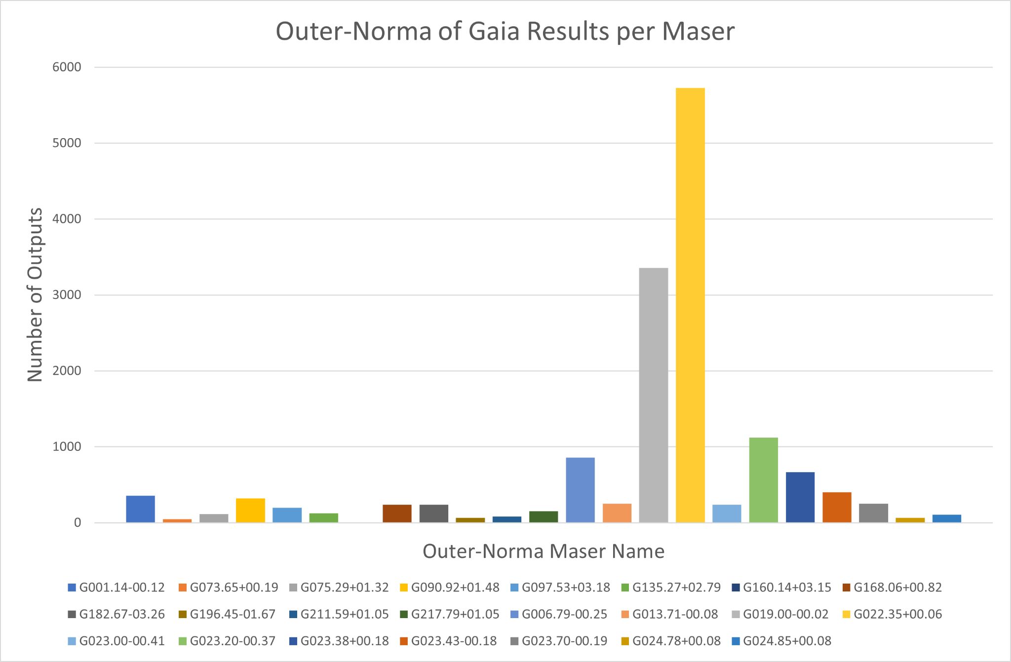
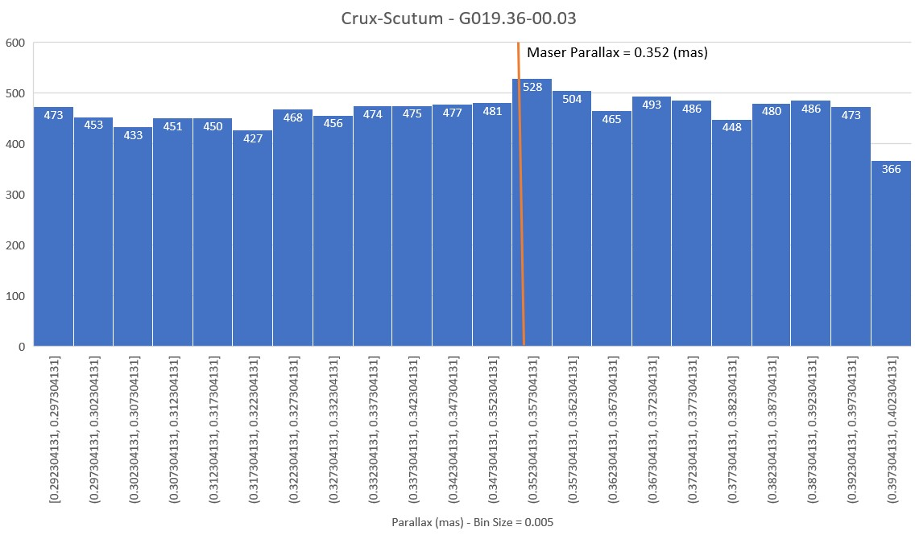
Stellar Mapping of the Milky Way Galaxy
Amethyst Barnes, Kayla Clink, Serena DeCandia
Faculty Advisor(s): Luis Henry Quiroga-Nunez, Dept. of APSS, Florida Institute of Technology
Faculty Observer: Dr. Hamid K. Rassoul, Dept. of APSS, Florida Institute of Technology
Introduction
Methods (Cont.)
Using data from the paper Trigonometric Parallaxes of High-mass Star-Forming Regions: Our View of the Milky Way, plotted in Figure 1, (Reid et. al. 2019), stellar objects found within separate arms of the Milky Way are analyzed and compiled to assist in outlining, shaping, and modeling the overall spiral structure of the galaxy.
By using Gaia’s Data Release 3 (GDR3), data from Figure 1, Microsoft Excel, and a created ADQL query, a 3D cone search was performed around masers to locate points in three of the Milky Way’s spiral arms: Outer-Norma, Crux-Scutum, and Carina-Sagittarius.
The second query written searched a spherical region around each maser (radius of 120 pc) and the output results were exported to do data analysis.
Excel was utilized to create histograms for each arm that displays the number of sources found per each maser input from the 3D query in GDR3, which can be seen in Figures 2, 3, and 4.
For each maser point, specifically for those with many points, a histogram of parallax measurements was created with a vertical line marking where the maser-parallax is shown (Figure 5).
Figure 4: Carina-Sagittarius points per maser. Max: 45810, Aver: 2340, Total: 91257. 10 masers found with 0 output.
Results/Conclusion
An ADQL query performed a 3D spherical search around the masers found in the spiral arms Outer-Norma, Crux-Scutum & Carina-Sagittarius.
Histograms were produced to show the distribution of sources found around each maser.
The combined data found during this research will be used in the future to plot a top-down distribution of the found sources in each arm.
Y (kpc)
X (kpc)
Figure 3: Crux-Scutum points per maser. Max: 10247, Aver: 1684, Total: 70753. 0 masers found with 0 output.
Figure 1: Distribution of high-mass stellar regions within the Milky Way (2019). [Red: Outer-Norma, Blue: Crux-Scutum, Purple: Carina Sagittarius]
Methods
Microsoft Excel was used for all numerical calculations, including converting the masers into units that GDR3 can recognize, calculating the size for the 3D cone search, which is calculated from the parallax of each maser, and all error analysis.
A .csv file was exported and uploaded into Gaia’s database, where the columns could be designated.
Two ADQL queries were written, the first which performed a general 2D circular search around the masers.
Figure 2: Outer-Norma points per maser. Max: 5727, Aver: 650, Total: 14960. 1 maser found with 0 output.
Figure 5: Histogram of the parallax measurements for outputs of one maser from Crux-Scutum. The orange line represents the parallax of the maser.

