Slide 1
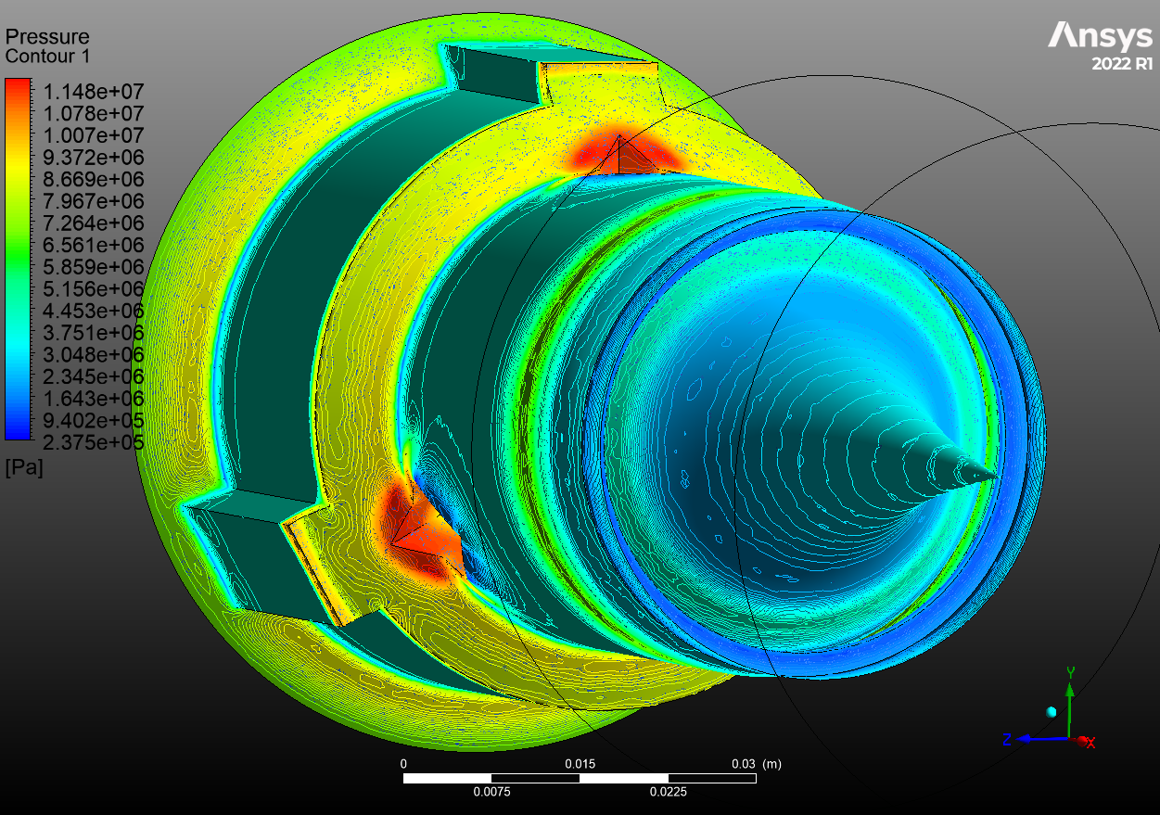
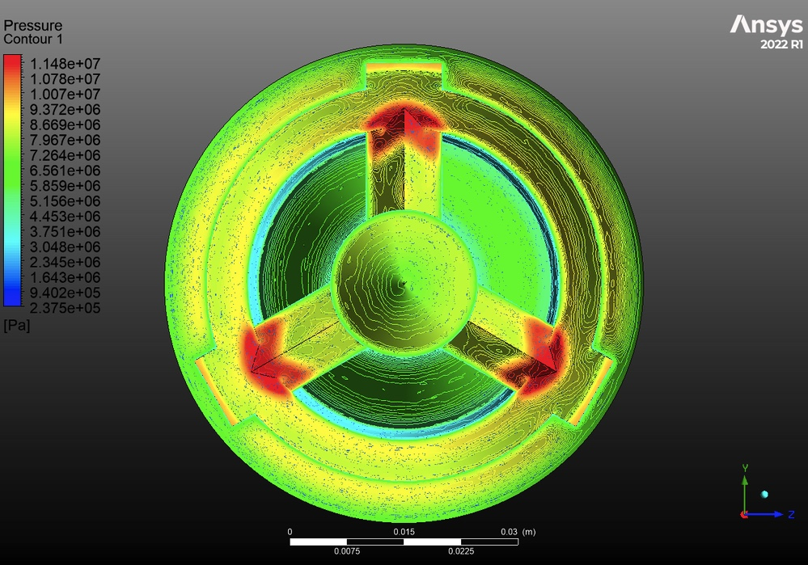
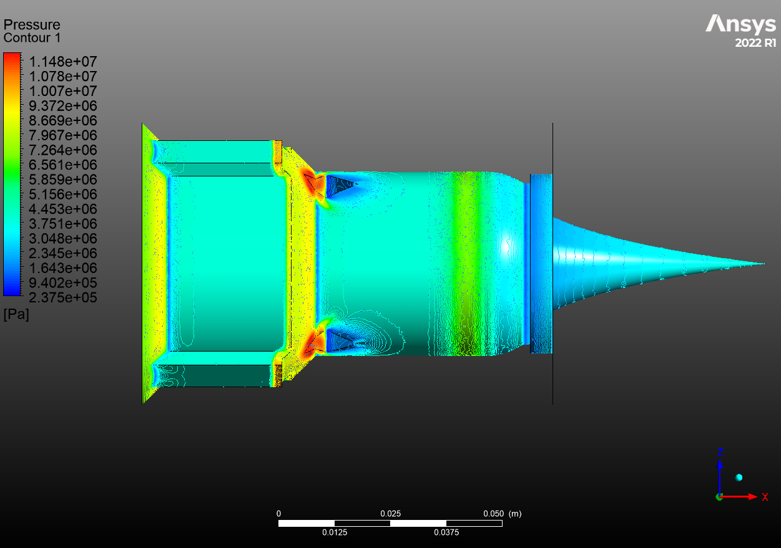
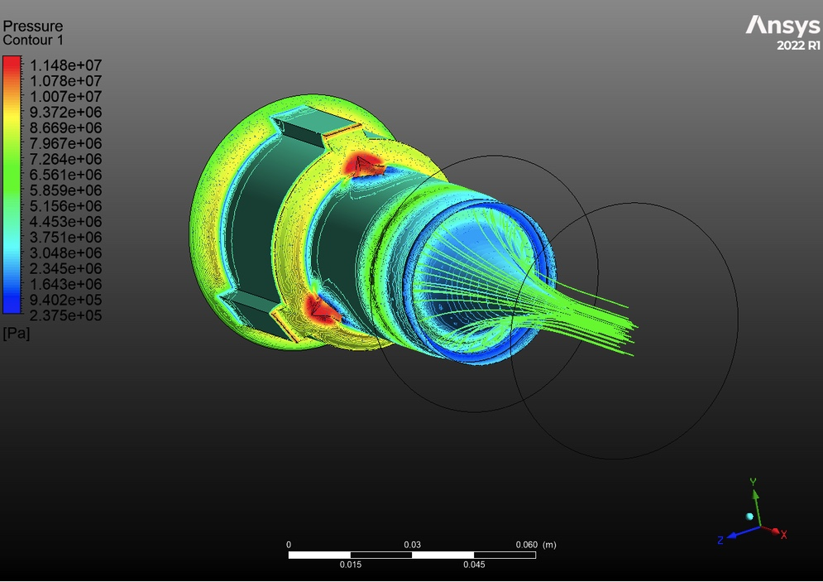
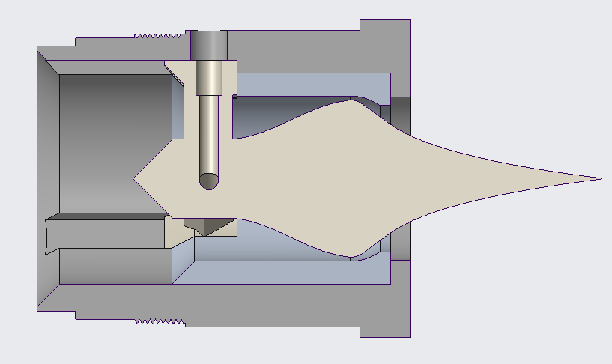
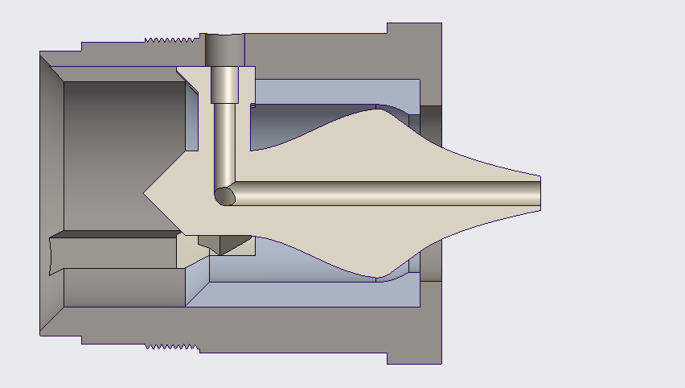
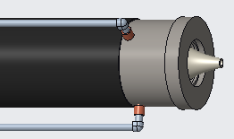
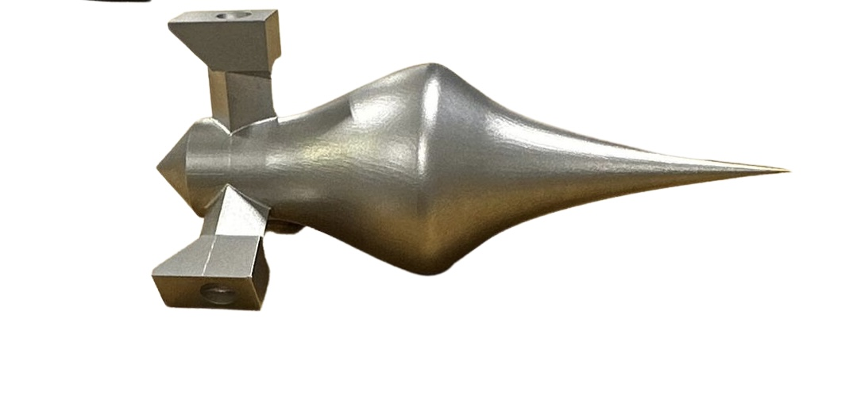
The Aerospike Project
R. Amaya-Ayala, P. Kennedy, W. Mahony, C. Garthwaite, J. Porter,
A. Alli, F. Alshutayri, O. Dode, B. Kandine, A. Mamindla, K. Price
Faculty Advisors: Dr. Douglas Willard & Dr. Daniel Kirk
Dept. of Aerospace, Physics and Space Sciences, Florida Institute of Technology
MISSION
SIMULATIONS
The Aerospike Project is a research project aiming to optimize ideally-expanded aerospike rocket nozzles in order to maximize thrust efficiency. This was done by calculating the specific thrust from initial conditions, and then comparing between two configurations, a solid-powered toroidal full spike and a solid-powered toroidal truncated spike utilizing a N₂ base bleed.
PROJECT PLAN
ANSYS Fluent was used to simulate fluid flow on computer-designed models providing insight into the behavior of fluids, exhaust gases, and heat transfer in these complex geometries.
Simple 2D designs were used to simulate different fuel and material types first, then implemented into 3D models for optimal results after being tested and vetted.
Boundary conditions were represented in the form of pressure inlet, pressure outlet, nozzle wall, and far field.
Design a full aerospike nozzle and a truncated aerospike nozzle with a N₂ base bleed meeting initial conditions, requirements, and capable of testing on META
Perform simulations on CAD designs and propellant to confirm designs and supplement theoretical values
Manufacture nozzles to support 10 sec. static test fire
Test fire each aerospike nozzle utilizing META, collecting thrust, pressure, and temperature data
Analyze data, calculate for actual specific thrust and thrust efficiency, and compare to theoretical values and between aerospike nozzle configurations
MANUFACTURING
Full spike fabrication:
Spike was outsourced, made of 17-4 PH Stainless Steel
Coated with nickel conductive aerosol paint
Bleed lines through the t-bar were made in-house
Truncated spike w/ base bleed fabrication:
Truncated spike was outsourced, made of 17-4 PH Stainless Steel
Coated with nickel conductive aerosol paint
Same geometry as full spike, except it utilized a 40% truncation from the tip
Bleed lines through the t-bar, into the spike, and out the truncation made in-house
Cowl fabrication:
Cowl made in-house from 17-4 PH Stainless Steel
Coated with nickel conductive aerosol spray
Housing fabrication:
Housing made in-house from 17-4 PH Stainless Steel
Coated with VHT Flameproof ceramic aerosol paint
Plumbing and META system integration at the housing
DESIGN
Initial Conditions:
Chamber Pressure = 1000 psi
Chamber Temperature = 2238.589 K
Expansion Ratio, ε = 8.4486
Exit Radius = 18 mm
Exit Area = 1017.876 mm
Specific Gas Constant, R = 58.31 $\frac{lbf∗s}{lbm∗°R}$
Theoretical Values:
Thrust = 216.26 lbf
Mass Flow Rate, ṁ = 1.4283 $\frac{lbm}{s}$
Throat area = 120.48 mm
Throat Radius = 6.19 mm
Specific Impulse by Mass = 151.41 $\frac{lbf∗s}{lbm}$,
Specific Thrust = 1.158
Exit Mach Number = 3.226
Exit Temperature = 1856.23 K
Exit Pressure 14.7 psi
ACKNOWLEDGMENTS
Without our sponsors, Dr. Douglas Willard, Ronald Fussell, and Trent Linville, none of this would have been possible. Their generous support and commitment to our team has been instrumental in helping us achieve our goals, and we are incredibly grateful for their contribution to our success.

