Slide 1
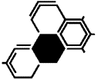
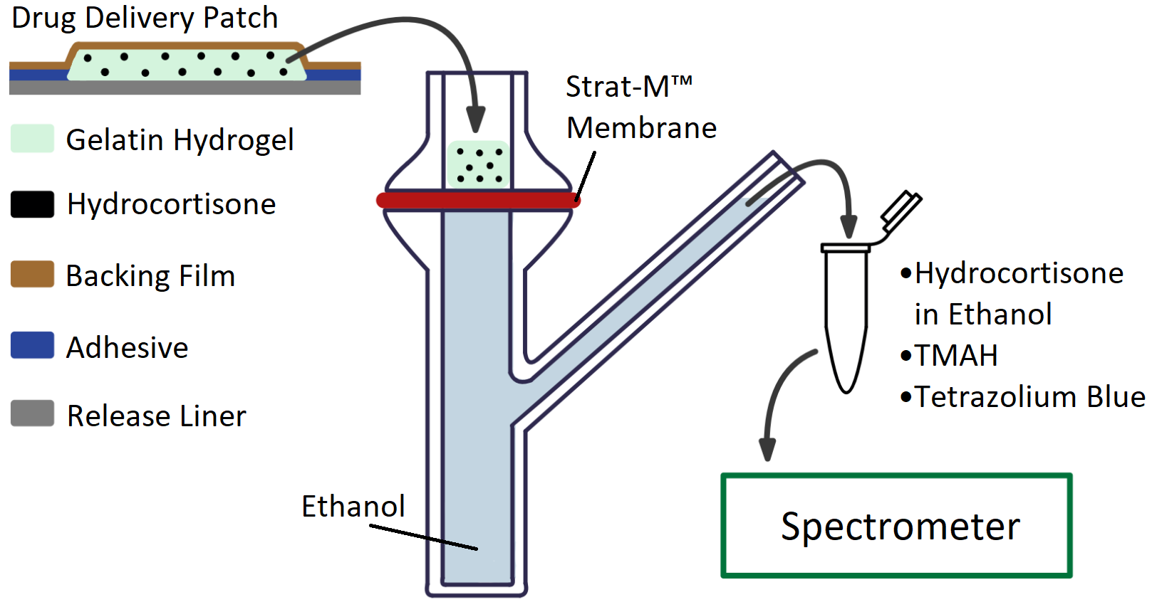
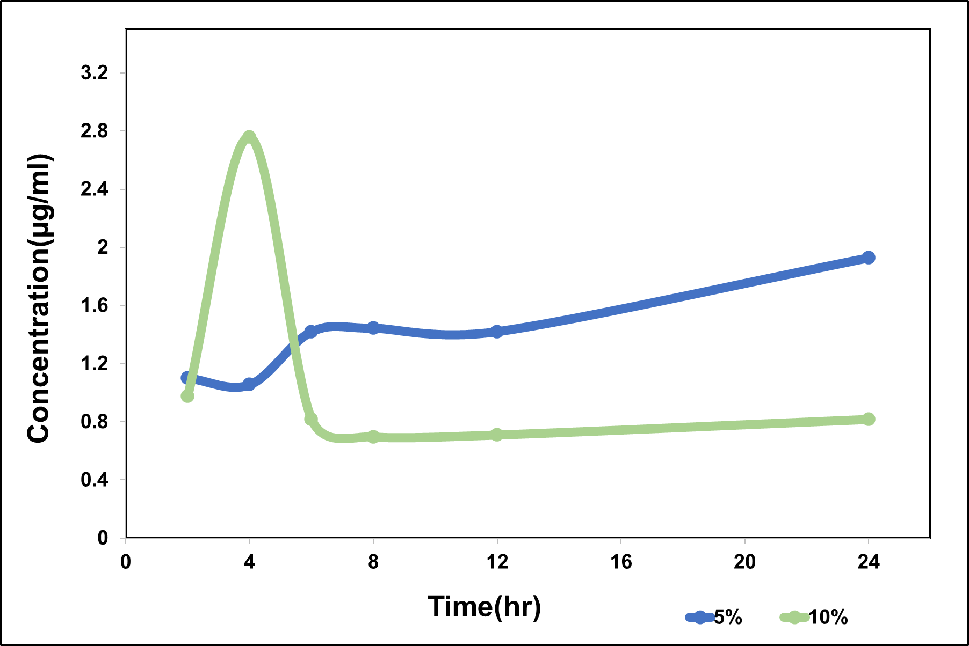
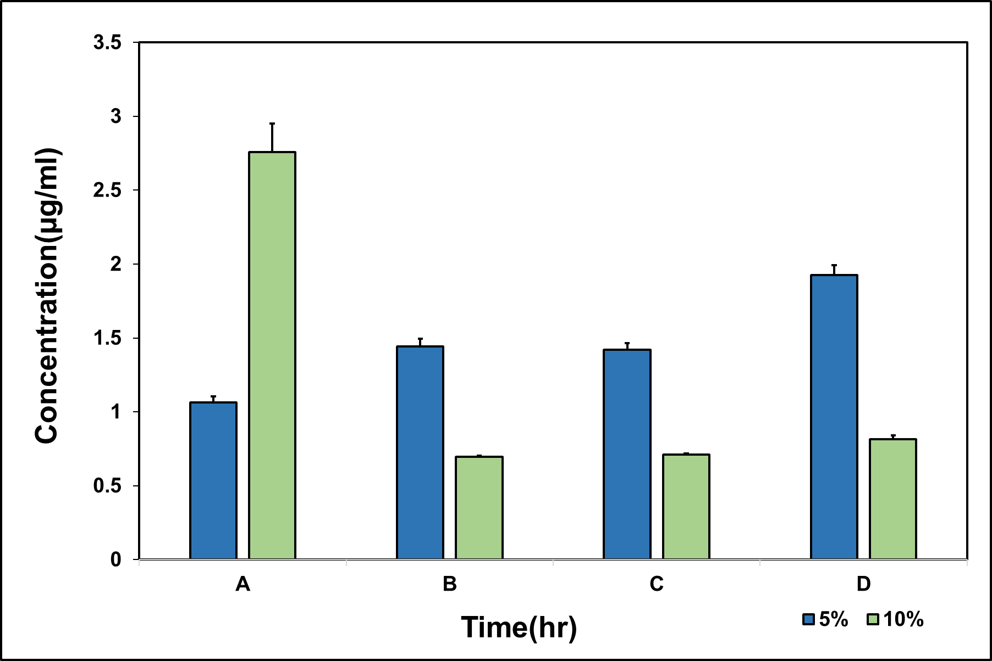
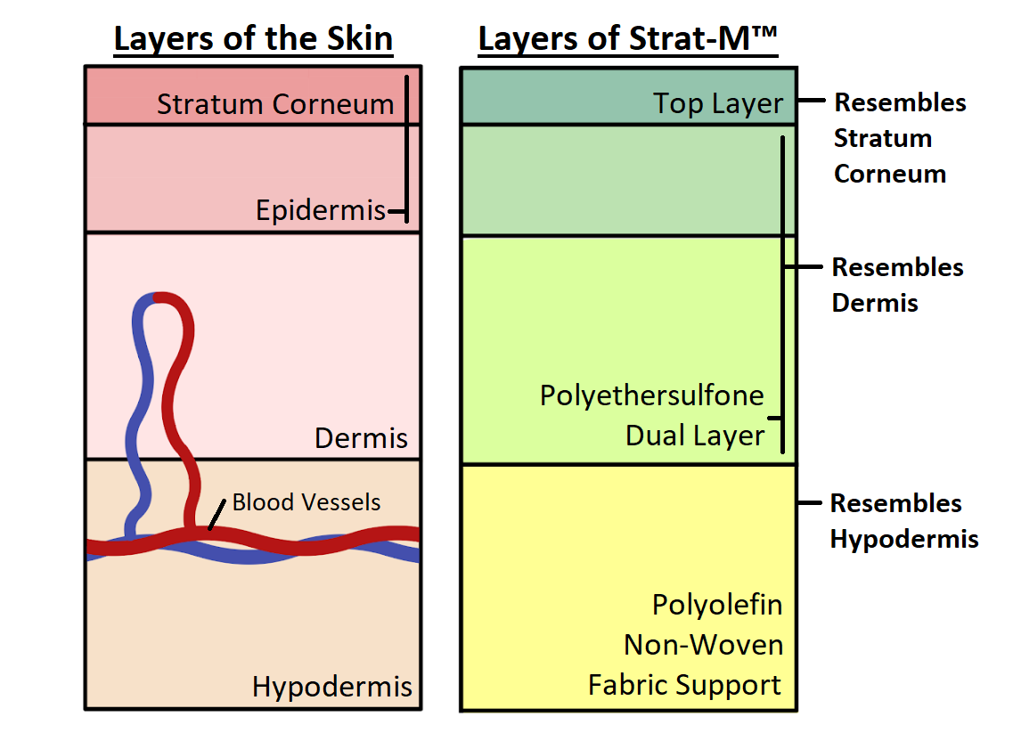
ReAction Patch: Transdermal Steroid Drug Delivery Patch
Genna Felder, Miguel Hernandez, Hannah Radak, Anna Thomas, Daniel Fafemi
Faculty Advisor: Dr. Venkat K. Chivukula, Dept. of Biomedical Engineering, Florida Institute of Technology
Motivation
Design & Methods
Eczema affects nearly 31 million Americans.
Current treatment modality: suppression of symptoms with topical steroids.
Discontinuing the use of topical steroids can cause the patient to go through severe drug withdrawal.
ReAction patch aims to be a cost-effective solution to help patients experiencing drug withdrawal symptoms.
Figure 2. Schematic representation of study. Gelatin-hydrocortisone hydrogels of 5% and 10% w/v were fabricated and crosslinked using glutaraldehyde. Hydrocortisone was diffused through Strat-M™ into the Franz cell in a 37°C incubator. Solution acquired from Franz cell was reacted with Tetrazolium Blue dye. The reacted product was then analyzed through a spectrometer and compared against a standard curve.
Objectives
Results
Develop a transdermal drug delivery patch system designed for topical steroid withdrawal tapering.
Determine the weight/volume of gelatin hydrogel most effective to deliver a therapeutic dose of steroid to a patient.
Test drug diffusion through Strat-M™, a skin-like membrane.
Figure 3. Comparison of 5%w/v and 10%w/v gelatin hydrogel diffusion over a 24 hour period. 5%w/v shows a controlled release profile. 10% w/v shows a burst release profile.
Figure 4. Statistical comparisons of several time points(TP) A) 4hr TP demonstrates that 10%w/v gelatin hydrogel has a burst release profile B) 8hr TP 5% w/v gelatin hydrogel has a higher release rate than 10%w/v C and D) 12hr and 24hr TPs confirm the results shown in B.
Economics
Conclusions & Future Work
Fixed Costs | $12,072.90
Manufacturing Costs per Unit (Variable Costs) | $364,000
Retail Price (Box of 7 patches) | $40
Expected Units Sold | 64,000,000
Determined the release profiles of different w/v gelatin hydrogels.
Perform cell studies on skin cells to get a better idea of the phenomenon of Topical Steroid Withdrawal.
Perform experiments with different materials and drug concentrations.
Acknowledgements
Dr. Venkat Keshav Chivuluka, Nashaita Patrawalla, Dr. Christopher Bashur, Dr. James Brenner, MD/PhD Tatiana Karpova, Dr. Kishore, Karen at glassblowers.com, Aurora Burkus-Matesevac.
Figure 1. Comparison of layers of skin vs. layer composition of Strat-M™.

