Slide 1
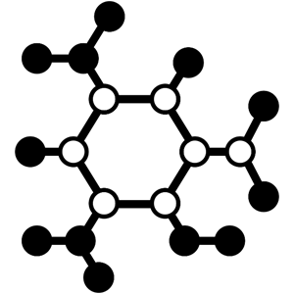
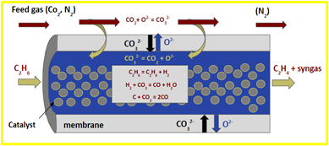
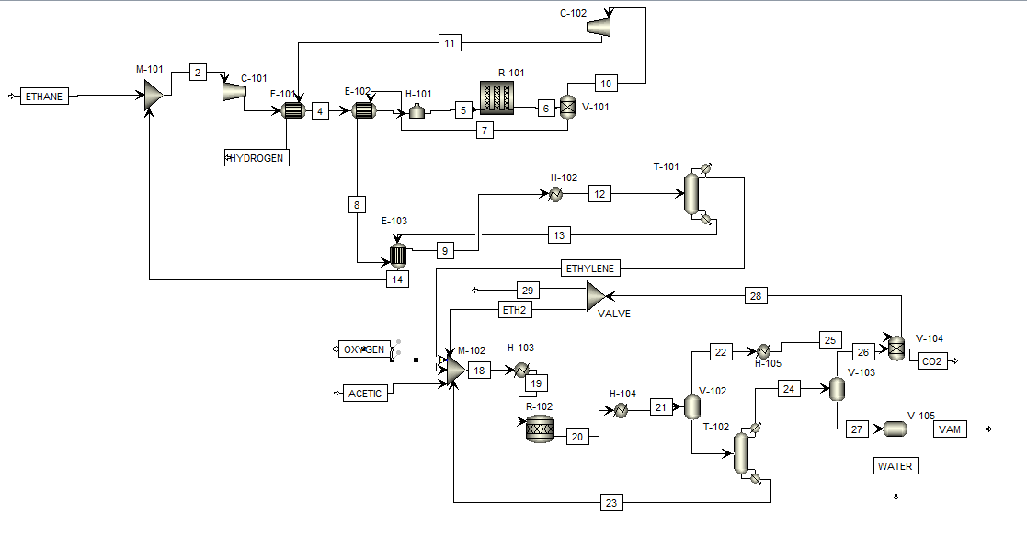
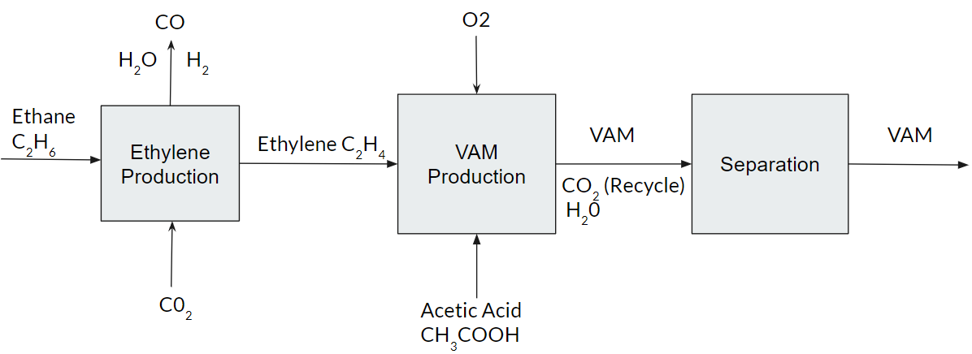
Reduction of CO2 in the Production of VAM Using a Membrane Reactor
Aidan Stewart, Deuce LaDuke, Jack Hogan, Ryan Hull
Faculty Advisor: Dr. Jonathan E. Whitlow Dept. of CHE, Florida Institute of Technology
Introduction:
Vinyl Acetate Monomer (VAM) is a compound used in the manufacturing process of polymers. VAM production is well established but emits large amounts of CO2. Our aim is to reduce CO2 release and incorporate it back into the process by utilizing a membrane reactor.
Process Flow Diagram:
Membrane Reactor:
Legend:
Ethane Production ☐
VAM Production ☐
Separation ☐
Novelty:
Using a membrane reactor at high temperature results in the dehydrogenation of Ethane. This produces Ethylene in association with CO2 from the VAM production. Ultimately reducing Carbon Dioxide emissions.
Block Flow Diagram:
Reactions:
Ethane to Ethylene:
C₂H₆ → C₂H₄ + H₂
Secondary Membrane Reaction:
H₂ + CO₂ → CO + H₂O
VAM Reaction:
C₂H₄ + O₂ + C₂H₄O₂ → C₄H₆O₂ + 2H₂O
E-10X
Shell & Tube Heat Exchangers
M-10X
Mixers
C-10X
Compressors
H-101
Fired Heater
H-102 → H-105
Heat Exchangers
R-101
Membrane Reactor
T-101 & T-102
Distillation Columns
R-102
Plug Flow Reactor
V-101-V-103
Flash Separators
V-104
Scrubber
V -105
Decanter

