Slide 1
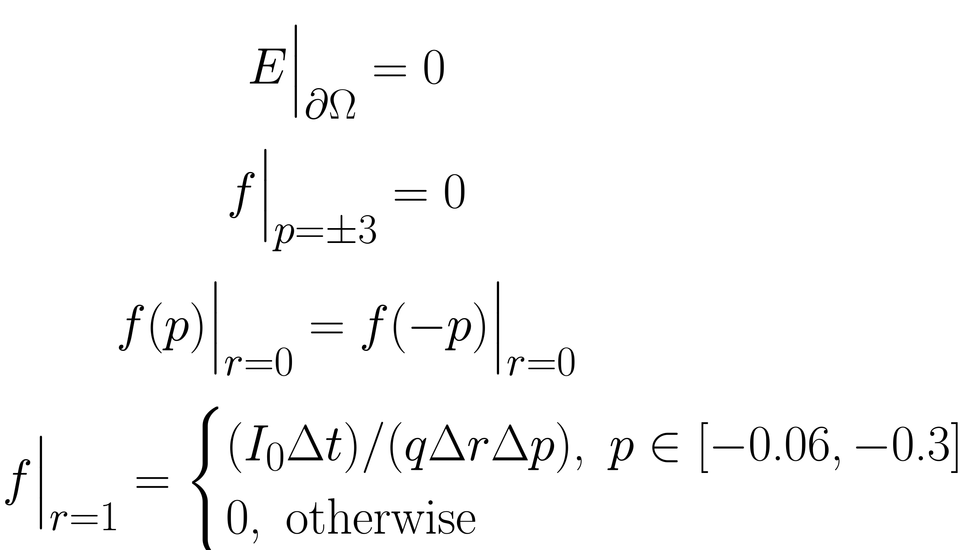
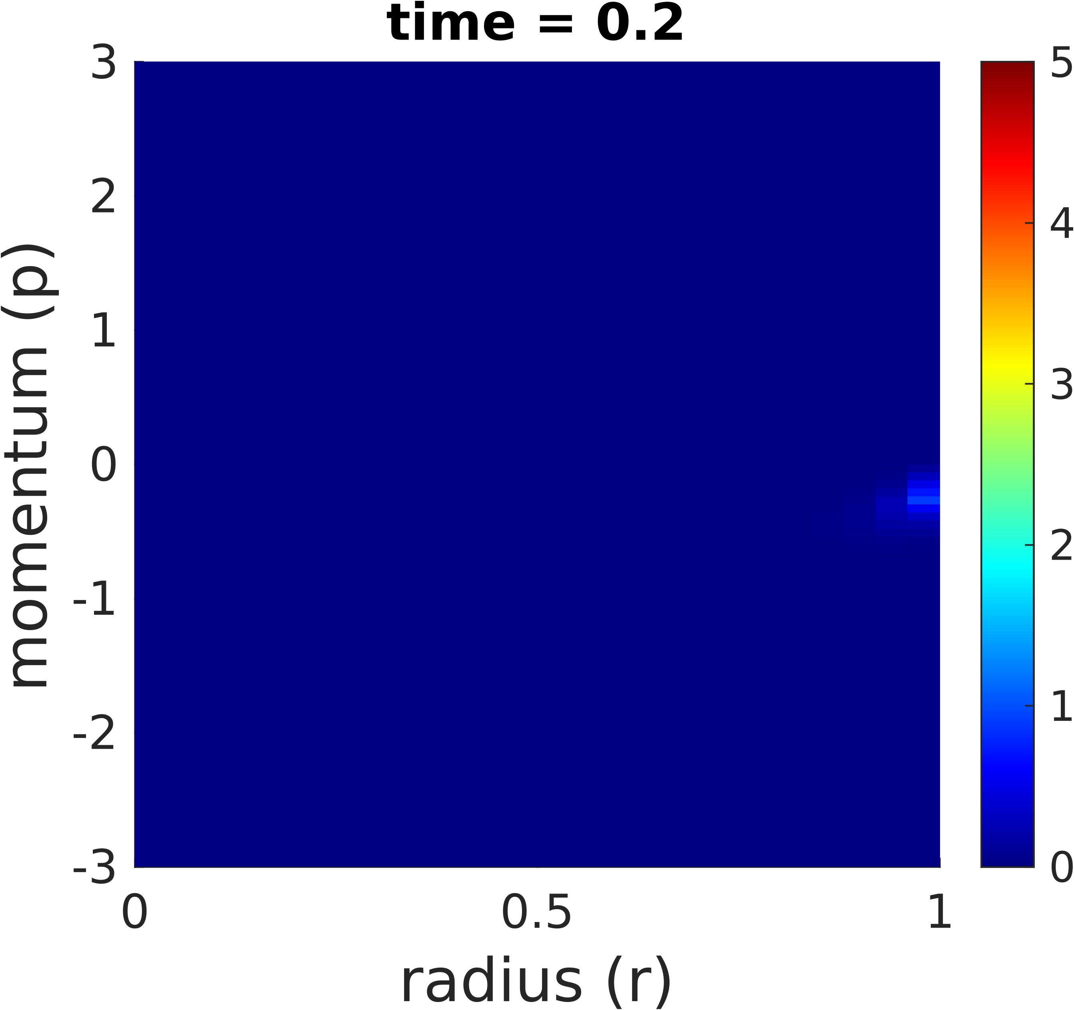
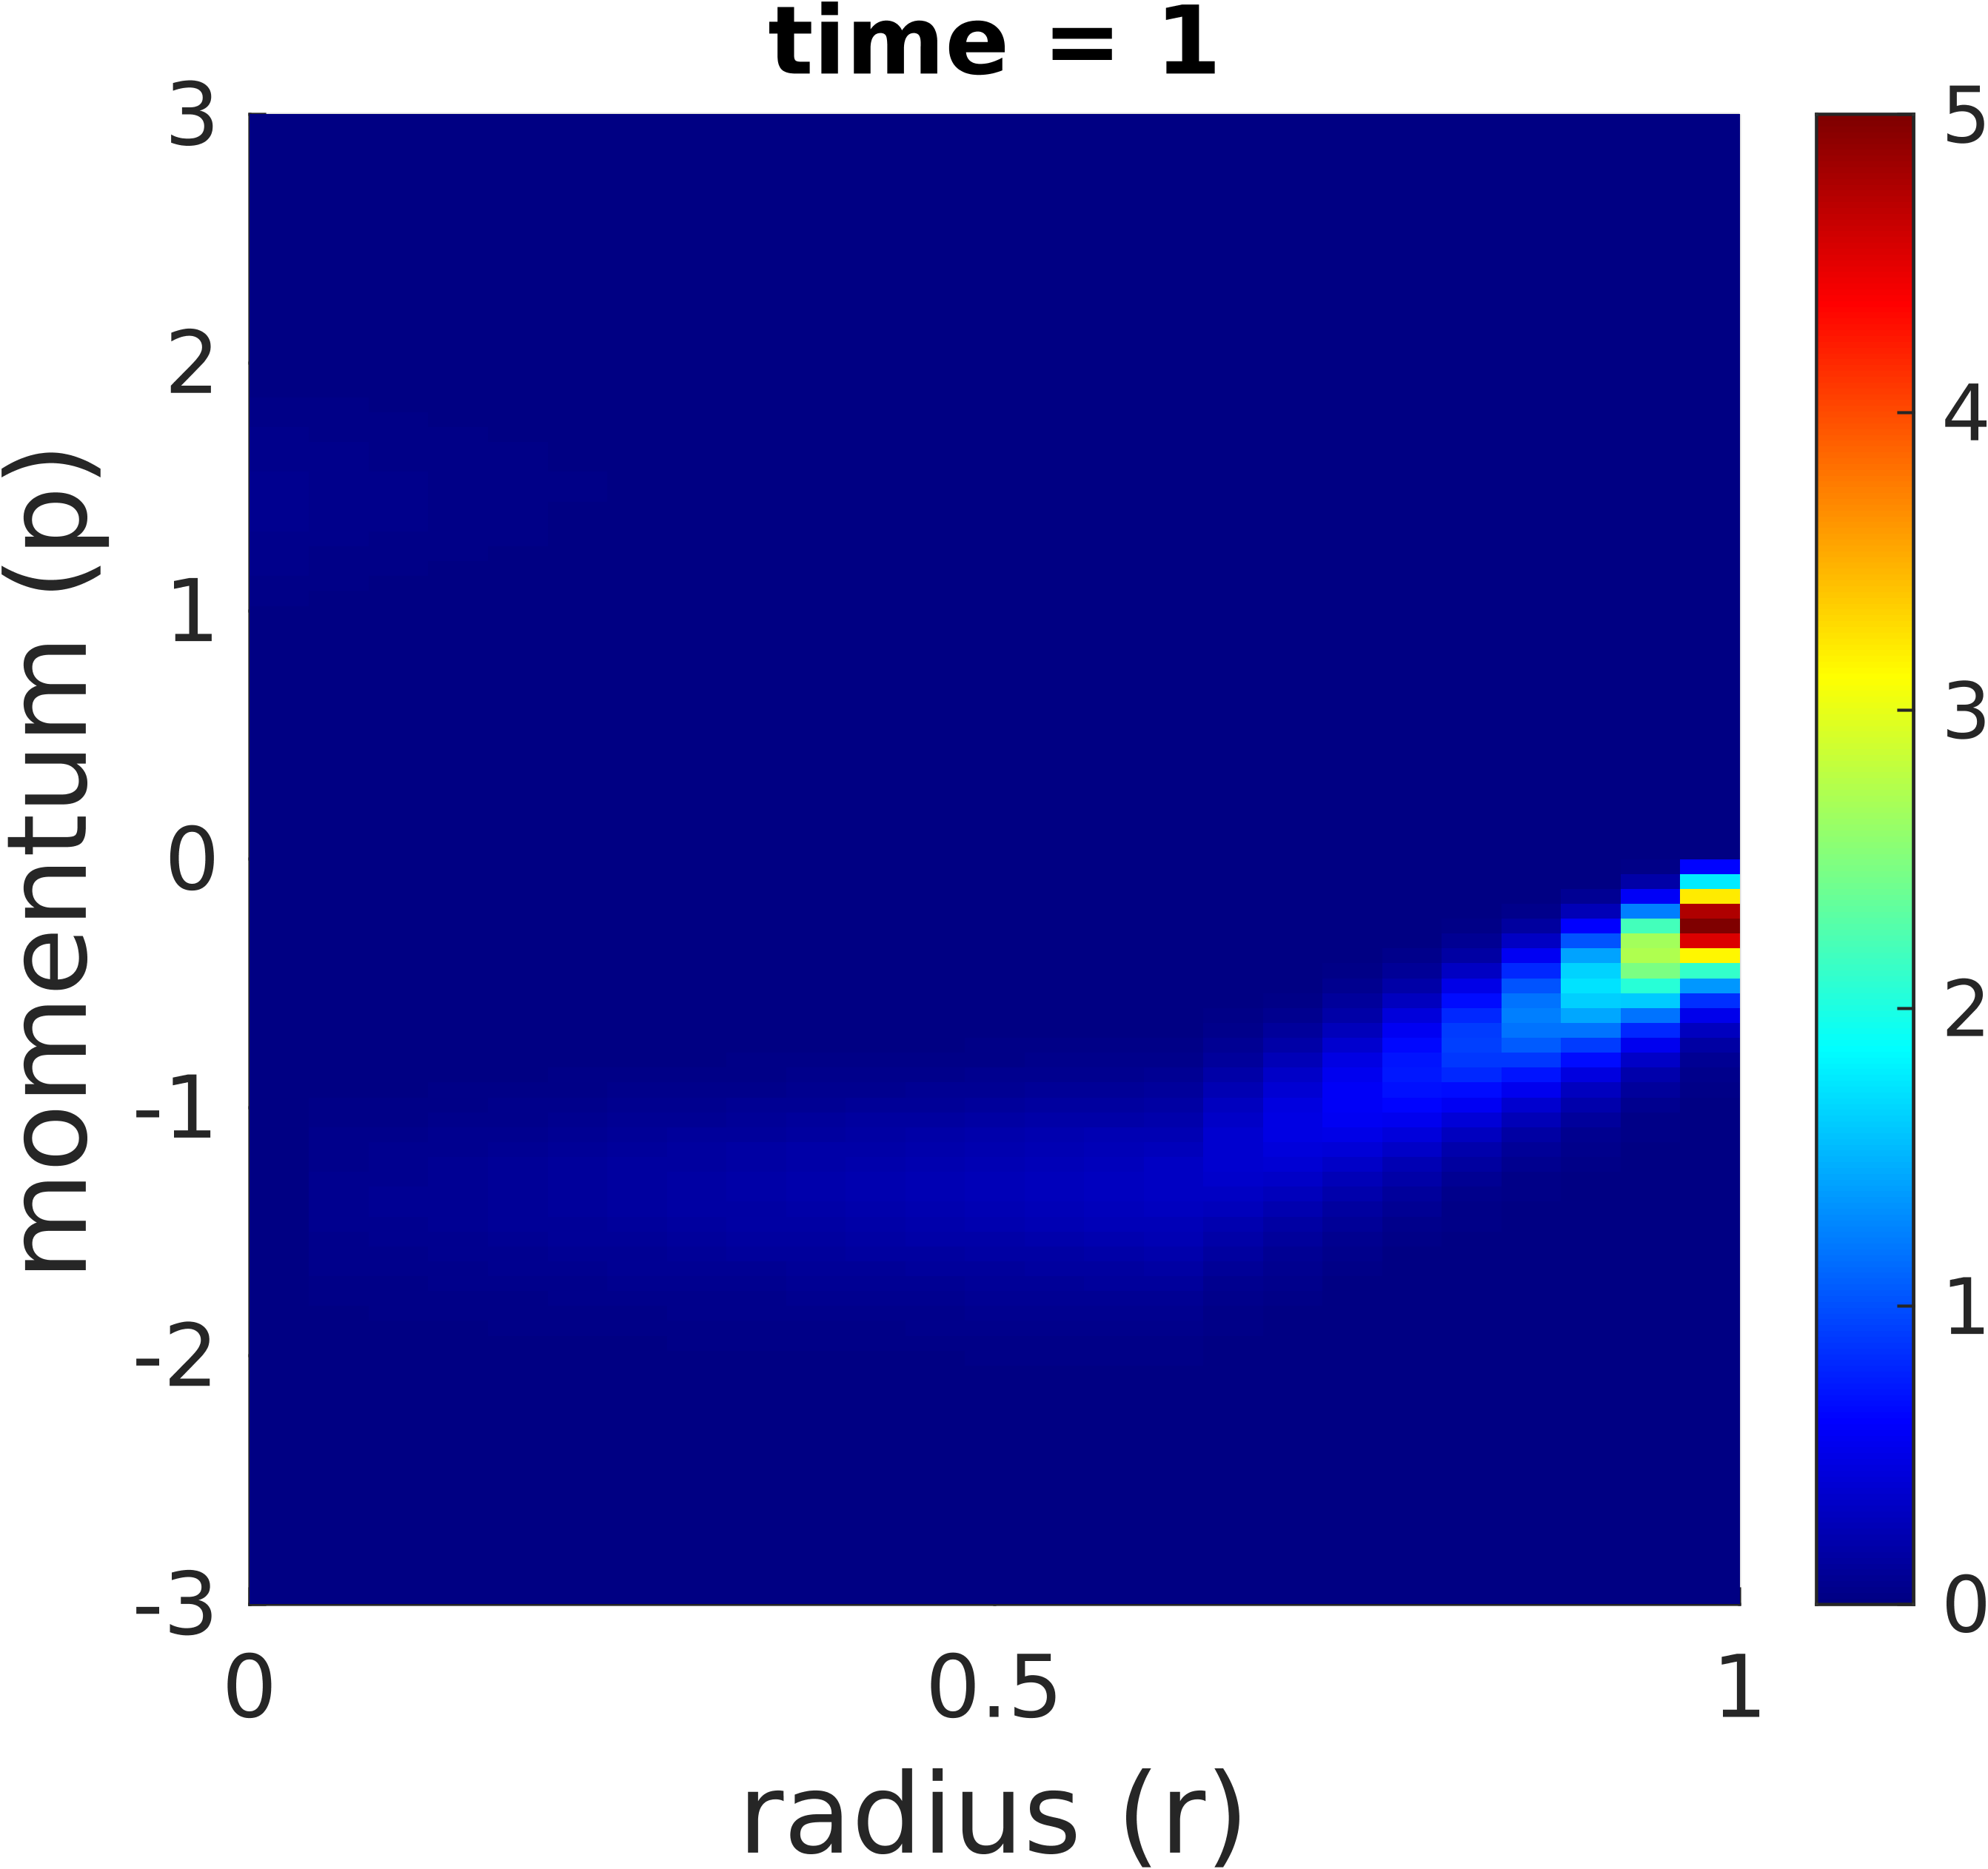
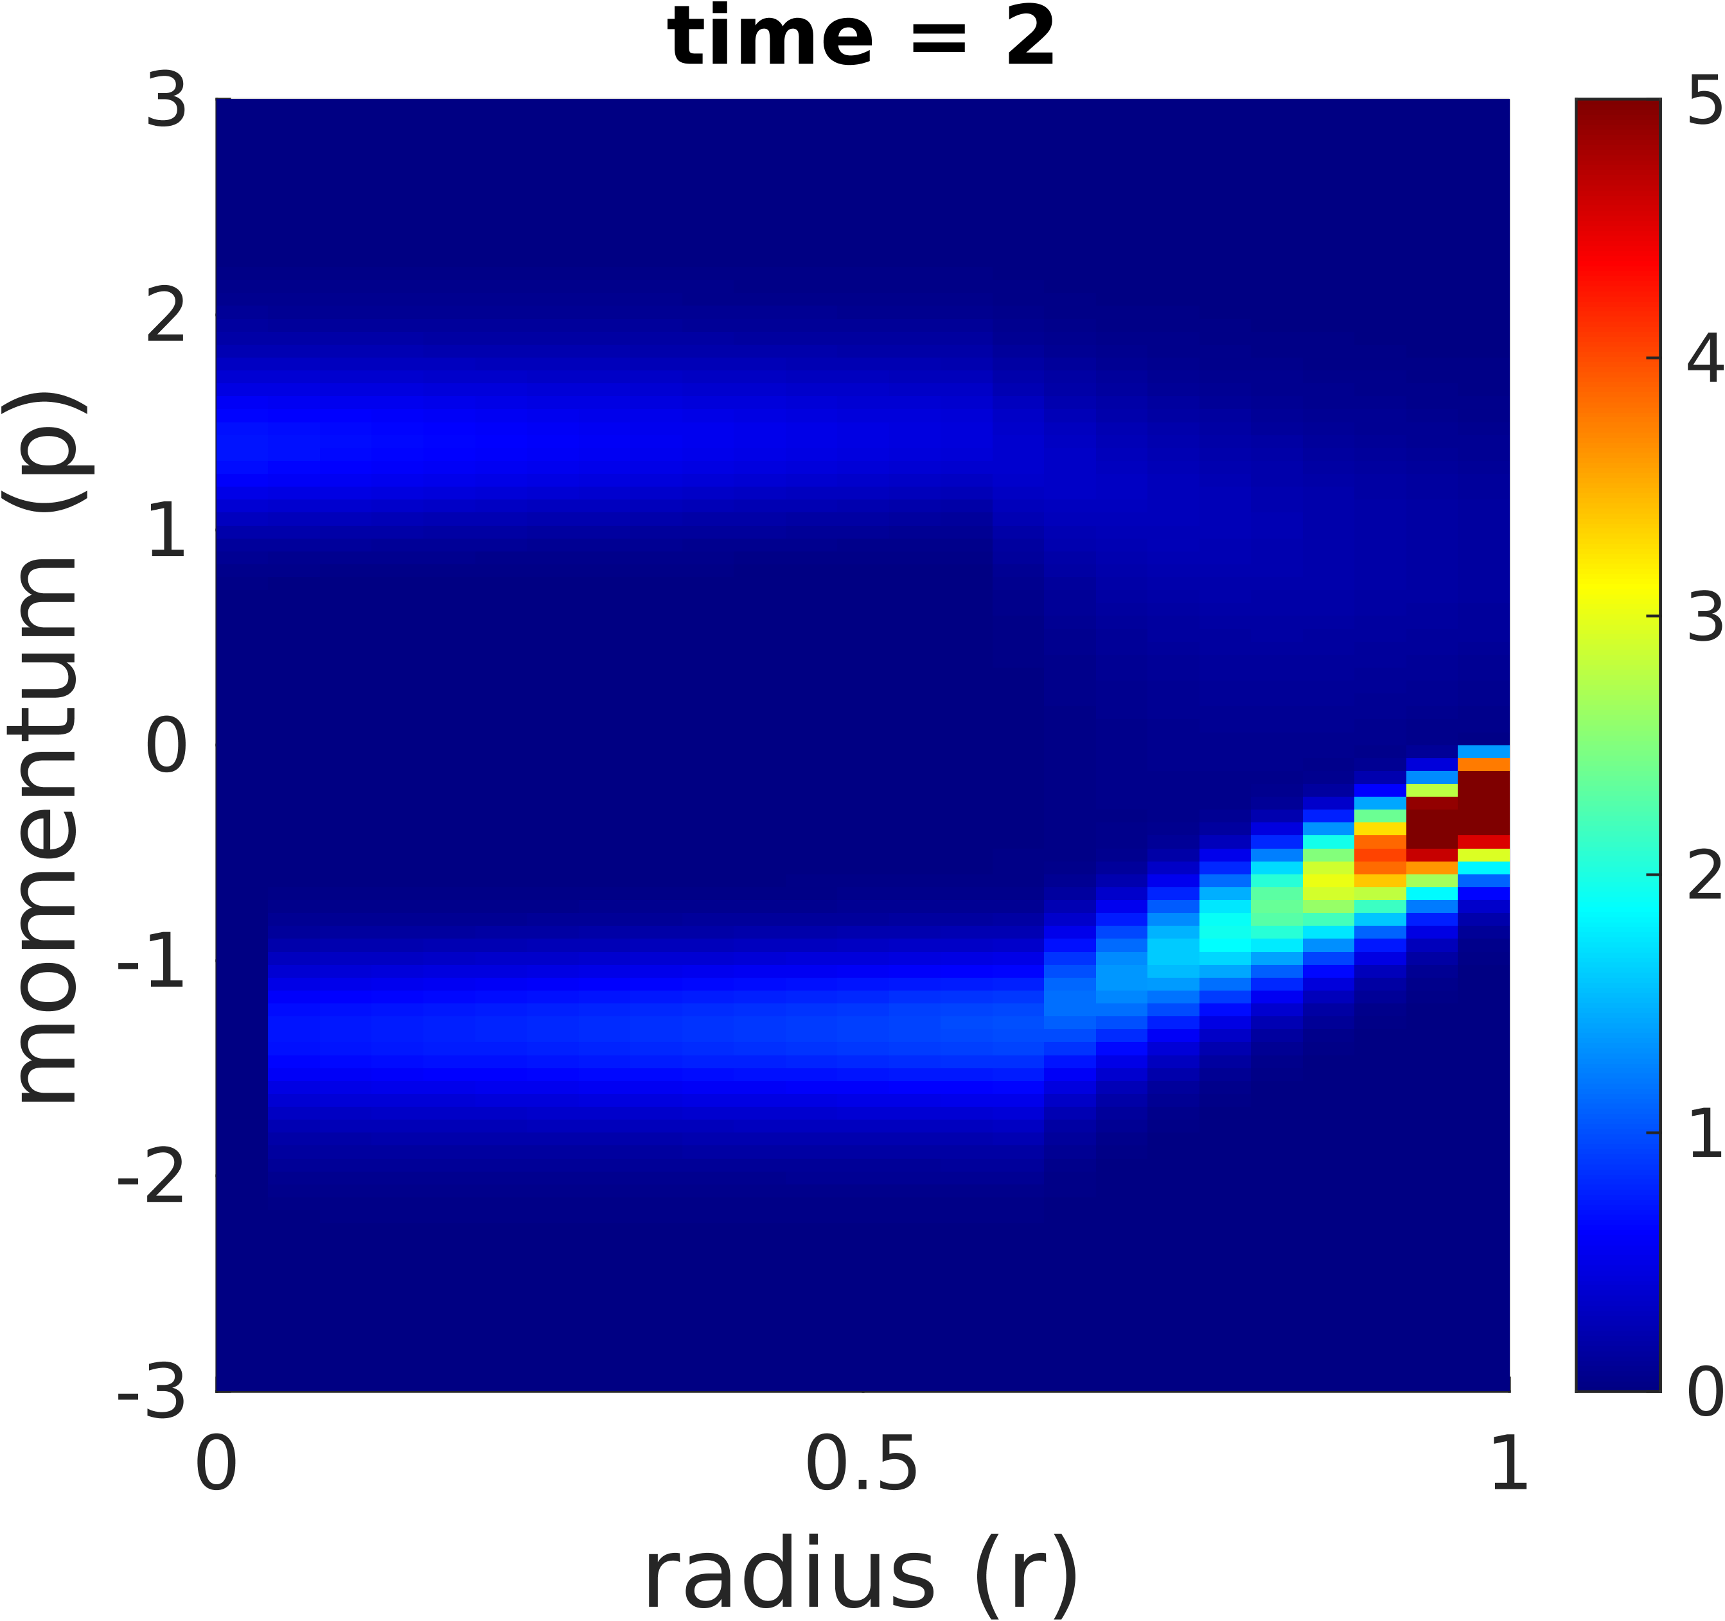
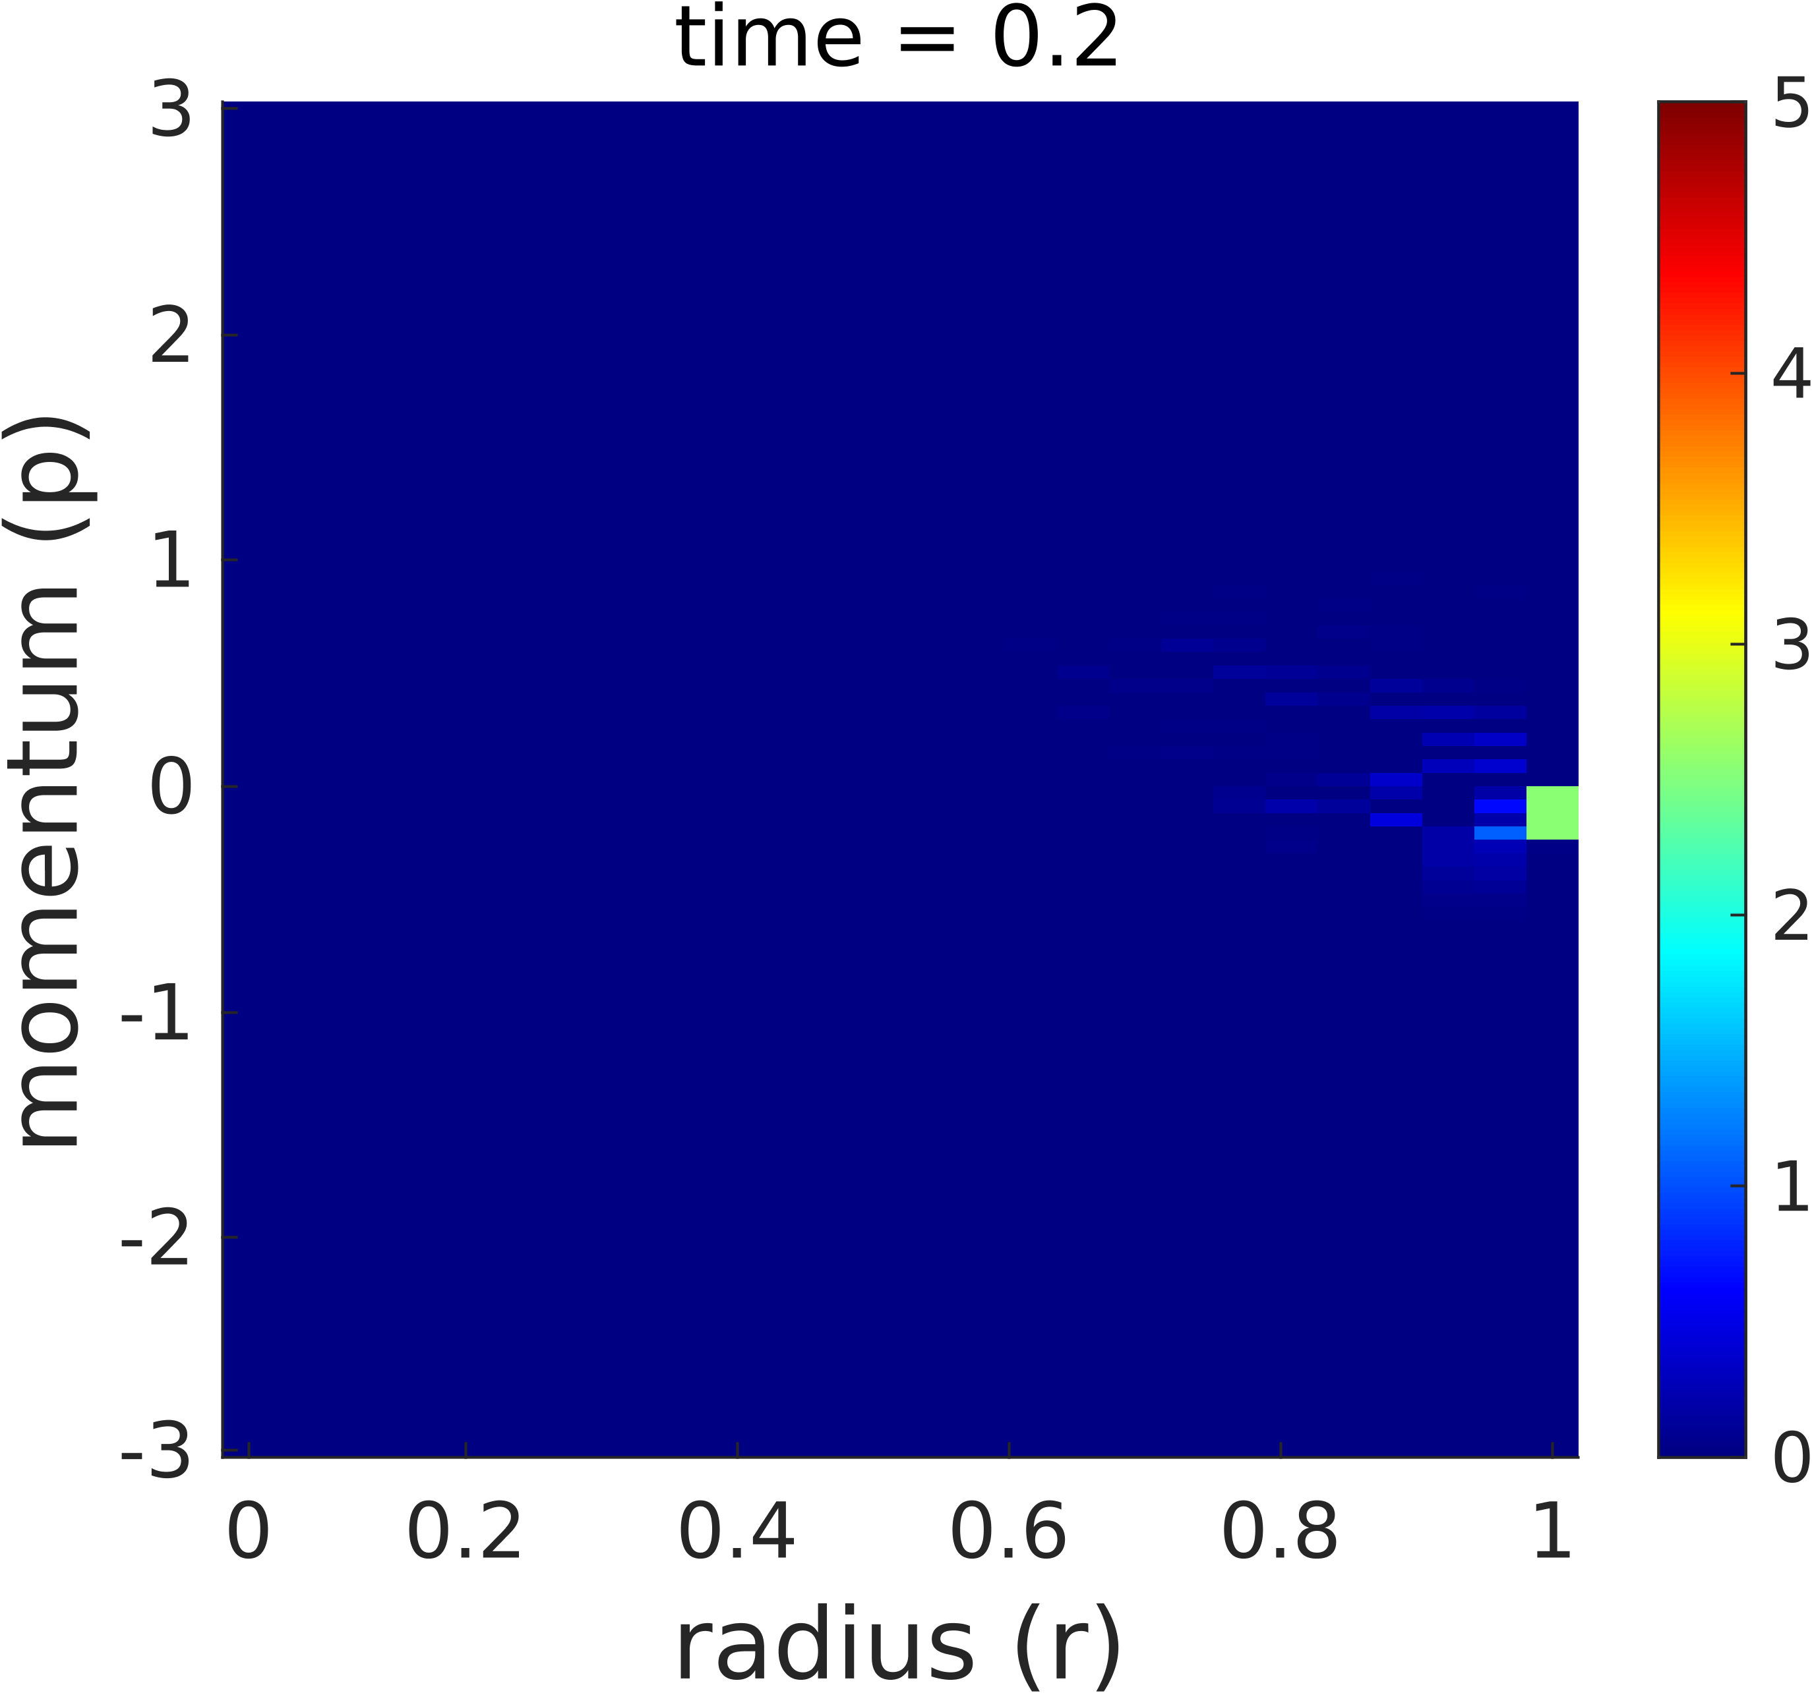
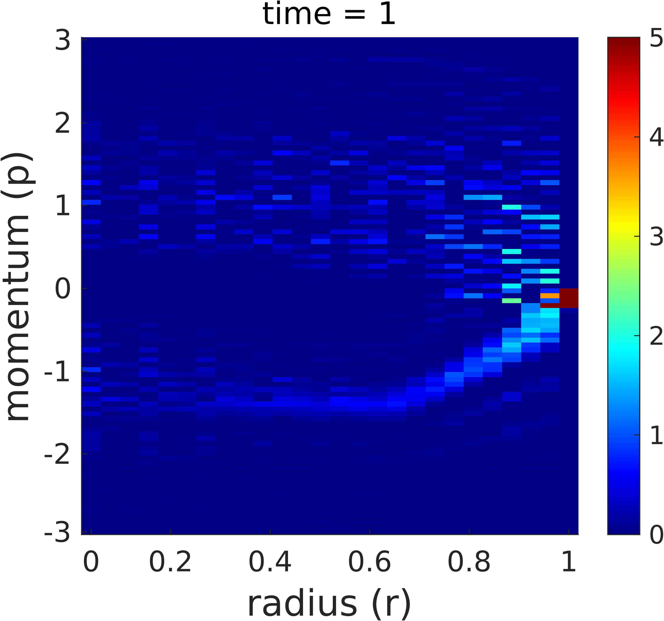
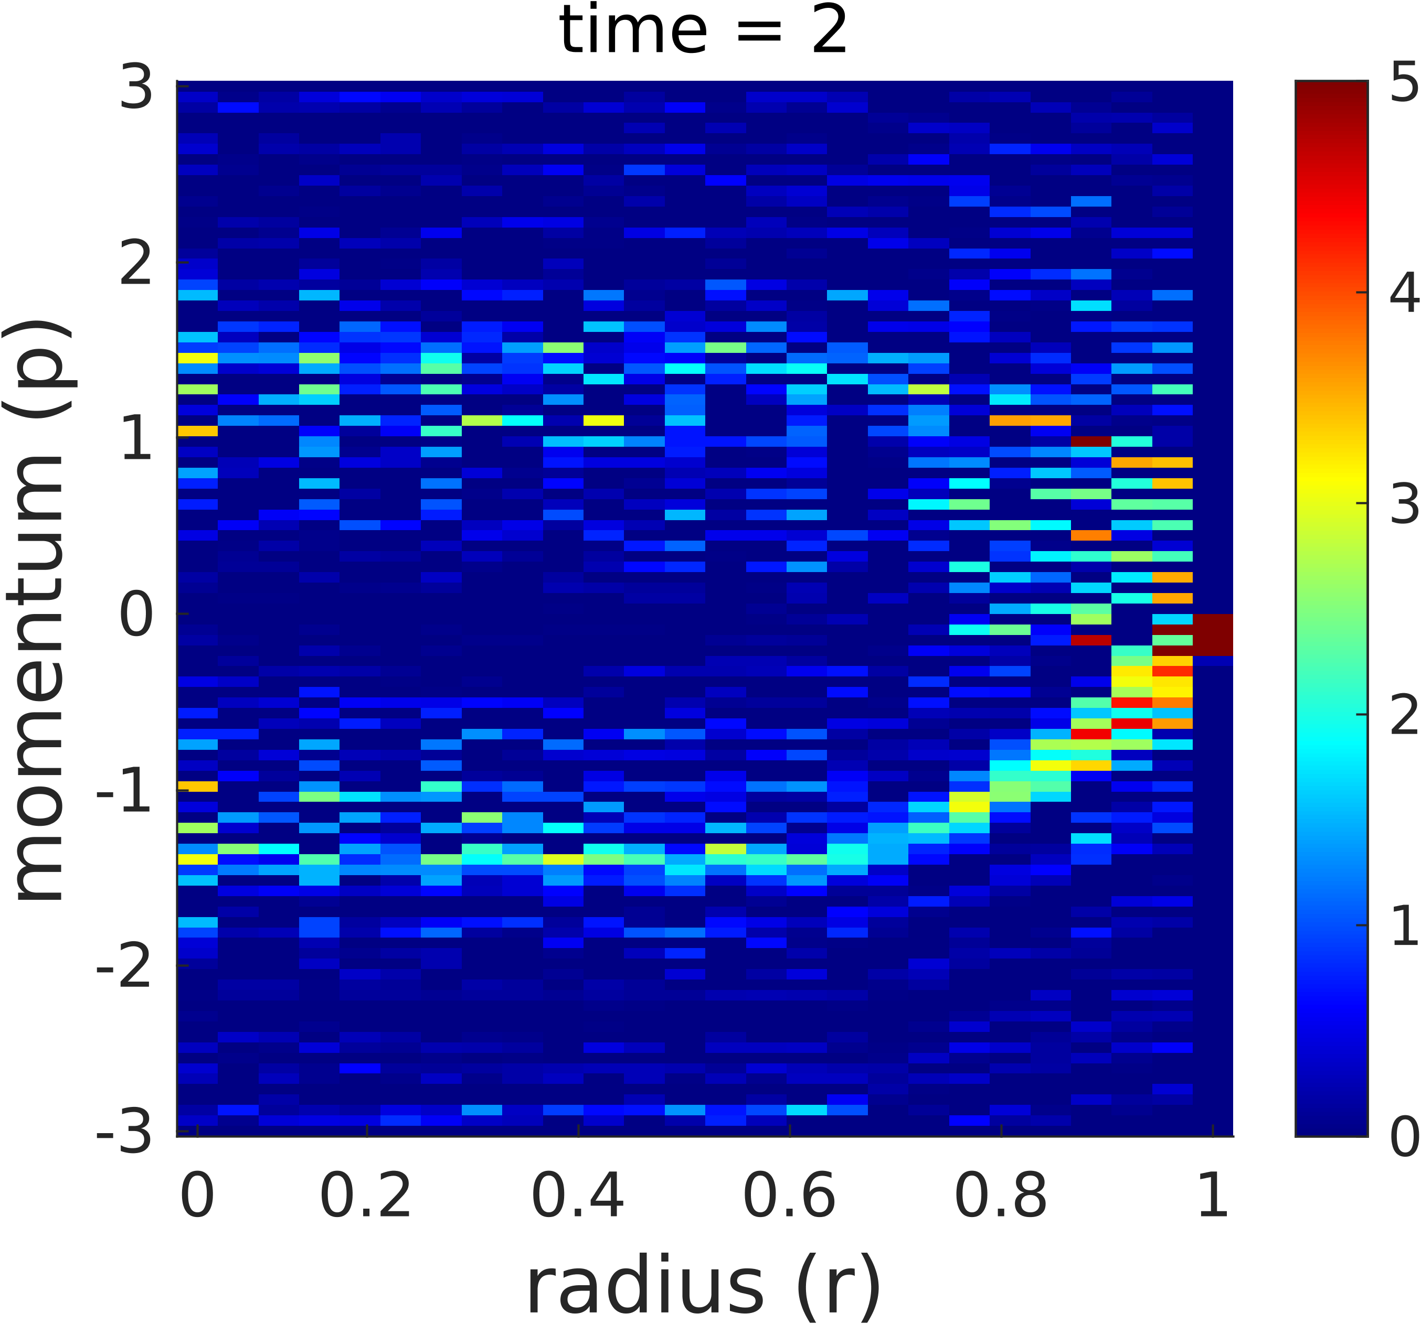
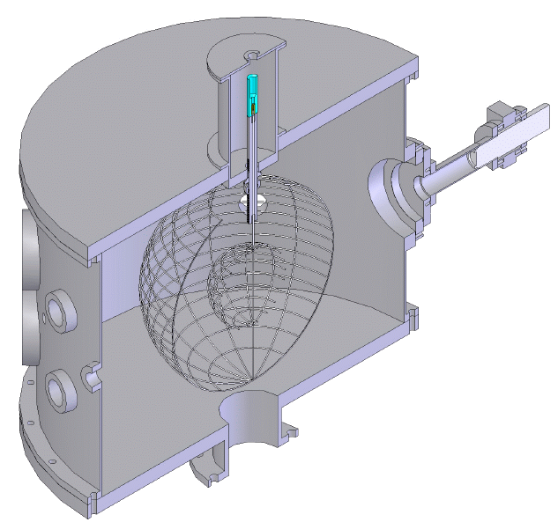
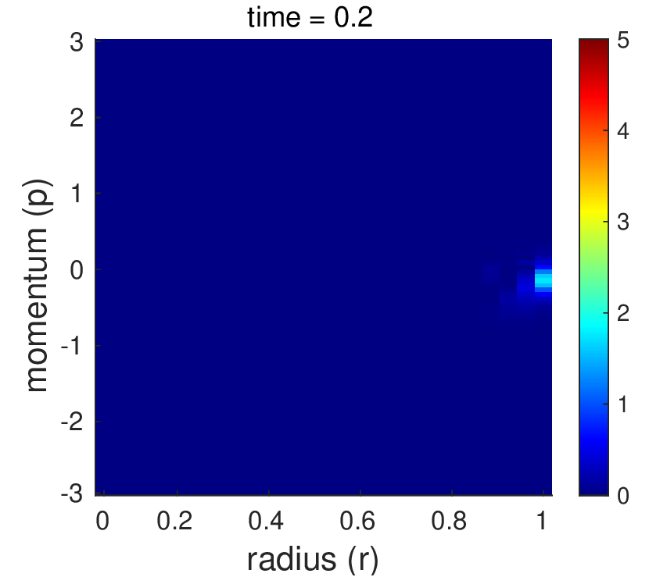
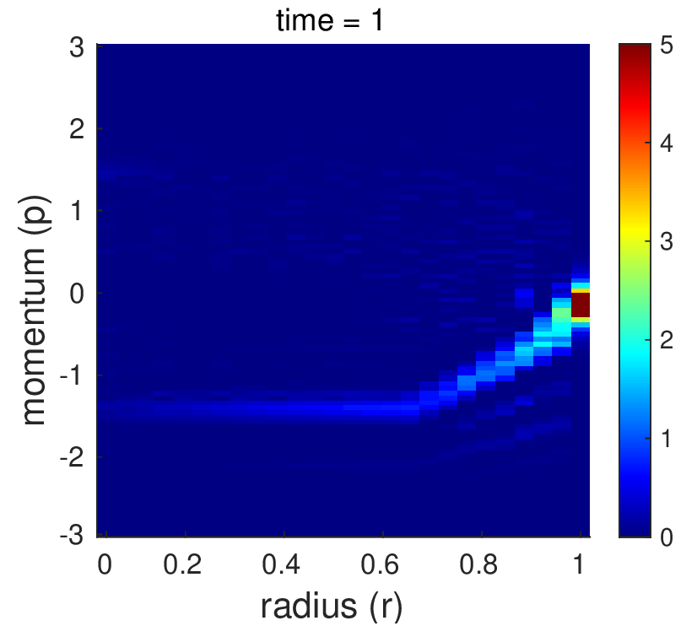
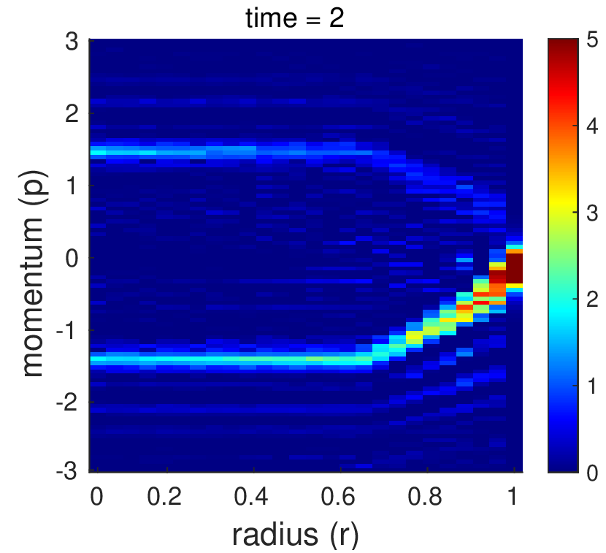
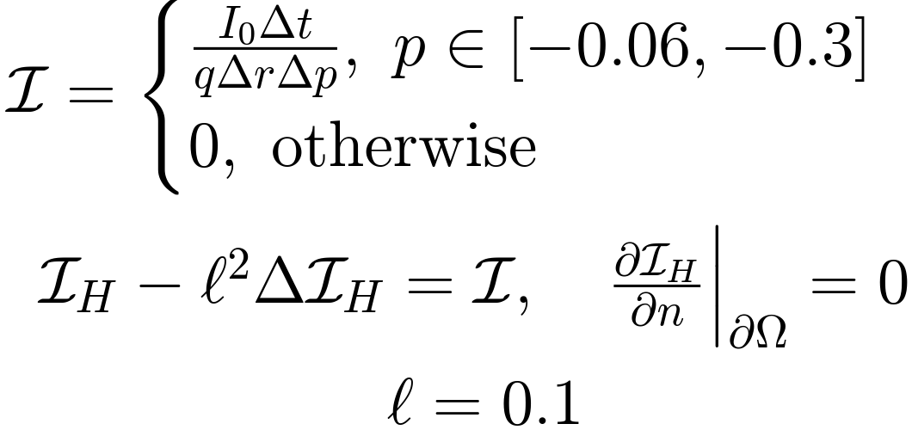
Numerical Models for Inertial-Electrostatic
Confinement Fusion
Nico Braukman
Faculty Advisor: Dr. Vladislav Bukshtynov, Dept. of Mathematical Sciences, Florida Institute of Technology
INTRODUCTION
Inertial-Electrostatic Confinement (IEC) fusion devices trap plasma ions with a spherically-symmetric electrostatic field that accelerates ions inward, where they can collide and fuse [2]. IEC devices are simple to construct, and using them to study plasma motion will help advance fusion energy research.
Here, plasma motion in an IEC device is numerically simulated by solving the Vlasov-Poisson equations using the finite volume and finite element methods.
VLASOV-POISSON EQUATIONS
Describe the time evolution of a collisionless plasma in an electrostatic field. The spherically symmetric system simplifies to one dimension of space, one dimension of momentum. The following system of PDEs is solved up to normalization of units:
Boundary Conditions:
Vlasov:
Poisson:
Finite Volume Method Solution
FINITE VOLUME METHOD (FVM)
In the FVM, the flux through the boundaries of each sub-cell in the domain is computed to determine the time evolution of the ion density function. This computation is implemented in MATLAB.
The discretized conservation form of the Vlasov equation is solved as [1]:
The electric field is solved using Gauss' law [1]:
where the total charge is the sum of enclosed free charges and the effective charge due to the cathode.
FINITE ELEMENT METHOD (FEM)
In the FEM, the ion density is determined at each time step by solving the weak form of the Vlasov equation over a piecewise linear (P1) finite element space:
The electric field due to free charges is determined by solving the weak form of the Poisson equation over a piecewise constant (P0) finite element space:
Then, the total electric field (including effects of the cathode voltage) is given by:
These equations are solved using the FreeFEM [3] PDE solving software.
Finite Element Method Solution
ION INJECTION HOMOGENIZATION
The ion injection term is homogenized in an attempt to reduce errors. In the future, parameter will be found by solving an optimization problem.
CONCLUSIONS
The FVM solution successfully reproduces the qualitatively expected physics of the system. In the FEM solution, the ion injection term introduces errors which accumulate over time. In the future, spectral methods for solving the Vlasov-Poisson equations will be investigated.
REFERENCES
[1] J. Black, M. Wood-Thanan, A. Maroni, E. Sánchez. Study of inertial electrostatic confinement fusion using a finite-volume
scheme for the one-dimensional Vlasov equation. Phys. Rev. E, 103(2), 2021.
[2] G. H. Miley, S. K. Murali. Inertial Electrostatic Confinement (IEC) Fusion. Springer, 2014.
[3] F. Hecht. New development in freefem++. J. Numer. Math., 20(3-4), 2012.
Above: "Homer" IEC device at Univ. of Wisconsin-Madison [2]

