Slide 1
Resume’s, CV’s, & Cover Letters
Career Services

Slide 2
Application Documents
What do I need?
You may be asked for a
  Resume
  CV
  Cover Letter
  Application
  References
  Transcripts
Follow All Instructions
The term resume and CV can sometimes be interchanged

Slide 3
What is the Difference:
Resume
Curriculum Vitae - CV
Cover Letter
Most common
Focuses only on relevant info, need to change per job
1-2 pgs
For academic & research positions
Entire academic + experience background
3+ pages
Relates your application in conversation format, fills in any gaps
Business Letter format
1pg

Slide 4
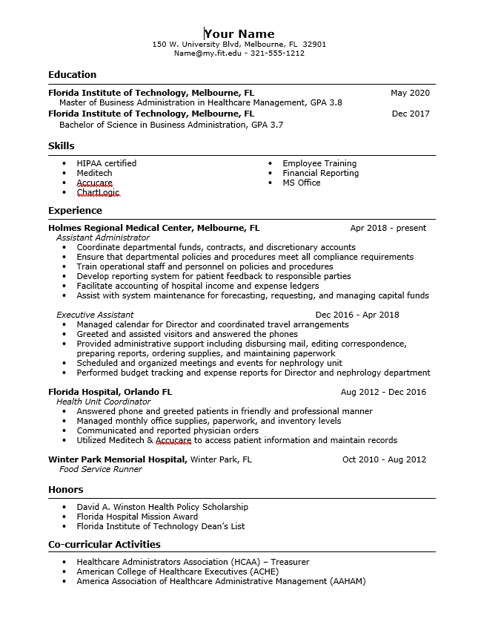
Resume
Basic Sections:
Name & Contact
Education
Experience
Skills
Awards & Activities
Traditional Format: Recommend for most industries
Samples: www.fit.edu/career

Slide 5
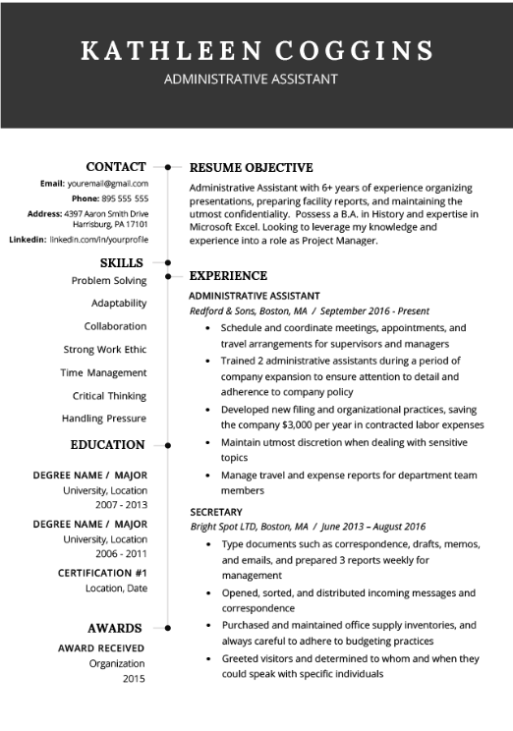
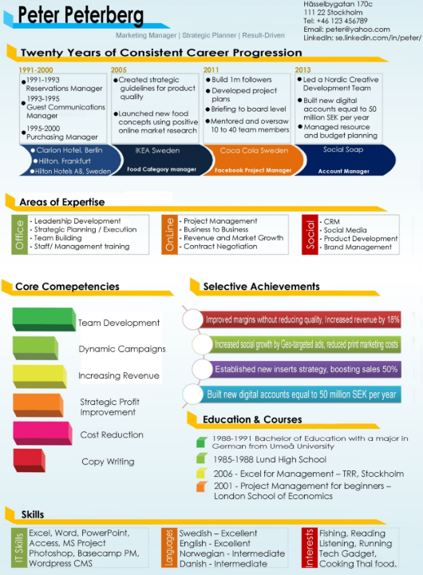
Modern & Creative Resumes

Slide 6
ATS Optimized
Only put the most valuable details, extra info can be given at the interview
Applicant Tracking Systems
Make sure to upload the correct file format asked by the system (.pdf is the best choice if it is allowed)
Use keywords that match the job description in your skills and experience section and standard section titles
Avoid using tables, graphics, text boxes, and header/footer space as ATS systems often do not read these areas
Use standard formatting and fonts (Times New Roman/Arial), as well as standard headers (such as "Experience")
Traditional Formats are best suited for ATS

Slide 7
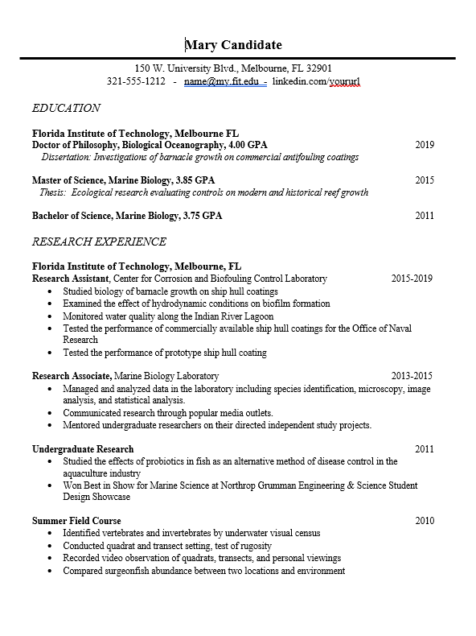
CV Curriculum Vitae –”Course of Life”
Basic Sections:
Name & Contact
Education
Research or Teaching Experience
Publications or Presentations
Awards or Grants
Professional Memberships
References
Samples: www.fit.edu/career
Grad School of Illinois

Slide 8
Blended CV/Resume
Used for higher level or very competitive positions
  Such as those that require a minimum of a masters
Typically 2-3 pgs
May provide more sections than a typical resume, but follows bullet format with relevant information
Can be useful for those with many years of experience

Slide 9
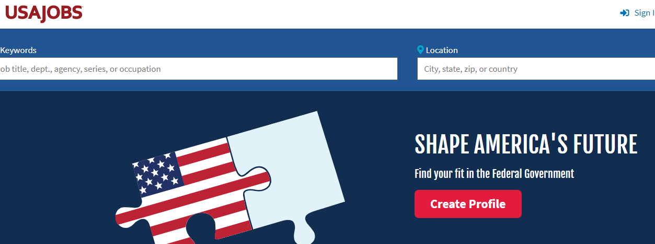
Federal Resume
https://www.usajobs.gov/Help/faq/application/documents/resume/what-to-include/

Slide 10
Cover Letter
A well written cover letter can help you stand out!
Basic Sections:
Name & Address
Date
Company Name & Address
Greeting
3-5 Paragraphs
Signature
Not typically required for most jobs, but shows a candidate is very interested.

Slide 11
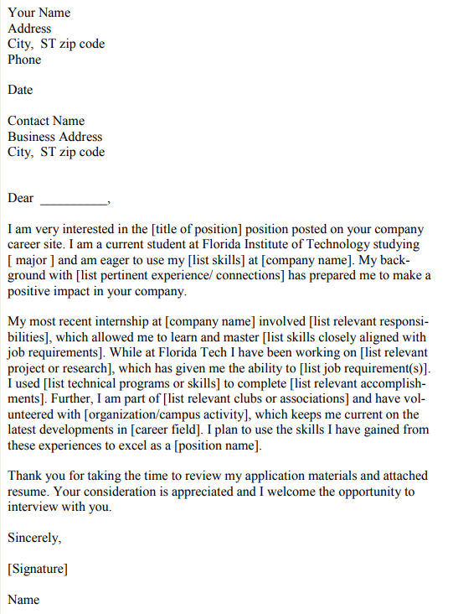
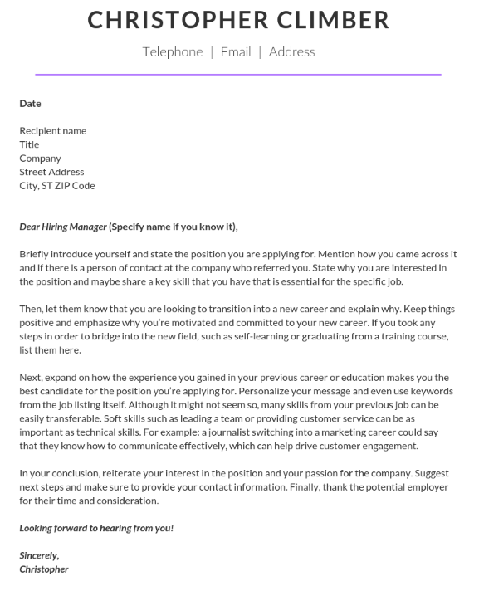

Slide 12
Cover Letter
Best Practices:
Write specifically to the company and name the position
Generic reproduced letters do not stand out
Double check grammar
Provide additional info the recruiter needs:
  When can you start
  Are you moving to that area
  Share a positive reason for a work gap or career change
  Any longer details that could not fit in a resume
Professional tone while sounding personal
Sample: www.fit.edu/career

Slide 13

Make an Appointment on
https://www.fit.joinhandshake.com

