Slide 1
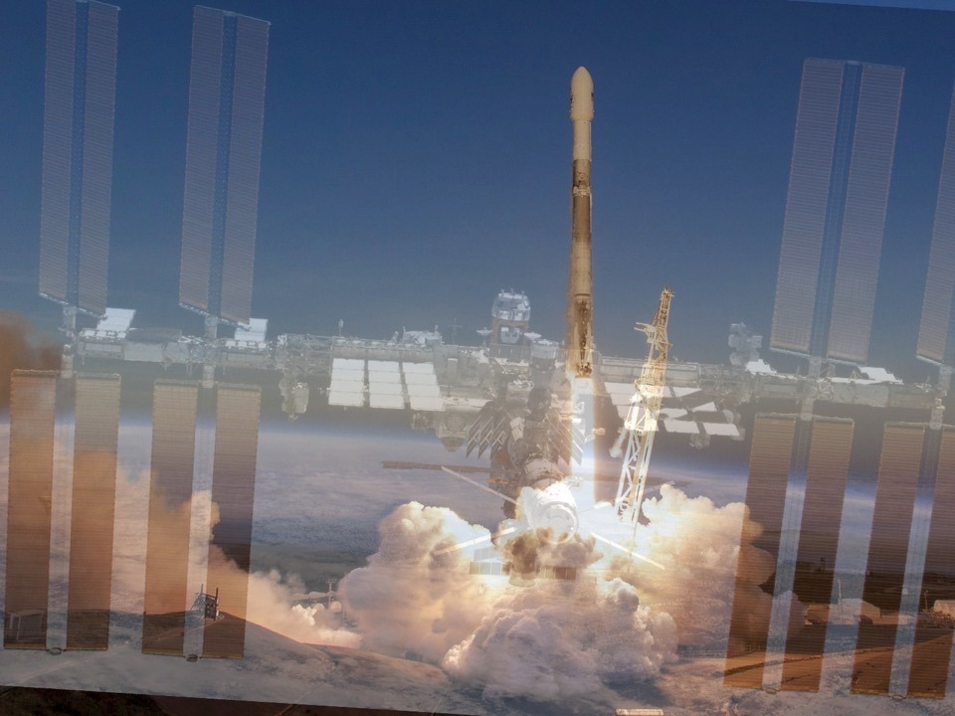

a program of the
National Center for Earth and Space Science Education and the Arthur C. Clarke Institute for Space Education
Revised August 30, 2026
by Drew Palmer (Florida Tech)
Inspire…then Educate

Slide 2
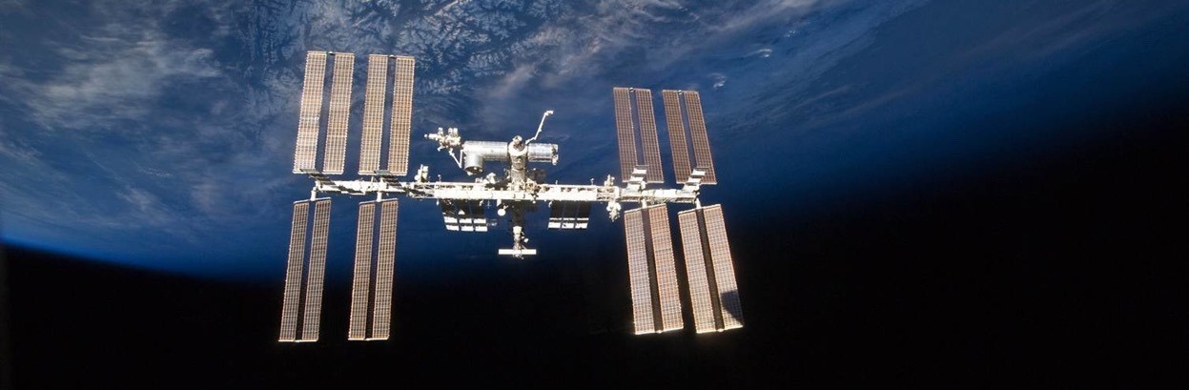

New Spaceflight Opportunity for Communities
School Districts grades 5-12; 2-Year Community Colleges; 4-Year Colleges and Universities with emphasis on Minority Serving Institutions;and informal education and out-of-school organizations
SSEP Mission 22 to the ISS
September 1st - November 3rd

Slide 3

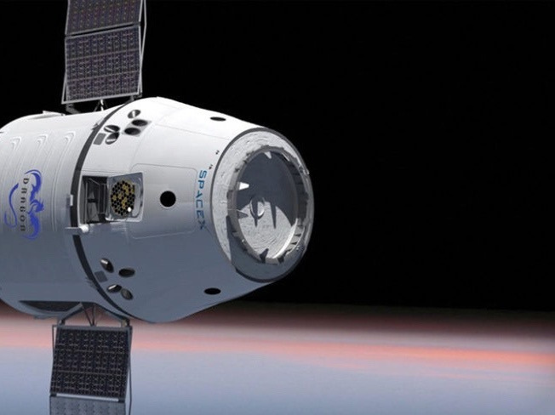

Inspiring and engaging the next generation of scientists and engineers by providing communities with their own
very real space program.
The Student Spaceflight Experiments Program (SSEP) immerses students in authentic scientific research of their own design, using a spaceflight opportunity on the International Space Station (ISS).
One microgravity experiment proposed by student
teams will be launch from Kennedy Space Center and operated by astronauts on the ISS

Slide 4

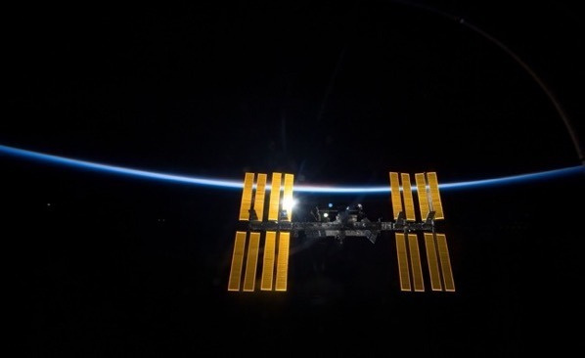
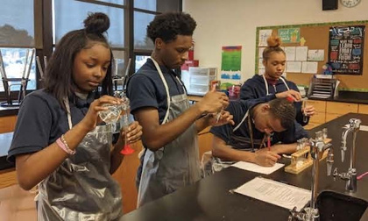
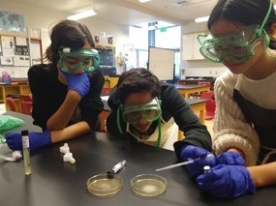
Become Part of the Adventure on the High Frontier
•
Student teams across the community design a microgravity experiment in a science discipline of their choice, and through a formal written proposal, make the case for why their experiment should be selected for flight to ISS.
•
Experience a real 2-step science proposal review process
•
SSEP Student Researchers from Harper Woods, MI (left) and Bellevue, WA (right) designing and testing microgravity experiments for SSEP Mission 14 to ISS
SSEP provides STEM project-based learning through immersion in a fully authentic, high-visibility research experience –an approach that embraces the Next Generation Science Standards

Slide 5
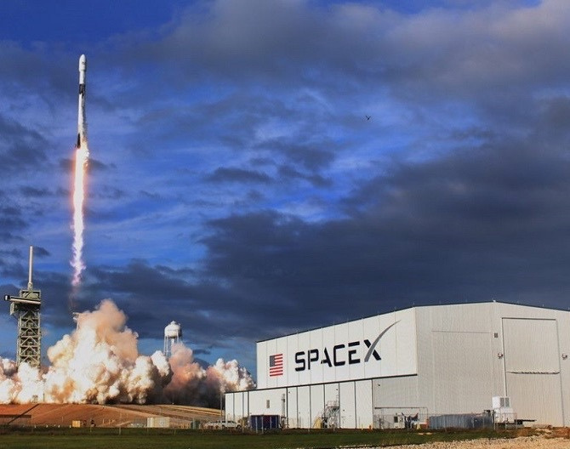

One Student Designed Experiment In Each SSEP Community Selected for Launch to the ISS
•
SSEP Mission 22 flight details are TBA but likely will be ferried to the ISS in a Dragon spacecraft launched atop a SpaceX Falcon 9 rocket launching from Launch Complex 39A (LC-39A), Kennedy Space Center, Florida
SSEP students and their families, teachers, and other community
stakeholders will be given the opportunity to attend the launch
•

Slide 6
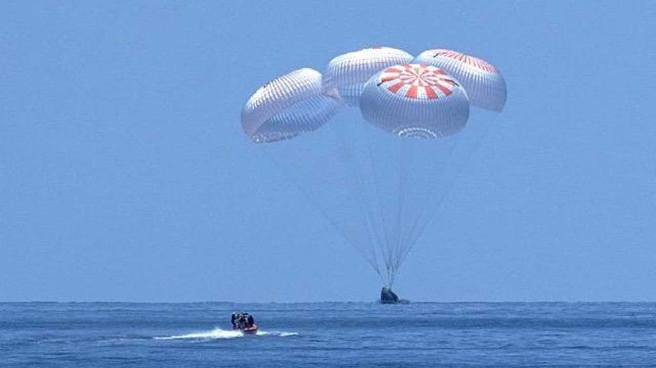
Astronauts Aboard ISS Conduct SSEP Flight Experiments
•
ISS Crew Members operate the flight experiments according to Crew Interactions defined by the student flight experiment teams
Experiments are then returned to Earth, splashing down off the
coast of Florida
The payload is retrieved, and experiments returned to the students for analysis
•
•
SSEP is NOT a simulation –participating communities are truly a part of America’s Space Program.

Slide 7

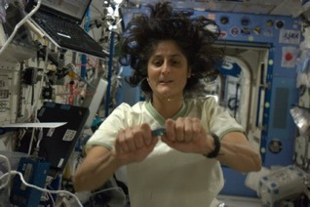
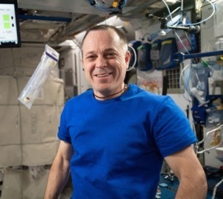
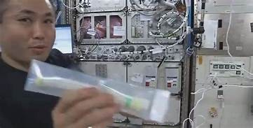
Student Experiments Aboard ISS
SSEP student microgravity experiments have been conducted by 32+ ISS Crew Members
To view videos of all SSEP launches to date, and for information about and videos of astronauts that have operated SSEP experiment on the ISS, visit: http://ssep.ncesse.org/current-flight-opportunities/launch-and-on-orbit- operations-history/
ISS Commander Sunita Williams (USA) activates a student experiment during SSEP Mission 2 to ISS
Flight Engineer Koichi Wakata (Japan) shakes to mix a student flight experiment
from SSEP
Mission 3b/4
to ISS
Flight Engineer Ricky Arnold (USA) demonstrates weightlessness with a SSEP mini-lab during SSEP Mission 12 to ISS

Slide 8
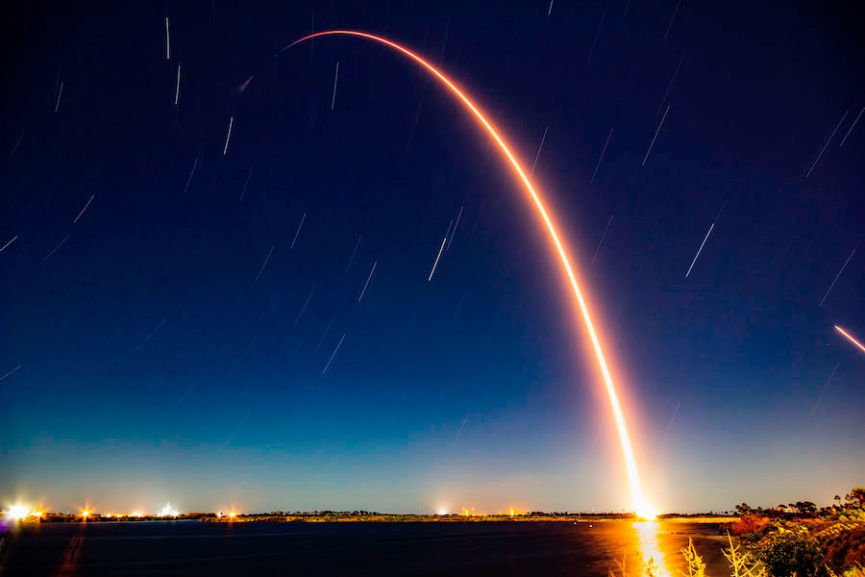
Live Launch Viewing Opportunities
•
•
•
•
•
•
•

Slide 9
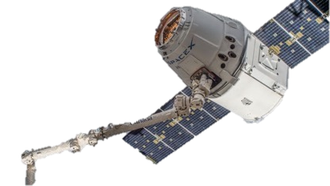
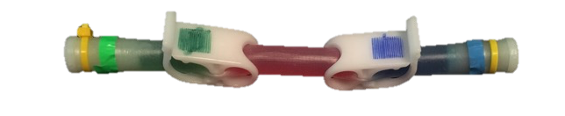
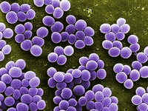
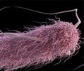
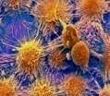
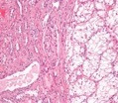

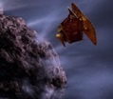
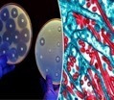
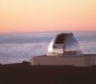
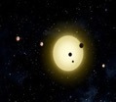
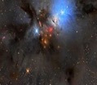

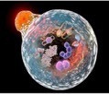
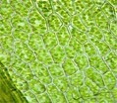
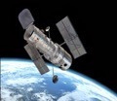
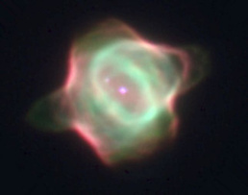
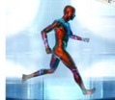

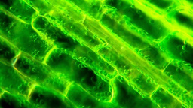
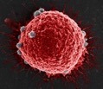

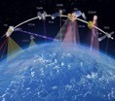
Resources in Support of Microgravity Science and Experiment Design
•
The essential question for design of an experiment –
What physical, chemical, or biological system would I like to explore with gravity seemingly turned off for a period of time, as a means of assessing the role of gravity in that system?

Slide 10
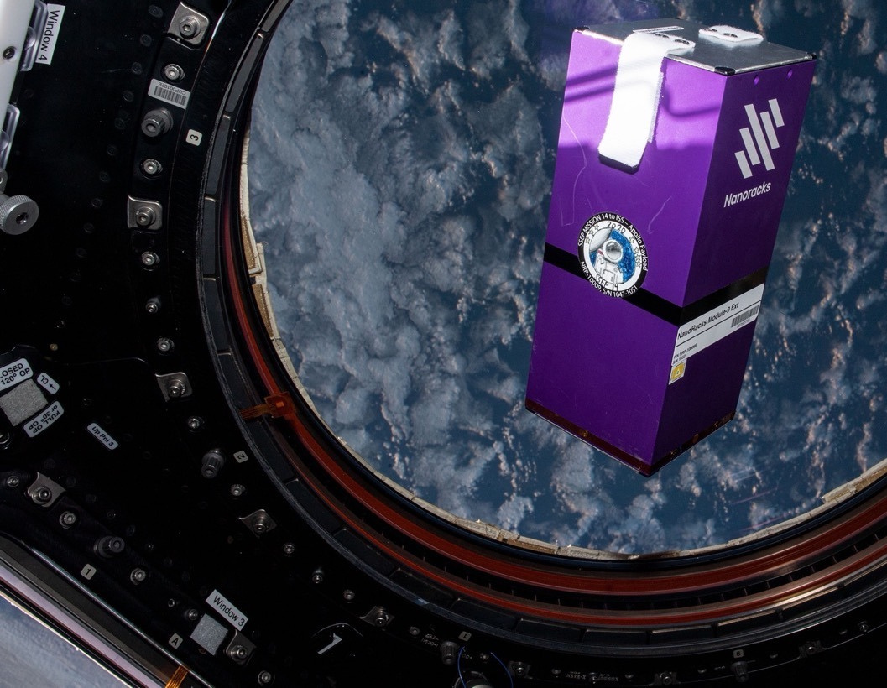

Hundreds More Students Engaged in STEAM Initiative –the Mission Patch Art and Design Competitions
•
Up to two Mission Patches from each community are
selected to fly to the ISS with the flight experiment
•
After flight, the Mission Patches are embossed ‘Certified Flown in Space’, returned to the community, and serve as enduring symbols of the community’s engagement in SSEP
The Mission Patch Competition forges interdisciplinary connections between STEM fields and art and design, so that SSEP is a true STEAM (Science, Technology, Education, Art, and Mathematics) initiative
•
•
Through the first 19 SSEP flight opportunities (through Mission 17 to ISS) –
224, 589 grade preK-16 studentstook part in the art and design competitions and
195,012 Mission Patch designs have been submitted

Slide 11
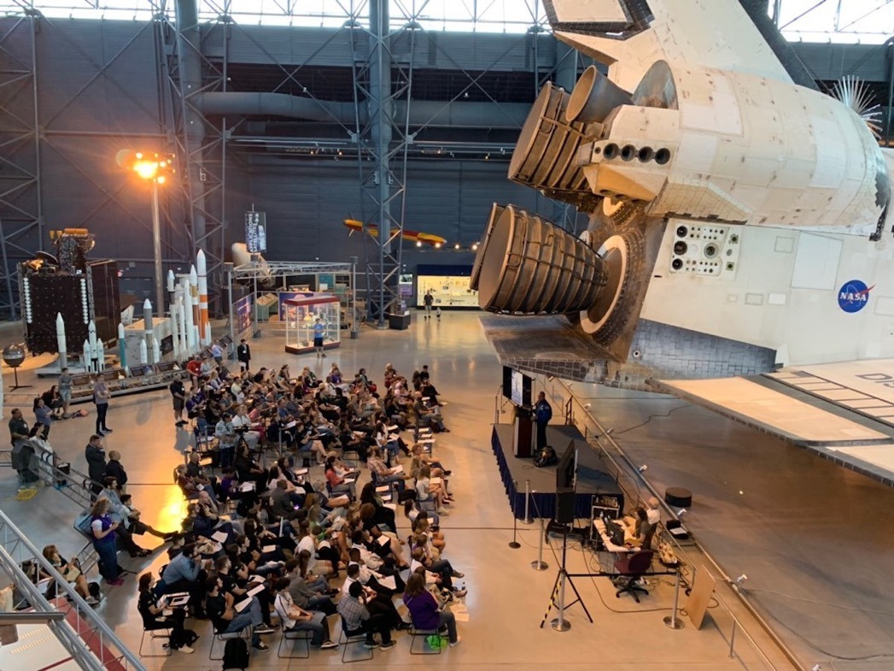

Annual National Conference
Student researchers present on their experiment designs, and those with experiments that flew, report on analysis and results
Presentations by nationally recognized space
scientists and engineers about exploration on the frontier and inspiring students to follow in their footsteps
•
•

Slide 12




A program of the National Center for Earth and Space Science Education in the U.S., and the Arthur C. Clarke Institute for Space Education internationally. It is enabled through a strategic partnership with Nanoracks, LLC working with NASA under a Space Act Agreement as part of
the utilization of the International Space Station as a National Laboratory.

Slide 13
Florida Tech Details: Team Composition
Team Size: 3-5 (STUDENTS ONLY)
Team composition:
  Undergrads/High School students (dual enrollment)
  1 grad student per team maximum
Graduate students can serve as team mentors! Looks great on your CV/Resume! Help put science into space!
Team leader will be POC for communication about the SSEP

Slide 14
Florida Tech Details: Proposal
Proposal length 5 pages (MAX)
  Background & Hypothesis
  Significance
  Experimental Design
  Methods of Analysis
MUST BE WRITTEN BY STUDENTS! Faculty can only advise!
SSEP will provide training and access to resources to help you write your proposal once your team is registered!

Slide 15
Florida Tech Details: Timeline & Selection
September 1st – Program start
  Build teams
  Research projects
  Write proposals
  Rewrite proposals
November 3rd – Projects due to internal selection committee
November 12th – 3 projects selected by internal committee
December (TBD) – 1 project selected by National Committee
FALL 2027 – Project launch

Slide 16
What are the experiment limitation?
NO POWER
MUST BE STABLE AT ROOM TEMPERATURE AND PRESSURE
2 FLUIDS CAN BE TRANSFERRED FROM SEPERATED CHAMBERS INTO A PRIMARY REACTION CHAMBER.
MUST BE ANALYZED ON GROUND
BSL0 (NO RISK TO ASTRONAUTS)

Slide 17
Florida Tech SSEP Selection Committee
Dr. Andrew G. Palmer, SSEP Community Director
Dr. John Z. Kiss, Provost
Dr. Brooke Wheeler, College of Aeronautics
Dr. Kunal Mitra, COES - Biomedical Engineering and Science
Dr. Melissa Borgen, COES

Slide 18
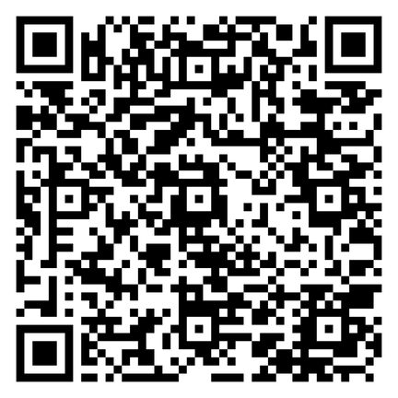
Questions?
https://www.fit.edu/engineering-and-science/academics-and-learning/student-spaceflight-experiments-program/

