Slide 1
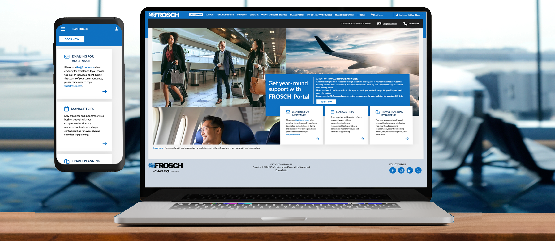


We’re excited to get you started!
First, you’ll need to register for the FROSCH Travel Portal in order to update your traveler profile.
In order to book travel as part of Florida Institute of Technology Inc’s travel program with FROSCH, you must have a current traveler profile. This enables your Travel Advisor to provide the best possible service. Your traveler profile can be securely updated from the Travel Portal. Once complete, you’ll be able to book travel with a set group of Travel Advisors.
The FROSCH Travel Portal is a seamless gateway for travelers, travel arrangers, and travel managers to access travel-related tools, resources, and information.
Secure access to update traveler profiles
Seamless online booking tool access via SSO
Contact information for FROSCH Travel Team
Integrated dashboard for past, present & future itineraries and invoices
Links to additional travel tools, including airline check-in sites, Seat Guru, and more
Travel alerts & other duty of health resources via GuideMe
Resources, including training materials, FAQs, and policies

Slide 2
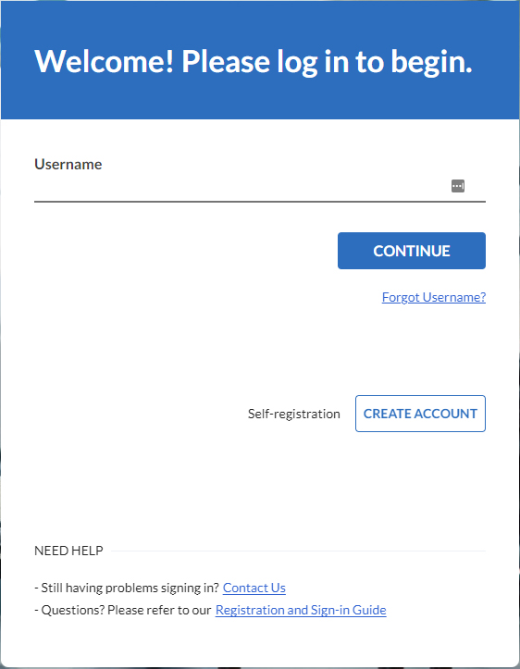

How to Register for the Travel Portal
FROSCH has created a secure, customized portal for Florida Institute of Technology Inc travelers: https://client.frosch.com.
This secure site provides access to your traveler profile, your online booking tool, itineraries and invoices, as well as important FROSCH contact information. You’ll also find additional training materials, travel alerts, FROSCH’s monthly newsletter, and many other resources.
Your account has already been created during implementation; please login using your company-provided email as the username. Then, click “forgot password” and follow the steps to reset/create your account password.
LOGGING INTO THE TRAVEL PORTAL FOR THE FIRST TIME
Make sure you are connected to the Internet and open your browser. Google Chrome works best.
Click HERE or enter the following URL into your browser: https://client.frosch.com.
Feel free to bookmark this link for easy access later.
1
2
Login by following these steps:
Username – Enter your Florida Institute of Technology Inc provided email address. Click Continue.
Password- You will need to use the “Forgot Password” feature, to create a new password to access your account.
Make note of your new password; you will need it to access the Travel Portal in the future.
After creating your password, you will be taken to the Florida Institute of Technology Inc Travel Portal.

Slide 3
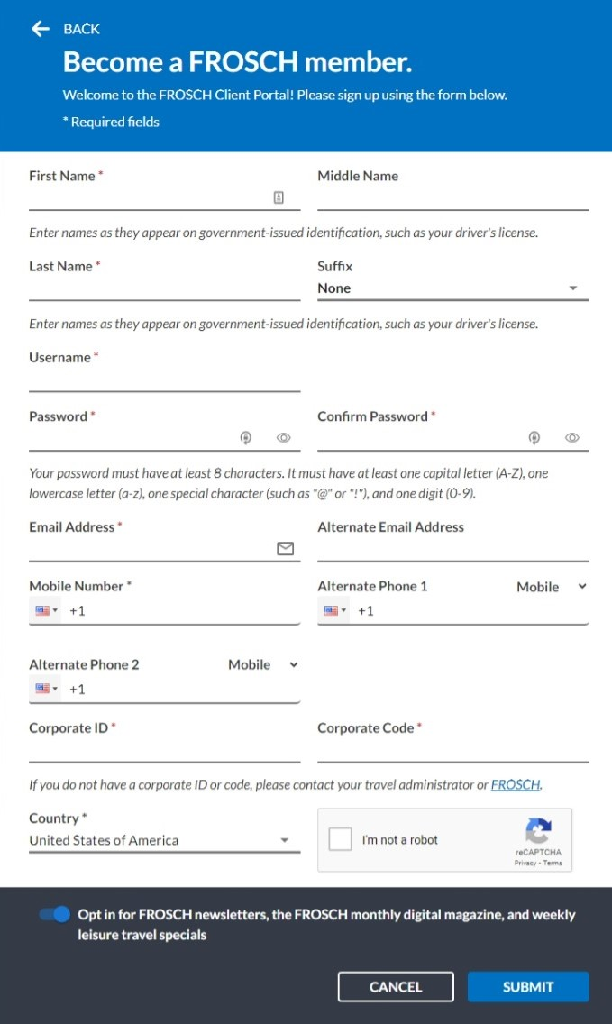
How to Self-Register for the Travel Portal
FROSCH has created a secure, customized portal for Florida Institute of Technology Inc travelers: https://client.frosch.com.
LOGGING INTO THE TRAVEL PORTAL FOR THE FIRST TIME
1
Make sure you are connected to the Internet and open your browser. Google Chrome works best.
Click HERE or navigate to https://client.frosch.com and at the bottom of the page, click on the link to register in the third bullet.
2
Follow the prompts on the form, filling in all relevant details. Required information is marked with a red asterisk.
First*, Middle, and Last Name* as it appears on your government issued ID.
Email* – Enter your Florida Institute of Technology Inc provided email address.
Password* – Choose a unique password.
Corporate ID* – 19794 is the 5-digit number assigned to Florida Institute of Technology Inc.
Corporate Code* – flotf is the 5-letter code assigned to Florida Institute of Technology Inc.
Country* – This field will default to the United States of America; please update accordingly.
Mailing List Checkbox – Check if you want to subscribe to FROSCH’s email list for exclusive travel deals and newsletters.
Alternate Email & Phone – Enter an email only if you would like to subscribe with a different email address.
Security Question & Answer – Choose a security question and enter an answer, which will be used to reset your password should you forget it.
Enter the CAPTCHA codes as they appear on your form.
Make note of your password; you will need it to access the Travel Portal in the future.
After completing registration, you will be taken to Florida Institute of Technology Inc’s Travel Portal.

Slide 4




Importance of Your Traveler Profile
An accurate profile ensures the best possible service.
Your traveler profile securely houses your personal info and travel preferences. Your team of Travel Advisors leverage this information to ensure your travel reservations and our service exceeds expectations.
24/7 ACCESS FOR TRAVELERS & TRAVEL ARRANGERS
Access and update your profile information at any time without the need to contact your Travel Advisor.
YOUR PERSONAL DATA IS SECURE
Our online travel profile system provides a secure way of handling your personal data.
UPDATE PROFILES FROM ANYWHERE
Change your travel preferences from anywhere with access from your desktop via the FROSCH Travel Portal or smartphone with Obex for Business (if applicable).
CENTRAL REPOSITORY FOR BETTER SERVICE
Storing all travel preferences and profile data in the same location enables your team of Travel Advisors to provide optimal service.
Important Profile Reminders
It is imperative that your full name be entered as it appears on the legal identification you will travel with.
Notice that your email address is pre­-populated; you may need to contact your HR department to update this field.
All memberships (Airline Frequent Flier Memberships, Car Rental Programs, Hotel Rewards Programs, etc.) must match the name in your profile.
Mandatory fields include Name, Phone Number, Date of Birth, and Gender. Mandatory fields are customized for each client and will be marked with a red [REQUIRED] notice.
When updating your profile, make sure to scroll through the entire page to be sure all required fields are completed.
Profiles should be reviewed periodically for accuracy.

Slide 5
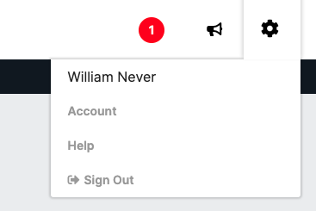
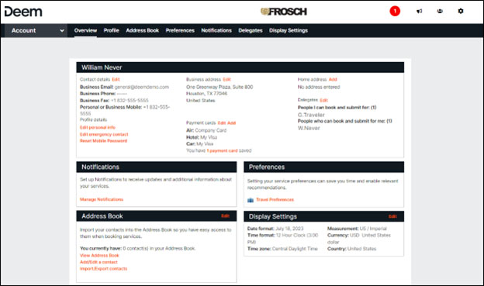
How to Update Your Traveler Profile
Navigating to Deem to update your profile
Log into the Travel Portal using your company-provided email address and the password you created the first time you logged in.
Within the Portal, click on More + in the main navigation at the top of the page. From the dropdown menu, select Update Profile.
1
2
Within, Deem click the Gear icon on the top-right of the page and choose Account.
You will be directed to your Account Details page.
Travel Arrangers may also have the capability to search and select traveler profiles to view and modify.
On the next page, you will be presented with your Profile, including links to update your Contact & Profile Details, Payment options, Home Address, Delegates or Travel Arrangers, Email Notifications, Travel Preferences, and Display Settings.
Click the Edit Personal Info, Profile or any of the orange Edit links to begin verifying your profile details.
As you complete each section, click Save at the top of the page, and move on to the next section listed on the left. Fill out all mandatory items per your company travel policy, which are indicated using a red [REQUIRED] notice.
3
You’ll need to fill out details including:
Personal & Employee Information: Basic Information, Addresses, Contact Information, Emergency Contact, TSA Secure Flight Information
Travel Preferences: Air Travel Preferences, Hotel Travel Preferences, Car Travel Preferences, Frequent Traveler Programs, Passport & Visa Information if applicable
Some mandatory fields may not be editable; this indicates these fields must be updated via your company HR department.
To ensure all changes have been captured, make sure to click the orange Save button at the top of each section.

Slide 6





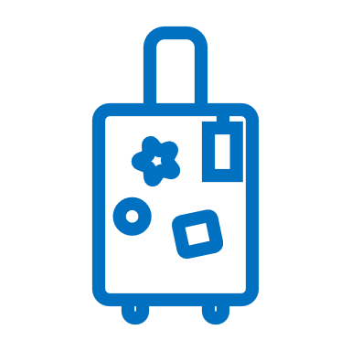

Book Travel with FROSCH Advisors
We’re here to assist you 24/7.
TEAM OF TRAVEL ADVISORS
Direct to FROSCH: ###-###-####
Email: FloridaTech@frosch.com
Hours: 7:00AM - 8:00PM CT (Mon-Fri)
IN-HOUSE AFTER-HOURS
Direct to FROSCH: ###-###-####
Local: ^^^-^^^-^^^^
Access Code: Sabre G2YL
FROSCH ACCOUNT MANAGER
Catherine Maldonado
Direct: 332-223-6704
Email: catherine.maldonado@frosch.com
ONLINE BOOKING SUPPORT
Toll-Free: 877-686-3374
Email: onlinesupport@frosch.com
Hours: 7:00AM - 7:30PM CT (Mon-Fri)
PERSONAL & VACATION TRAVEL
Toll-Free: 888-601-8490
Email: froschleisure@frosch.com
MEETINGS & EVENTS
Toll-Free: 650-762-1834
Email: meetings&events@frosch.com
EMAIL Florida Institute of Technology Inc’S TEAM OF FROSCH TRAVEL ADVISORS
To correspond with your Travel Advisors, please use your dedicated email address: FloridaTech@frosch.com. Please always keep FloridaTech@frosch.com copied in your email exchanges to ensure prompt assistance.
CALL FROSCH 24/7 VIA A SINGLE DEDICATED toll-free PHONE NUMBER
A dedicated toll-free number has been set up for Florida Institute of Technology Inc travelers to directly reach FROSCH’s Travel Advisors: ###-###-####. There is no need to dial a separate number outside of the service hours listed above; this phone number automatically forwards to FROSCH’s in-house After-Hours service. Calls received after standard service hours may incur an additional After-Hours fee.
Important reservation notes
No fare or space is guaranteed until ticketed. Once a reservation is ticketed, you will receive a confirmation and itinerary with a record locator via email.
For most non-refundable tickets for travel in the US, you have 24 hours from the time of issuance to request that FROSCH void the ticket with no penalty incurred.
FROSCH has a price match guarantee! FROSCH utilizes leading technology and creative faring techniques to ensure we provide you with the lowest possible airfare on every itinerary. Should you find a fare or rate that is more favorable, please immediately bring it to the attention of your Travel Advisors with screenshots of the final page of the booking process. If confirmed, FROSCH will match the price.

Slide 7








Best Practices for Bookings
At FROSCH, we’re here for you.
The same team of Travel Advisors is available to assist with your bookings, as well as any changes to your travel before or while you’re on the road. We pride ourselves on providing excellent customer service; below are some tips to help us exceed your expectations!
ALWAYS EMAIL FloridaTech@frosch.com
Always keep the team email address, FloridaTech@frosch.com, copied on your correspondence to ensure prompt assistance.
ADD YOUR PREFERRED ADVISOR TO THE SUBJECT LINE
If you prefer to work with a specific travel advisor, add their name to the subject line of your email.
BE AS DETAILED AS POSSIBLE WITH YOUR REQUESTS
Add as many details as possible in your original request, including traveler name(s), dates & times, origin & destination cities, accommodations, and car rentals.
ADD URGENT TO SUBJECT FOR SAME-DAY
If you are booking same-day travel, use the word “URGENT” in the subject line to alert the team.
ADD TO AN EXISTING RESERVATION
Let your advisor know if you are adding to an existing itinerary, instead of creating a new one for a new request.
NO FARE OR SPACE IS GUARANTEED UNTIL TICKETED.
Once a reservation is ticketed, you will receive a confirmation and itinerary with a record locator via email.
ENSURE DATA SECURITY; NEVER EMAIL SENSITIVE DATA.
Due to our security settings, emails with credit card information will not be delivered. Please also note that we cannot store CVV numbers for credit cards due to PCI and GDPR compliance regulations.
HAVING TROUBLE UPDATING YOUR PROFILE? EMAIL IN-HOUSE SUPPORT.
For assistance with this tool, email onlinesupport@frosch.com or call 877-686-3374 . If you need assistance modifying a booking, contact your team of advisors.

Slide 8
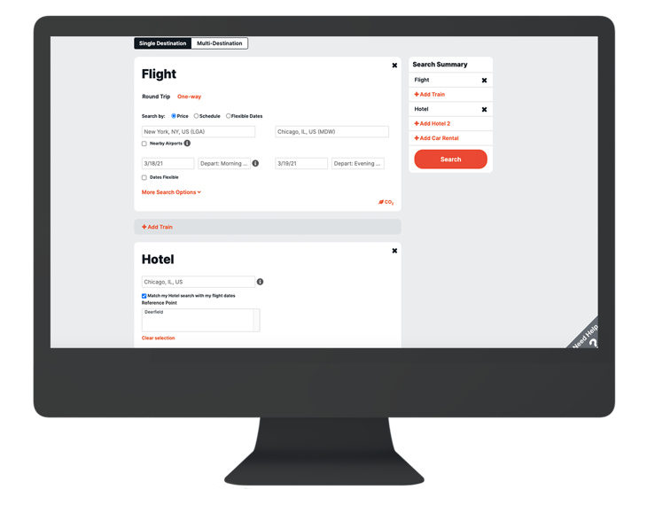



How to Access Deem
Prefer to book yourself? Access the tool anytime.
To book online, FROSCH has created a link to Deem on your Travel Portal that can be accessed 24/7.
THE HOMEPAGE
On the homepage, you will find a Trip Search and any important Alerts from your company or FROSCH. Use the nav bar to access current Reservations and Unused Tickets.
On the Reservations page, click on any of your upcoming or archived trips to view an overview of the reservation. From this window, you can Book Again, Print Itinerary, or View Details. Email the itinerary from the Trip Details page.
HOW TO GET ASSISTANCE
FROSCH ONLINE SUPPORT
Call 877-686-3374 or email onlinesupport@frosch.com; our in-house team is available M-F, 7:00 AM - 7:30 PM CT.
VIA DEEM WEBSITE
Within Deem, select Help on the main menu at the top of any page to access the Help Center.
HELP GUIDES ON TRAVEL PORTAL
Within the Travel Portal, click on the Online Booking tab to access FAQs and download additional resources.

Slide 9
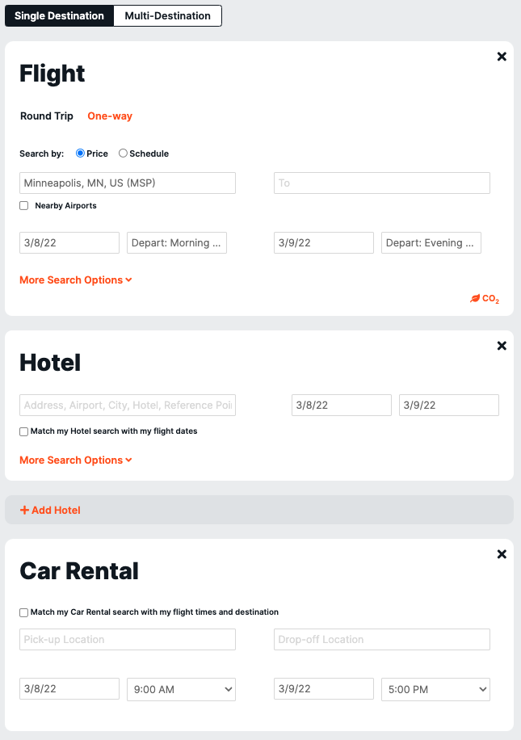
How to Book Online in Deem: Search
Book simple and recurring itineraries with a few clicks through your online booking tool.
Deem is available to Florida Institute of Technology Inc travelers to book air, car, train and hotel reservations. Should you need a complex itinerary booked or find a price that seems higher than it should be, your team of advisors can assist.
Booking a trip
1
Click Travel or Trip Planner in the top navigation to book flight, hotel, rental car, and airport parking reservations.
At the top, select Single Destination or Multi-Destination.
Under Flight, select round trip or one-way, then enter the cities, dates and times you wish to depart and return.
Click More Search Options to select Class of service, Fare Type and Preferred Connecting Airport, if applicable.
2
Click Add Hotel if you wish to add a hotel reservation.
Check the box if you wish to have your search criteria pre-populate from your flight information.
Under Hotel, enter the address, airport, city, hotel or a reference point and the dates of your stay.
Click More Search Options to select a distance to search within.
Click Add Hotel to make an additional hotel reservation
3
Click Add Car Rental if you wish to add a car rental.
Check the box if you wish to have the pick-up and drop-off locations pre-populate from your flight information.
Enter the location(s) and dates of your rental, as well as preferred pick-up and drop-off times.
4
Click the Search button on the left-side of the page under Search Summary.

Slide 10
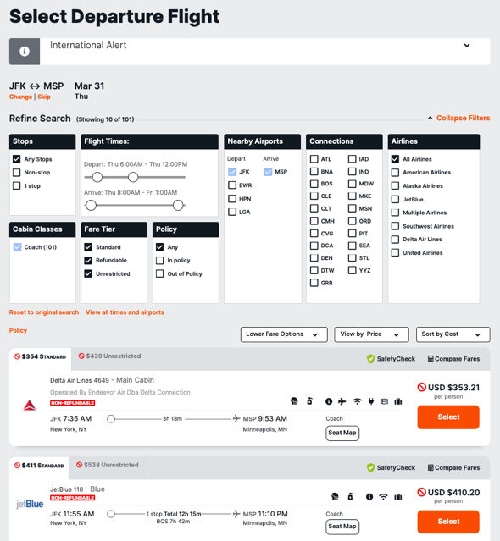
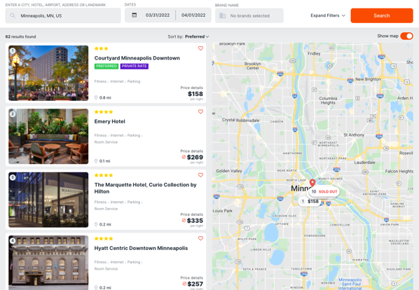
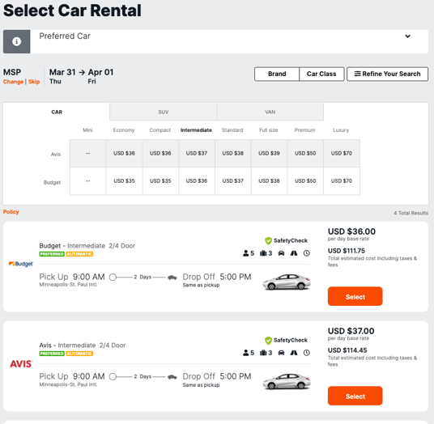
How to Book Online in Deem: Select
5
Select your desired flights from options presented.
If your flight selections are outside of your corporate travel policy, you may be asked to select a reason that closest explains why you are out of policy.
You may modify or narrow your search using the options at the top of the page. You can also sort the results by price or schedule.
Preferred airlines will be indicated as such in the search result.
6
On the next page, select your hotel.
Refine your search using the button in the top right corner.
Any hotel options that offer a negotiated rate for your company will be indicated as such.
Click on your preferred hotel and then click the orange Select button next to the room category you’d like to choose. Use the tabs to find out more details about hotel or view photos.
Review the hotel and click Continue.
7
On the next page, select your car rental.
Refine your search using the table at the top of the page.
Any car rental options that offer a negotiated rate for your company will be indicated as such.
Review the mileage and rate information for each option presented. Click on the orange Select button next to car rental you’d like to choose.
Click Continue.

Slide 11
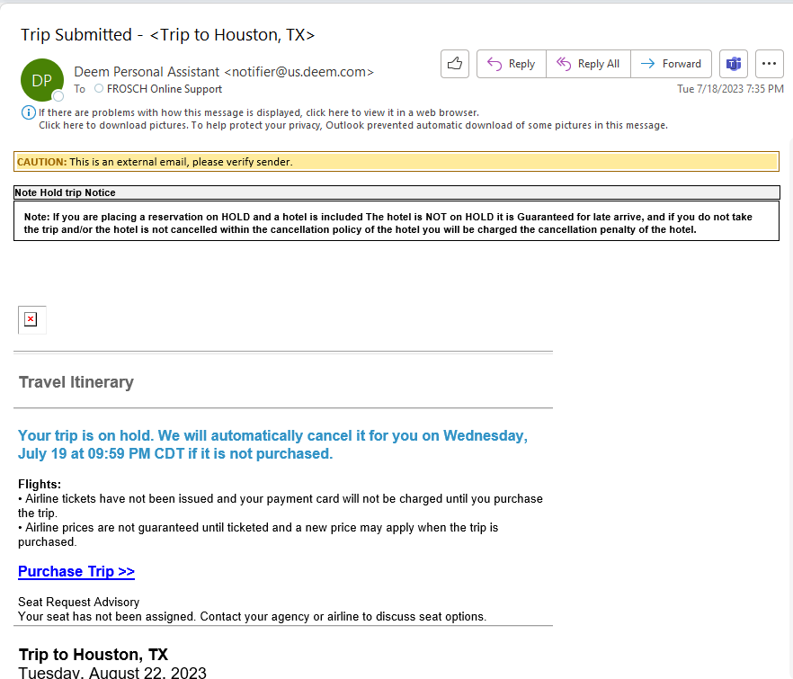
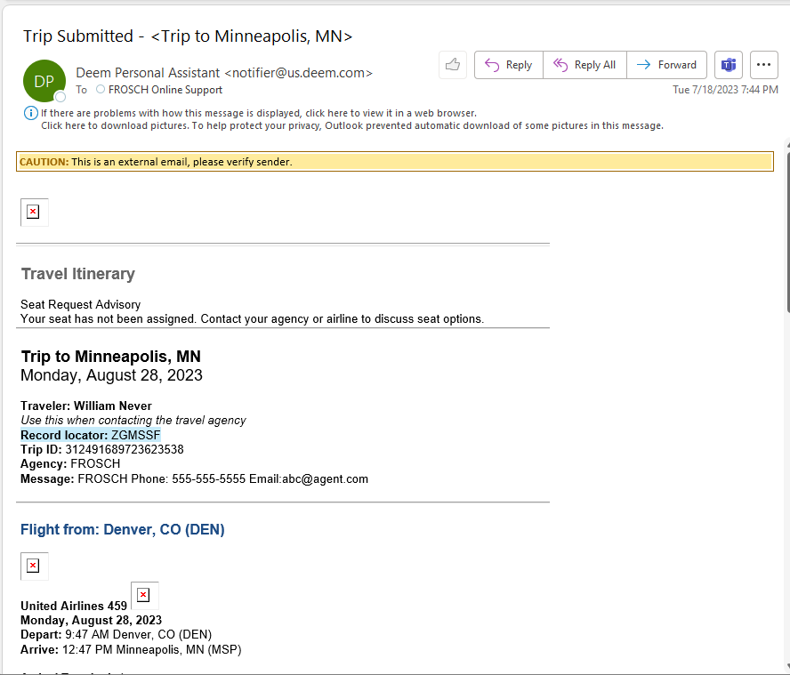
How to Book Online in Deem: Book
8
On the next page, Review Trip, review your itinerary details carefully, including any applicable fare rules and other restrictions.
You may select your seats by clicking the orange Select Seats link under your flight selection.
You may put your trip on Hold, Change your trip, or Start Over. If you put your trip on Hold, you will receive an email similar to the screenshot on the right.
9
To finalize your booking, click Continue. On the next page:
Give your trip a nickname for your reference.
Verify your personal information.
Use a personal credit card for all air travel reservations and hotel guarantee.
Select or enter the required information to complete your travel booking.
Click Purchase, then OK on the pop-up window.
10
Your Trip Summary will contain your record locator.
Scroll to the bottom and select Done.
You will receive a confirmation email from Deem immediately after you book, confirming your reservation was received and is being sent to FROSCH to process.
Your final itinerary will be sent once the reservation has been ticketed and will contain your ticket number and all supplier confirmation codes.

Slide 12
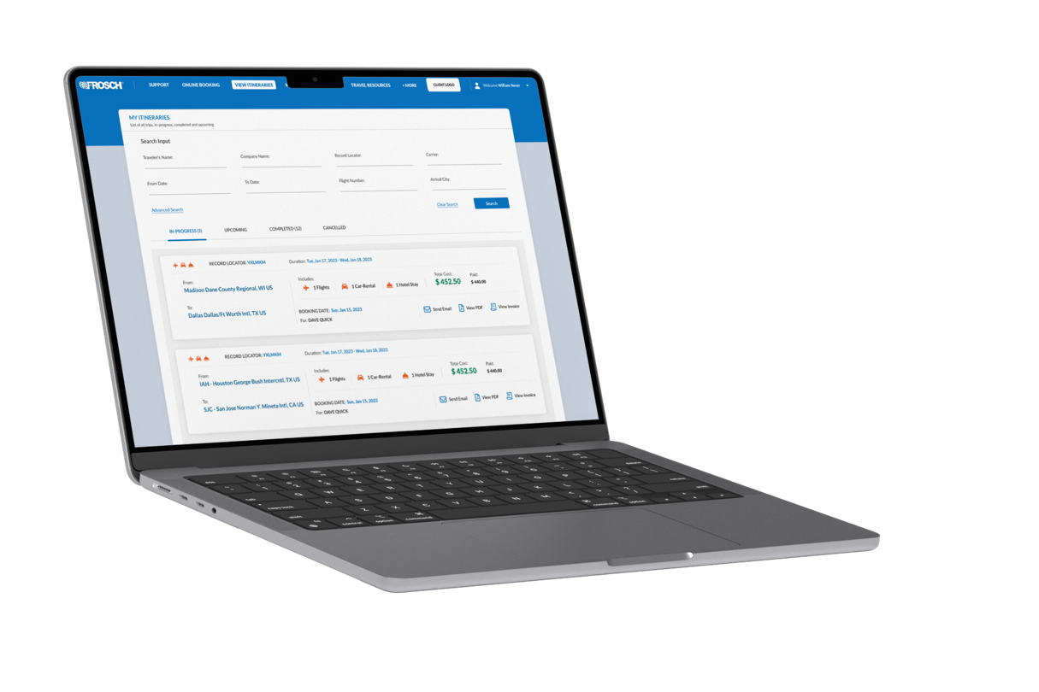
How to Access Itineraries & Invoices
Past to present, find everything you are looking for in Itineraries.
Your FROSCH Itinerary will include important details about your upcoming trip, including:
Agency Record Locator
FROSCH 24/7 Contact Information
Company-Specific Tracking (client matter numbers, department, etc.)
Links to Check-In, Boarding Pass Info, & Baggage Policies
Satisfaction Survey Link
Travel Advice
Access past & present itineraries from the travel portal
1
Navigate to the FROSCH Travel Portal.
Click on the “View Invoice Itineraries” tab in your Travel Portal.
Use the tabs to toggle between In Progress, Upcoming, Completed, & Cancelled itineraries.
2
Search using the various fields. Click on Advanced Search to search by Ticket or Invoice Number, or Issue Date.
Click on the “Record Locator” to access Itinerary details.
Click on the envelope icon to email the itinerary to an email address as an HTML email, attached PDF or calendar reminder.
To view a corresponding invoice, click on the “View Invoice” icon.

Slide 13

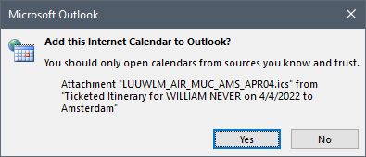
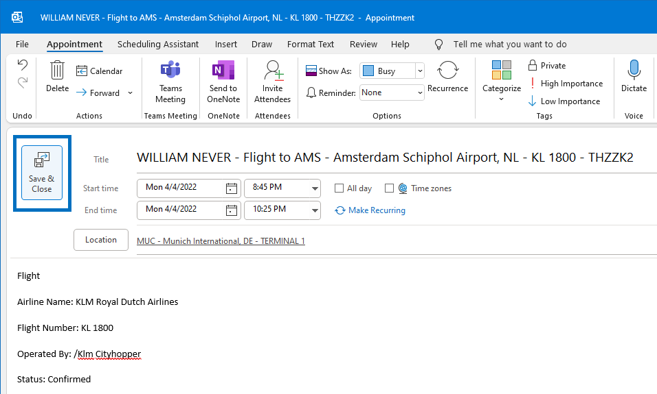
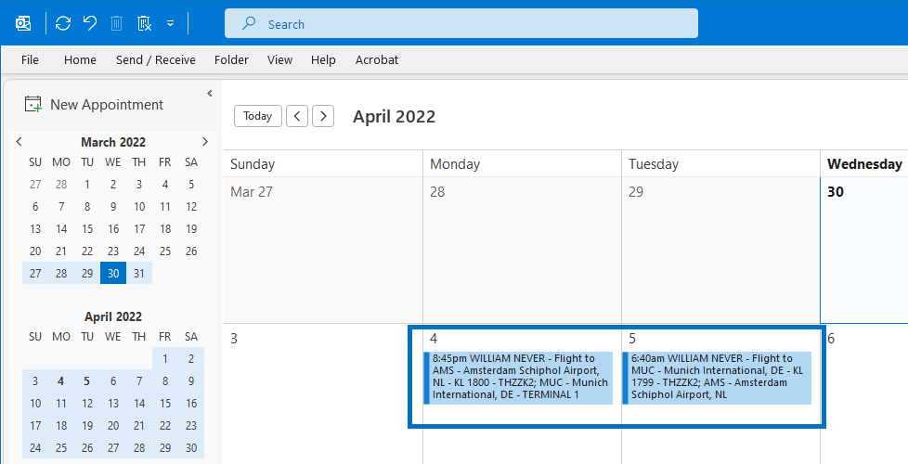
How to Add Trips to Your Calendar
Travelers and travel arrangers can seamlessly integrate travel details into their calendar.
FROSCH itineraries support calendar integration via calendar files (with .ics file extension) attached to the trip email confirmation. This standard file format is supported by Microsoft Outlook, Google Calendar, Apple Calendar, and more. In addition to a PDF of the itinerary, your trip email confirmation includes a separate .ics calendar file for each booking.
HOW TO ADD AN ITINERARY TO YOUR OUTLOOK CALENDAR
1
In your trip confirmation email from FROSCH, double-click on the .ics file attachment.
Click Yes to confirm in the pop-up window.
If you can not find your trip confirmation email, navigate to your FROSCH Travel Portal and click on the “View Invoice Itineraries” tab. Search for your trip and click on the envelope icon associated with it. Enter your email address and check PDF and Calendar Attachment.
2
Review the reservation’s information and click Save & Close.
The reservation will be added to your main calendar.
Repeat steps 1 & 2 to add more reservations.
3
HOW WILL TRIP INFO BE DISPLAYED?
Dates and times for calendar items are automatically converted to local times based on the device’s time zone.
If there is an air booking in the trip, the calendar item will display as “Busy” for the duration of the flight.
If there is a hotel booking, the calendar item will display as “Busy” between 3 PM and 6 PM local time for check-in events and between 9 AM and 11 AM for check-out events.
If there is a car booking, the calendar item will display as “Busy” for an hour at the scheduled pick-up and drop-off times.

Slide 14





About FROSCH Global Travel Services
FROSCH is the preeminent provider of business travel services.
Founded in 1972, FROSCH is a full-service travel management company with locations across six continents. FROSCH utilizes our industry stature to ensure our clients receive the best possible travel experience. As a company, we aspire to define ourselves as the travel company of choice, to deliver industry-leading expertise and service to our customers while building on the tremendous pride our employees have in all they accomplish.
NO CALL CENTERS, EVER.
Florida Institute of Technology Inc has been assigned a team of Travel Advisors who have been trained on your corporate policies, procedures and culture. The team will become personally familiar with all travelers.
TRUE EXPERTS IN TRAVEL
Our Travel Advisors are some of the savviest in the industry; familiar with creating complex global itineraries, utilizing creative ticketing to ensure lowest cost airfares, and servicing the most VIP of clients.
IN-HOUSE AFTER-HOURS
You’ll reach a FROSCH Travel Advisor any time of day, any day of the year. Even in an emergency situation, you can rest assured that your calls will not be routed to call centers or third-party contractors.
SERVICE EXCELLENCE
Our goal is to respond as quickly as possible and deliver the unexpected, a FROSCH core value, at every touch point. We aim to answer the phone within five rings and respond to email in less than fifteen minutes.
INTERESTED IN PERSONAL TRAVEL?
Our team of Luxury Travel Advisors have spent years cultivating first-hand knowledge of destinations and experiences around the world. Coupled with our global portfolio of partners that help unlock extras, let FROSCH afford you the exclusive access and benefits necessary for the vacation of your dreams. Get inspired with our first-hand experiences on www.froschluxurytravel.com.
Email froschleisure@frosch.com to book your next dream journey!

Slide 15



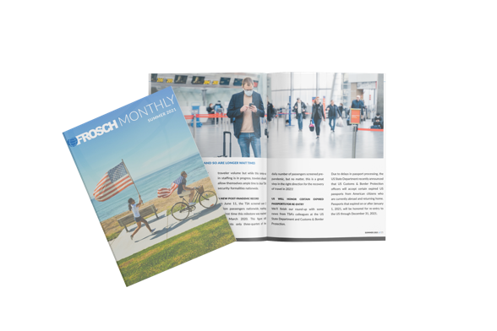
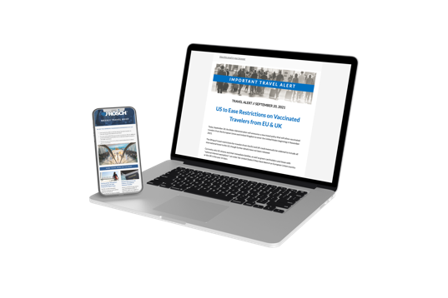
You’ll travel better with us.
Simply by booking with FROSCH, you’ll enjoy the following benefits.
FROSCH’s unique global technology solutions enable our Travel Advisors to service you locally, in your language and currency, while accessing global fares in over 50 markets. Our technology ensures the lowest applicable fare and availability, while the content is secured based on Florida Institute of Technology Inc’s travel policy.
AIRLINE RELATIONSHIPS
FROSCH has negotiated direct agreements with the world’s leading airlines, including the One World, Sky Team and Star Alliance, resulting in up-front discounts and complementary upgrades when traveling internationally, based on availability.
HOTEL DISCOUNTS
As a FROSCH client, you’ll enjoy discounted rates and complementary amenities at hotels around the world, with the FROSCH Hotel Collection, ABC Corporate Services, and Florida Institute of Technology Inc’s own preferred hotel directory, if applicable.
CAR PROGRAMS
FROSCH has negotiated agreements with the industry’s leading car rental and black car service companies.
SIGN UP FOR COMMUNICATIONS!
We’re dedicated to keeping you informed. Whether it’s Florida Institute of Technology Inc’s customized Travel Portal, traveler training, or our publications, we strive to keep our travelers informed about not only their travel program, but the travel industry itself.
Click HERE to sign up for email communications from FROSCH. Choose to receive our daily travel bulletin, travel alerts, monthly digital magazine, vacation offers, and more.

Slide 16
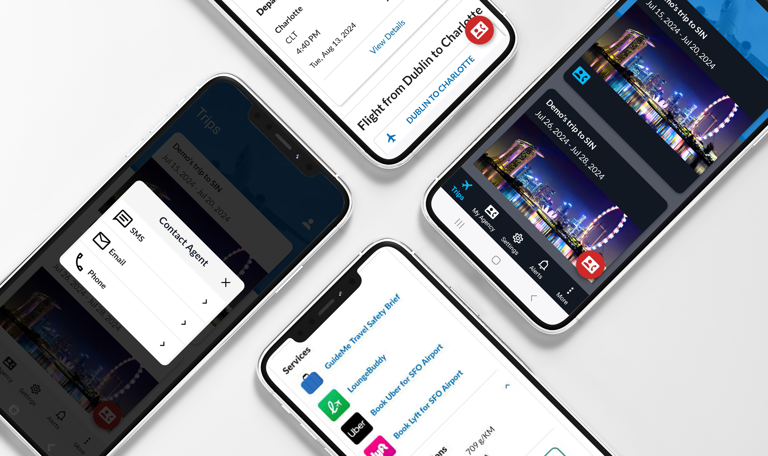
Obex for Business
The smarter way to travel.
Obex for Business™ is a powerful mobile application created to better manage your business travel. Access past, present, and future trips and contact your Travel Advisor to make changes with a single tap.
Easy access to booking details
Automatically updates with all relevant bookings with the newest trips at the top
Find details at a glance: traveler names, dates, destination, type(s) of reservations
STREAMLINED SUPPORT with a tap
Text, email or call your Travel Advisor with the pink contact button on the bottom-right
Smart technology will notify advisor of the trip you’re inquiring about
Do more right from the app
Update your traveler profile by tapping the icon in the top-right of the Trips timeline and selecting My Profile
Tap More to Book Online with Deem
Check-in for flights, find hotel and car reservation details
Turn on SMS Flight Notifications in Settings
Order an Uber from the airport to your hotel
Purchase lounge access through LoungeBuddy

Slide 17
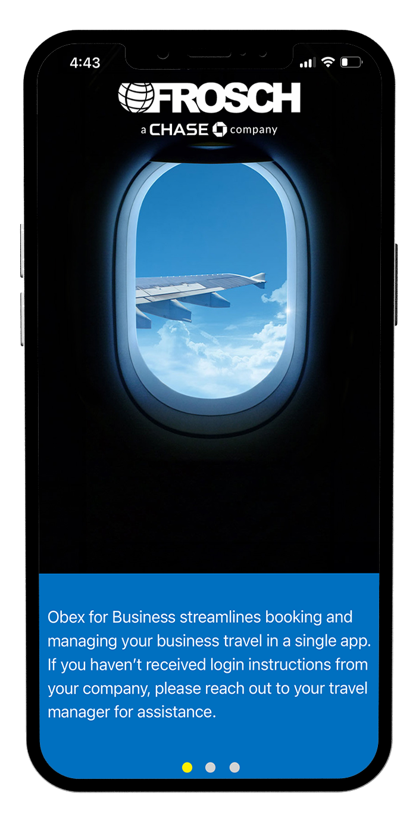
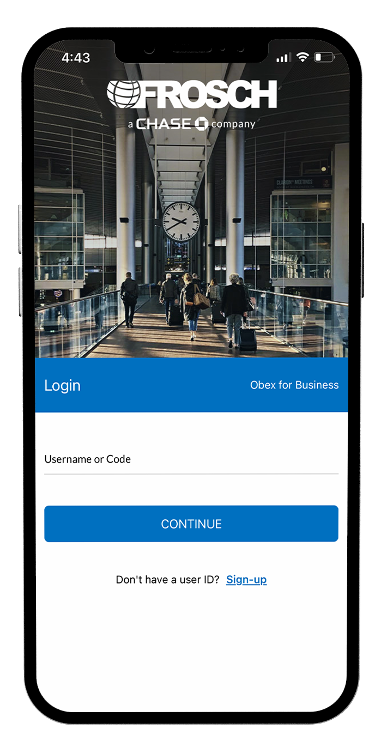
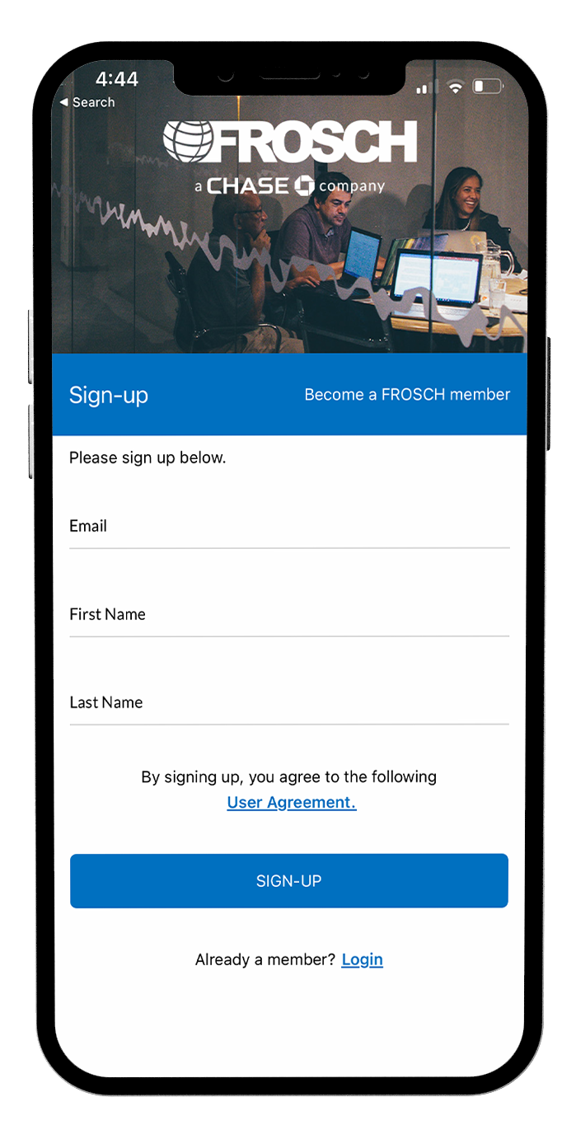


How to Download & Register for Obex
Download the smartphone app for Apple or Android devices.
First-time login instructions
1
Search for Obex in the Apple Appstore and Obex for Business in the Google PlayStore.
Download and install the app to your Apple or Android mobile device.
2
Click through the three welcome messages. If your company has SSO enabled, enter your Florida Institute of Technology Inc email address in the Username or Code field on the Login screen and click Continue.
If your company does not have SSO enabled, click the Sign-Up link. On the next screen, enter your Florida Institute of Technology Inc email address, as well as First & Last Name. Click Sign-Up.
3
After logging in for the first time, you will be prompted to enter your mobile phone number.
A text message will be sent to the number with a verification code; enter your verification code in the app to finalize your set up.
To take advantage of the app integrations, simply download and login to app. From the trip timeline, you’ll be able to access it with a single tap.
Purchase airport lounge passes
VeriFLY vaccine passport integration
Book travel online with Deem
Request an Uber at the airport
CLICK HERE FOR A SHORT TRAINING VIDEO

Slide 18
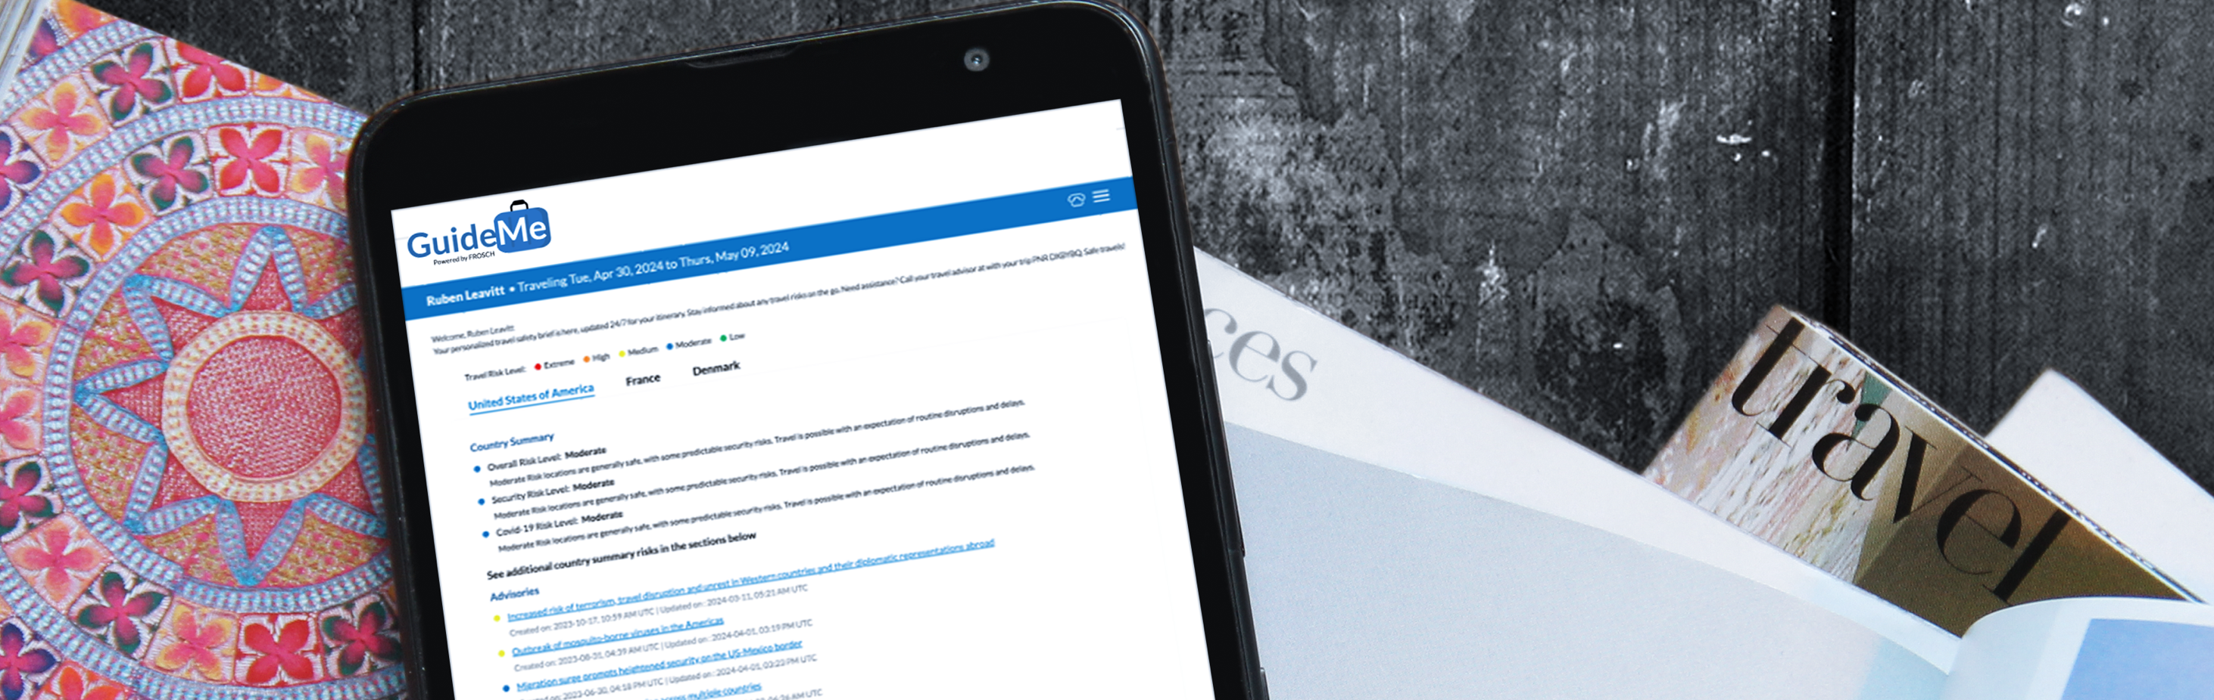
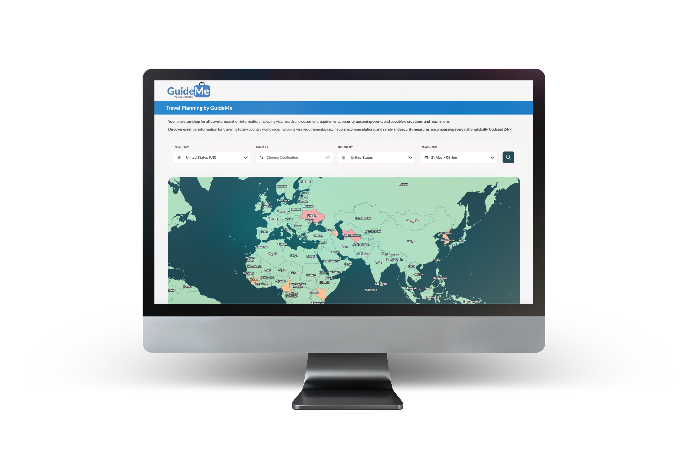
GuideMe: Travel Risk Information
FROSCH's GuideMe is designed to support business travelers with two essential tools: a comprehensive travel planning and a robust travel safety brief.
GuideMe Travel Safety Briefs
Stay informed and protected with applicable travel advisories and alerts throughout your journey.
For each of your itineraries, you’ll receive a unique travel safety brief. Details within the brief are updated 24/7 and automatically refresh each time the brief is accessed.
Each communication includes risk details across ten categoriesr for each country on your itinerary, travel dates, the record locator number, and contact details for your FROSCH travel team.
Itinerary: Access with a link at the top of each itinerary, titled “Your GuideMe Travel Safety Brief” or from the Travel Portal Itineraries & Invoices tab
Email & SMS: 48 hours prior to the trip, travelers will receive a link to their travel safety brief link in an email and/or in a SMS message
Obex App: Within each trip in Obex, travelers can access their travel safety brief directly within the app
Travel Planning Tool
Prepare for international trips with detailed guidance on visa requirements and necessary documentation.
Streamline the travel preparation process with this travel research tool available in the Travel Portal. From the Online Booking tab in the main Portal navigation, plug in your travel destinations and dates to find:
Visa requirements
Health information
Possible travel disruptions
Vaccinations requirements
Safety information
Document requirements

