Slide 1

Procurement Card Rules and Guidelines (Workday – Expense Cards)
Procurement Services• 2020

Slide 2
Lee Karnbach Director
Carissa Franklin
Admin II
X-8155
Denise Flutie
Buyer III
X-7256
Shannon Rey
Buyer III
X-7709
2nd floor R.A. Work Bldg 8am-5pm, Monday-Friday
Purchasing@fit.edu

Slide 3

Why are we helping to Educate?
To assist in maximizing the use of the University’s budgeted funds.
To keep the University compliant with IRS and other governmental regulations
To work to protect FL Tech and its’ employees for compliance with audits by the IRS, Department of Labor, Department of Education etc.
4. Accountability
It is everyones responsibility to be Accountable!

Slide 4
BOA Statements and Accounts

Slide 5

How it Works
Billing Cycle
Limits and Balances
From the 1st of each month to the end of the month
All transactions from the previous month need to be reconciled by the third business day of the new month
Credit limit is reinstated the 1st of each month
Unused balances do not roll over
Card holders are responsible and accountable to know their credit limits and current balances at all times
Card limits can be raised with an Account Change Request form upon justification and signed approval

Slide 6
How do I get a P-card issued with access to Grant Restricted Funds? Your P-card application must first be submitted to the Office of Sponsored Programs for review. Upon signed approval, the request will be forwarded to Procurement Services.

Slide 7
Contact BOA Immediately and Inform P-card Coordinator If your card is compromised, lost, or stolen or Regarding any disputed charges/billing errors BOA: 888-449-2273

Slide 8
Transactions and Taxes

Slide 9
Transactions
Card Limits
Where Allowed
For Travel
Purchases are not to exceed $5,000 total per transaction
Split Transactions are prohibited: more than one transaction per card or with multiple cards
In store
By phone
Online
If Amazon- Purchase through registered FIT Business Prime account only using FIT P-card
Airline tickets, hotel reservations, and car rentals within your monthly limit after approved travel authorization

Slide 10
FL Tech Tax Exemption
Cardholders should not pay Florida Sales Tax on any transactions
The cardholder is responsible to:
Provide FL Tech tax exemption card for every purchase in person and online
Check your receipts! At the time of sale is the greatest opportunity to have the vendor reverse an erroneous tax charge
If unable to reverse/avoid tax, submit explanation & documentation attached to the affected receipt(s)
*You May Not use the FL Tech Tax Exempt Card for personal use. The misuse of tax exempt status is considered tax fraud and you may be fined and/or convicted with a felony.

Slide 11
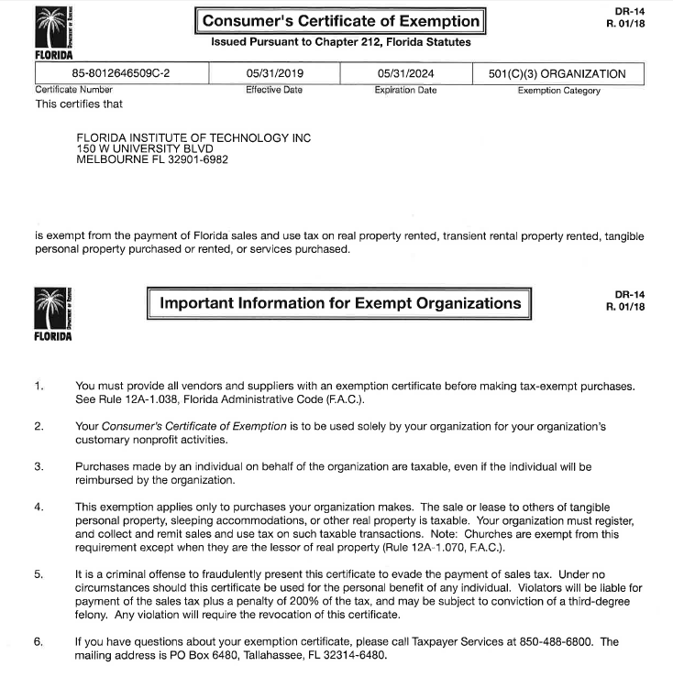

Slide 12
Receipt Requirements

Slide 13
Reconciling Receipts
Statements
Reconciling
Missing Receipts
The department head must approve all transactions each month
Each statement must have two signatures; the cardholder and the department head
All itemized receipts are to be given to your reconciler along with attached business purpose explanations
Obtain duplicate receipt from vendor whenever possible
If no duplicate, complete Missing Receipt form with supplier name, business reason for the purchases, and itemized totals

Slide 14
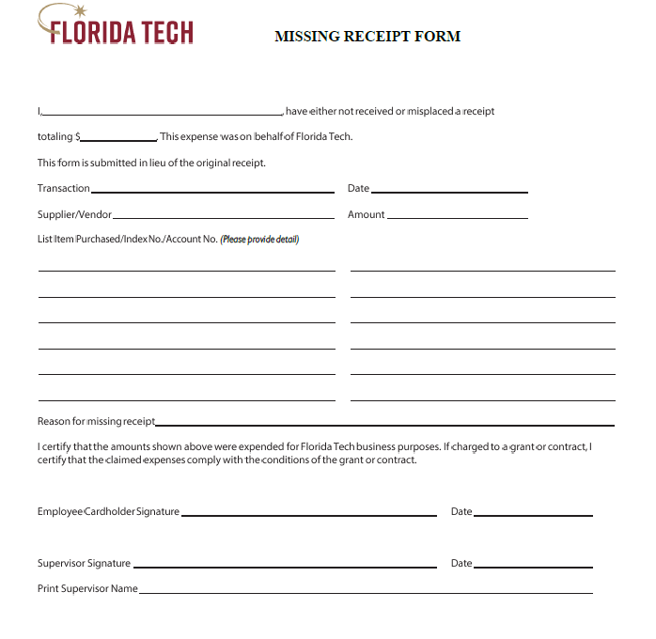

Slide 15

Detailed Receipts
Each Transaction
Documentation Includes
Receipt/Sales draft
Line item description and line item pricing
Tip, if applicable
Travel receipts: make copies to attach to travel expense forms
Vendor name
Transaction amount
Date of purchase
Itemized list
Explanation of business purpose for purchase(s)

Slide 16
Detailed Receipts (Cont.)
Meals, Special Events, and Entertainment: Business Purpose
Must provide business purpose in writing either on receipt or attached to receipt
Necessary for food/drink purchases at restaurants or grocery stores, and all other entertainment
Complete business purpose includes:
Reason for the purchase
Date of meeting/event
Location of meeting/event
Type of meal
List of attendees names or group name if applicable (eg: Volleyball team, board meeting etc.)

Slide 17
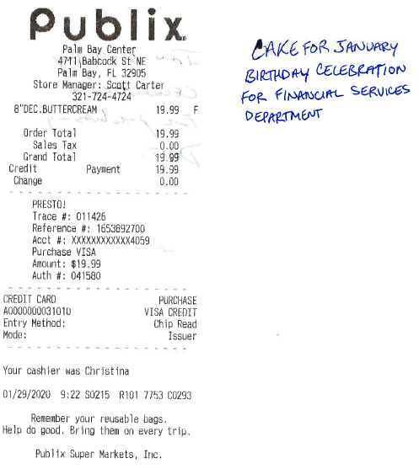
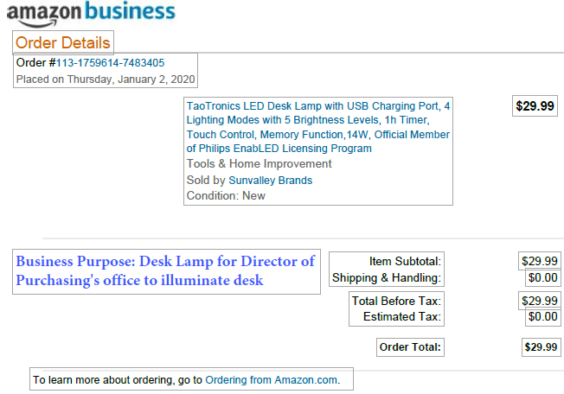
Financial Service’s Conference Room 01/29/2020 Attendees: Rachel P. David L. Steve V. Lee K. Denise F. John C. Robert C. Carissa F. Dory S.
Maria S. Kayla K. Angela C.

Slide 18
P-Card Use for Fuel Use the P-card to purchase fuel for rental vehicles when traveling on approved business for the university. A rental car agreement must accompany any fuel receipts. Do not use the P-card to purchase fuel for personal vehicles. Please utilize the Mileage Claim Form instead.

Slide 19
Prohibited Items and Restrictions

Slide 20


Prohibited Items
P-cards cannot be used for personal purchases or purchases at FL Tech Venues/On Campus
Alcoholic beverages
Capital equipment –regardless of cost
Construction/ remodeling
Consultants
Speaker fees
Parking/Traffic Violations
Tuition
Live Animals
Computers/laptops
Hazardous Chemicals/radioactive isotopes/laser etc

Slide 21

Prohibited Items (Cont.)
P-cards cannot be used for personal purchases or purchases at FL Tech Venues/On Campus
Controlled Substances
Donations
Fines
Purchase/repair of luggage
Cash Advances
Cashback for purchases/returns
Excessive tips (greater than 20%)
Peer-to-peer mobile payment services
Software/technology subject to Traffic in Arms Regulations (ITAR), enumerated on the US Munitions List (e.g. firearms, weapons, certain infrared cameras, certain UAVs, etc)
If you have any questions or concerns please reach out to the Procurement Services team

Slide 22
Procurement Card Violations

Slide 23
The disciplinary action taken is dependent on the severity of the violation, along with other relevant factors.
Disciplinary action can be taken on cardholders who violate the “P-card Rules and Guidelines” or Procurement Policies
Non-compliant purchases will receive an email reminder and you will need to schedule additional training with Procurement Services. Your department head will be copied on the correspondence
On the second violation the cardholder will receive a written p-card violation warning that will require the cardholder’s signature and the signature of their department head

Slide 24
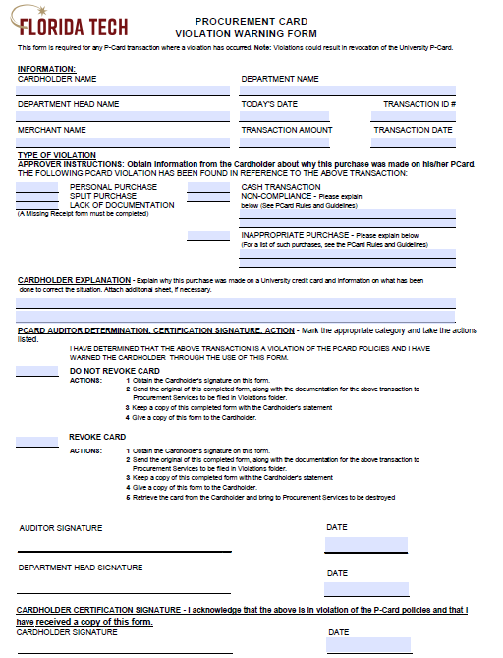

Slide 25
The cardholder may be asked to provide detailed explanation and documentation for any potential violation(s)
Any Combination of these actions may be taken at the determination of the University
If a third violation occurs your card privileges will be revoked
Further actions may be determined by Florida Institute of Technology depending on the severity of the violation
If you have any questions or concerns about whether a potential purchase is within the P-card Rules and Guidelines, please reach out to the Procurement Services team and we will be happy to assist you in determining the proper course of action

Slide 26

Thank you for attending. Please don’t hesitate to call on us, our team is here to help:
Add a fun graphic here-
purchasing@fit.edu 321-674-8155 All contact info, forms, and policies can be found on our website: www.fit.edu/financial-services/procurement-services/

