Slide 1
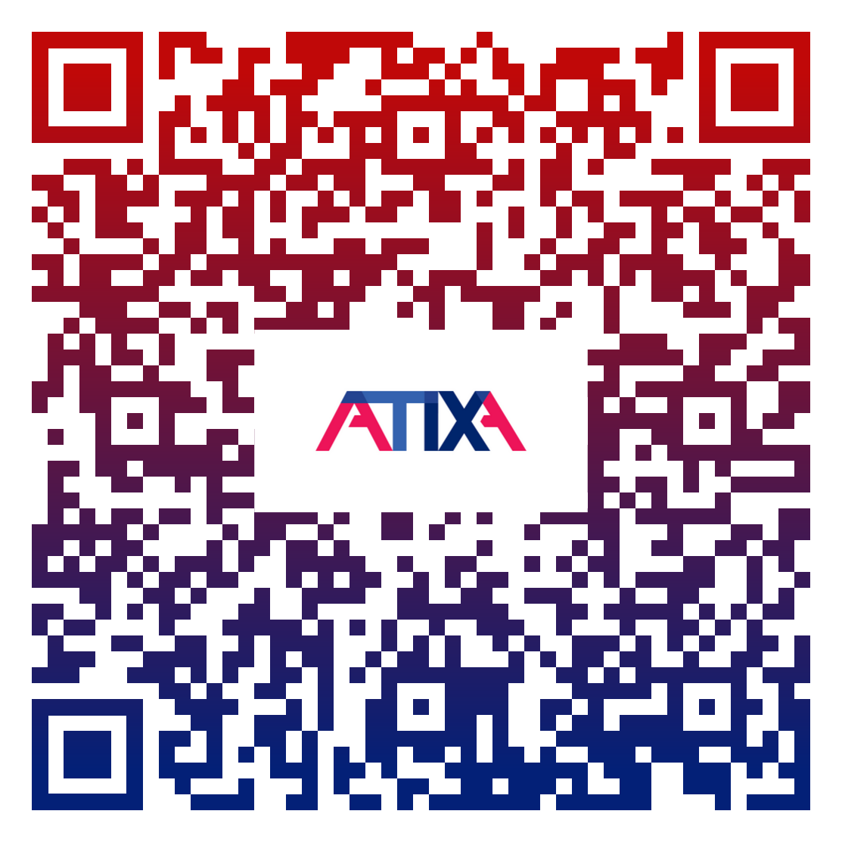
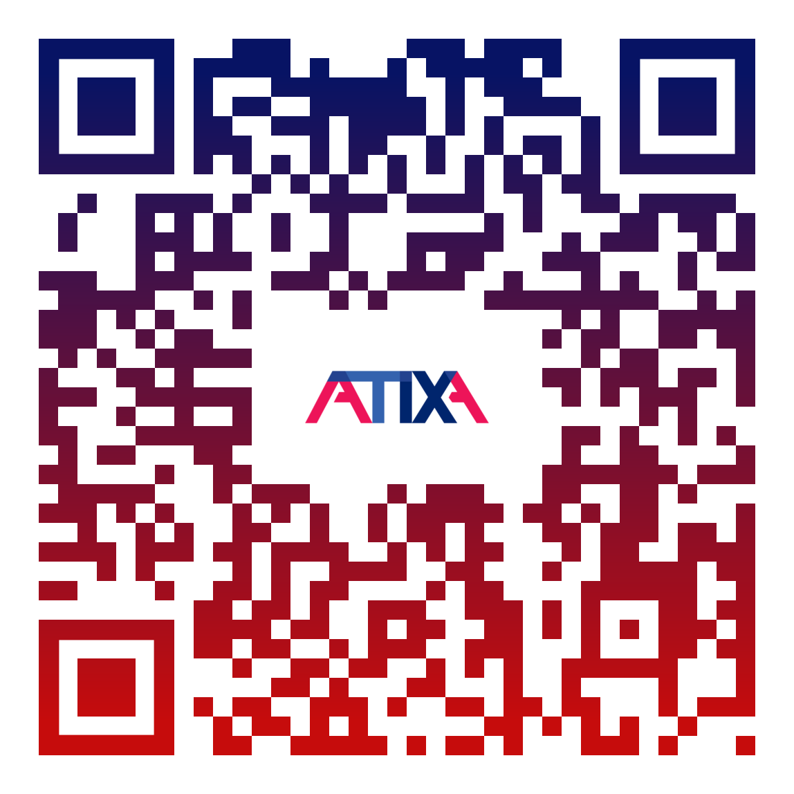
Practical Strategies for Addressing the Challenges of Expanding Civil Rights Compliance Beyond Title IX
Step 1. Register here!
Step 2. ATIXA Event Lobby (access to slides)

Slide 2
Practical Strategies for Addressing the Challenges of Expanding Civil Rights Compliance Beyond Title IX
October 29, 2025
Presented by: Saundra K. Schuster, Partner, TNGconsulting, LLC
President, ATIXA
FICURMA Annual Compliance Conference

Slide 3




Who We Are
Together with our member organizations ATIXA and NABITA, the leading organizations for Title IX administrators and school professionals dedicated to improving the safety of their campuses, we are dedicated
to creating safer and healthier communities.
TNG is the risk management touchstone for thousands of schools, colleges, universities, and workplaces across the country.

Slide 4

Sources of Civil Rights Compliance Obligations
The compliance environment is evolving, especially in the education field
  There are no comprehensive Title IX-style regulations guiding all compliance
Civil rights compliance sources are a combination of:
  Regulations
  OCR Resolution Agreements
  OCR sub-regulatory guidance
  Court cases
  State laws

Slide 5
Title IX of the Education Amendments of 1972 (sex discrimination in education)
Title VI of the Civil Rights Act of 1964 (Race, National Origin, Color, Shared Ancestry, Ethnic Affiliation)
Section 504 of the Rehabilitation Act of 1973 (Disability discrimination)
Title II & III of the Americans with Disabilities Act of 1990 (Disability discrimination and accommodation mandate)
Age Discrimination Act of 1975
Title VII of the Civil Rights Act of 1964 (race, color, religion, sex, national origin in employment)
Other federal laws
State Laws
Primary Civil Rights Laws Impacting Educational Entities

Slide 6
Covered Programs and Activities
Admissions
Recruitment
Financial Aid
Academic Programs
Student Treatment and Services
Discipline
Classroom Assignments
Grading
Extracurricular Activities
Clubs and Organizations
Athletics
Housing
Facilities
Employment

Slide 7
Civil Rights Laws Compliance Enforcement

Slide 8
Enforcement Mechanisms
Civil rights laws compliance are enforced through government agencies, assigned to oversee the specific law, including the Department of Education’s Office for Civil Rights (OCR) and through the Department of Justice (DOJ), and the Equal Employment Opportunity Commission (EEOC)
  These agencies assess the institution for compliance with federal law
  Individuals at institutions may file complaints with the designated oversight agency
  The agency may investigate complaints and reach resolution agreements with the institutions to remedy discrimination or harassment
Individuals or the DOJ may also bring lawsuits in federal court
  Courts develop their own standards for liability that may differ from agency compliance obligations
Notes:
DOJ has ultimate oversight authority of Title VI and oversees/approves the work of OCR in relation to Title VI
OCR can open a compliance review without a complaint having been filed

Slide 9

The Shifting Compliance Landscape
Increased scrutiny on Title VI compliance
Expanding expectations of a designated compliance coordinator
Expectations of expanded role of Title IX Coordinator
Issues impact education as well as employment
Issues often Involve multiple protected classes
Civil Rights compliance is now an ecosystem not a silo

Slide 10
Collaboration v. Centralization

Slide 11
Potential Models
Centralized Compliance Office
  Provides for efficiency, consistency, shared data and unified policies
Hub and Spoke Model
  A central coordinator (typically the Title IX Coordinator) with Deputy Coordinators in H.R., Conduct, Disability Services
Distributed Specialists with a Cross-Functional Committee
  Beneficial when reporting lines are sensitive or rigid

Slide 12
Benefits of Collaboration or Centralization
Efficiency in addressing multiple civil rights issues
Efficiency in staffing and cross-training
Ensure processes or a single office to address an incident that triggers multiple frameworks
  Example: student:student; student:faculty; student:staff; staff:faculty
  Multiple laws/policies
Create a shared intake process
Align definitions and documentation forms across policies and departments
Ensure a common investigation process
Ensure equity for all processes
Frame collaboration as risk mitigation not territory surrender

Slide 13
Common Challenges
Legacy silos (Title IX vs. HR vs. Conduct)
Confusion about jurisdiction
Uneven resources
Lack of clear communication
Integration of grievance procedures across regulations

Slide 14
Important Additional Considerations
Identifying institutional organization charts
Understanding and aligning organizational models
Assessing staffing needs
Conducting policy audits for overlap and gaps
  Creating shared definitions, timelines, structure
Developing “multi-path resolution processes”
  Consistent with due process requirements (students v. non-faculty employees v. faculty)
  Consideration of CBA’s
Creating a flowchart for coordinated resolution workflow

Slide 15
Important Additional Considerations
Develop a standard “Issue Routing Protocol”
  Who handles what?
Consider establishing a monthly compliance roundtable with the stakeholder offices
Create a “case closure checklist” to ensure all obligations are met
  Policy notices
  Notices of investigation and allegations
  Supportive measures

Slide 16
Implementing a Comprehensive Plan

Slide 17
Steps to Establish a Comprehensive Civil Rights Office
Establish strong, comprehensive policies
Understand the reporting structure to be applied
  President
  Compliance
  General Counsel
  HR
  Provost
  Student Affairs
Set the scope of the work/office
  Who does the office serve?
  What policies does the office enforce?
Determine the size of the team and the roles needed to support the work
  Internal versus external roles
Name for the office

Slide 18
Build Strong Allies
Senior Administrators
  Student Affairs, Provost, Deans, Department Chairs
General Counsel
School Site Administrators (K-12)
Human Resources and Employee/Labor Relations Partners
Compliance or Enterprise Risk
Student Conduct Offices
Faculty Affairs
Student Groups
Confidential Advocates
Community Partners
Campus and Local Law Enforcement
Student Support and Special Education Services (K-12)

Slide 19
Identify the Team
Identify the roles you need
  Title IX Coordinator
  Title VI Coordinator
  ADA/504 Coordinator
  Deputy Coordinators
  Investigators
  Case Managers
  Informal Resolution Facilitators
  Decision Makers
  Appellate Officers
  Advisors
Full time positions v. additional duties for existing employees
Train the team
Cross-train key stakeholders

Slide 20
Navigate the Challenges and Shifting Priorities
Internal Challenges
  Changes in leadership
  Changes in resources (and budgets)
  Staff turnover and burnout
External Challenges
  Changes in the legal frameworks – statutory, regulatory, case law
  Changes in political leadership
    Shifting federal priorities and scrutiny – Department of Education (ED), Department of Justice (DOJ), Department of Health & Human Services (HHS)
    Shifting state priorities
  Public pressure and negative publicity

Slide 21
Set Boundaries With External Parties
Be clear and consistent about the scope of your office's work and jurisdiction
Be honest and transparent about your team's capacity and workload
Know when and how to respond in urgent incidents
  Is this emergency your emergency?
Establish key partnerships with 24/7 resources
Work as a team to have consistent external messaging: Have a checkpoint with your team to discuss internal process, procedures, how things are operating, etc.
  Ongoing meetings (group and 1:1 meetings)
  Yearly strategic team meetings

Slide 22
Collateral Issues

Slide 23
Ensure Equitable Resolution Process
Equity focuses on providing support and resources to reduce disparities in access to the education program
Treat all parties equitably
  If the school/institution affords a right, privilege, benefit, or opportunity to one party, consider whether it should be provided to other parties
  Ensure parties have opportunity to fully participate in the resolution process
Ensure all employees involved in a resolution process operate without bias and/or conflict of interest
Should be reasonably prompt to enable the school/institution to fulfill its obligations to address hostile environments

Slide 24
Implications of First Amendment Issues
When administrators determine that behavior that would violate a protected right has occurred, but that behavior is likely protected by the First Amendment, there are still obligations that require response
  Response will be remedial rather than disciplinary/punitive
  The institution must document remedial actions, assess their effectiveness, and be able to demonstrate mitigation of any hostile environment that may exist
The free speech of one person or group may still harm another person or group, such that remedial obligations are created for the institution
Some problems may be intractable, but keep records of good faith efforts to attempt to ameliorate effects
Do not assume that off-campus or social media-based conduct is outside of school control

Slide 25

Assessing Compliance Efforts
Monitoring: Conduct regular needs assessment
  Identify strengths
  Identify program gaps
  Barrier analysis
  Address areas of improvement
  Assess resources
Identify patterns and systemic problems
  Internal reviews/audits/assessments
  Climate assessments
Complaint/investigation debriefing
Benchmarking

Slide 26
Conducting Equity Audits
Audits are intermittent assessments to measure compliance and to monitor barriers
Factors such as cost and personnel capacity impact regularity
Disciplinary/Conduct Outcomes
Reports/Complaints
Hiring, Compensation, Evaluation, and Promotion
Notes:
Audits are effective ways to assess the Title IX program.
Audits are intermittent assessments that evaluate whether a program is operated in an equitable way.
Audits are different than surveys, though survey data may be an important part of an audit.
Administering audits regularly tends to be the most beneficial, but there are cost considerations to performing audits on a regular schedule.
A rotational schedule of different kinds of audits are normal.
Different kinds of audits include:
Athletics equity audits.
May be done internally, but it is a LOT of work.
Entails reviewing the entire athletic program.
Requires significant understanding of Title IX athletics law and practice.
Must understand the three-prong analysis and the “laundry list.”
Involves review of scholarship, salary, enrollment, and other data, as well as visual inspections of facilities.
Usually done under privilege to shield the final report from being discoverable in a lawsuit.
Provides recommendations to move towards gender equity in athletics.
Scholarships and financial aid audit.
May be done internally, but also commonly completed by an external partner due to the data-intensive nature of these kinds of audits.
These audits measure the scholarships and financial aid offered to the general student body to ensure that the award process and the result are equitable.
Financial aid and other partners will need to be a partner in these audits because they hold the data.
Report or complaint audits.
Likely done internally but may be done externally if an independent perspective is important OR the data set is too large.
Review reports or complaints for patterns to identify trends or behaviors that may require specific action.
These kinds of audits may be especially relevant for sex discrimination complaints, disparate impact, disparate treatment, or culture/climate issues.
Hiring, Compensation, Evaluation and Promotion.
May be done internally, but also commonly completed by an external partner due to the data-intensive nature of these kinds of audits.
HR may generally hold these records and will need to be a cooperative partner.
Helps identify potential problem areas before complaints emerge.
Single sex facilities or programs audit.
This type of audit reflects several of the concerns outlined in the single sex programs section of this course.
In all likelihood for all but the largest recipients, this type of audit may likely be done internally.
An audit of single-sex programs and facilities would review any single-sex or preferred sex programs the recipient offers, with the goal of determining whether any areas of liability exist.
Other topics ripe for audits may come to the TIXC’s attention as a result of climate surveys or other feedback.
How often should recipients audit their programs?
It depends. If past audits have revealed problems in athletics or financial aid, for example, then it may make sense to perform more frequent audits.
Cost of audits may impact frequency.
Some audits that the TIXC may be able to complete independently, like report or complaint audits, should be done every year or two.
Other audits, such as those requiring significant collaboration from partners, could be placed on rotation so the TIXC always has an audit ongoing, but each office only expects to have an audit every 3-5 years.
There is no hard and fast answer.

Slide 27
Key Takeaways
Importance of advocacy for the process
  Resources
  Partnerships within the institution and externally
  Value to the institution and the community
Be Ready for Change
Build a Support Network
Take opportunities to learn from other practitioners and experts
Build the team that works for YOUR organization (no one size fits all)
Create a structure that builds sustainability
Continuous assessment enhances compliance

Slide 28
Questions?
Saundra K. Schuster, Esq.
Partner, TNG Consulting, LLC
Saundra.Schuster@tngconsulting.com

Slide 29
ALL ATIXA PROPRIETARY TRAINING MATERIALS ARE COVERED BY
THE FOLLOWING LIMITED LICENSE AND COPYRIGHT.
By purchasing, receiving, and/or using ATIXA materials, you agree to accept this limited license and become a licensee of proprietary and copyrighted ATIXA-owned materials. The licensee accepts all terms and conditions of this license and agrees to abide by all provisions. No other rights are provided, and all other rights are reserved. These materials are proprietary and are licensed to the licensee only, for their use. This license permits the licensee to use the materials personally and/or internally to the licensee’s organization for training purposes only.
If these materials are used to train Title IX personnel, they are subject to 34 C.F.R. Part 106. If you have lawfully obtained ATIXA materials by registering for ATIXA training, you are licensed to use the materials provided for that training.
34 C.F.R. 106.45(b)(10) (2020 Regulations) requires all training materials to be publicly posted on a Recipient’s website. Licensees subject to the 2020 Title IX Regulations may download and post a PDF version of training materials for their completed training to their organizational website to comply with federal regulations. ATIXA will provide licensees with a link to their materials. That link, or links to the materials on that page only, may be posted to the licensee’s website for purposes of permitting public access to the materials for review/inspection only.
You are not authorized to copy or adapt these materials without ATIXA’s explicit written permission. No one may remove this license language from any version of ATIXA materials. Should any non-licensee post these materials to a public website, ATIXA will send a letter instructing the licensee to immediately remove the content from the public website upon penalty of copyright violation. These materials may not be used for any commercial purpose except by ATIXA.

