Slide 1
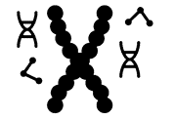
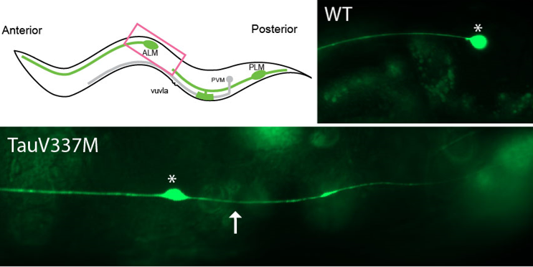
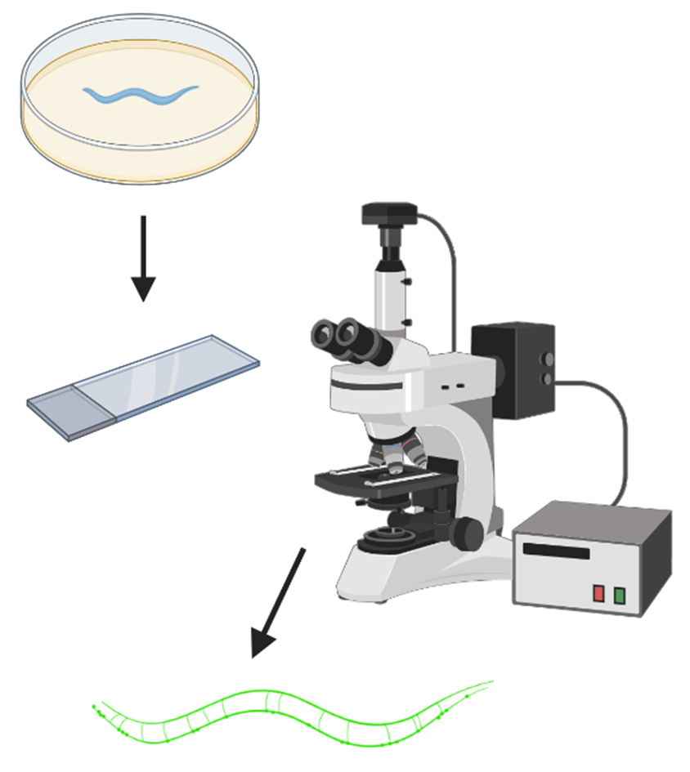
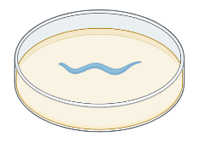

Disease-associated mutation in Tau causes neurodevelopmental defects
Caylin Lepak and Lillian Beavers
Dr. Melissa A. Borgen, Dept. of Biomedical and Chemical Engineering and Sciences,
Florida Institute of Technology
Background
C. elegans Anterior Lateral Mechanosensory neuron used to study neural development
Tau protein binds to and stabilizes microtubules (MTs) in neurons
Destabilization of MT’s has been linked to neurodevelopmental and degenerative disorders
Mutant Tau, TauV337M is causative for Frontotemporal Dementia
Manipulation of MT stability reveals genetic and molecular mechanisms for disease-associated allele of Tau, TauV337M.
Results
Conclusions
Tau V337M causes neurodevelopmental defects via reduced MT stability
rpm-1 functions downstream of Tau to influence MT stability
Reducing MT stability further using colchicine suppresses developmental defect
Levels of MT stability produce different phenotypes in ALM neuron
Disease-related Tau mutation causes developmental defects in ALM
A.
B.
Fig. 2. Mutations that decrease microtubule stability cause developmental defects in ALM morphology.
A) Diagram of C. elegans. Pink box represents region imaged. WT ALM cell bodies do not extend a posterior projection. TauV337M ALM extends a posterior projection (arrow). B) Quantitation of ALM morphology in different genotypes. TauV337M has a highly penetrant phenotype. Addition of rpm-1 LD causes partially suppressed phenotype. Established microtubule stability mutant, ptrn-1, with strong phenotype. Statistics: student’s T-test *p<0.05, ** p<0.01, *** p<0.001
Genetics
ALMs labeled with muIs32 [Pmec-7::GFP]
HuTauV337M mutation in Tau protein derived from human FTD patients
rpm-1 LD (ligase dead) has mutation that eliminates ubiquitin ligase activity
ptrn-1, deletion mutation causing knockout
Colchicine suppresses developmental defect in Tau mutant
Colchicine destabilizes microtubules
Colchicine suppresses Tau-related defect
rpm-1 LD reduces the Tau defect; Colchicine enhances suppression
    Colchicine and rpm-1 affect MT stability in parallel
Suggests a dosage-effect of MT stability
  Reduced stability → ectopic growth
  Strongly reduced stability → failure to form ectopic growth
Tau has complex effects on MTs
Methods
Characterizing ALM Morphology
Worms grown on standard NGM media.
Day 1 adults mounted on 2% agar pads on slides.
Worms imaged under 40X magnification
Fig. 3. Colchicine exposure during development suppresses the ALM morphology defect. Growing worms on 2mM colchicine resulted in significant decrease in ALM posterior projects. DMSO is the control condition. Fisher’s Exact Test, *p<0.05, ** p<0.01, *** p<0.001
Fig. 1. Workflow for assessing C. elegans ALM
Future Directions
Titrate Taxol exposure
Genetic epistasis with rpm-1 pathway
Imaging microtubule dynamics in vivo
Taxol exposure resulted in failed embryo development
Colchicine and Taxol Exposure
Worms grown on NGM containing 2mM Colchicine, 2 μM Taxol, or DMSO control.
Adults lay eggs on drug plates; progeny are grown up exposed to drugs.
Progeny grown to day 1 adulthood and scored as described.
Colchicine
Progeny scored
Taxol
No viable progeny
Acknowledgments
Supported by funds from the Beta Beta Beta Research Scholarship Foundation
Special thanks to Katrina Diel and Dr. Glenn Miller
Fig. 4. Taxol exposure resulted in failed embryo development. Taxol is a microtubule stabilizing drugs that prevents depolymerization of microtubules. Taxol exposure at 2μM resulted in a failure to produce progeny in all genotypes tested. This result was unexpected, as Taxol has been used to assess C. elegans development in previous studies. We suspect that the dosage was too high and was affecting cell division in developing gametes and embryos.
Contact
clepak2019@my.fit.edu lbeavers2021@my.fit.edu
mborgen@fit.edu
Notes:
Rpm-1 regulates synaptogenesis
Ptrn-1 promote MT function, minus end binding
Understanding the dynamics of microtubules at the cellular, molecular, and genetic levels will lead to advancements in treatments and therapies available for neurodevelopmental and neurodegenerative diseases.
Colchicine destabilizes microtubules
Colchicine significantly suppresses the Tau-related defect
rpm-1 LD reduces the Tau defect; Colchicine enhances suppression
Colchicine and rpm-1 affect MT stability in parallel
Suggests a dosage-effect of MT stability
Reduced stability → ectopic growth
Strongly reduced stability → failure to form ectopic growth
TauV337M has more complex affect on microtubules

