Slide 1




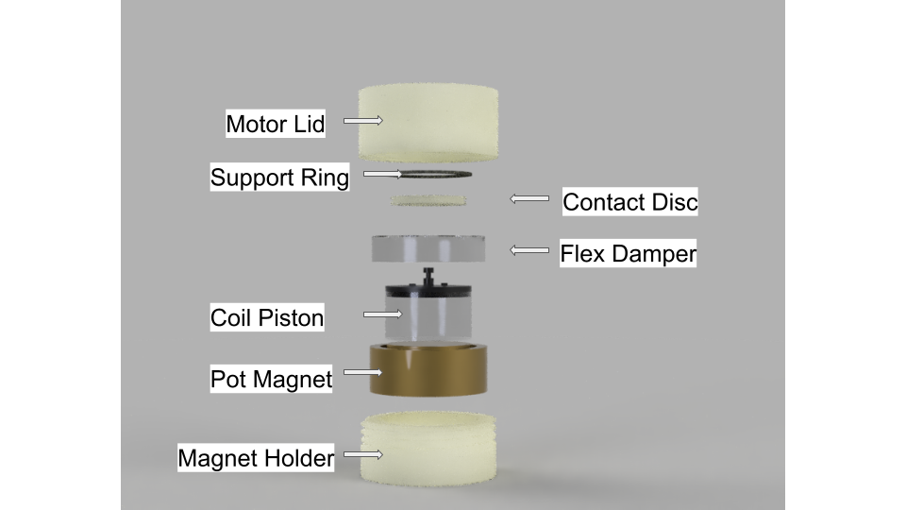
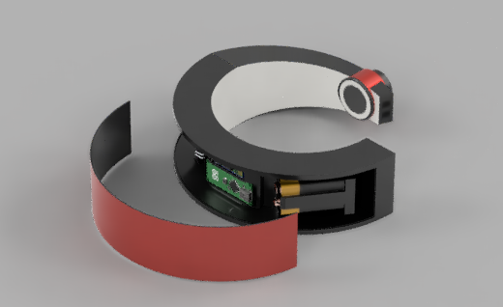
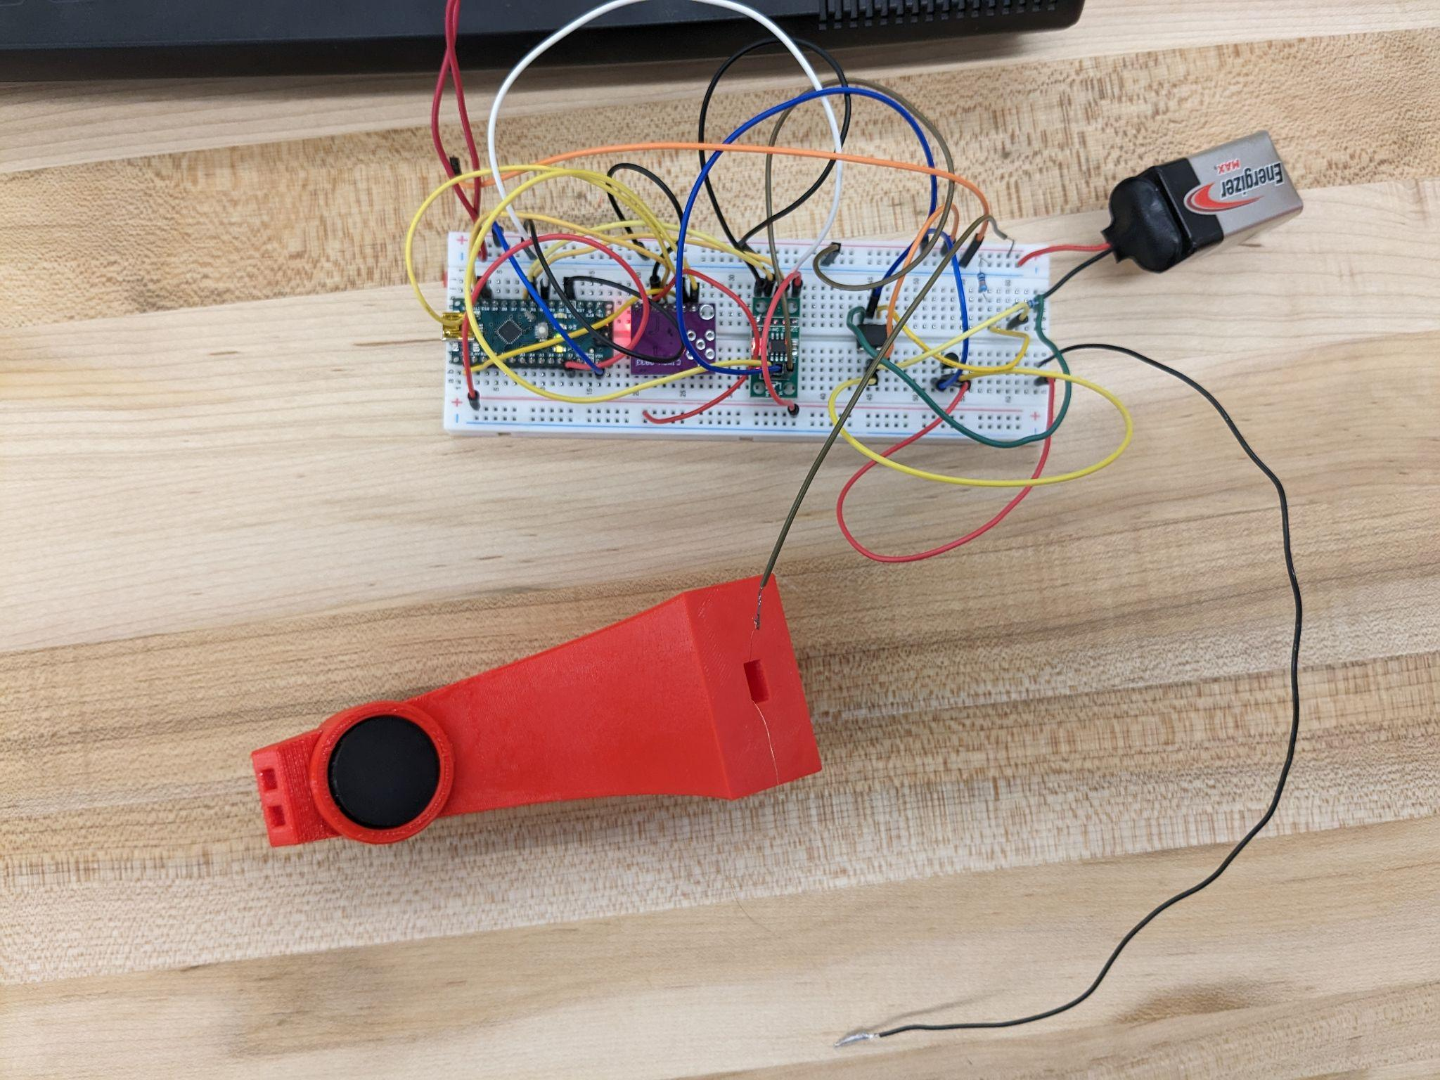
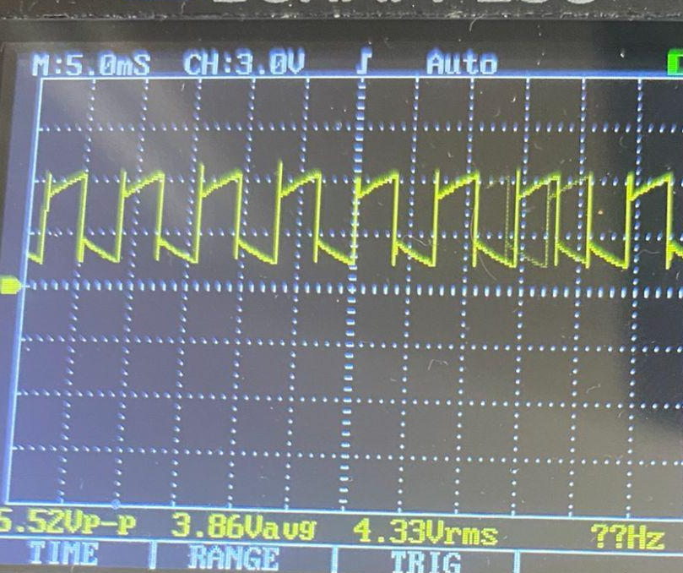
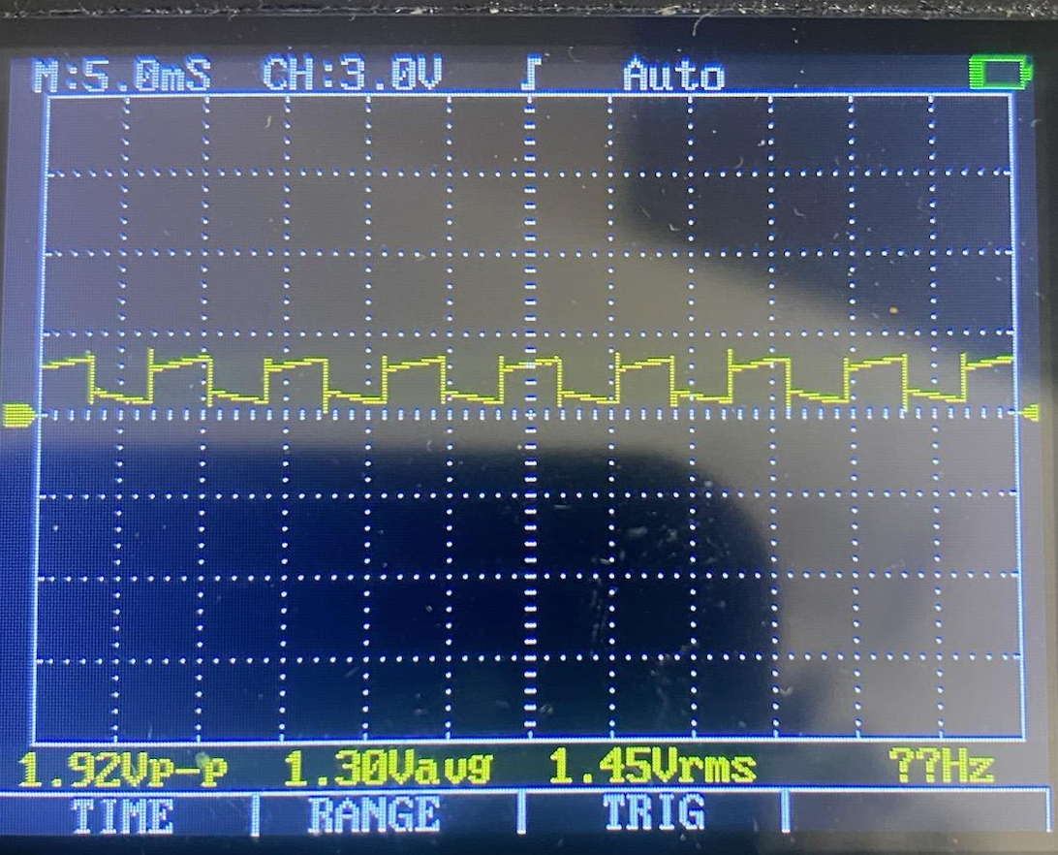
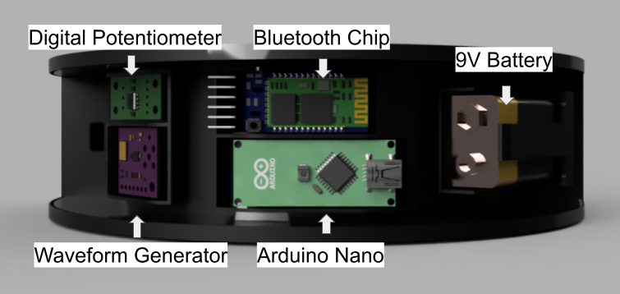
Echolynx: Wireless Electrolarynx Speech Aid
Benjamin Diaz, Rachel Lee, Luis Cuadros Lamas, Catherine Caicedo, Autumn Monsees
Faculty Advisor(s): Dr. Venkat K. Chivukula, Dept. of Biomedical Engineering, Florida Institute of Technology
Project Description
Product Design
Prototype Concept
There are over 100,000 tracheostomies a year, of which these individuals must use an electrolarynx which performs poorly. Our Team believes that we can address this shortcoming through wireless controls and ample sound insulation.
Motor Design:
A pot magnet based design focused on magnetic polarity in one major direction, helps to reduce the amount of voltage needed for a coil inductor to be repelled toward the contact disk.
Objectives
Testing and Results
To provide a product with .5-1 sec control response time and 4-6 hour operating time at 66% of the cost of a standard electrolarynx
Over 90% user convenience rating utilizing FDA approved materials.
Initial hardware testing to establish control response time and operating time for users prior to subject testing
Two part testing system uses a survey to evaluate convenience rating and a second randomly selected audibility test to evaluate the listener end experience.
Figure 1: Motor Design
Collar Style Design using flexible 3D printed resin and PLA for a universally device with great dynamic pitch adjusted using wireless controls.
Economics
Hardware Design:
This design uses the arduino controller for vibration control using a digital potentiometer and a waveform generator, which control the amplitude and pitch through inputs on a bluetooth controller.
Fixed Cost Per Unit | $218.70
Sales Price | $475
Profit Per Unit | $257.70
Break Even Point | 1920 Units
Image 1: Hardware Testing
Table 1: Economics Breakdown
Conclusion/Future Work
Our future work aims to reduce the size and cost of the device by replacing parts such as the Arduino nano unit with microprocessor chips.
Acknowledgements:
Dr. Chivukula, Caleb Phillips, L3 Harris Design Center, Moffitt Health Center, Gerardo Caicedo
Figure 2: Casing Design
Notes:
Need to adjust the testing and objectives to the new objectives

