Slide 1
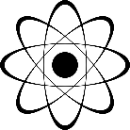
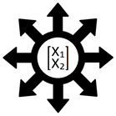
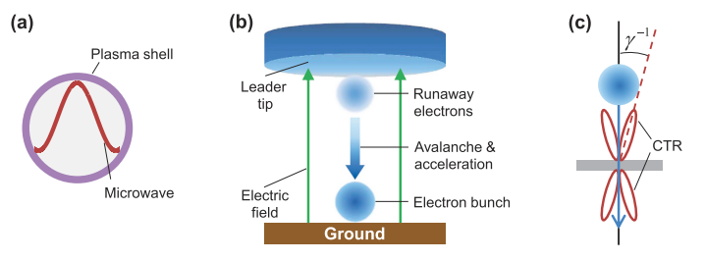
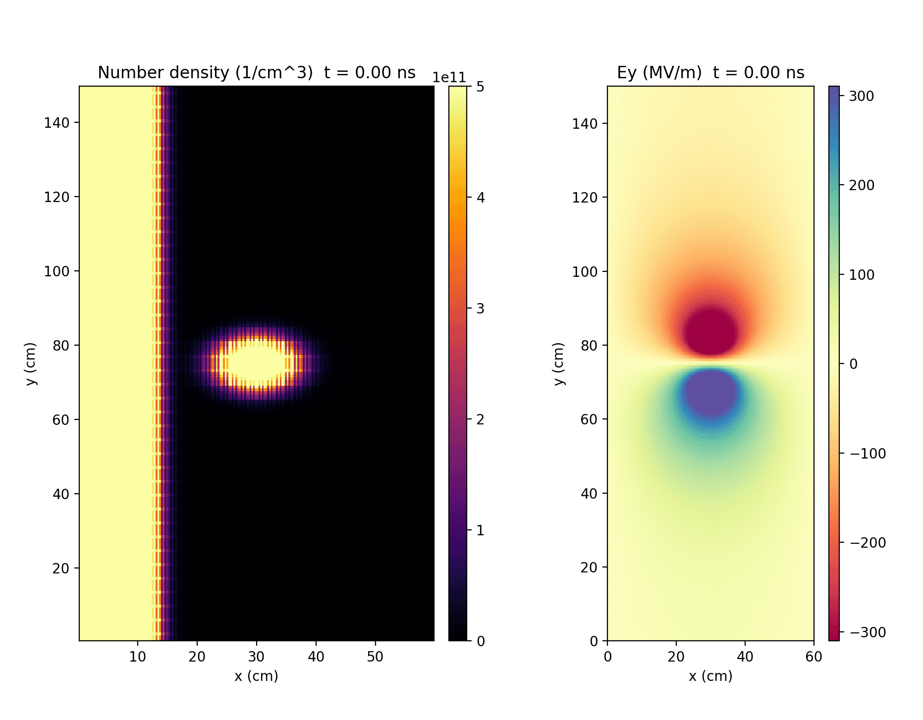
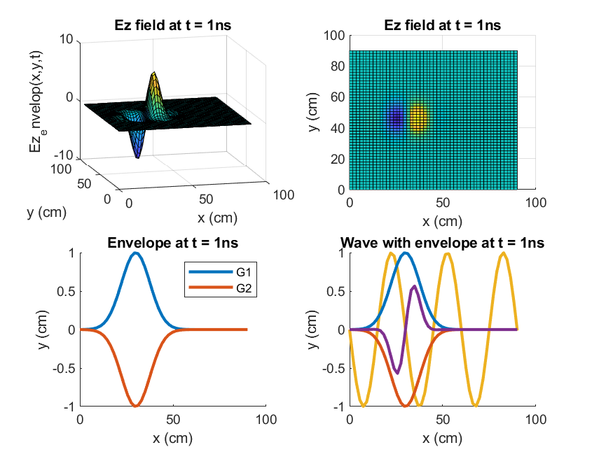
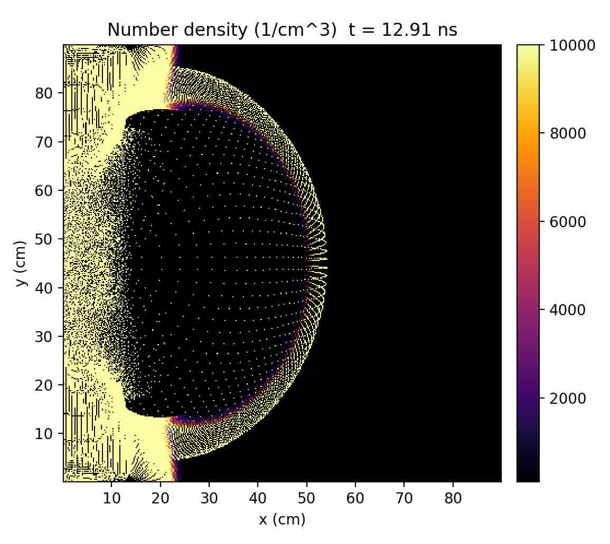
Testing the Relativistic-Microwave Theory of
Ball Lightning with Plasma Simulations Amanda Elliott
Faculty Advisor: Dr. Vladislav Bukshtynov, Dept. of Mathematical Sciences, Florida Institute of Technology
Introduction
Ball lightning (BL) is an unexplained phenomenon reported by thousands of eyewitnesses as a fireball, a few cm to 1 m in diameter, moving unpredictably and independently of the wind, sometimes observed during lightning storms. Here a potential theory for the creation of BL is explored [1]. The results of this research will advance lightning protection and aviation safety.
Results
Simulation 1: Microwave Pulse Generation
A relativistic (50 MeV) electron bunch with profile $n_{b}=n_{b0}\exp\left(−R^{2}/σ^{2}\right)$ and $n_{b0}=3.7{∙10}^{11}{cm}^{−3}$ is accelerated toward a ($n_{0}=50n_{c}$) conductor. A radial CTR pulse with peak $E_{y}=317$ MV/m is generated.
(a). BL structure is a hollow plasma shell that contains a standing microwave energy source.
This model explains the two most common types of BL termination: silent dissipation like a gas, and a violent, potentially lethal, explosion.
Steps in BL creation:
(b). In the last leader step of a lightning strike, a bunch of runaway electrons emerge from the leader tip. The bunch is accelerated to a relativistic speed by the electric field between the leader and ground and undergoes an avalanche.
(c). Coherent Transition Radiation (CTR) is produced by the electron bunch striking the ground or passing through conductors.
This radiation ionizes the air, trapping the wave in a plasma shell.
Computational Methods
An open-source Particle-in-Cell (PIC) code called Smilei [3] is used to simulate two parts of the theory.
Vlasov-Maxwell Collisionless Plasma
Both species, ions and electrons, are described by a distribution function $f_{s}(t,x,p)$, satisfying
$$\left(∂_{t}+\frac{p}{m_{s}γ}∙∇+F_{L}∙∇_{p}\right)f_{s}=0$$
with the relativistic Lorentz factor $γ=\sqrt{1+p^{2}/{m_{s}}^{2}}$
Relativistic Equations of Motion
${{dx}_{p}}/{dt={u_{p}}/γ}$
${{du}_{p}}/{dt}=\frac{q_{s}}{m_{s}}\left(E_{p}+\left({u_{p}}/γ\right)×B_{p}\right)+F_{pond}$
Pondermotive force: $F_{pond}∝−∇E^{2}$
Assumptions and Simplifications
Ionization is not simulated. Particles are initialized with a cold momentum distribution, $T_{e}=0$ eV. The mass of ions is the average of air molecules ~28.97 g/mol. The conductor along the $x=0$ boundary is simulated as an overdense plasma ($n_{0}≥n_{c}$) with profile: $n_{e}=n_{i}=n_{0}exp⁡(−x^{2}/σ^{2})$, with $σ=4$ cm.
Simulation 2: Microwave Bubble Trapping
Input: $E_{z}=exp⁡[−{\left(y/R\right)}^{2}]∙G_{1}∙G_{2}∙sin⁡(ω(t−x/c))$ with $G_{1}=exp⁡[−{[(t−x/c)/wR]}^{2}]$, $G_{2}=−G_{1}.$ $w=0.01 τ \text{for} \text{a} τ=2 \text{ns} \text{duration}\text{.}$ Plasma shell forms in conductor ($n_{0}=4n_{c}$) but expands without stabilizing.
Mathematical Model
Unitless Maxwell-Lorentz equations [2]:
$∇×E=−∂_{t}B$
$∇×B=∂_{t}E+2πJ$
$∇∙E=2πρ$
$F_{L}=\frac{dP}{dt}=\frac{2πq}{M}(E+V×B)$
Normalization laser-related units:
$$\frac{r}{λ},\frac{2πt}{ω},\frac{eE}{m_{e}ω},\frac{ρ}{en_{c}},\frac{J}{en_{c}c},\frac{P}{Mc},\frac{M}{m_{e}},\frac{V}{c},\frac{q}{e}$$
With reference variables: laser wavelength λ, laser angular frequency ω, critical plasma density $n_{c}=ε_{0}mω^{2}/e^{2}$, electron mass $m_{e}$, mass of species M.
Conclusions
Microwave pulse generation based on previous results [1] was replicated in Smilei [3], while the bubble trapping was not. The original results were generated by the author’s personal PIC code [2] and may not be reproducible on standard PIC codes that are designed for vacuum. Atmospheric molecule collisions with electrons cannot be simulated at this time scale (${10}^{12}≫{10}^{9} Hz$), but the resulting energy loss can be approximated [1] and may help stabilize the plasma shell.
References
[1] H-C. Wu. Relativistic-Microwave Theory of Ball Lightning. Scientific Reports 6, 28263, 2016. [2] H-C. Wu. JPIC & How to make a PIC code. 2011. [3] Smilei: smileipic.github.io/Smilei/index.html
Acknowledgements
Dr. Jean C. Perez for his stellar plasma physics education.

