Slide 1




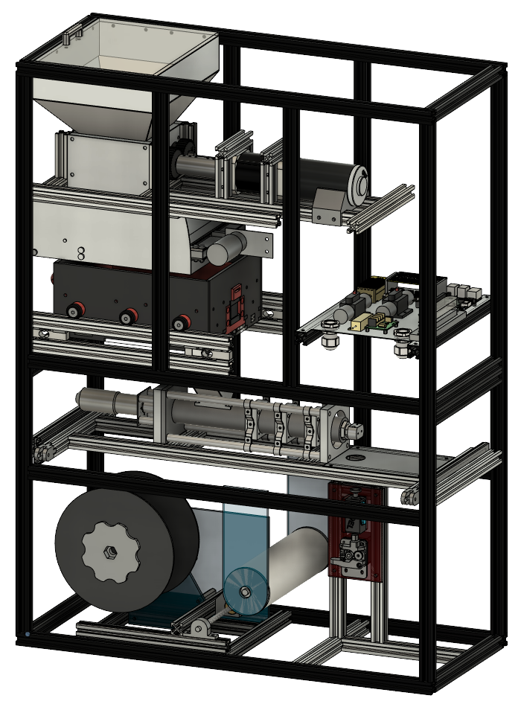
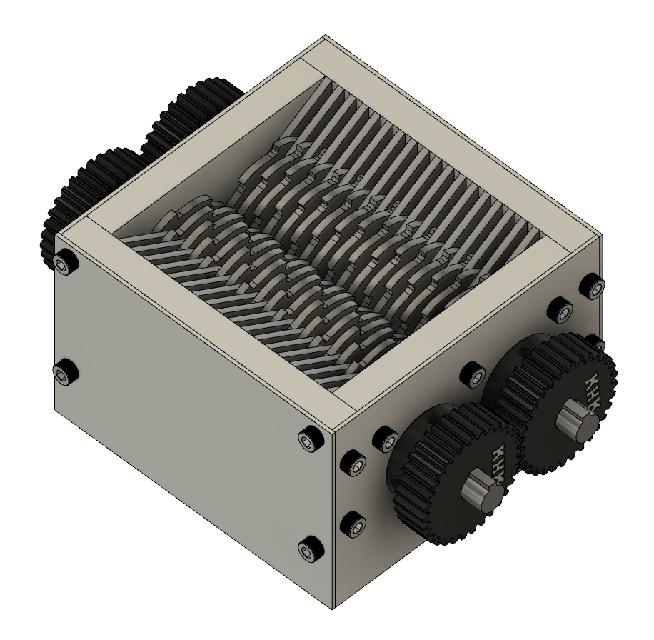
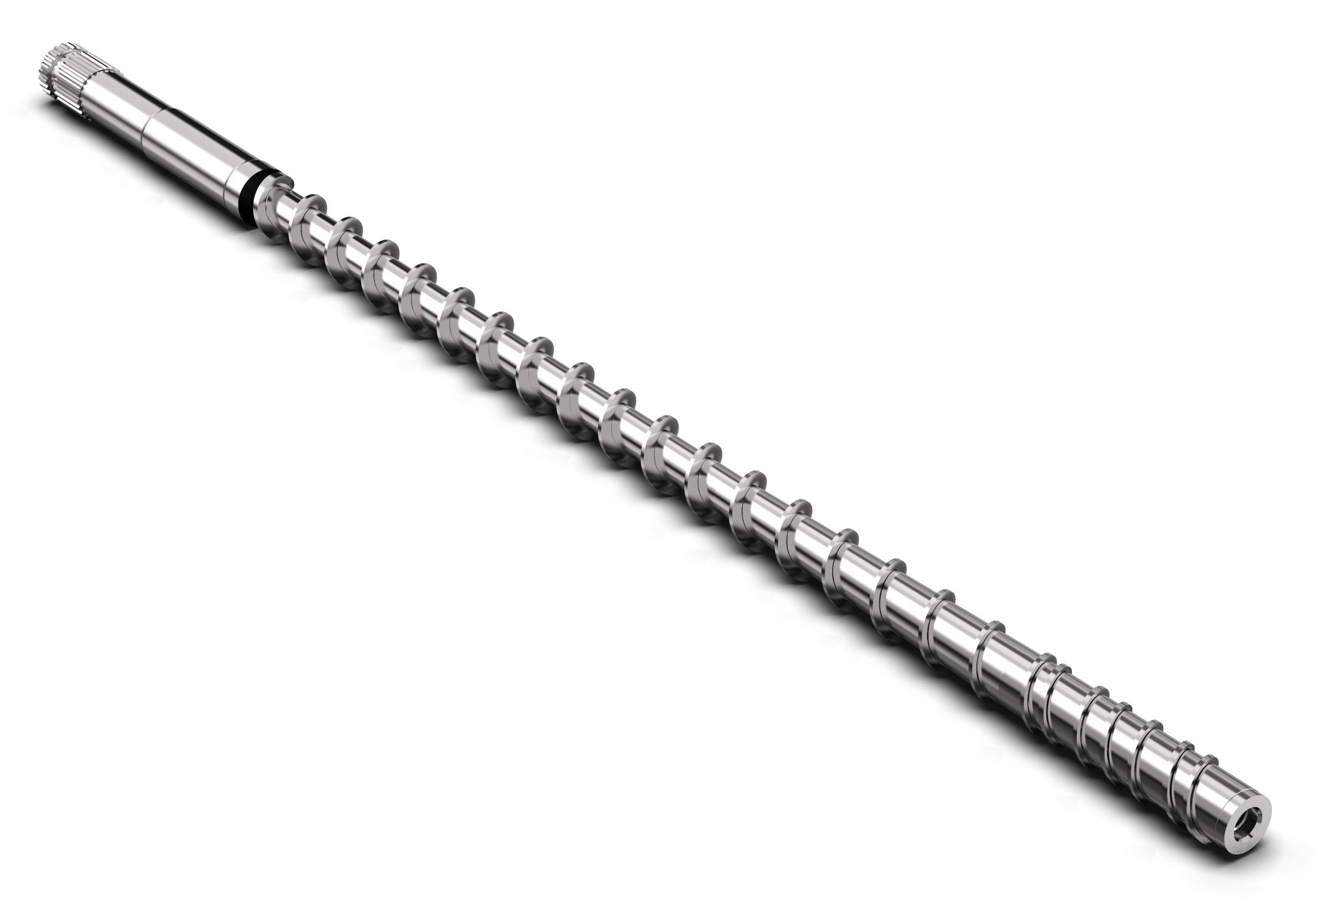
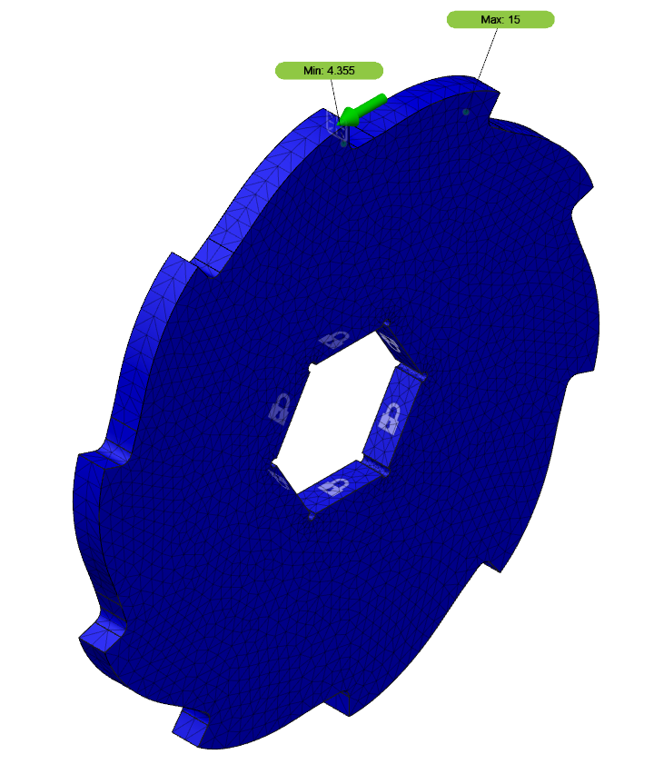
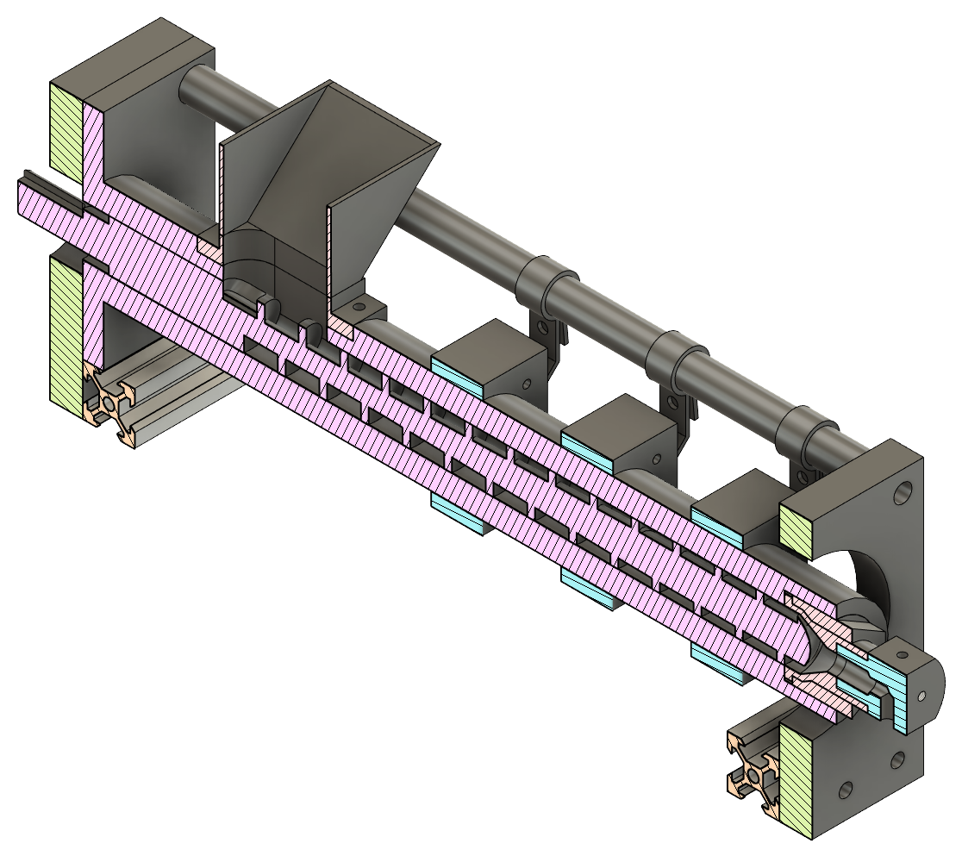
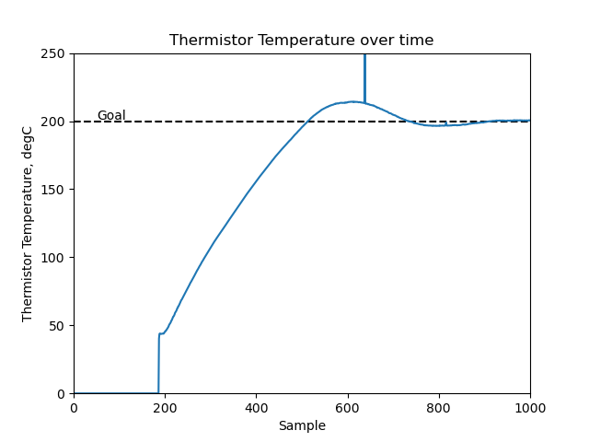
PLA-S-TECH: PLA Sustainable Technology
Sean Sapper, Ryan DeCarlo, Elliot Whitney, Samantha Dombrowski,
Dalton Prokop, Dominic Zaio, Tyler Stokes, David Deese, Blake Hengel, Yi Guo
Faculty Advisor: Dr. Douglas E. Willard, Dept. of Mechanical and Civil Engineering,
Florida Institute of Technology
Introduction
Objectives
Final Design
At the L3Harris Student Design Center (L3HSDC) at Florida Tech, there are many 3D printers active at any given time to complete print requests from students and faculty. The L3HSDC requested a machine to recycle 3D printing material in order to minimize plastic waste and reduce their material costs from 3D printing, as prints often require wasteful support structures or may fail altogether.
1. Design, build, and test a machine capable of:
Breaking PLA plastic into smaller pieces
Filtering and storing the broken down plastic
Melting plastic into recycled filament
Ensuring filament diameter is 1.75mm
Wrapping recycled filament on a standard spool
2. Design the machine with customer requirements:
Relatively small footprint (3’ x 3’ x 6’)
Comprised of commercially available parts
Accessible components for easy maintenance
User-friendly and safe to operate
Reducer
Shredder – 36 stainless steel blades powered by a CIM motor and heavy-duty reduction gearbox produce 230 N-m (170 ft-lb) of overall torque
Filter – Double-layered vibration table with access door to remove material larger than 3mm
Storage – Funnel container with volume enough to store up to 2.5 kg of shredded PLA plastic
Feeder – Motorized gears transfer a constant volume of plastic into the extruder mechanism
Producer
Extruder – Nitrided steel injection mold pipe melts plastic at 220°C and uses a three-stage compression screw to extrude the new filament
Tolerancing – Standard 3D printer extruder gears drive the filament towards the spool while using a filament sensor to keep diameter at 1.75mm
Spooler – A dual-stepper lead screw and limit switch assembly receives and spools the filament
Figure 1: Recycler Assembly (Uncovered)
Automation & Controls
Automation – Raspberry Pi uses Python code to communicate with serial devices via I2C & UART
Controls – PID control loops read thermistor and encoder data for extruder heating and spooler motion, respectively
Safety – Current sensing, circuit breakers, and an emergency stop button ensure safe operation
Warming
Melting
Compression
Figure 2: Shredder Assembly & Blade Analysis
Figure 3: Section Cut of Extruder Mechanism
Figure 4: Heat Block Temperature Control

