Slide 1
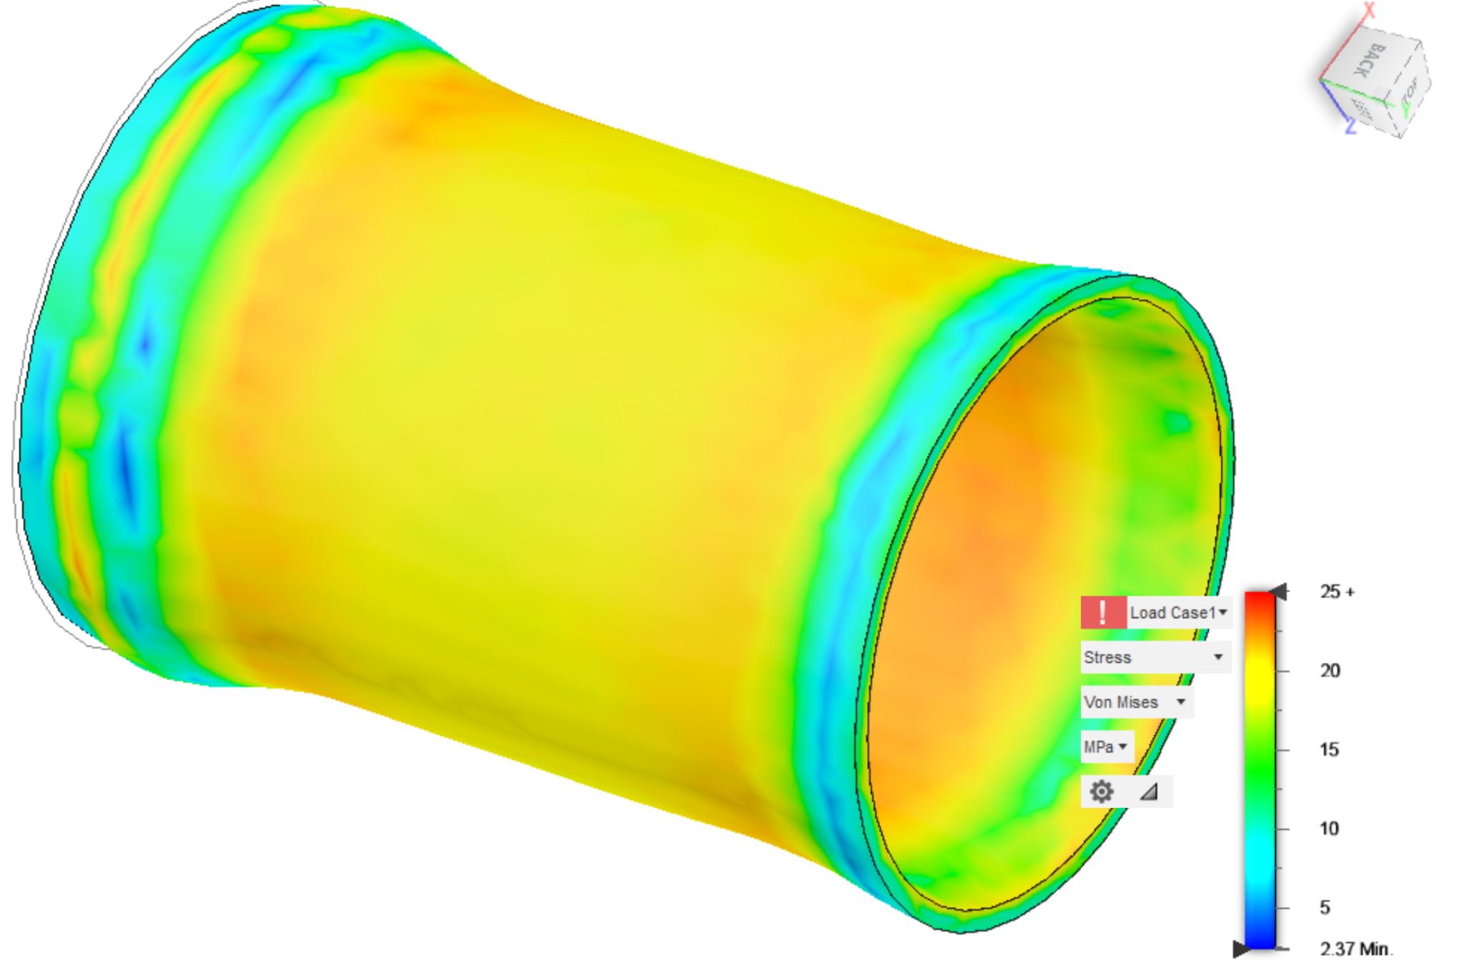
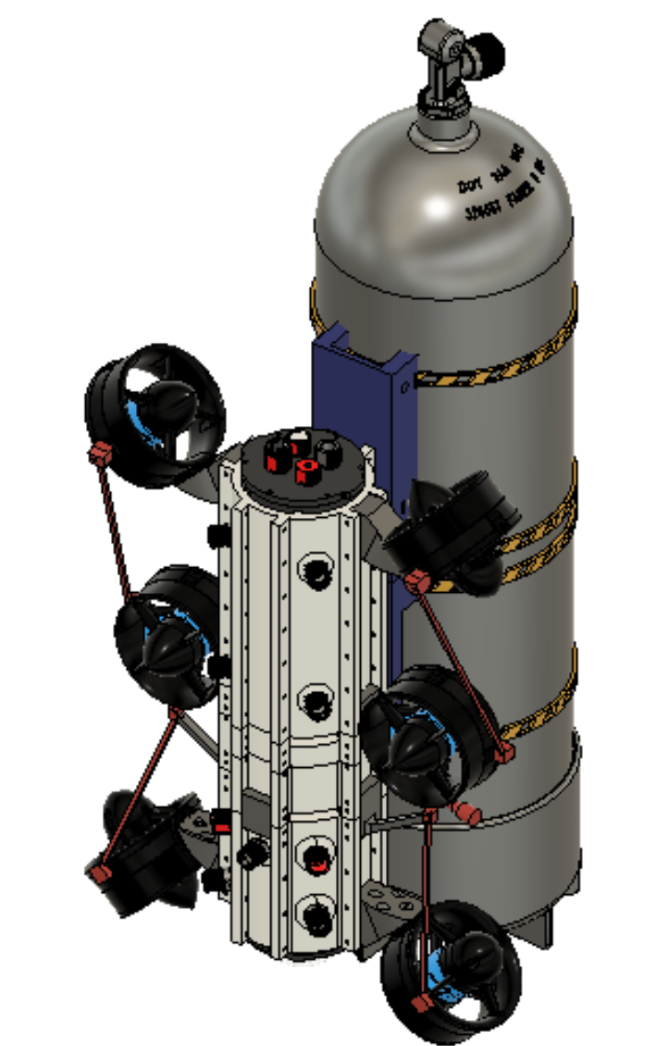
R3MORA
Remotely Operated 3D-Printed Mission Oriented Research Assistant Parker Baillon, Suzie Dixon, Katlynd Faust, Payton Herman, Harpoon Seabring
Faculty Advisor: Dr. Stephen Wood and Dr. Ronnal Reichard
Dept. of Ocean Engineering & Marine Sciences, Florida Tech
Introduction
Currently, remotely operated vehicles (ROVs) utilize standard pressure enclosures made from clear acrylic tubing, and thus are large and lack modularity. With the invention of resin 3D printers, pressure enclosures can now be customized to fit any vehicle’s needs. Project R3MORA is a multi-stage project that developed a diver-deployable ROV called R3MORA using the material properties gathered for Siraya Tech Stereolithography (SLA) 3D printed resin .
Objectives
Develop a set of material properties for Siraya Tech SLA 3D printed resins.
Design a 3D printed pressure enclosure for a small, diver-deployable ROV.
Impact
The publishing of the material properties opens the door for rapid prototyping of low cost pressure enclosures made out of SLA resin. It also increases the accessibility of pressure enclosures for academic ROV competitions such as MATE and SeaPerch because 3D printing is a low cost manufacturing method. This is relevant to both industry and student projects as SLA 3D printing becomes more common. The R3MORA vehicle increases diver safety and awareness by allowing them to investigate dangerous situations remotely. The vehicle also helps the diver by broadening their exploration area where certifications and risk limit accessibility.
Acknowledgements
We would like to thank all those involved in the Underwater Technology Lab, Structural Composites, Inc. and the Center for Corrosion and Biofouling Control for continuously lending their knowledge and support. Without any of the parties listed above R3MORA would not have been possible.
Material Testing
Compression
The properties shown in Table 1 were found following ASTM D695. Sculpt Clear with a six minute UV cure time was chosen to make the R3MORA vehicle due to its high stiffness.
Table 1: Compression Properties for the SLA Resin
Pressure Tank
Finite Element Analysis (FEA) was performed to simulate real-world conditions.
Figure 1: Fusion 360 FEA
The FEA results were compared with the results from the pressure tank to evaluate the validity of model. The cylinders imploded at an average of 250-psi, equivalent to about 563-ft, this confirmed the FEA prediction of 250-psi.
Environmental
The results from a water exposure experiment determined that each printed object did not absorb water after extended periods in water, but after 7-days, degradation occurred. The results from a sun exposure experiment determined that the resin continued to cure and get brittle, so a protective coating would need to be explored. The water and UV cure tests suggest that the Sculpt Clear cured resin will perform adequately in the marine environment during ROV operations.
R3MORA
Body Structure
R3MORA’s design allows for six degrees of freedom, a pressure rating of up to 400-ft, a speed of 3-m/s, a camera mount, four extra ports and a rail system for modularity. The body is split into two compartments with one side housing all communication electronics and the other the battery. Thruster connections are located along the body.
Figure 2: R3MORA Fusion 360 Model
Electrical
For the electronics, off the shelf components were controlled using the open-source software ArduSub and QGroundControl. R3MORA uses a 1080p camera, rechargeable battery, and a sensor that measures temperature and depth.
Scuba Tank Mount
The mount uses a custom 3d-printed mount, a scuba retractor, a pin, and hose clamps to hold the vehicle on a standard scuba tank.
Figure 3: Scuba Tank Mount Fusion 360 Models

