Slide 1


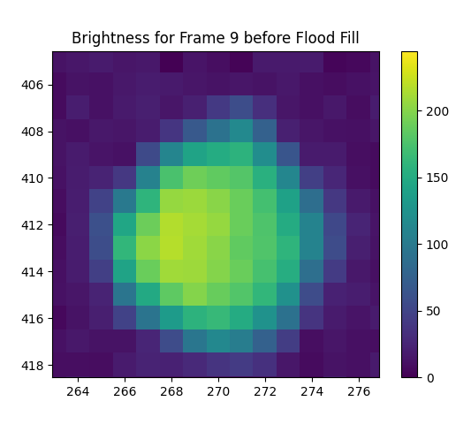
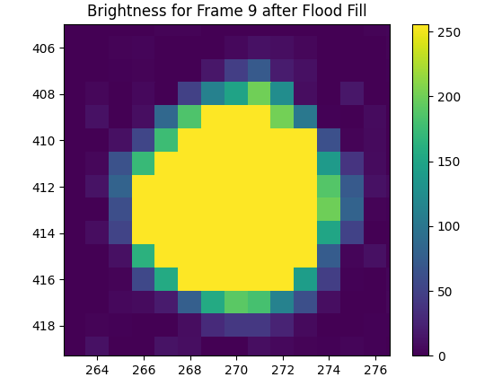
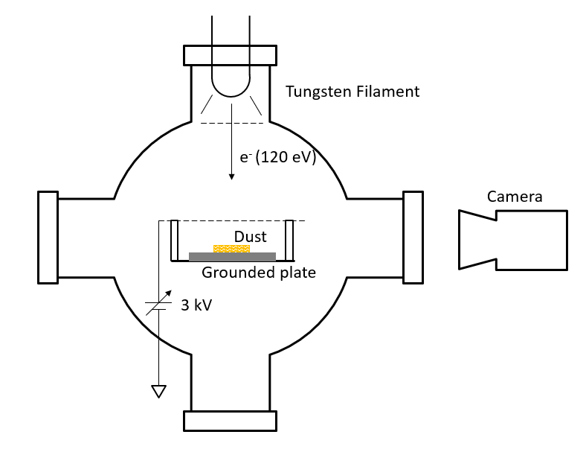
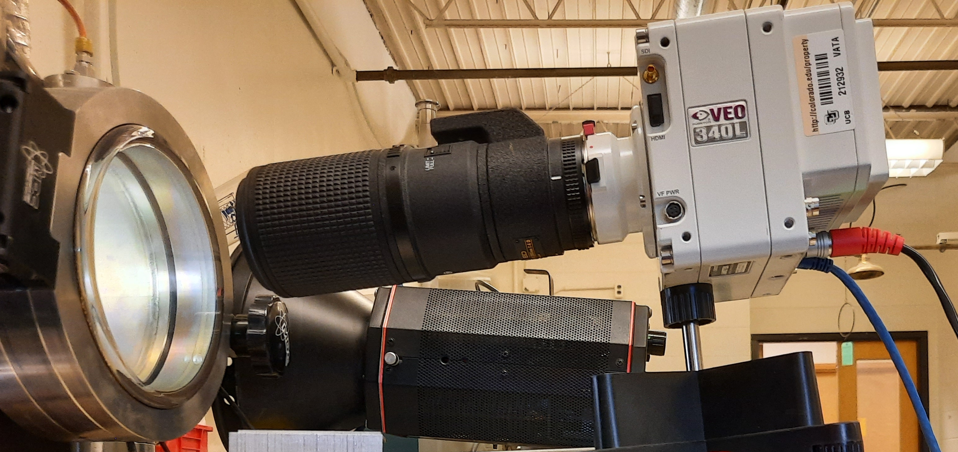
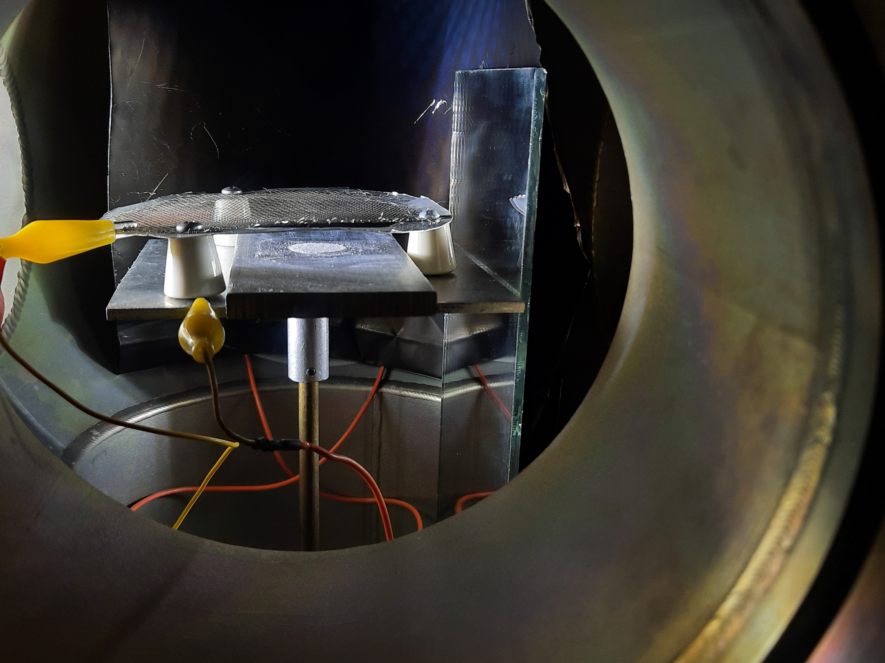
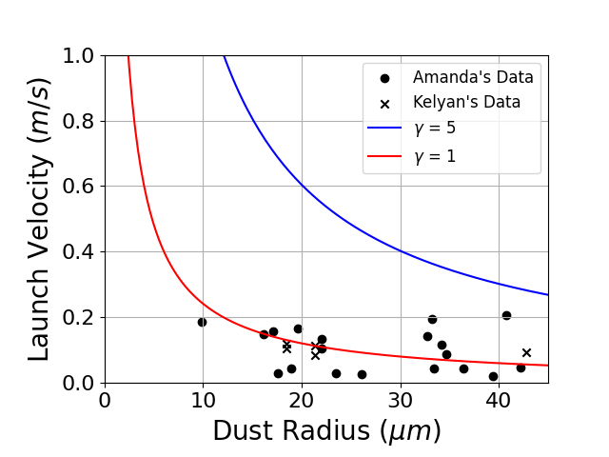
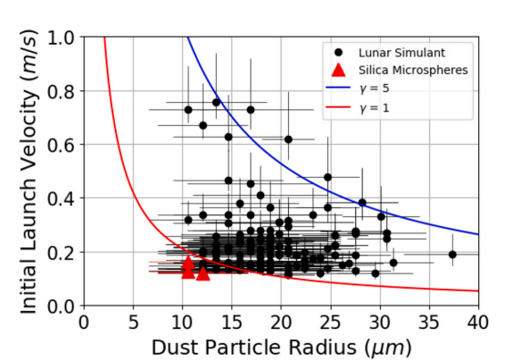
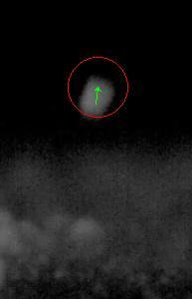
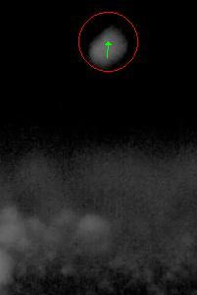
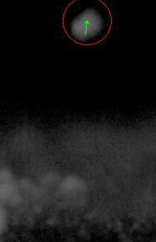
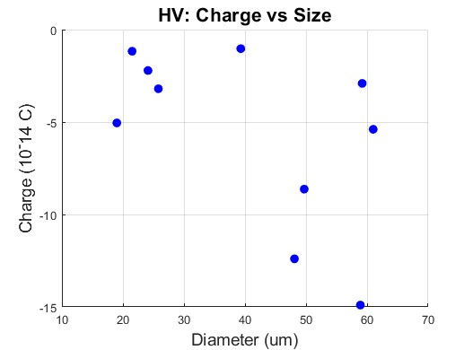
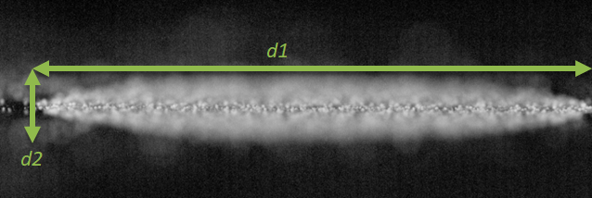
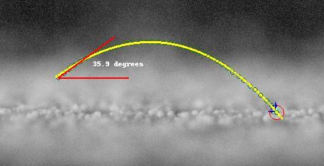
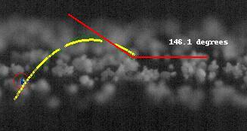
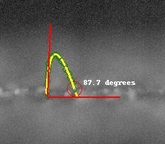
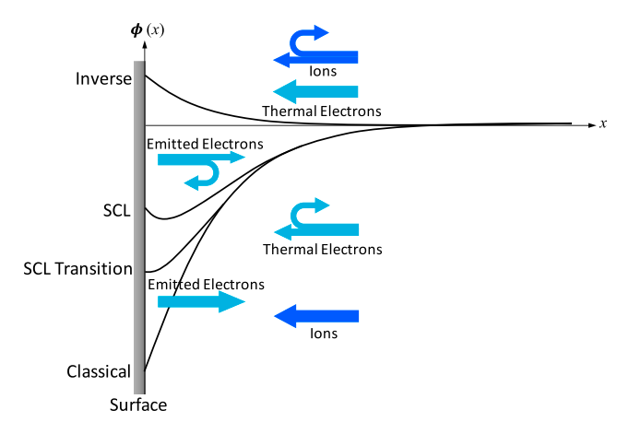



Electrostatic Dust Lofting: A Possible Cause for Beam Losses at CERN’s LHC
Amanda Elliott
Faculty Advisors: Dr. Paul Martin (APSS, Florida Tech), Dr. Xu Wang & Mihály Horányi (Univ. of Colorado, Boulder), Rudiger Schmidt, Daniel Wollmann, Christoph Wiesner, Philippe Belanger (CERN)
Faculty Observer: Dr. Hamid K. Rassoul (APSS, Florida Tech)
Introduction
Dust particles interacting with the proton beams have caused thousands of beam-loss events at CERN’s Large Hadron Collider (LHC), some of which led to premature beam dumps and even magnet quenches, frequently resulting in day-long shutdowns. It has been hypothesized that dust particles on the vacuum chamber wall of the LHC become negatively charged due to electron clouds and can detach from the chamber wall by the electric field of the beam. This project investigates such possibility.
Data Analysis
The properties of dust charging and levitation are characterized from recorded high-speed videos. Scripts were developed to process these videos.
Particle Tracking Scripts
Common Algorithms
Lofted particle detection
Multiple particle tracking
Size calculation using a Flood Fill algorithm (left)
Particle velocity and acceleration calculations
Camera angle correction
Experimental Setup
To test this hypothesis, we performed experiments in a vacuum chamber to study the electrostatic lofting of dust particles from a conducting surface.
Deposit a monolayer of silica dust, ${SiO}_{2}$, < 46 μm in diameter, on a conductor and onto the grounded plate, under the mesh. The mesh is 0.5 – 1 cm from the plate.
Pump chamber down to less than $5∙{10}^{−6}$ Torr.
Ground the mesh above the plate. Charge the dust by a
60 - 120 eV energy electron beam from a tungsten filament that has a current of up to 180 mA.
Turn off charging. Apply a bias voltage to the mesh up to
3 kV that generates an electric field of ~3 kV/cm.
Record dust movement during charging and high voltage (Steps 3-4) with a high-speed camera at 900-1500 fps.
Charging Lofting
Dust trajectory is parabolic.
Previous results (right) [1], new results (left).
Surface potential [1]: $φ=\frac{vR}{γ}\sqrt{\frac{ρ}{3ε_{0}}}$
Lofted angle calculation using QR-Factorization.
High Voltage Lofting
Dust grains travel in vertical trajectories.
Charge is calculated from the equation of motion: $F_{y}=ma_{y}=m\frac{dv_{y}}{dt}=qE−mg$and electric field
$E=V/d$. Surface potential: $φ=q/(4πε_{0}R)$
Conclusions
We observed that dust particles are lofted both during electron beam charging and during the application of the external electric field. Our results provide experimental evidence that dust particles can be detached from a conducting surface and help to understand the mechanism of how dust particles can enter the LHC beam. There is consistently high activity when charging at 80 eV and low currents. We theorize the presence of a space-charge limited (SCL) plasma sheath [2] between the plate and the mesh, which would explain why the 80 eV charging potential is preferred.
Acknowledgements & Next Steps
This research was funded by NSF’s physics Research Experience for Undergraduates (REU) program. Experiments are ongoing, with the goal of better replicating LHC conditions using sudden impulse charging and high voltage application. Additional applications of dust mitigation research include space exploration and manufacturing.
References
[1] A. Carroll et all., Laboratory measurements of initial launch velocities of electrostatically lofted dust on airless planetary bodies, Icarus 352 (2020).
[2] X. Wang et all., Plasma potential in the sheaths of electron-emitting surfaces in space, Geophysical Research Letters 43, 525 (2016), Publishing Ltd 525.

