Slide 1


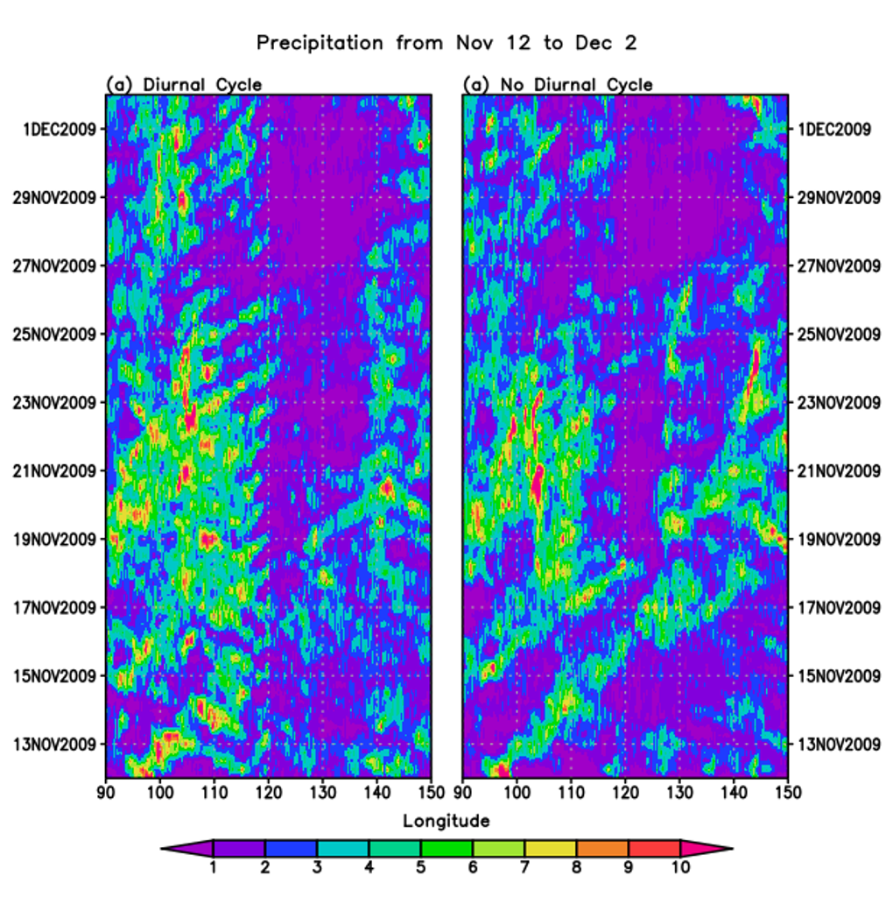
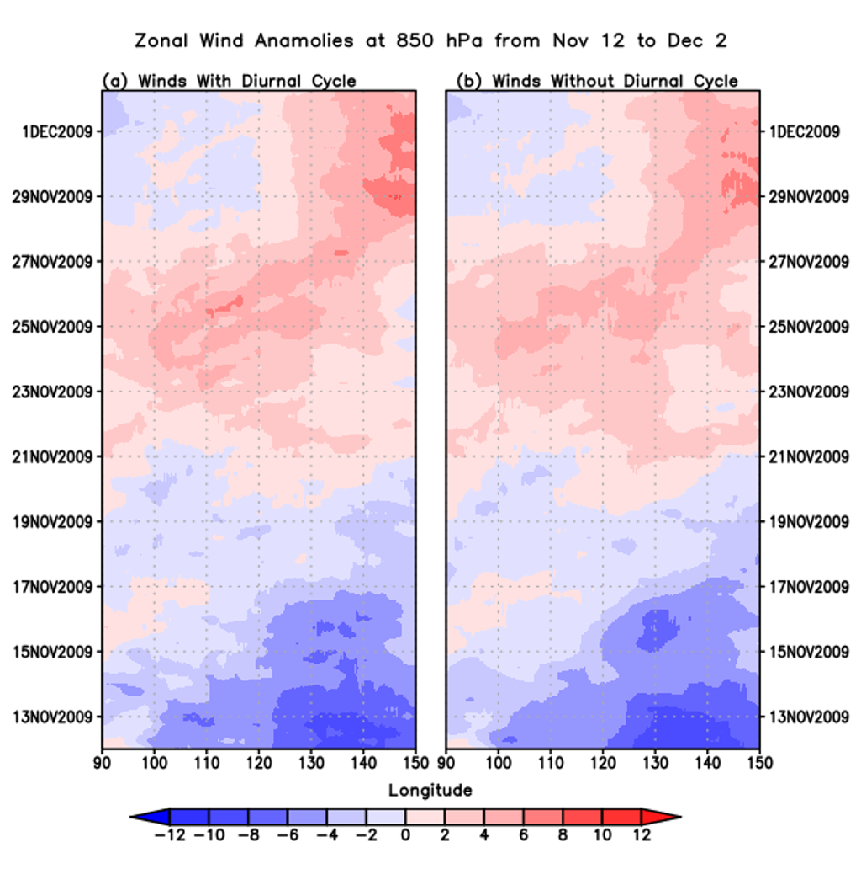
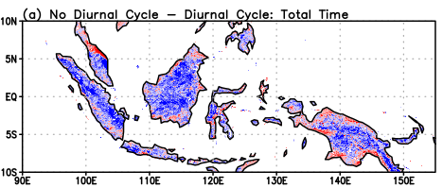
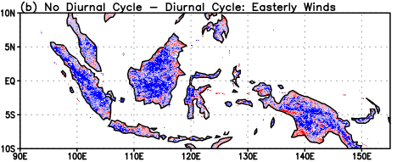
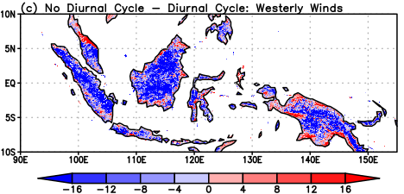
Exploring the Role of the Diurnal Cycle of Solar Radiation on Precipitation Over the Maritime Continent
Jenelle A. Edwards
Faculty Advisor(s): Dr. Pallav Ray, Dept. of Ocean Engineering and Marine Sciences, Florida Institute of Technology
Abstract: The MJO is a global oscillation that occurs on a sub-seasonal timescale and is best known for its deep convection and propagation through the Maritime Continent (MC). Due to the numerous variables that can impact the propagation of the MJO through the MC, including the atmospheric moisture, winds, and topography, predicting the patterns of the MJO proves to be difficult for models. This study looks at how the diurnal cycle of solar radiation and background wind patterns impact the MJO precipitation across the MC and for each of the 3 major islands. The diurnal cycle of solar radiation had the tendency to produce more rain than the simulation with no diurnal cycle. By analyzing the wind patterns over the total time period, it was able to be determined that times where there were westerly winds produced more precipitation than the easterly winds.
Introduction:
The Madden-Julian Oscillation (MJO) is a global oscillation that propagates eastward along the equator and operates on a sub-seasonal timescale of 30 to 60 days. The Maritime Continent, or the MC, is a distinctive geographic area located along the equator, recognized by its land-sea distribution consisting of thousands of islands and having semi enclosed, shallow seas (Barrett et al., 2021). This creates a barrier for the MJO, causing it to behave unpredictably where it could stall, terminate, or even split (Hagos et al., 2016). The variability of the MJO causes difficulty for scientists, and therefore models, to predict. Scientists have made strides to understand factors that could be the cause of the variability such as moisture, sea surface temperatures, topography, solar radiation, and winds (Barrett et al., 2021). This study will explore how the diurnal cycle of solar radiation affects the precipitation patterns over the MC. The simulation will explore the spatial variation of precipitation over the MC due to solar radiation and winds.
Results:
The negative values in Table 1 show that precipitation values are consistently greater for the DC simulation. This is held true for the total time period and for both easterly and westerly wind regimes.
              The westerly winds produced higher values of precipitation during the DC simulation when averaged over the entire MC, indicated by the negative numbers with higher magnitudes.
When broken down into individual islands, the precipitation associated with the westerly winds proved to remain greater over Sumatra and Borneo, whereas the easterly winds produced slightly more precipitation over Papua New Guinea.
Figure 1: Hovmöller diagram of the rainfall averaged over 10°S to 10°N 12 Nov 2010 to 2 Dec 2009 for the DC and NODC simulations.
Figure 2: Hovmöller diagram of the zonal wind patterns averaged over 10°S to 10°N from 12 Nov 2009 to 2 Dec 2010 for the DC and NODC simulations.
Winds During Precipitation | Total MC (90°E to 155°E) [mm/day] | Sumatra (90°E to 105°E) [mm/day] | Borneo (110°E to 120°E) [mm/day] | Papua New Guinea (130°E to 150°E) [mm/day]
Total Time | -4.61 [-0.43] | -5.40 [-0.39] | -5.99 [-0.51] | -3.53 [-0.40]
Easterly Winds | -6.07 [-0.52] | -7.57 [-0.54] | -7.64 [-0.57] | -5.58 [-0.56]
Westerly Winds | -8.40 [-0.63] | -9.84 [-0.62] | -10.91 [-0.77] | -6.43 [-0.54]
Data and Methods:
The model used in this study was the Weather Research and Forecasting Model (WRF) V3.8.1. The area of interest was 10°N to 10°S and from 90°E to 155°E, an area encompassing the MC. To complete the simulation in this study, there were two dataset outputs used from the WRF Model. One dataset calculated the variables while considering the diurnal cycle of solar radiation, labeled as the control simulation, DC, and the other dataset calculated the variables while considering a simulation where the diurnal cycle was kept constant at a daily average throughout the day for each grid point, NODC.
There are 82 time points that run from 00 UTC on November 12th, 2009, and are collected every 6 hours, making the final time step 12 UTC on December 2nd, 2009. The GrADS programming tool was used to display the raw data that was used to analyze the precipitation and propagation of the MJO event due to the diurnal cycle. This time period was broken up further in terms of easterly and westerly wind regimes by finding the latitudinal average of zonal winds over 90E to 150E. Easterly winds ranged from t=1 to t=36 and the westerly winds from t=37 to t=82.
Table 1: Difference in average daily precipitation between the NODC and the DC simulations for each wind regime and for the total MC and the three major islands. Values in brackets are normalized to the total time of the measurements.
Conclusions:
The diurnal cycle of solar radiation plays a key role in determining the amount of precipitation that will fall over the MC. The simulation with the diurnal cycle of solar radiation produced higher values of precipitation over the the entire MC and over its three major islands. When broken up by wind regime, the westerly winds for the DC tended to produce greater precipitation than the NODC, shown by the negative values. During the easterly wind regime, the DC had larger precipitation than the NODC but there was not as large of a difference between the two simulations than during the westerly wind regime.
References:
Barrett, et al. (2021). Climate Dynamics. doi:10.1007/s00382-021-05699-8
Hagos, et al. (2016). Journal of Advances in Modeling Earth Systems. Doi:10.1002/2016MS000725
Acknowledgements:
Thank you to Dr. Ray and Xin Zhou for assistance with GrADS, the data acquisition and processing.
Figure 3: Calculated difference between the NODC and the DC simulation for: (a) the total time period, (b) the easterly winds, (c) and for the westerly winds.

