Slide 1



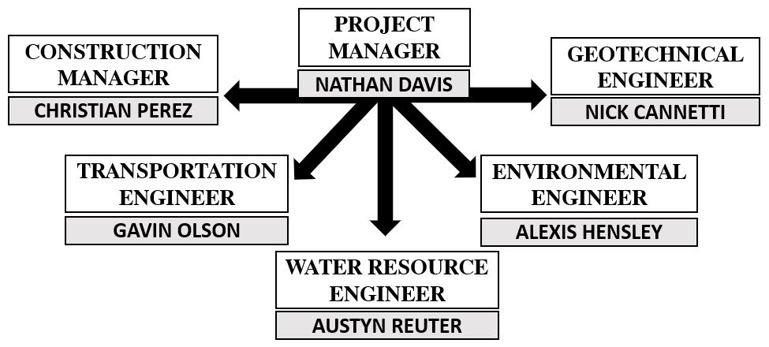
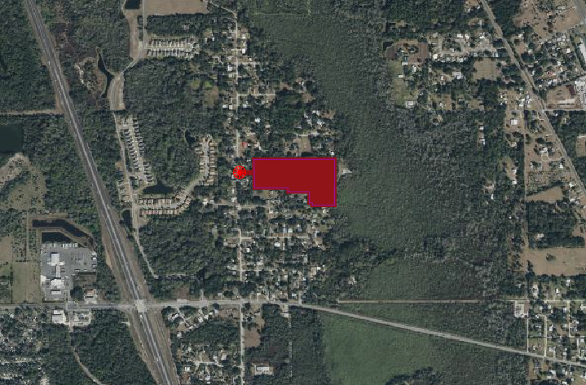
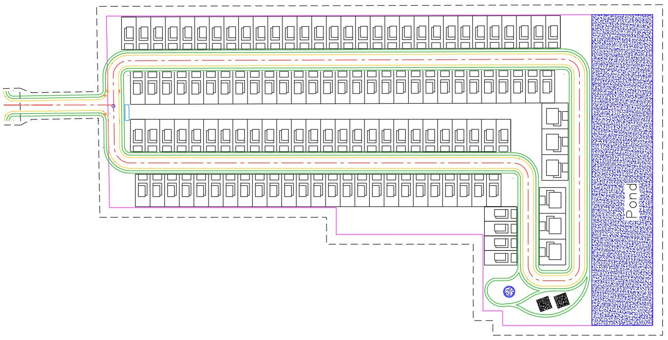
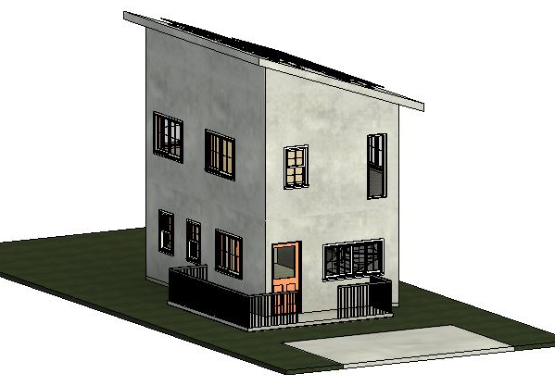
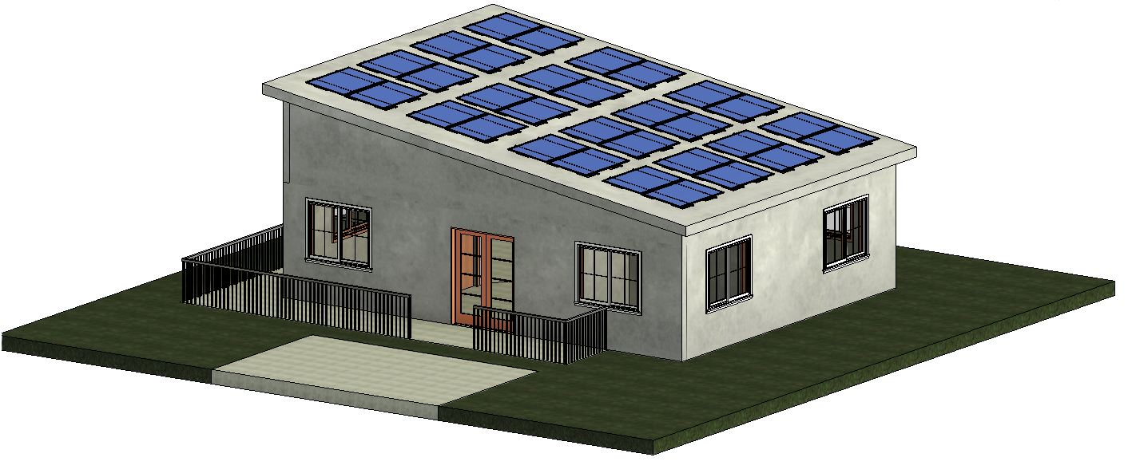

Sustainable Community by A-Team Design & Build LLC
Alexis Hensley, Austyn Rueter, Christian Perez, Gavin Olson, Nathan Davis, Nick Cannetti
Faculty Advisor(s): Dr. Troy Nguyen, Dept. of Civil Engineering, Florida Institute of Technology
MISSION STATEMENT
“The central mission of this project is to design and construct a tiny home community that helps bridge the gap for affordable housing. The houses will utilize solar panels to supplement power requirements.”
PROPOSED SITE LOCATION:
I-95
PROJECT FEATURES
Site is located in Mims, Florida off of Pine Ave.
Plan shows 120 tiny homes with roadways and sidewalks in the community
Subdivision includes 57 single family homes, 57 multi-family homes and 6 ADA homes
Stormwater Pond located on the east side
W. Main St
SITE PLAN
DESIGN FEATURES
Transportation:
Design of all new roads and sidewalks in community.
Architectural:
Conceptual design of all three home floor
layouts.
Water Resources:
Design of Water systems, Sanitary systems, and Stormwater systems.
Geotechnical:
Design of foundations for homes and roads based on existing soils
CONSTRUCTION BUDGET
Cost for H1 (single-bedroom home)
  $110,259.12
Cost for H2 (two-bedroom home)
  $115,085.08
Cost for H3 (ADA home)
  $122,672.52
An additional 20% will be added to these values for overhead and profit.
Total projected cost:
  $13,580,654.63
Total projected profit:
  $2,716,130.93
H1 & H2:
15kWh Solar Panels
MGO SIP Panels
CONSTRUCTION FEATURES
Materials:
Innova Panel MGO SIP for walls and roofs.
Local RCA for subgrade.
Sustainability:
15kWh solar panels
  9 per Single and Multi-family homes
  16 per ADA homes
TYPICAL MORTGAGE PAYMENTS
In Brevard County, the average rent is $1,860.
Over a 30-year mortgage, the monthly payment for the two-bedroom home, assuming an interest rate of 7% with a minimum down payment of 3.5%, would be $1,043.
ADA:
PROJECT IMPACT
Affordable housing compared to conventional apartment rentals in the area
Sustainability by using SIPs and solar panels
Using SIPs to reduce cost and schedule of project
CONSTRUCTION SCHEDULE
Estimated Construction Schedule 2 years from start to finish
Schedule based on RS Means, that uses real world data
Using Innova Panels we are able to expedite the build time significantly
Multiple units will be built simultaneously with no conflict

Slide 2
A-Team Design & Build LLC
Alexis Hensley, Christian Perez, Gavin Olson, Nathan Davis, Nick Cannetti
Faculty Advisor(s): Dr. Nguyen, Dept. of Civil Engineering, Florida Institute of Technology
INSTRUCTIONS
Do not use a color background
Keep all content within the gold lines and blue and crimson bars (other than title block and icons)
Do not change the size of the poster
Please keep the text readable. The only font allowed is “Calibri”. It is available on all Microsoft products . Minimum font size is 48 pts.
The size is already set to exactly the print size. Please arrange and size all the images and text properly.
Ensure that all images are at least 300 dpi
The name of any faculty should be put in as “Dr. [First Name] [Middle Initial]. [Last Name], Dept. Of [name of department], [name of institution]
Names of any sponsors, mentors, volunteers, helpers, etc. can be put in the acknowledgements section. Put in text only. Do not put in any additional logos in the poster other than the ones already in the template.
Your Poster file should be named as follows:
SHOWCASE_SPRING2023_POSTER_CAPSTONE MAJOR_YOURTEAMNAME*
(Example: SHOWCASE_SPRING2023_POSTER_ME_SUNNUCLEAR)
Note: The project name should be exactly as the registered project name.
*If this is an individual project, please place the title of your project instead of the team name
For your “Category”, please use:
Please place the symbols from those shown below for any category that is represented within your project in the top right corner of your poster. For example if your project is aerospace engineering and the project includes electrical work, and computer programming the symbols for aerospace engineering, electrical and electronics engineering, and computer sciences will be placed as shown above. All the category symbols can be found on the next slide.
Please follow all instructions above.
The submission may be rejected if the formatting guidelines are violated or the file is not properly named.
**delete this text box, arrow and the example symbols**

Slide 3



























DELETE THIS SLIDE BEFORE SUMISSION
Aerospace Engineering
Civil
Engineering
Physics
Computer Science
Biomedical Engineering
Biological Science
Astrobiology
Astronomy and Astrophysics
Marine Conservation
Chemical Engineering
Mathematical Sciences
Chemistry
Mechanical Engineering
Electrical
Engineering
Planetary Science
Biochemistry
Genomics and Molecular Genetics
Computer Engineering
Computer Information Systems
Software Engineering
Applied Mathematics
Biomathematics
Construction Management
Environmental Science
Fisheries and Aquaculture
Biology
Meteorology
Ocean Engineering
Oceanography
Sustainability

