Slide 1
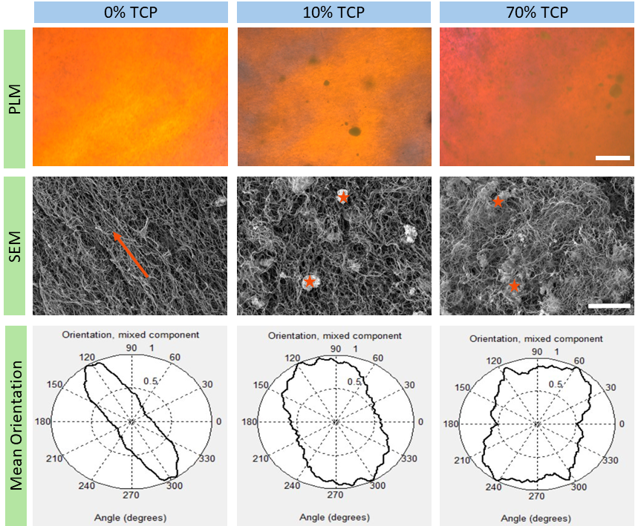
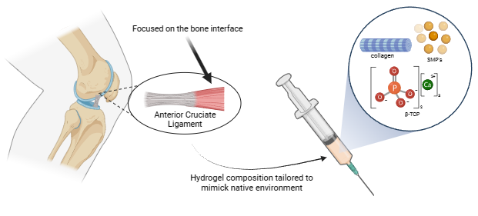
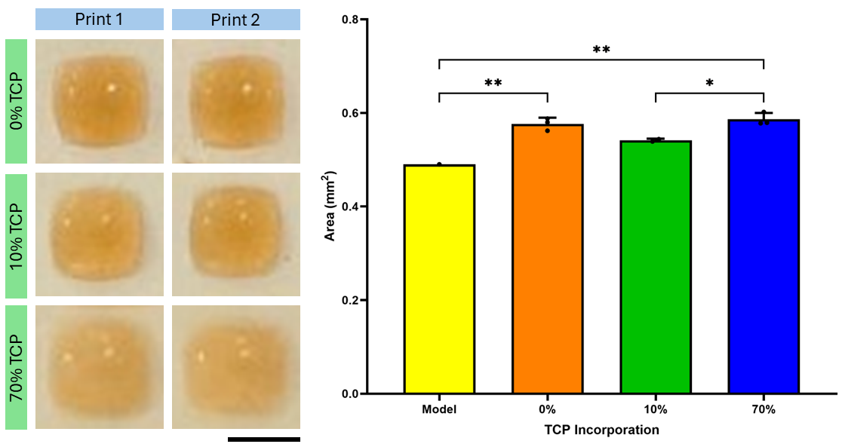
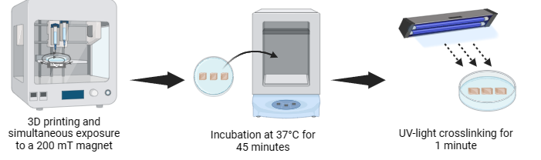
Innovative 4D Printing: Engineering Anisotropic Collagen-TCP Scaffolds for Bone Regeneration
Karly Liebendorfer
Faculty Advisor: Dr. Vipuil Kishore, Dept. of Biomedical Engineering and Science, Florida Institute of Technology
Introduction
Results
β-TCP Impact on Cell Viability:
Composite biomimetic scaffolds fabricated by combining collagen with bioceramics show immense promise for use in bone tissue engineering (BTE) applications. In this realm, application of extrusion-based 3D printing strategies with collagen-based composite inks yield 3D scaffolds with high precision. While these scaffolds could mimic the 3D complexity of native tissue, the microarchitectural aspects (i.e., collagen anisotropy) are lacking. Recent work in our lab has shown that combining extrusion-based 3D printing with magnetic alignment approaches in a 4D printing scheme triggers high degree of collagen anisotropy in printed scaffolds. The goal of this study is to assess the impact of β-tricalcium phosphate (β-TCP) incorporation on the rheological properties of collagenous inks as well as on collagen anisotropy and print fidelity of 4D printed scaffolds. ​
β-TCP Impact on Collagen Alignment:
Figure 5: Alamar blue results were recorded over 14-days and showed an increase in Saos-2 cell metabolic activity with time for all groups. Higher β-TCP concentrations appeared to cause a decrease cell proliferation compared to the 0% and 10% groups.​
Figure 3: Increasing β-TCP concentration interrupts the collagen alignment process during 3D printing. Polarized light microscopy (PLM, scale bar: 200 µm) and scanning electron microscopy (SEM, scale bar: 10 µm) results confirmed greater collagen alignment in 0% β-TCP scaffolds. However, adding β-TCP (starred) hinders collagen alignment especially at higher concentrations. A Fast-Fourier Transform analysis found that the mean orientation is more oblong with smaller ceramic amounts.
Methods
Project Approach:
Conclusions
Higher β-TCP concentration led to a disruption in collagen alignment and cell viability.
Print fidelity is not significantly impacted by ceramic incorporation.
Preliminary results demonstrate promise for using 4D printing methods to generate biomimetic scaffolds for BTE applications.
β-TCP Impact on Print Fidelity:
Figure 1: Schematic illustration depicting 4D printing strategy to regenerate a biomimetic scaffold.
Future Work
Printing Strategy using a Magnet:
The effects of β-TCP incorporation on osteogenic cell response is currently under investigation.
Studies are currently underway to identify the optimal ink composition that will yield composite scaffolds with retention of collagen anisotropy.
Acknowledgments
Figure 4: Print fidelity was found to be comparable between collagen only and β-TCP incorporated groups (Scale bar: 5 mm).​
This work was supported by a grant from National Institute of Health (NIH 2R15AR071102)​.​
Nashaita Y. Patrawalla for designing the initial model and experimental parameters.
Figure 2: Schematic illustration demonstrating 4D printing approach and processing steps.

