Slide 1
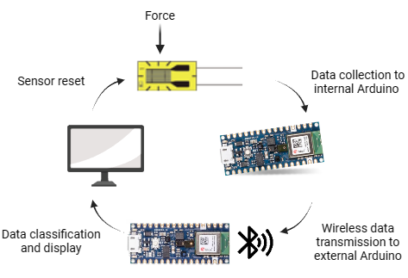
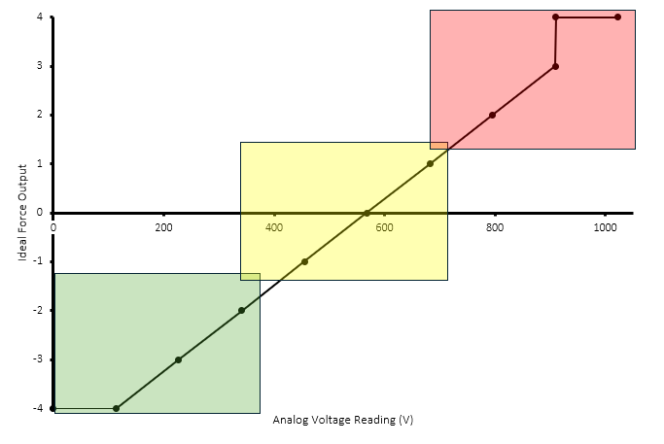
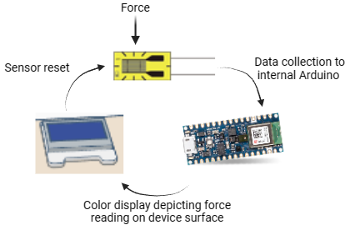
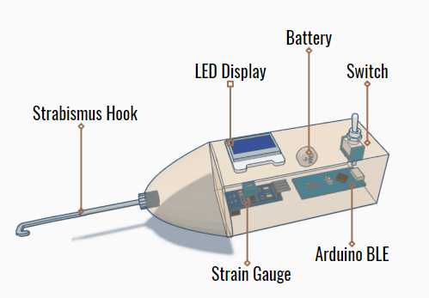
StrabiSense: A Novel Force Sensor for Strabismus Surgery
Ingrid Cooper, Karly Liebendorfer, Michael Ninomiya, Seda Yilmaz
Faculty Advisors: Dr. Linxia Gu, Dept. of Biomedical Engineering, Florida Institute of Technology
Introduction
Quantitative Approach:
Results
Amblyopia (lazy eye) results from imbalanced extraocular muscle tension and is corrected through surgery. Current protocol entails a surgeon utilizing free-hand techniques to approximate the amount of tension given off by the extraocular muscles during the live procedure. However, there is no standardized methodology, particularly in the surgical training process. Therefore, we aim to create a novel force sensor that measures muscular changes.
LCD Color Output Display:
Objectives
Develop a force sensor for quantifying extraocular muscle deformation forces.
Streamline real-time data into surgical recommendations.
Figure 2: Diagram of the sensor system with wireless data transmission and output display.
Qualitative Approach:
Figure 4: Diagram illustrating the coded color system that displays on the device’s LCD. Each color corresponds to a real-time force range detected by the internal strain gauge.
Economics
Materials Cost / Unit | $180
Projected Price Point | $750
Total Business Cost | $100
Break-Even Sales Point (in units) | $470
Conclusion
Our tool can transform strabismus surgery and surgical training with real-time data for precision muscle corrections.
StrabiSense equips surgeons with unprecedented quantifiable data on ocular muscle tension.
The device could significantly improve surgical outcomes.
Design Methods
Device Shape and Internal Electrical Framework:
Figure 3: Diagram of the device’s internal sensor system connecting to a display output on the outer casing for streamlined data interpretation.
Future Work
Improve and compact the design for enhanced handling and expand applications.
Design a surgeon-friendly app.
Autoclavability for easy sterilization and reuse.
Key Features:
Surgical hook with drill chuck for stability and changeability for sterilization purposes.
Measures and guides muscle adjustments with force feedback.
Wireless data transfer.
Acknowledgements
Figure 1: Diagram of the device’s external casing with the corresponding internal circuit pieces and layout.
Mohammad Ahmed, Dr. Linxia Gu, Dr. Kourosh Shahraki, Dr. Donny Suh, Dr. Jim Brenner, and Maria Fernanda Sagastume

