Slide 1
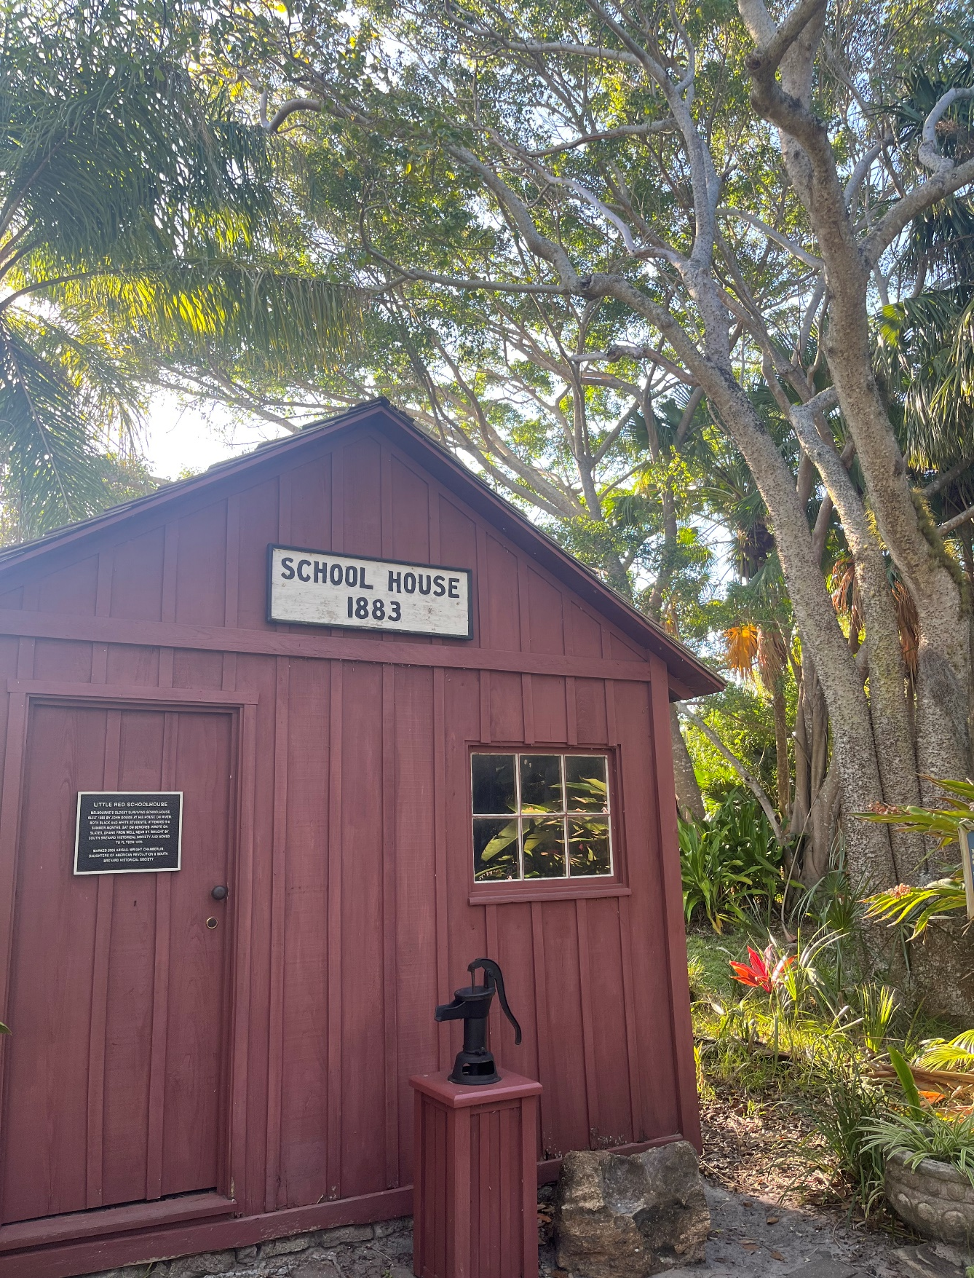
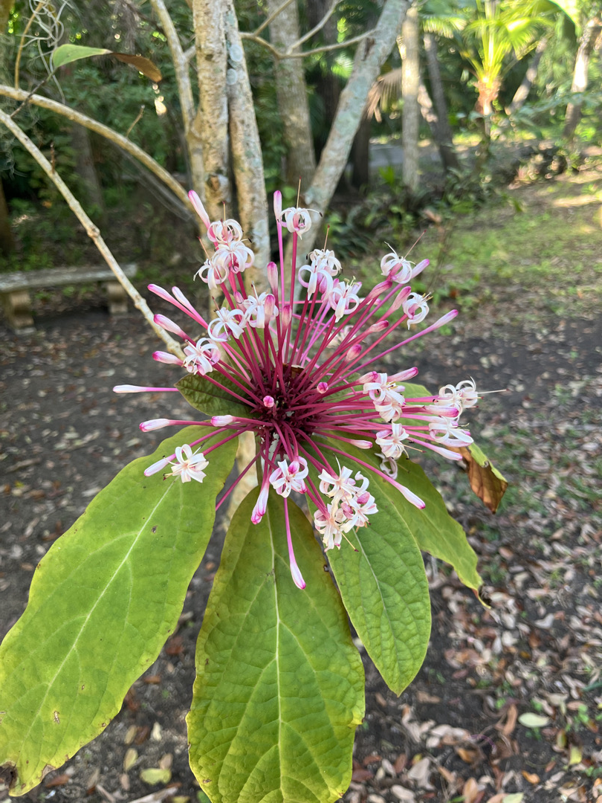
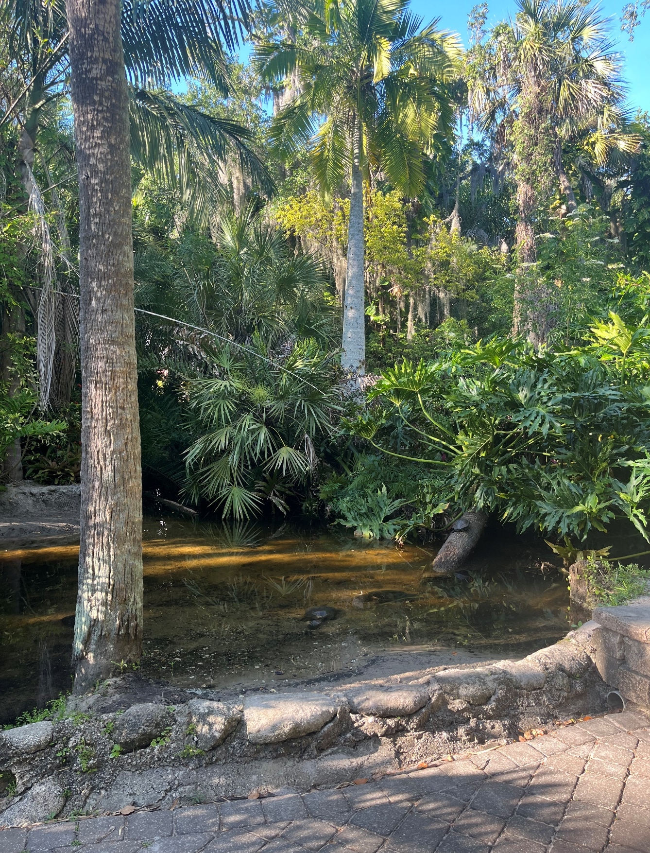
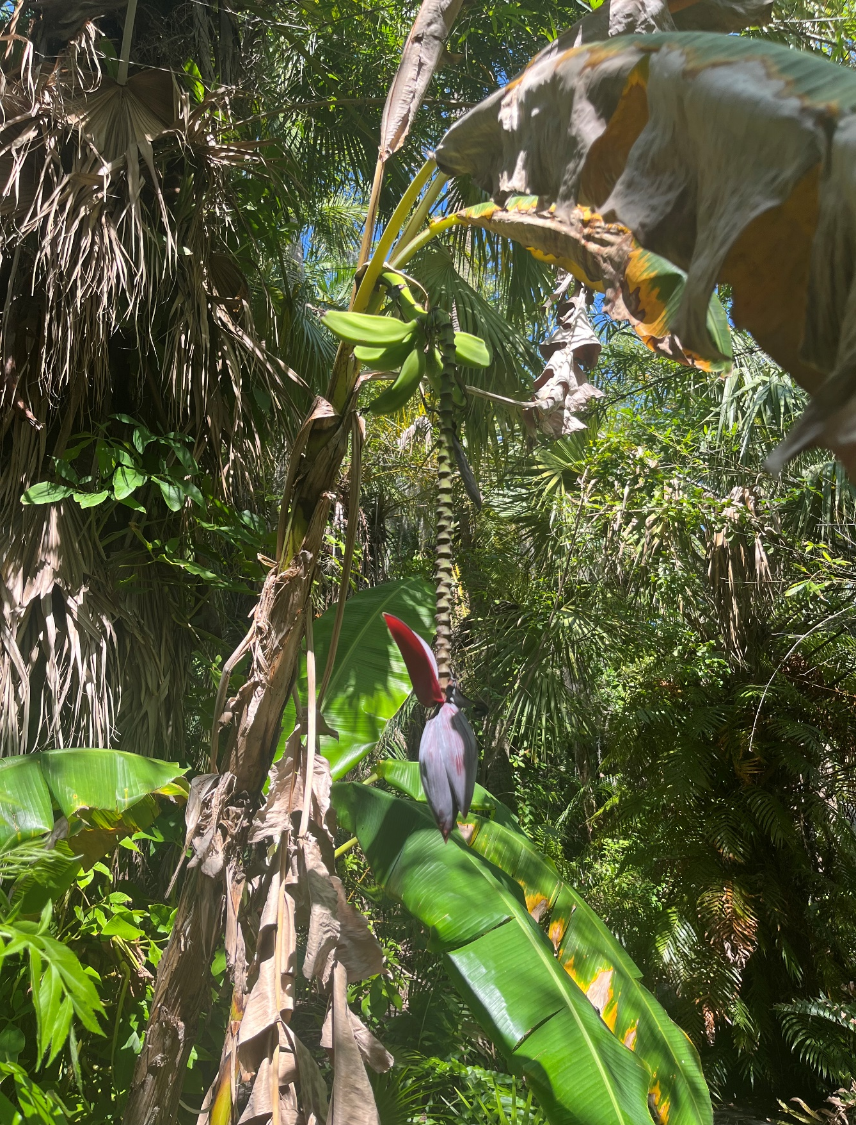
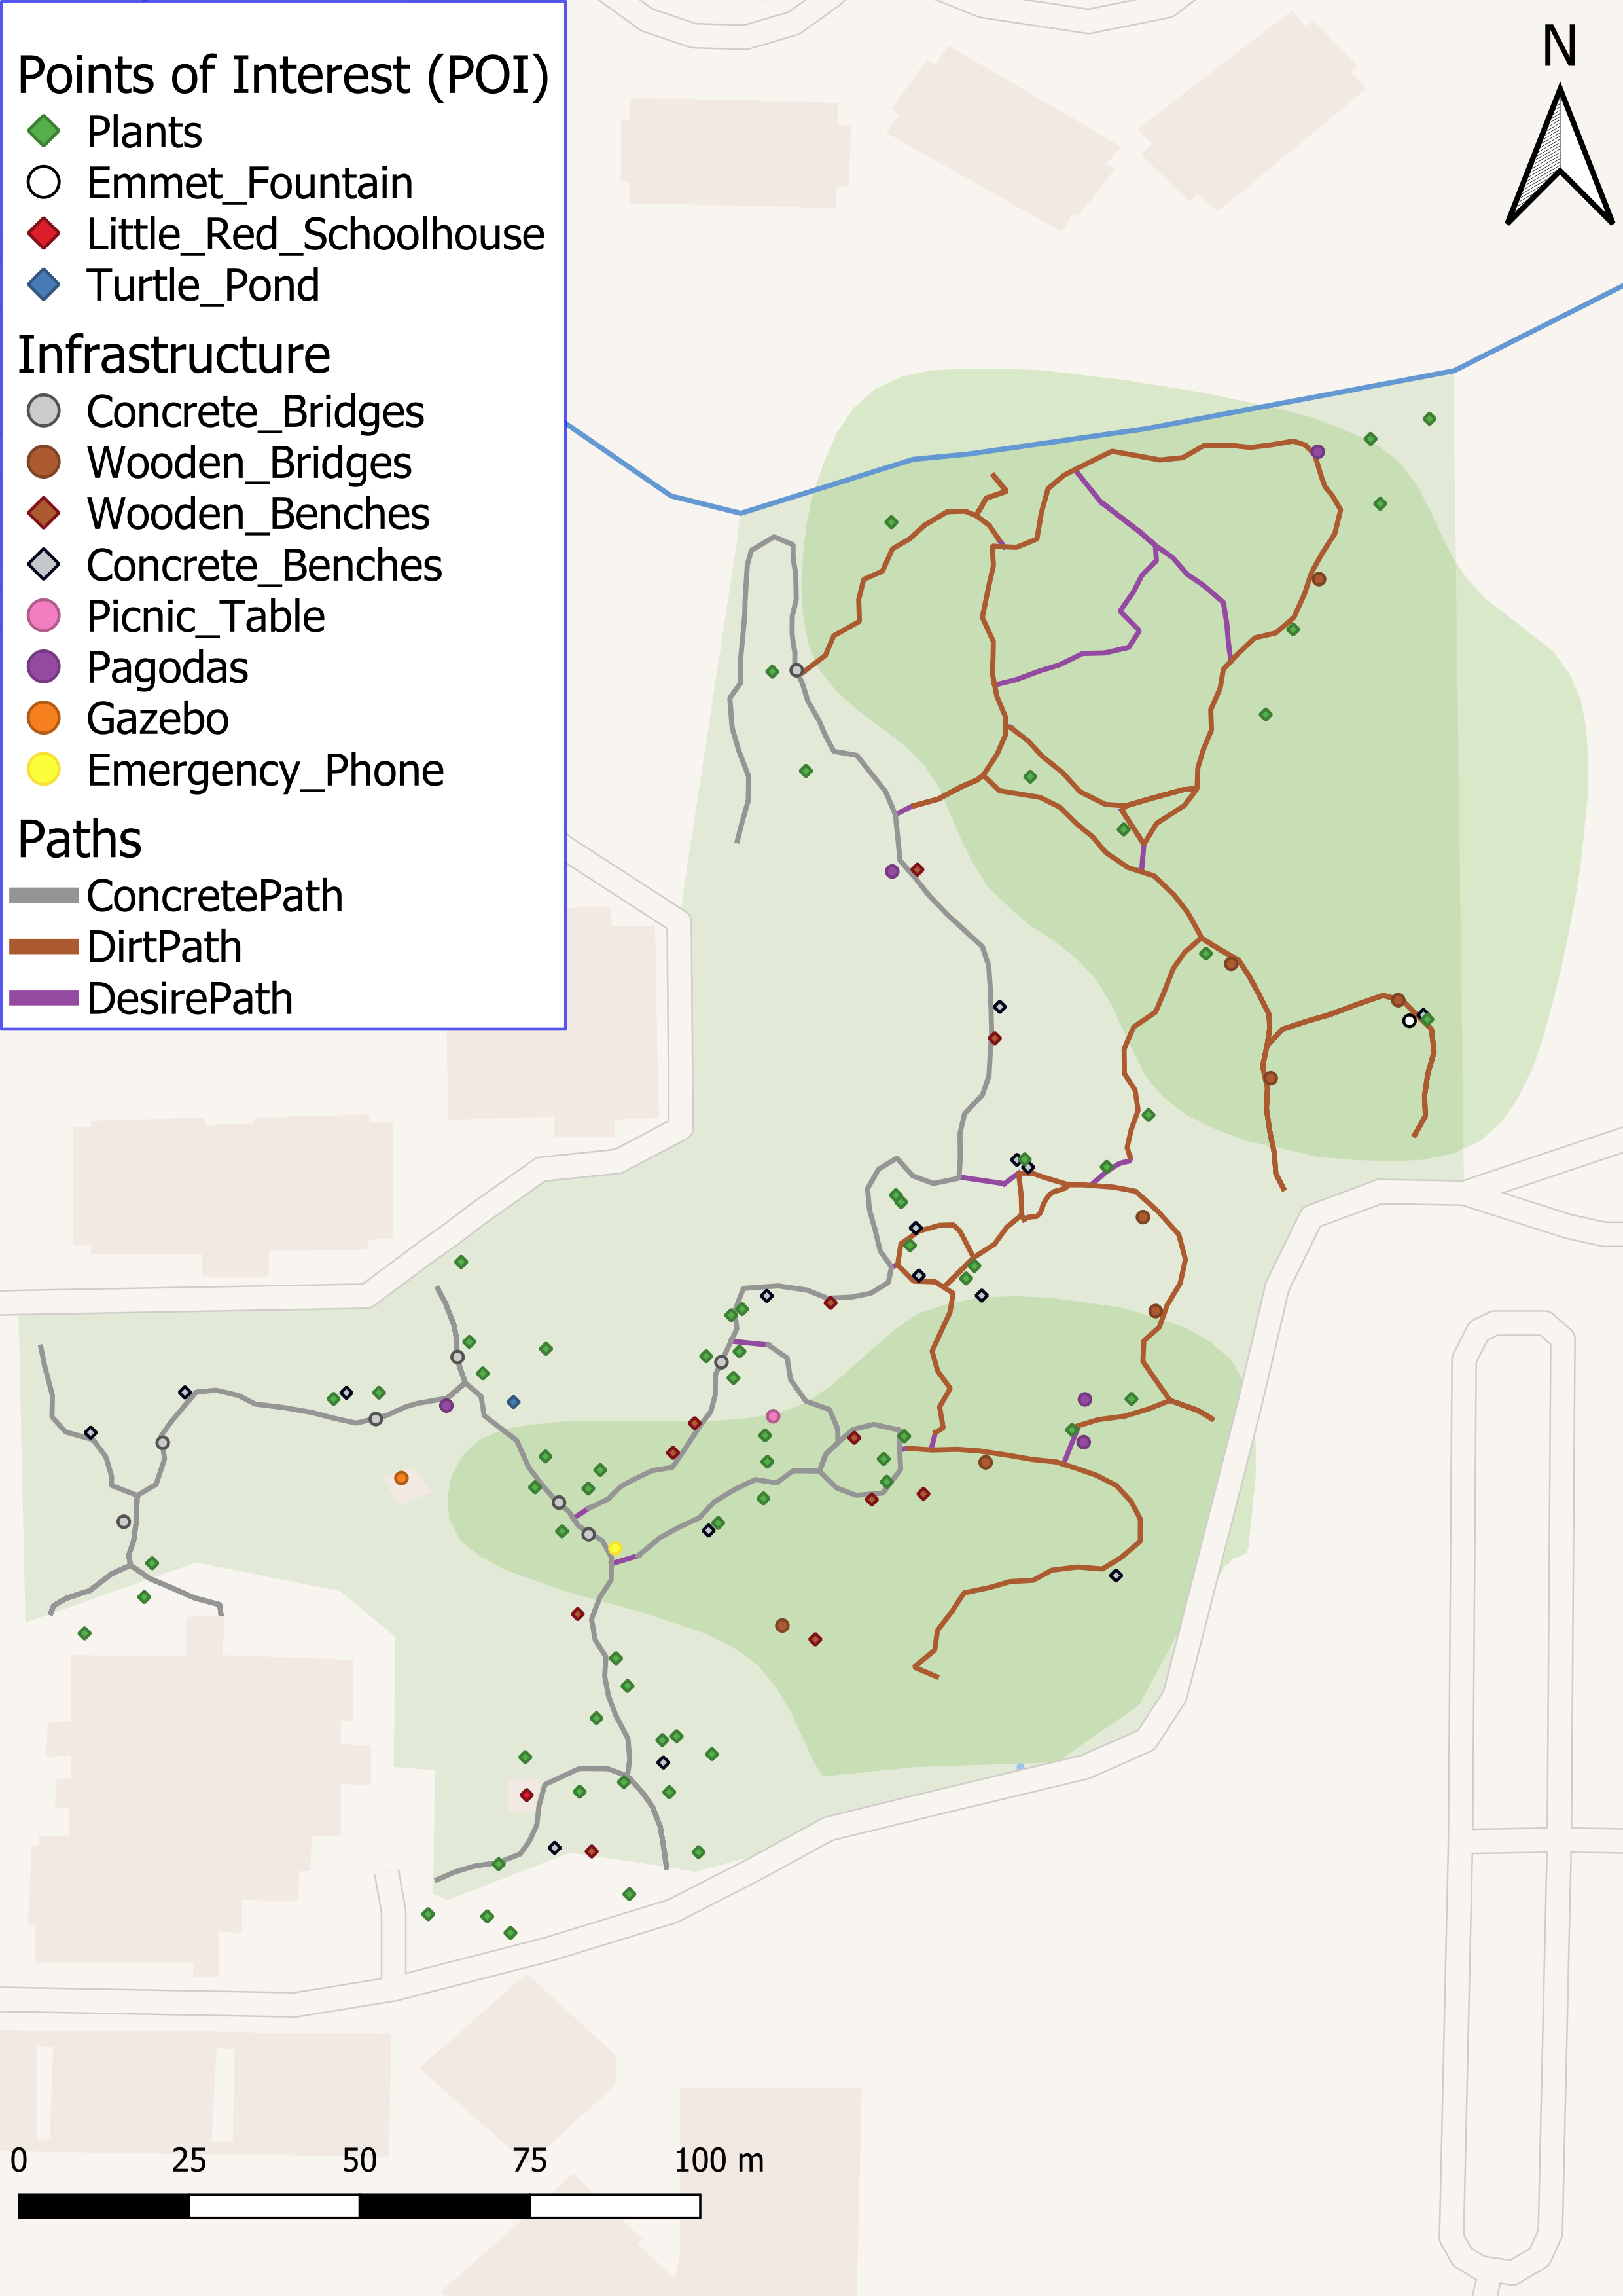
Mapping the Botanical Gardens: A Guide to Florida Tech’s Greenspace
Paolo A. Soto
Faculty Advisor(s): Dr. Emily Ralston, Dept. of Ocean Engineering and Marine Science, Florida Institute of Technology
Dr. Ken Lindeman, Dept. of Ocean Engineering and Marine Science, Florida Institute of Technology
Introduction:
The Joy & Gordon Patterson Botanical Gardens on the Florida Tech campus are an important asset to the university. The garden provides a large recreational area for students, faculty and the public. It is also home to numerous interesting native and imported plant species. This abundance of natural capital is advertised as a perk of studying at Florida Tech, additionally this 16-acre watershed provides campus with flood protection. Therefore, it is important for visitors to be able to locate the various notable features of the gardens. Additionally, spatial data will be essential in guiding efforts to restore or re-vamp areas of the botanical gardens. While maps of the gardens exist, they are largely outdated and backend data remains inaccessible. This project sought to fill these information gaps and develop a product that can be updated into the future using GIS-mapping software.
Objectives:
Identify features of interest in the gardens.
Build a visitor-friendly ArcGIS Online map.
Methods:
Identify features of interest in the gardens
All GPS tag data was collected on an iPhone 13 using the free trial of the app Fulcrum.
GPS tagged benches, pathways, pagodas and all other infrastructure.
GPS tagged plants and other areas of interest.
Tag data was exported to QGIS and checked for accuracy using Qfield. This allowed for corrections to be made while in situ.
Build visitor-friendly ArcGIS Online map
QGIS map build exported to ArcGIS Online.
Results:
Table 1 represents data points collected over the course of mapping; 118 points were collected.
Figure 1 is an initial QGIS build of the map with all the collected data visible, figure 2 highlights some notable points.
Discussion:
Given the strong correlations between greenspaces and better mental health^{[1-3]} it is important that Florida Tech maintains the wellbeing and usability of the campus botanical gardens. To help support this goal, this project filled information gaps and built a data product that can be well-utilized by visitors and management alike.
Acknowledgements:
Thank you to Gordon Patterson, Joy Patterson, Cathy, Kirk, Delanie Hallock, and Lars Spencer for supporting my project. Thank you to the developers of OpenStreetMap, QGIS and QField for providing excellent open-source applications.
Citations:
Holt, Elizabeth, et al. “Active and Passive Use of Green Space, Health, and Well-Being amongst University Students.” International Journal of Environmental Research and Public Health, vol. 16, no. 3, 1 Feb. 2019, p. 424, www.ncbi.nlm.nih.gov/pmc/articles/PMC6388138/, https://doi.org/10.3390/ijerph16030424.
Kanelli, Argyro Anna, et al. “Can Campus Green Spaces Be Restorative? A Case Study from Tanzania.” Sustainability, vol. 16, no. 3, 1 Jan. 2024, p. 1094, www.mdpi.com/2071-1050/16/3/1094, https://doi.org/10.3390/su16031094.
Lee, A. C. K., and R. Maheswaran. “The Health Benefits of Urban Green Spaces: A Review of the Evidence.” Journal of Public Health, vol. 33, no. 2, 10 Sept. 2010, pp. 212–222.
Object Type | Amount on map
Plants | 66
Bridges | 15
Benches | 26
Other POI | 11
Table 1: Items tagged for QGIS map build.
Figure 2: Notable POIs tagged.
Figure 1: QGIS map build of Botanical Gardens.

