Slide 1

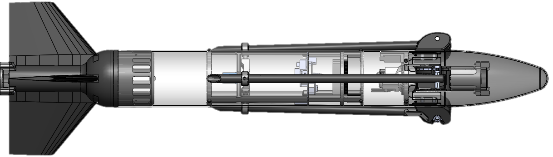
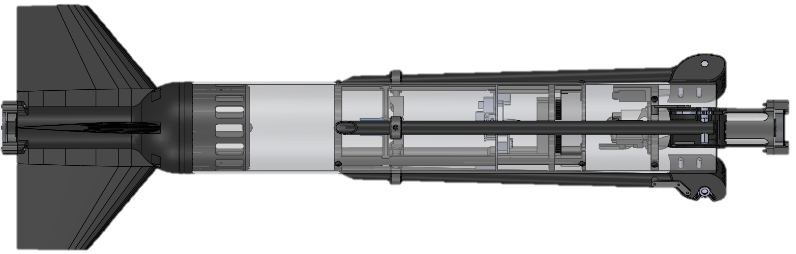
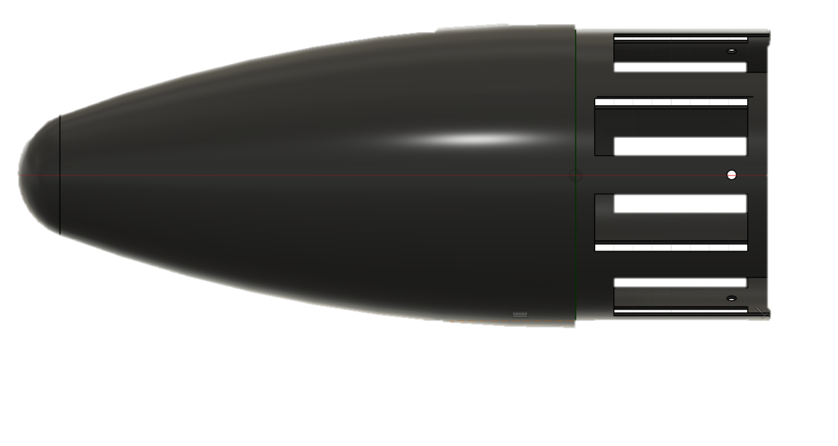
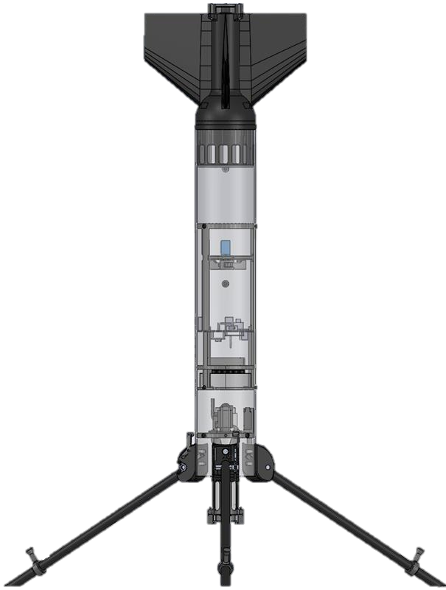
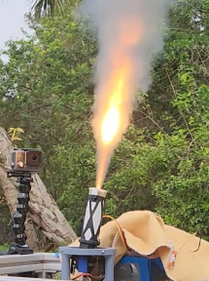
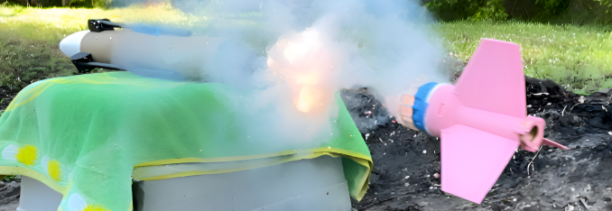
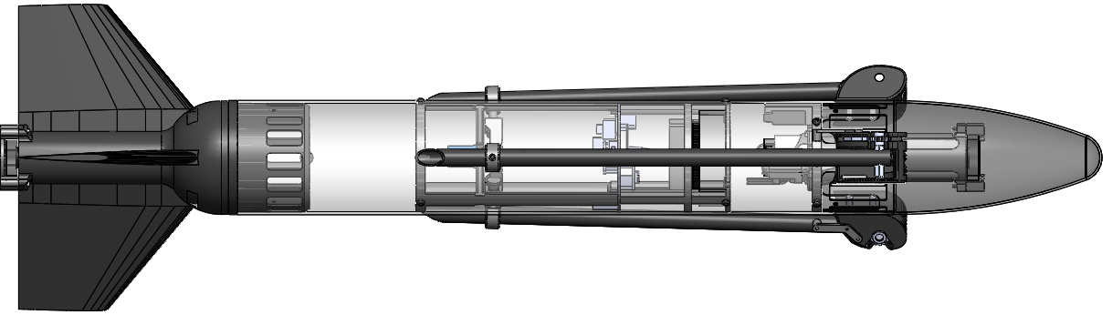
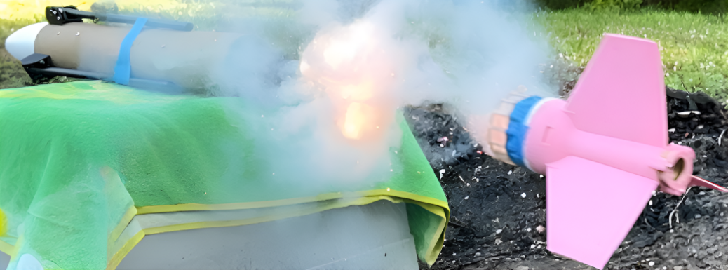

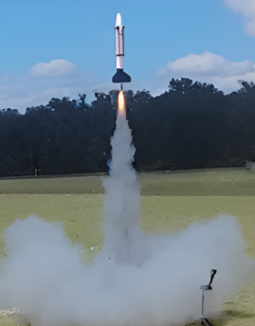
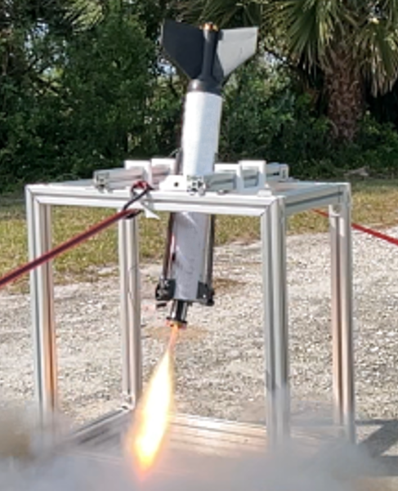
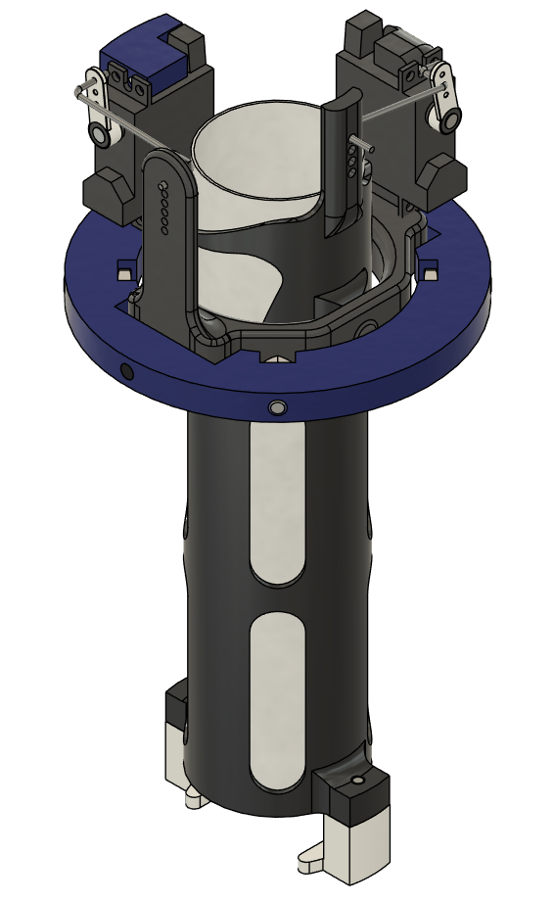
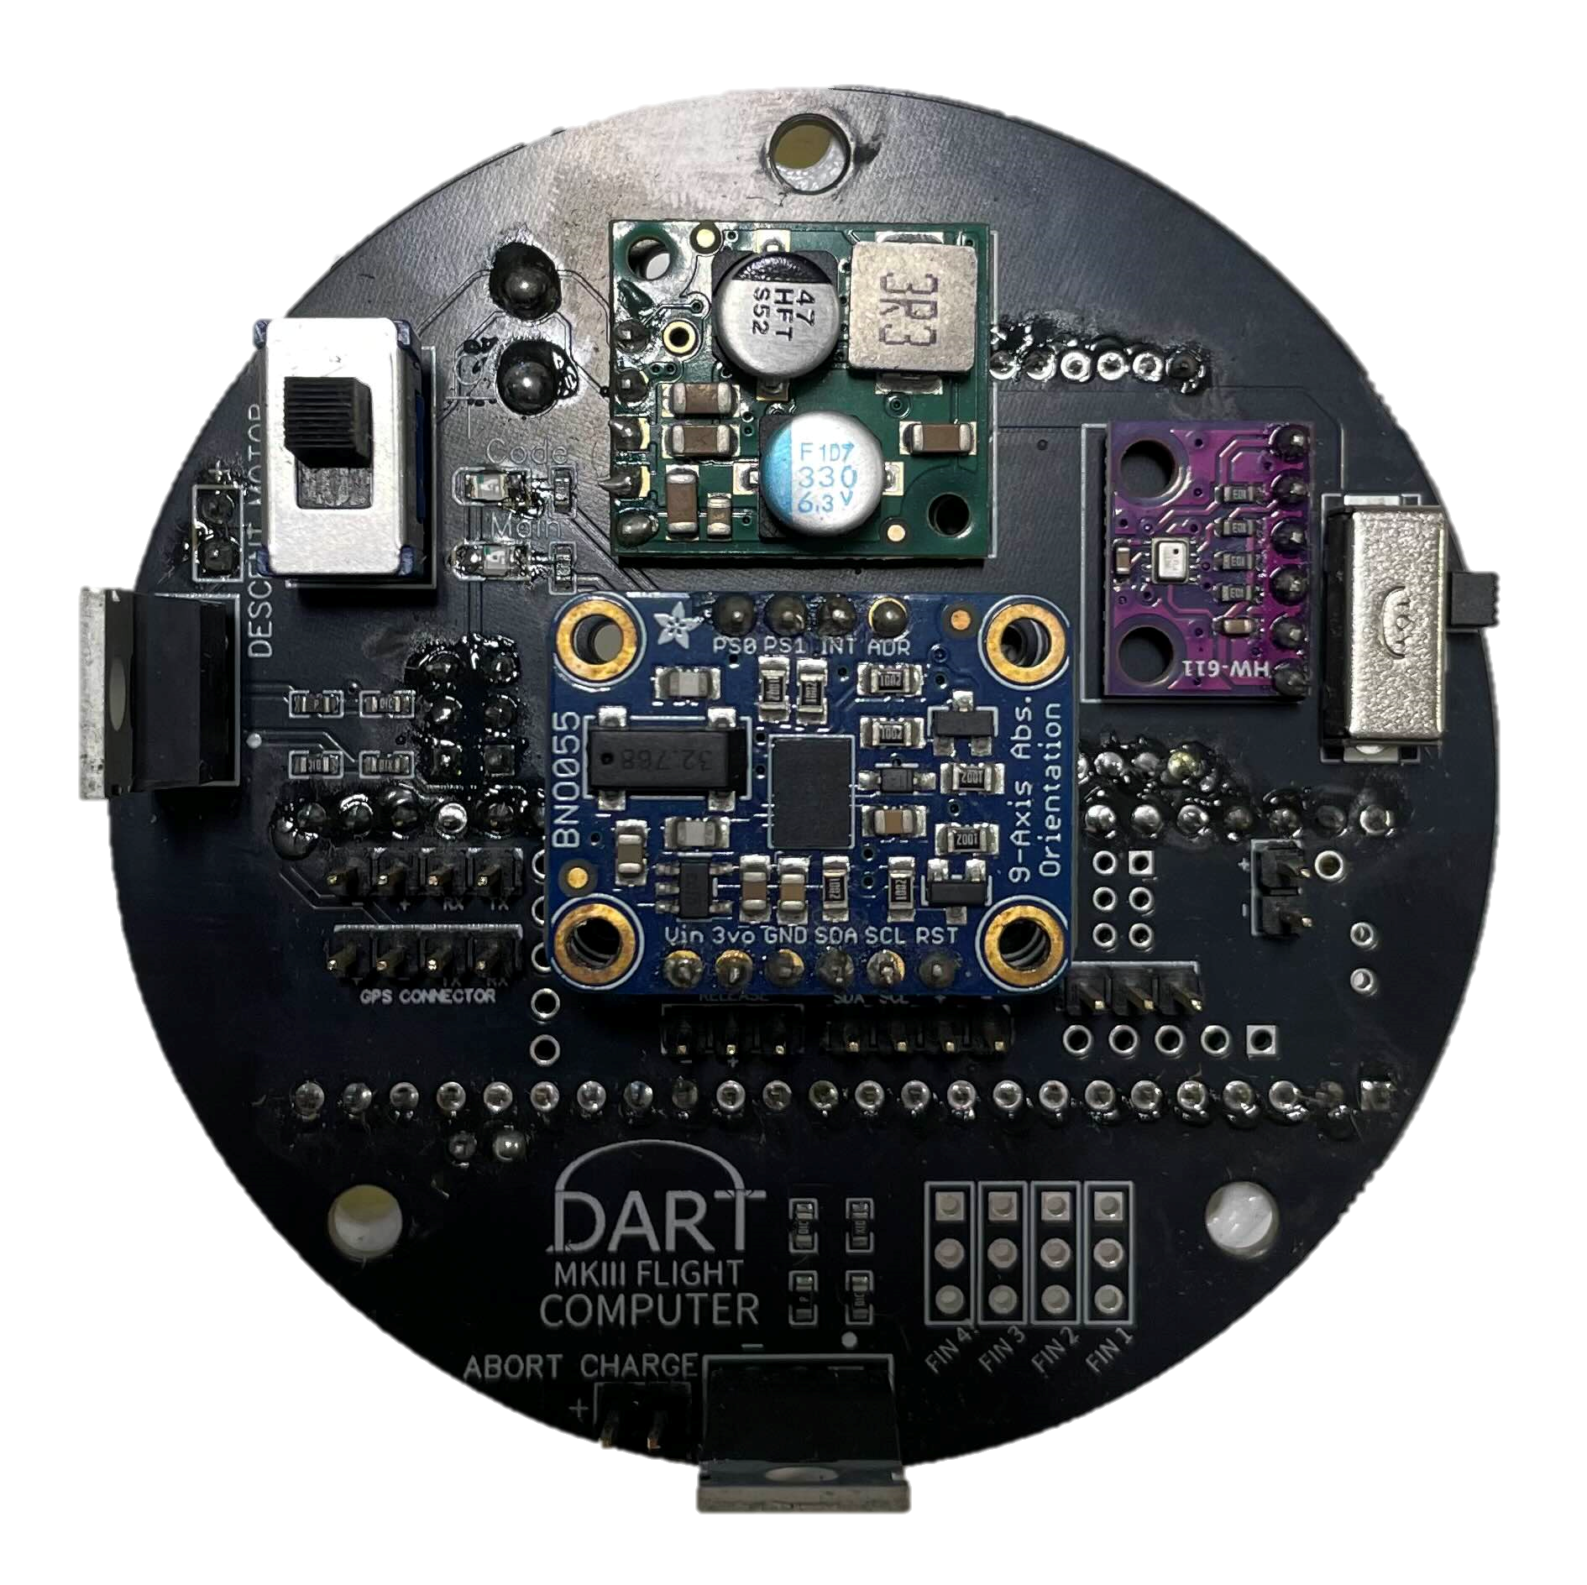
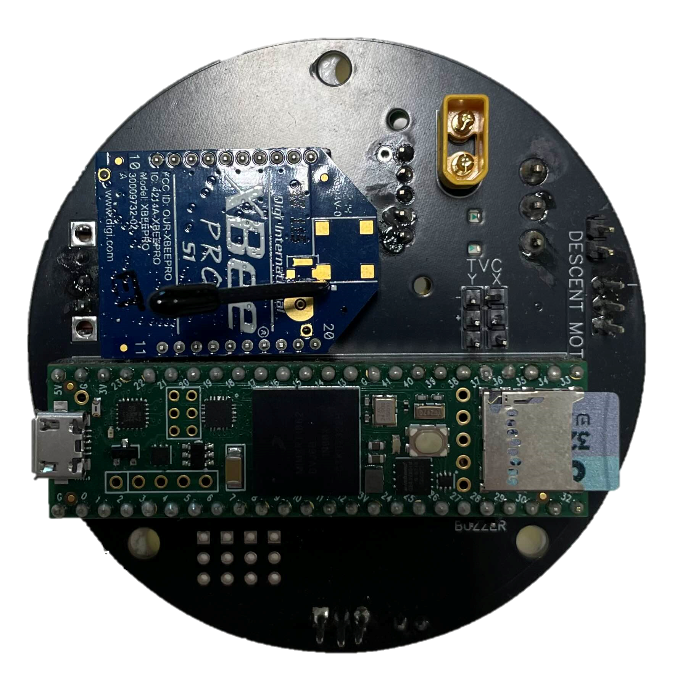
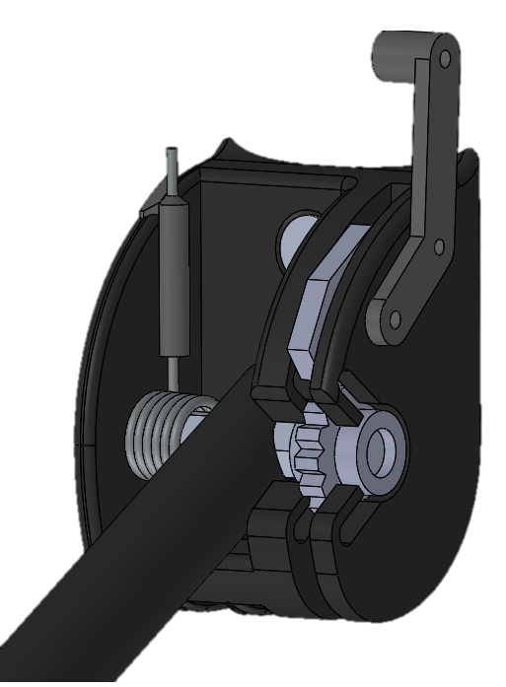


DART – Small-Scale Rocket Payload Delivery
L. Aagaard, K. Jamal, B. Lougheed, J. O’Hara, Z. Figueroa, J. Smith, R. Struthers, N. Tardy, M. Vale, J. Vennink
Faculty Advisors: Dr. Firat Irmak and Dr. Darshan Yadav, Dept. of Aerospace Engineering, Florida Institute of Technology
Summary
Concept of Operations
Impact and Future Work
Demonstrator for Autonomous Rapid Transport (DART) is a small-scale, thrust-vector-controlled rocket designed for autonomous, propulsive landing. The project demonstrates point-to-point payload delivery with over 50 meters of lateral displacement and supports the U.S. Space Force’s Rocket Cargo Vanguard initiative using reusable rocketry to deliver payloads. The system integrates TVC, GNC, and lightweight structures in a unique landing geometry.
Launch
Powered Ascent
Apogee
Powered Descent
Landing
DART serves as a testbed for precision landing techniques in small-scale, reusable rockets. It enables future research in TVC, GNC, and rapid-response delivery systems. The project expands Florida Tech’s capabilities in autonomous rocketry and experimental controls. Future work includes advanced controller development and precision guidance capabilities.
$$75 \left[m\right]$$
$$50 \left[m\right]$$
Vehicle Design
Testing & Validation
771.5 mm
Static Fire Tests
Verified thrust and motor timing
Assessed TVC functionality and performance
Abort System Tests
Verified abort signal reception
80.73 mm
Thrust Vector Control (TVC) Mechanism
Ascent Tests
Verified aerodynamic stability and structural design
Verified parachute deployment functionality in-flight
Attitude Control Tests
Stabilized rocket in 2DOF (pitch/yaw) gimbal mechanism under vectored thrust
Tuned TVC behavior with visual feedback
Nose Cone
Ascent System (Tri-Fin Design)
Abort System
Interior Mounting Structure
Landing Leg Hinges (x3)
Landing Legs (x3)
Controls
Propulsion
Structures
Conclusions
Custom Arduino-based flight computer combines sensor readings, flight logic, and control outputs
PID control logic relates vehicle orientation to TVC gimbal angles
2 commercial-off-the-shelf solid rocket motors satisfy Class 1 amateur rocket restrictions
High thrust ascent motor required for initial aerodynamic stability
Long burn descent motor provides enhanced control authority for landing
1.5 kg mass budget required for Class 1 amateur rocket classification
Overall safety factor of 1.4
(NASA-STD-5001)
PLA and PA6-CF additive manufacturing leveraged to support complex component geometries
Over 85% reusable structure
Rocket-propelled vehicles offer an appealing alternative to conventional aircraft for time-sensitive cargo delivery
Advancements in commercial rocketry align with this endeavor
Barometer
Radio
Acknowledgements
Pawl Wedge
Torsion Spring
The DART team thanks our faculty advisors, Dr. Firat Irmak and Dr. Darshan Yadav, our graduate student assistant, Steven Holmberg, and the Florida Tech L3HSDC staff.
Front
IMU
Back
TVC Mechanism
Gear
Landing Leg Hinge
Microcontroller

