Slide 1
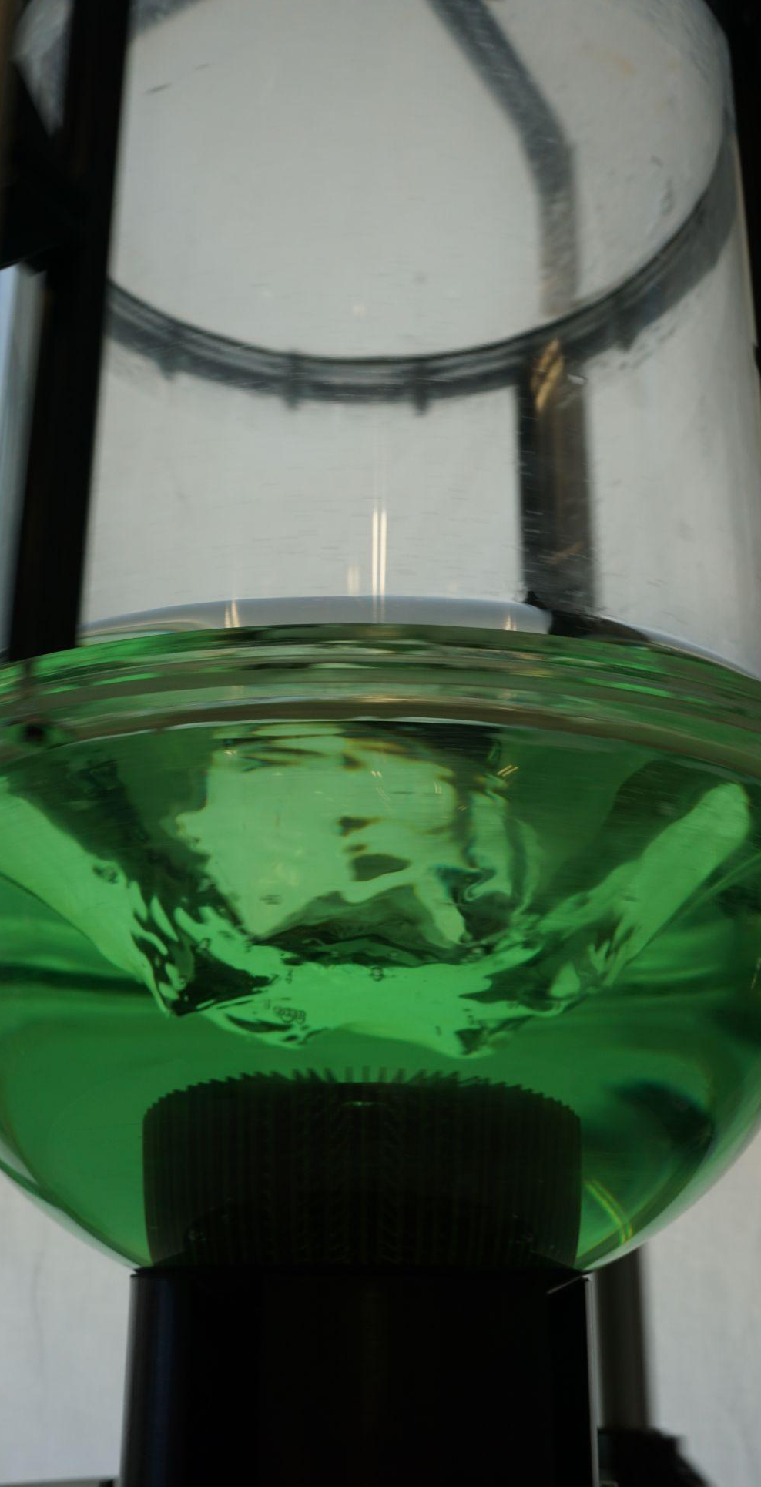
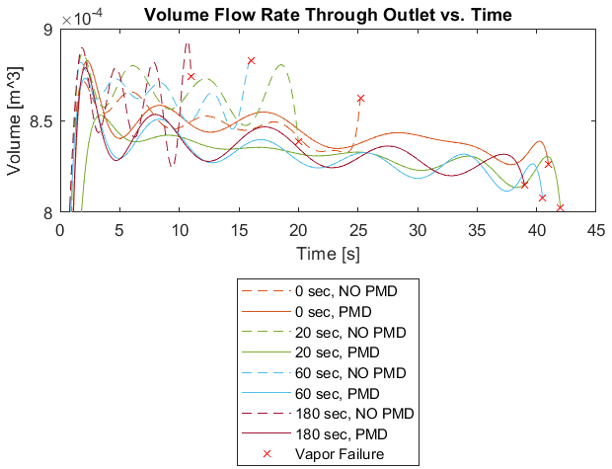
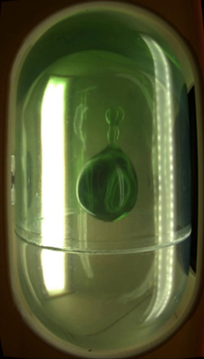
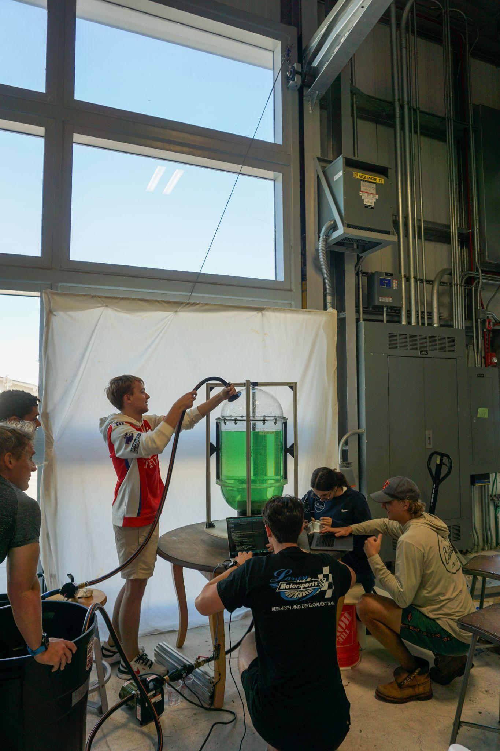
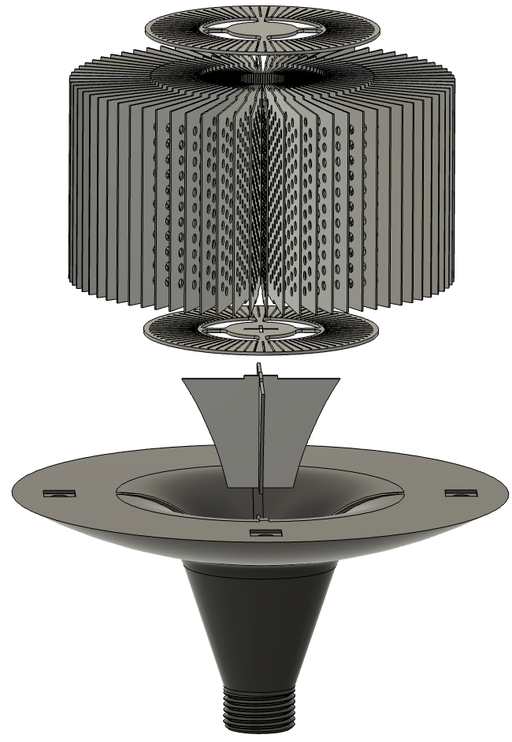
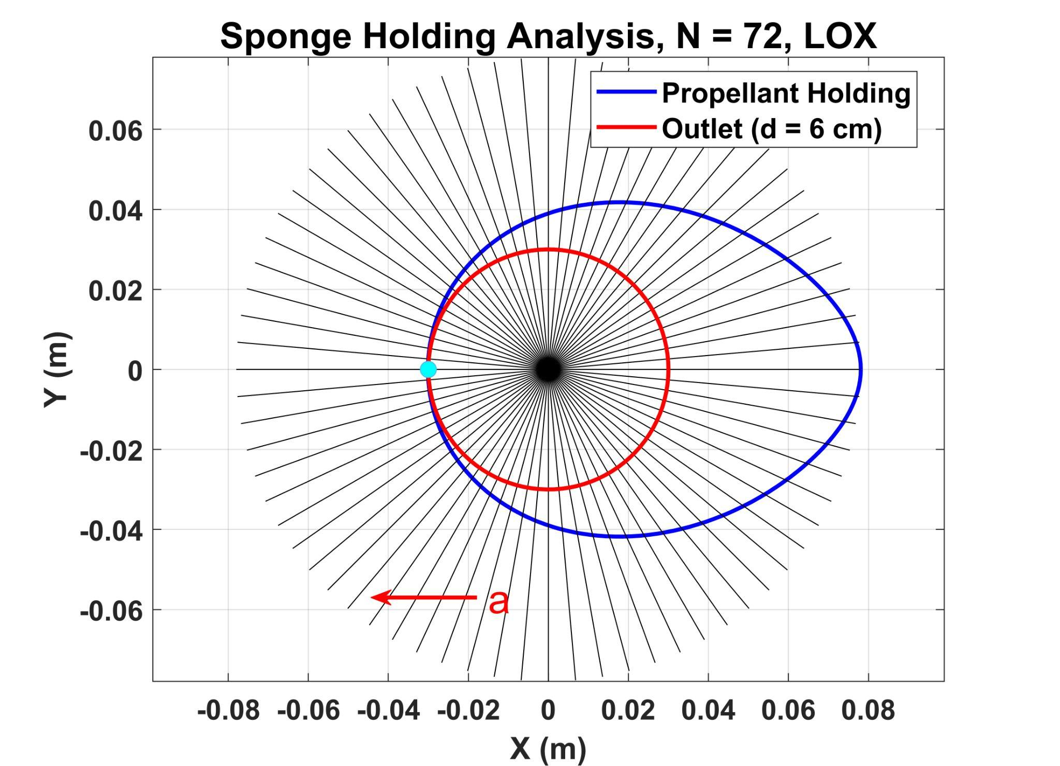
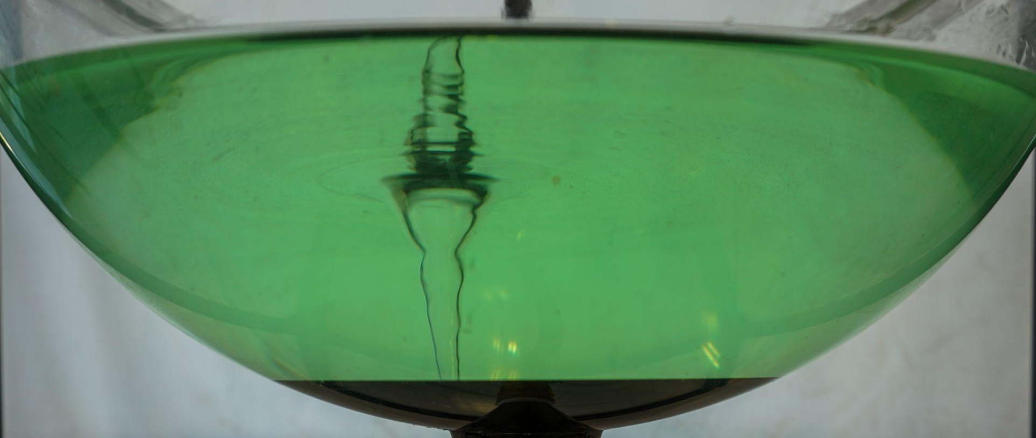
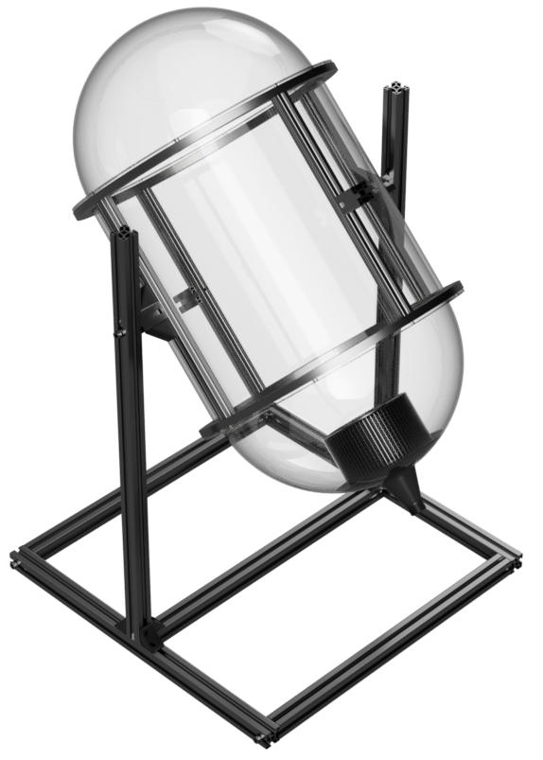
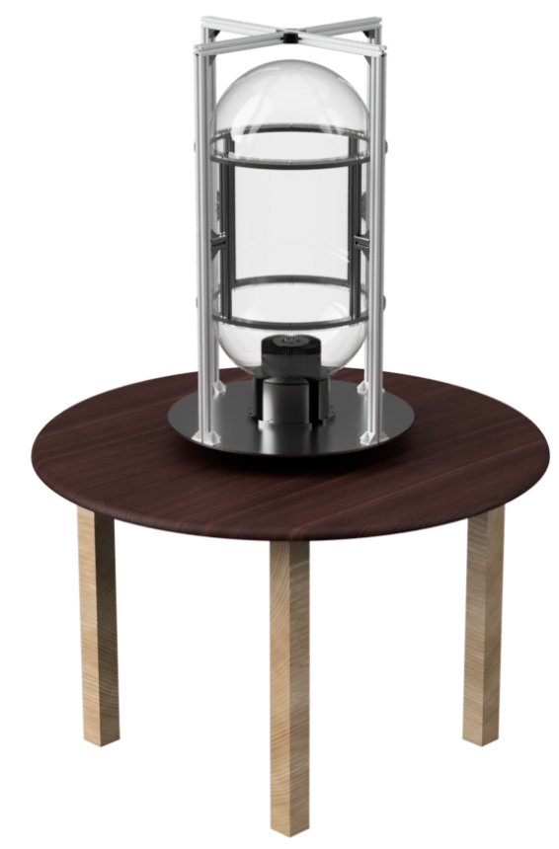
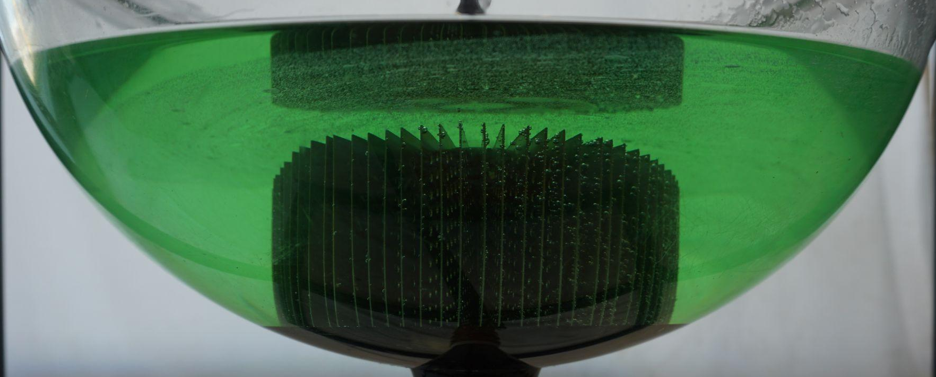
S.L.O.S.H. - System for Liquid Orbital Supply and Handling
A. Alexy, J. Broussard, A. Dean, D. Garceau, J. Grady, B. Kerridge,
B. Smucker, R. Wagner, C. Zelasko
Faculty Advisor: Dr. Daniel R. Kirk, Dept. of Aerospace, Physics, and Space Sciences,
Florida Institute of Technology
Why Manage Propellants in Microgravity?
Deep space missions start with mastering in-orbit propellant transfer
In microgravity, liquid propellants don’t settle–they float
Vapor leads to system failure, engines demand pure liquid
Project Objectives
Design Propellant Management Device to handle Liquid Oxygen (LOX)
Develop equipment to simulate operating conditions
Conduct quantitative tests using cryogenic simulant (water)
Evaluate/Analyze device performance
What Did We Learn?
Florida Tech SPHERES Experiment
LOX Propellant Management Device (PMD) Design
Conclusions
PMD shows significant improvement for drain angles 0°-25°
PMD components successfully mitigated vortices, reducing residual fluid levels
Loss in flow rate while testing PMD was within acceptable limits
‘Sponge’ - retains propellant within 6cm diameter under accelerations
7.7cm
Anti-Vortex Device - mitigates vortices and vapor ingestion
4.32cm
Modular Outlet - can change components in/out
9cm
Testing & Equipment
1.02 m
1.81 m
10° no PMD
Gimbaling Apparatus
Rotating Apparatus
10° with PMD
Notes:
1.81 mm

