Slide 1
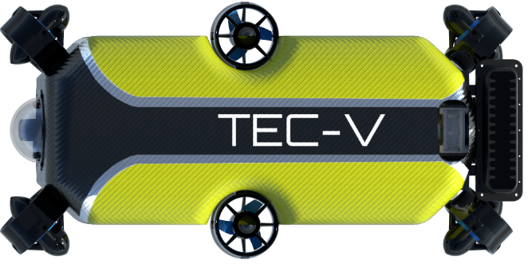
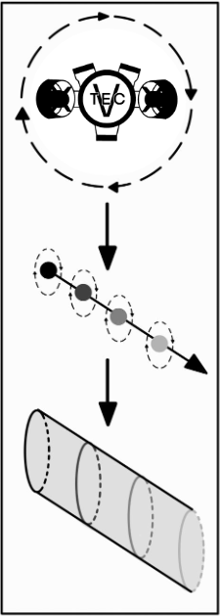
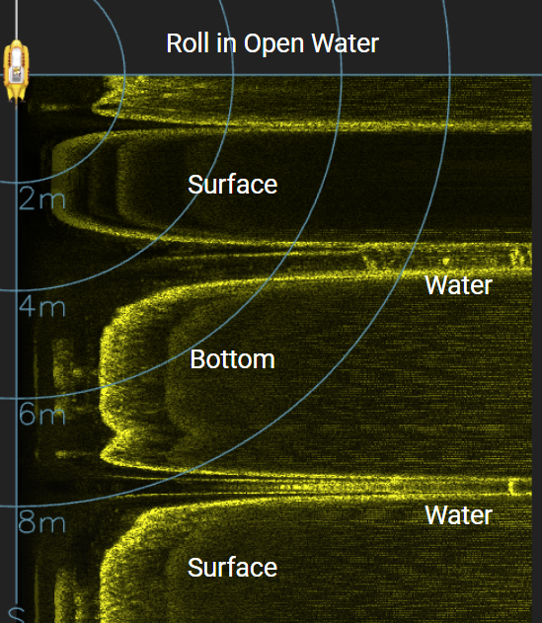
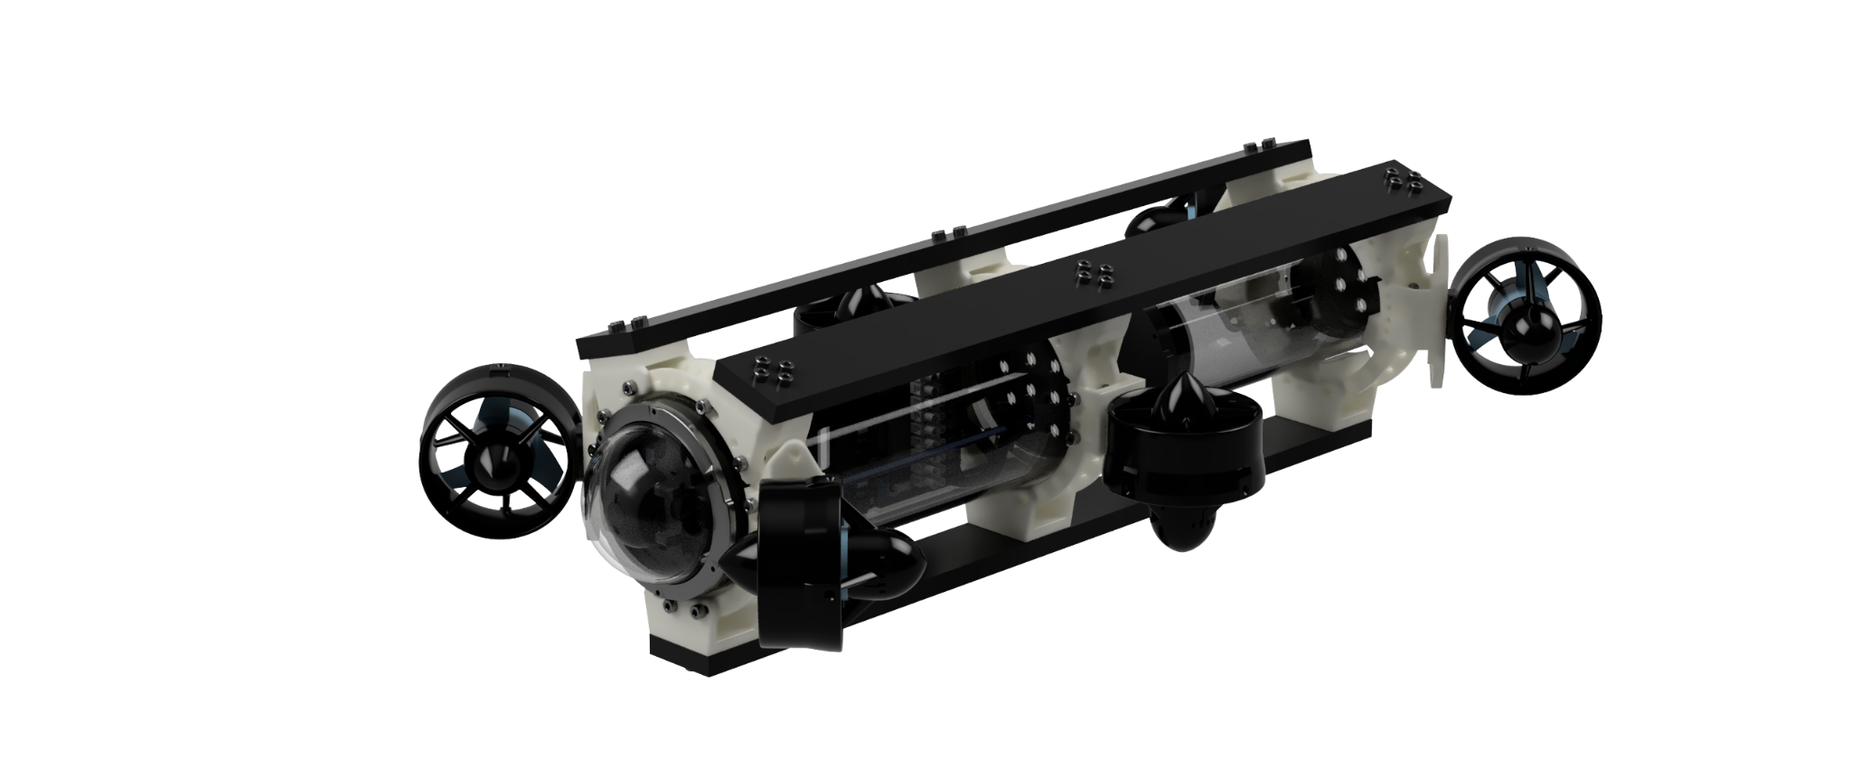
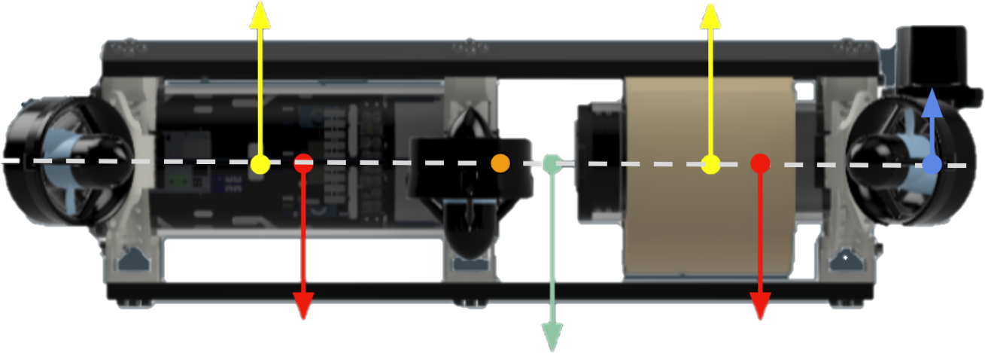
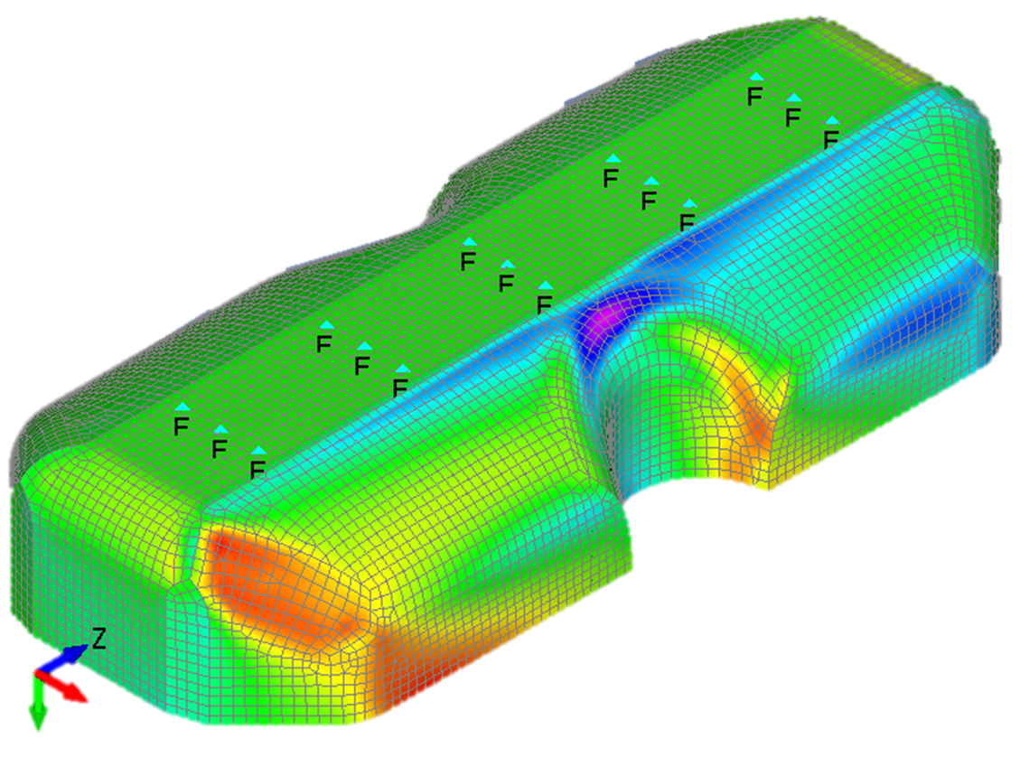
TEC-V ROV
Stephen Coster, Henry Hill, Gabor Papp, Michael Dowling
Faculty Advisor: Dr. Stephen Wood, Dept. of Ocean Engineering and Marine Sciences, Florida Institute of Technology
Abstract
Mapping Procedure
High-resolution, three-dimensional maps of enclosed underwater environments would benefit a wide range of industries and fields. The Topographic Exploration Cave Vehicle, TEC-V, is a remotely operated vehicle (ROV) platform aimed toward safe underwater exploration of enclosed environments, such as caves, shipwrecks, and port structures by using acoustic technology and custom-engineered hydro-mechanical architecture to effectively maneuver and scan the environment. The TEC-V platform spans multiple disciplines including mechanical, electrical, systems, computer science, and ocean engineering.
Activate vertical facing side-scan sonar
Perform roll maneuver to scan a “cylinder”
Traverse forward and repeat roll
Post-process data and stitch together “cylinders”
Objectives
Develop a modular, cost-effective platform for confined underwater environment exploration
Perform a hydrostatic and hydrodynamic analysis to achieve desired properties
Effectively integrate and test sonar mapping procedure for future development
Figure 1: TEC-V Model
Figure 4: Mapping Procedure
Fairing
Sonar
The carbon fiber fairing was designed as a structural element that offers desired hydrodynamic effects. Calculations and FEA simulations were performed to evaluate the strength under maximum loading conditions. A combination of hand lamination and vacuum bagging was used for manufacturing.
TEC-V uses the Cerulean 450FS side-scan sonar which offers high-resolution imaging with an effective range of up to 100 meters. The position of the sonar at the aft of the vehicle minimizes hydrodynamic effects without obstructing the scan. The sonar records a detailed scan data that can be easily exported in CSV format for further data processing and manipulation.
Figure 2: Moment Analysis
Mechanical Design
TEC-V consists of two acrylic pressure enclosures that house the vehicle’s electrical components. A 6-thruster layout was selected to grant the vehicle 5 degrees of freedom (DOF). Modular brackets were 3D-printed with PETG to hold the structural members. High density buoyancy foam was fitted around the aft chamber and a moment analysis was conducted to optimize vehicle dynamics.
Acknowledgments
The team would like to express thanks to the students in the Underwater Technology Lab (UTL) for their support and guidance. Also a special thanks to Dr. Ronnal Reichard and the team at Structural Composites, Inc. for their expertise and donations to this project.
Figure 3: Fairing FEA Simulation

