Slide 1
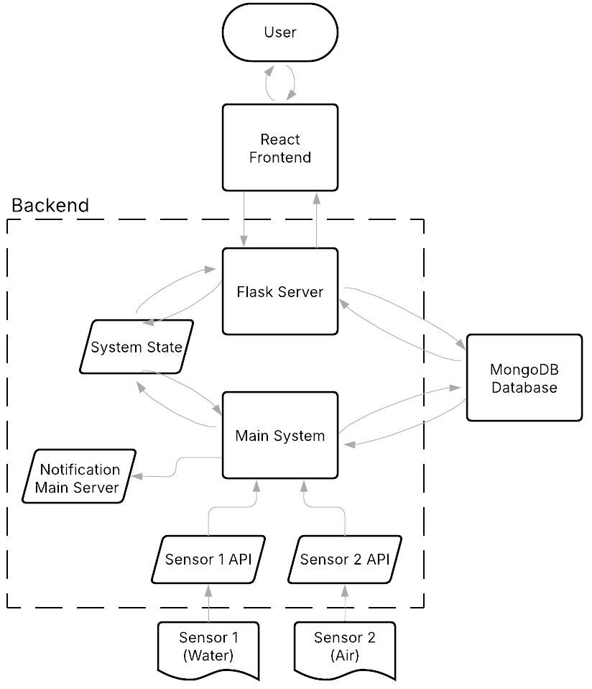
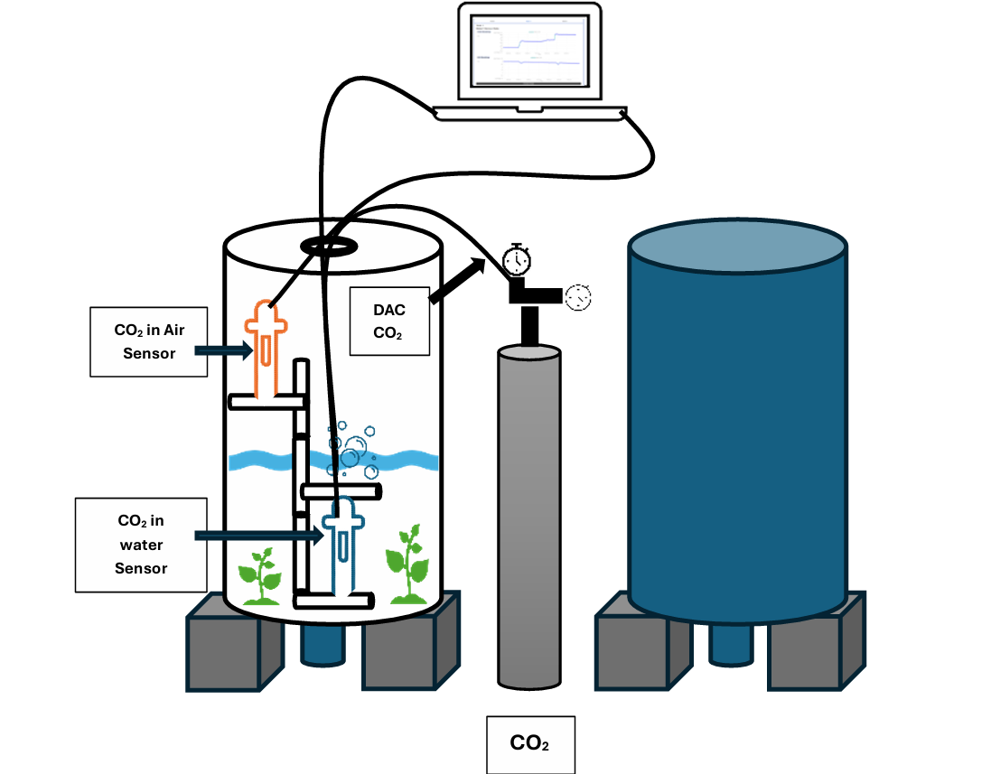
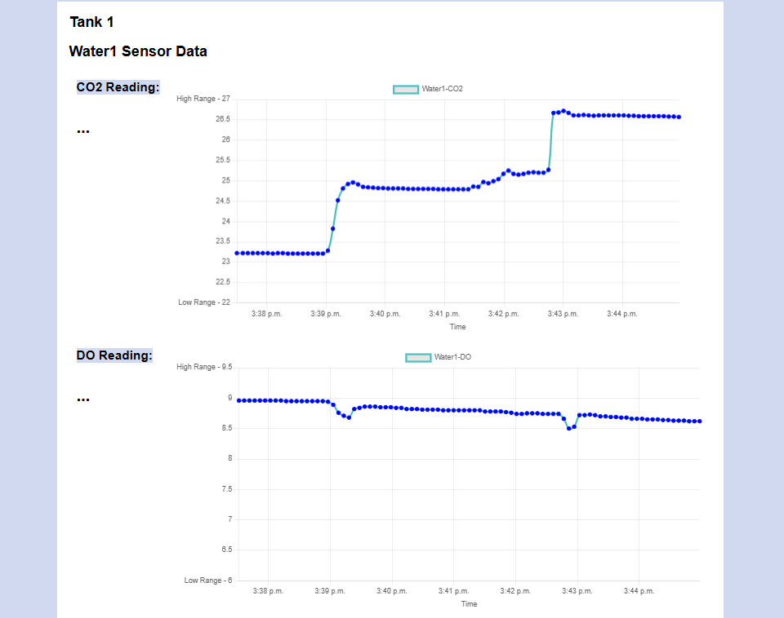
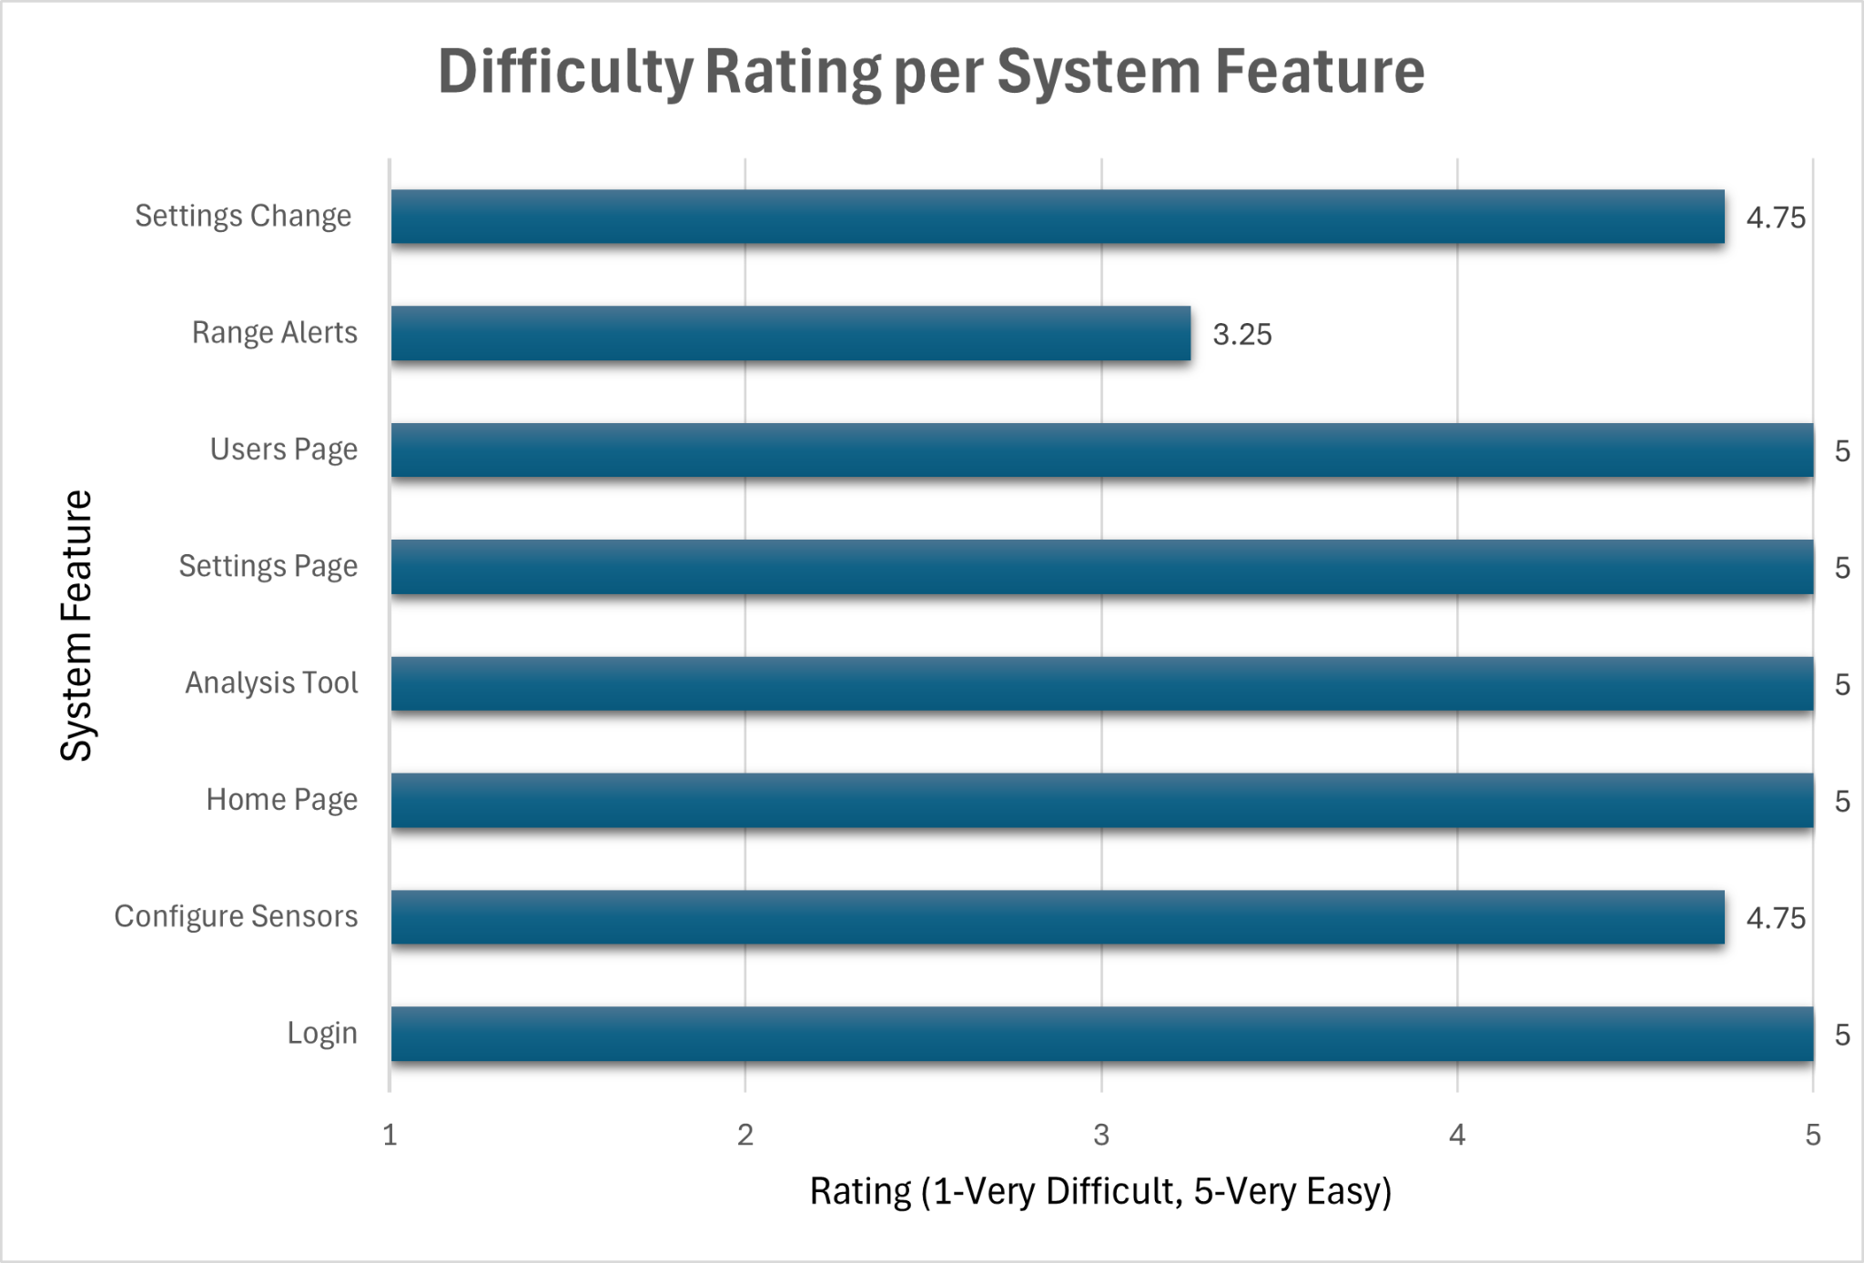
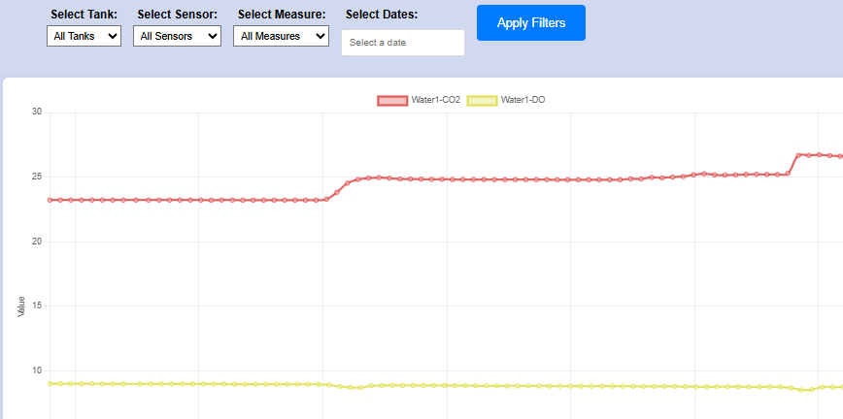
Web Application for Aqualab Sensor Monitoring and Analysis
(WAASMA)
Greg Thompson, Ruth Garcia, Haley Hamilton
Faculty Advisor(s): Dr. Khaled A. Slhoub, Dept. of Electrical Engineering and Computer Sciences, Florida Institute of Technology
Client: Dr. Ralph G. Turingan, Dept. of Ocean Engineering and Marine Sciences, Florida Institute of Technology
Motivation
The Aqualab Team, led by Dr. Turingan, is analysing how much carbon dioxide is absorbed in seawater as it used in food-production by marine algae. Multiple sensors are utilized to measure the data and a web application is needed to efficiently record data and allow the values to be viewed in real time as well as give alerts when measurements are outside of desired ranges.
Project Features
Connects to and reads from each sensor being utilized.
Displays current/recent sensor measurements in real time via a web application.
Allows user to set/change desired measurement ranges.
Alerts given when measurements are out of specified range on screen and with email push notifications.
System records past measurements securely in a database.
System allows 3 different roles with different permissions (Admin, Operator, Observer).
Analysis Tool allows users to view and filter all data by sensor and time as well as download data into a CSV file.
Allows user to change the frequency at which data is read from the sensors.
User Management System which allows Admin user to create new users and keeps track of all users, ensuring they log in to use the application.
System Architecture
Environment Setup Diagram
GUI
Evaluation Results
Home Page
Goals
Design, build, and test a web application that:
Connects to and reads carbon dioxide and dissolved oxygen data using Manta+40 sensors from Eureka Water Probes.
Displays the sensor measurements per tank
Notifies users when sensors are out of a specified range
Records all data securely in a database management system
Implement additional features for more efficiency:
Analysis Tool to display filtered past measurements
User Management System
Intuitive and simple user interface
Future Improvements
Future: Dr. Turingan is planning for another iteration of this project:
Automatic dispensing of CO2 into tanks
Additional sensors of different types
Improvements:
Increased GUI “Out of Range” alerts clarity
Increased “Change Range” button and calculated relationships visibility
Adding units to measurement displays and chart for increased clarity
Analysis Tool

