Slide 1
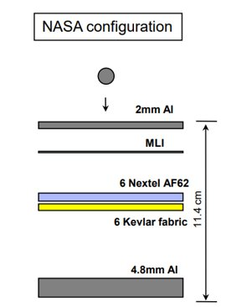
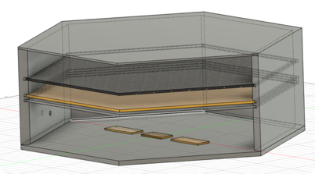
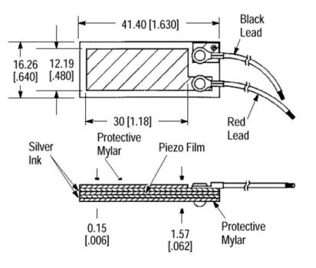
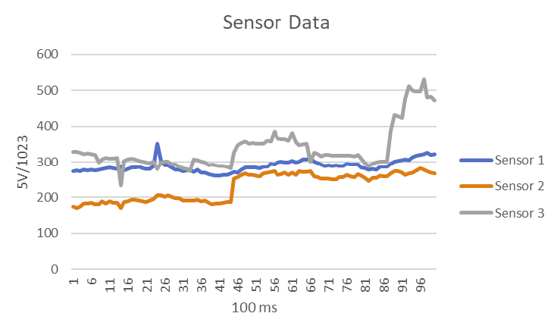
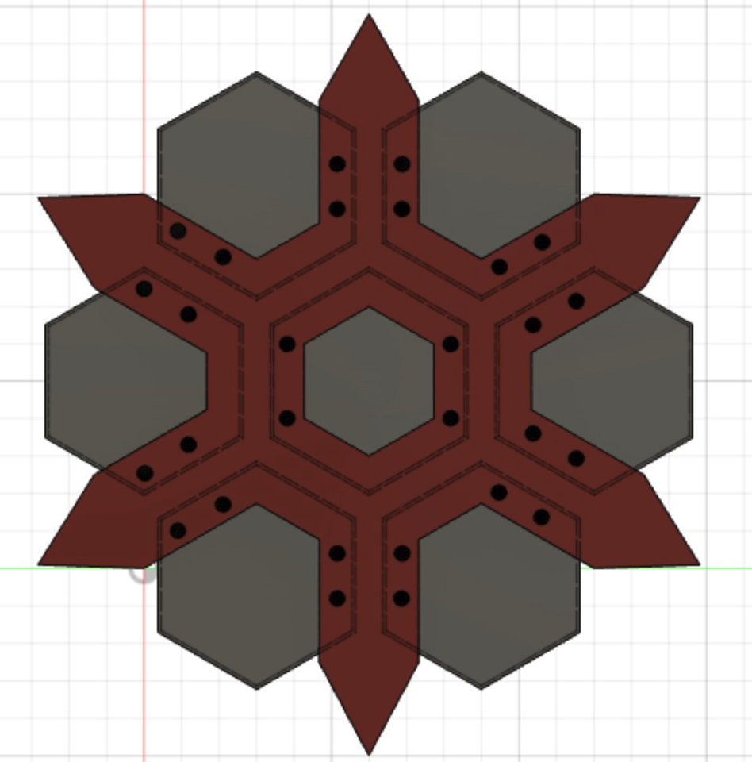
S.H.A.R.D.
Matthew Meesit, John Bruce, Paul Awad, Julian Herrera,
and Matthew Manley
Faculty Advisor: Dr. Doug Willard, Dept of Aerospace/Mechanical, Florida Institute of Technology
Project Objectives
Background
Software
There are 500,000+ pieces of orbital debris the size of a marble or larger. There are also hundreds of millions of pieces of debris that are smaller.
Traveling at orbital speed, these debris are strong enough to threaten life of Astronaut and spacecrafts.
Example: Columbia disaster
OBJ-01. The design shall have a modular layout, and individual tiles shall be replaceable without the need for the deconstruction of the overall design.
OBJ-02. The design shall detect impacts capable of causing plastic deformation of the outermost and innermost protective layers.
OBJ-03. The design shall have an improved sensor resolution in comparison to modern designs. The design shall be able to process, store, and display data from the tiles in a user-friendly manner.
OBJ-04. The design shall be operable within temperatures and pressures encountered in space.
Sensor data directed to software application
User produces a model of the shield tile system and assigns particular sensors to each tile in the application
Once all the configuration is in place, sensor data is directed to software application
User can select tiles for analysis of sensor data
Application will alert user if there is a rupture in the tile system
Structural Layout
The protective layer system that makes up the main structure of the tile will be modelled after the NASA variant of the Whipple Shield [Micrometeoroid and Orbital Debris Environment & Hypervelocity Shields].
Sensors
RDCS
Using vibration sensors
From testing a relation between impact energy vs volt​ was determined
Sensors can read up to 100V​ but limited by Arduino (5V)
Adhesive in-between sensor and contact surface to reduce sensitivity. 2mm thick on outer and 1mm on inner layers
adhesive also reduces voltage to become more handleable and readabilty
Reaction Damage Control System​
RDCS subsystem will repair the tile when hit by debris​
Current design will use foam sealant to fill rupture hole​
Foam sealant will be contained within a 5mm wide layer on top of the Nextel layer
Design Models
Software Data
Clamping
Clamping system will use an aluminum base
Holes will be drilled in the bottom layers and the base
​Screws and nuts will be used to weld the tiles together
Peak jump is when impact occurred.
The unsteadiness from wind/ACO
impact was close to sensor 3.

