Slide 1


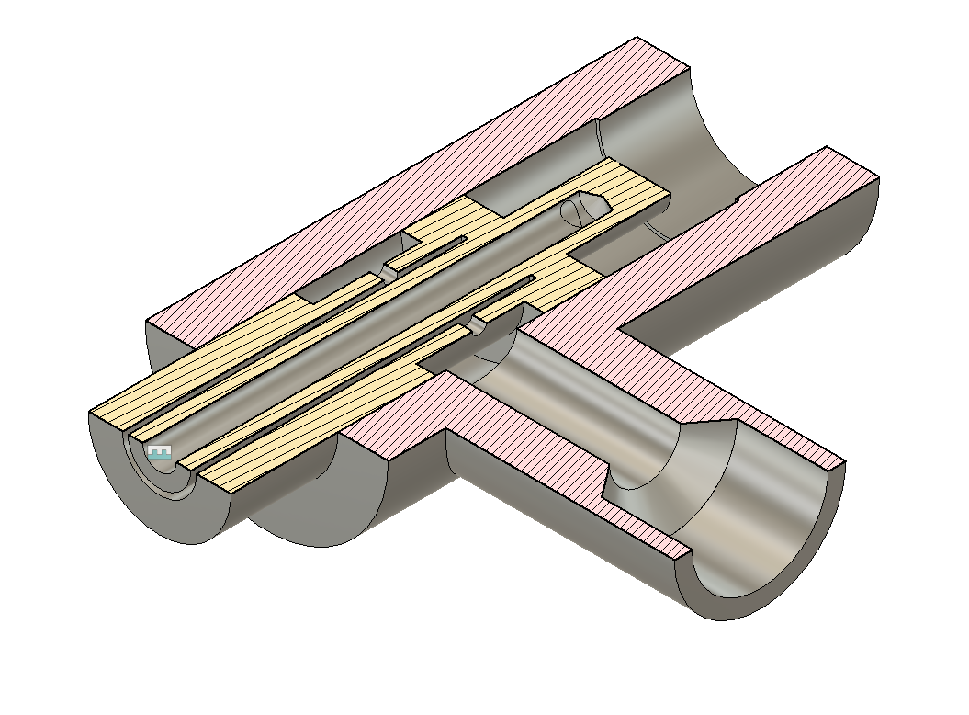
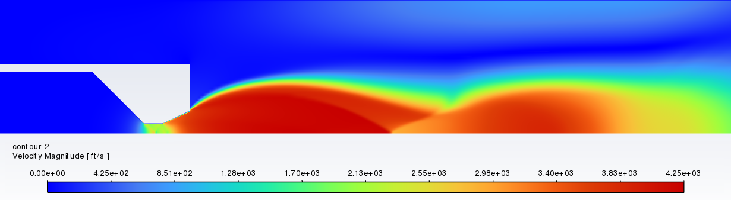
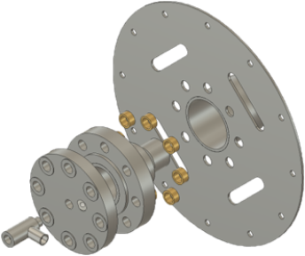
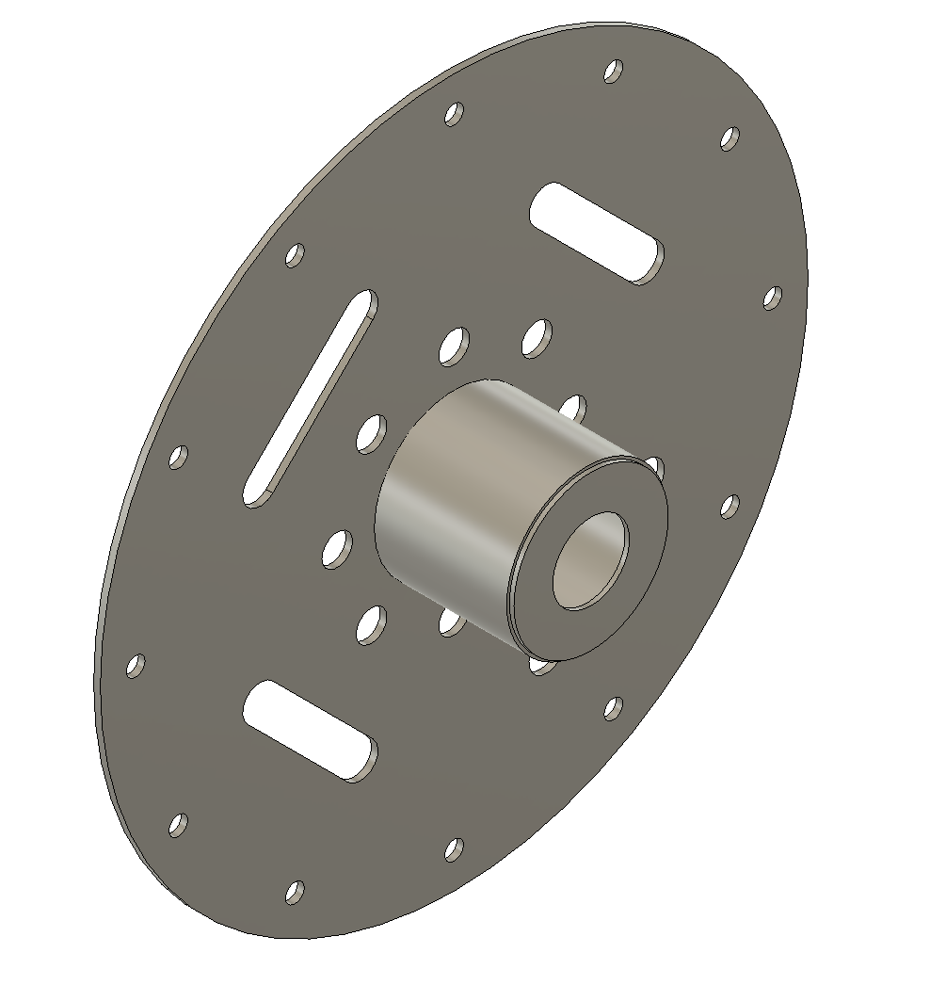
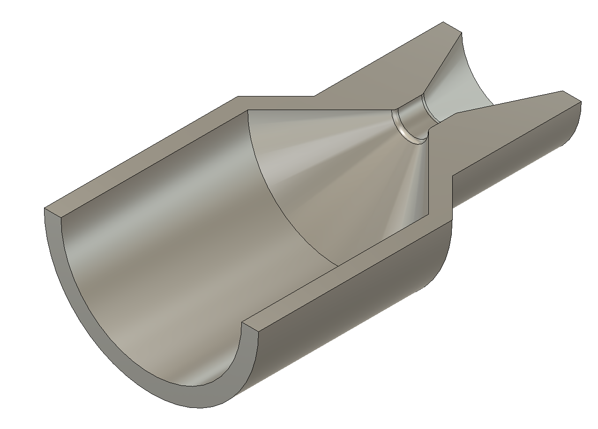


META Rocket Engine
Justin Ball, Nicholas Fenex, Mitchell Gabriel, Anderson Goncalves, Derek Morgia, Blake Pegrum, Matthew Pendleton, Kristjana Reppen, Daniel Westfall
Faculty Advisor(s): Dr. Douglas Willard, Dept. of Aero. Engineering, Florida Institute of Technology
Nozzle
Injector
Engine Specs
Thrust: 360 lbf
Specific Impulse: 140 sec
Chamber Pressure: 1000 psig
Chamber Temperature: 1165°F
Exit Mach: 3.14
Propellant: 95% Ethanol
Oxidizer: 50% Hydrogen Peroxide
Spark plug ignition
Modular injector
Large factors of safety for multiple test fires.
  Conical design for ease of manufacturing.
Performance was validated using ANSYS Fluent, RPA, and hand calculations.
0.6" extension at throat to extend lifespan while causing minimal performance loss.
Swirler injector design
Pressure Drop: 20%
Mass Flow: 2.5lbm/s
Discharge Coefficient: 0.5
Cooling System
Closed-loop water cooler
Integrated with adapter plate with ergonomic handles.
Volumetric Flow: 18 Gal/min
Funded by the Office of Naval Research and VFW post 7464

