Slide 1
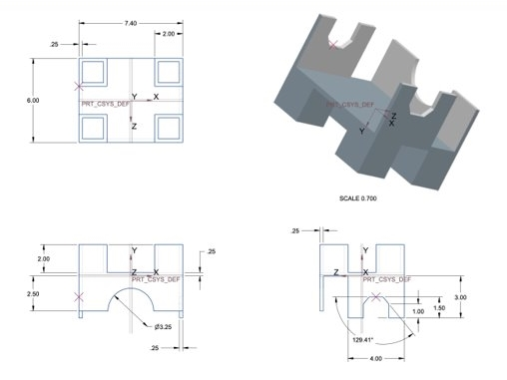
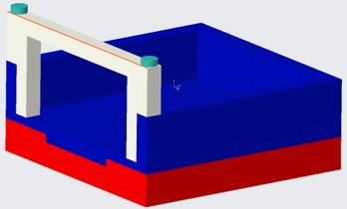
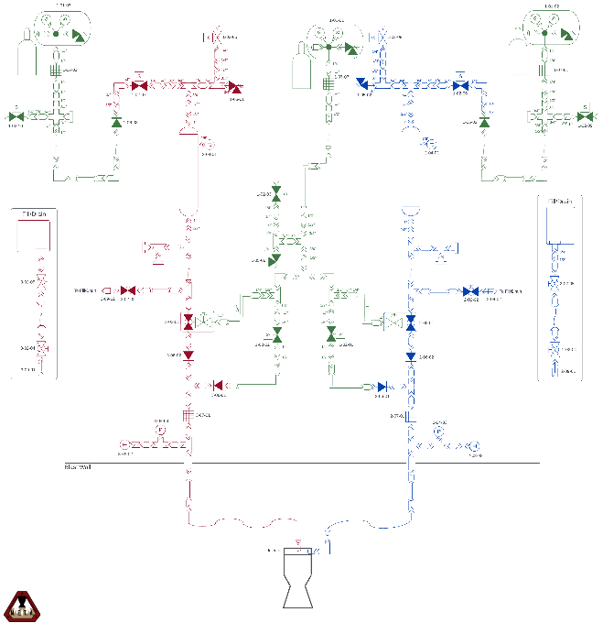
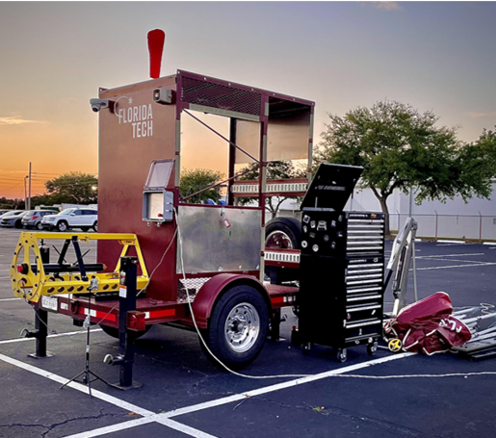
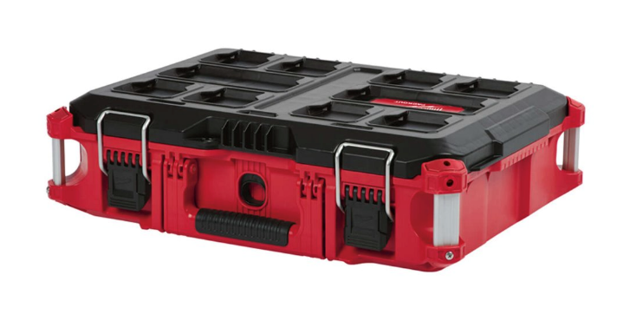
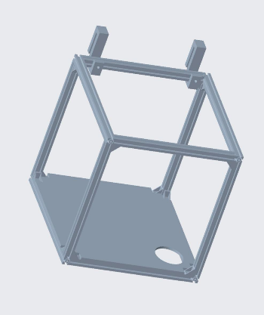
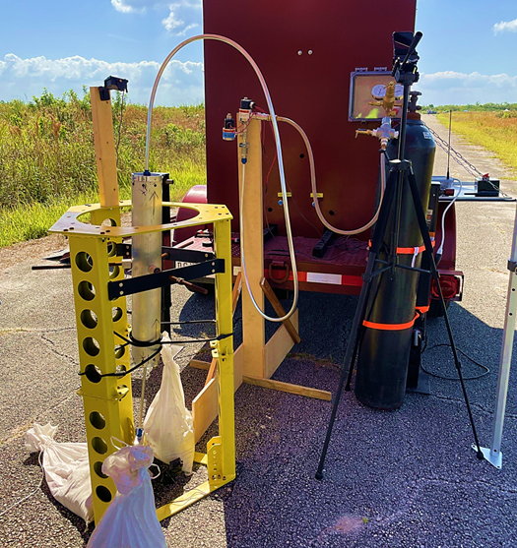
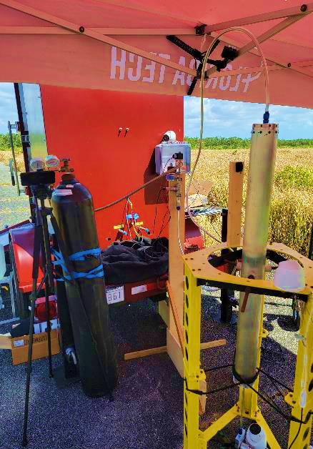
Mobile Engine Testing Application (META) Test Stand
Quang Dinh, Tatiana Forbes, Nickolas Heysler, Kenny Hibbard, Garrett Ho,
James House, Kailyn Lake, Ian Leon, Abbigale Smith, Simona Vileniskyte,
Trenton Wright
Faculty Advisor: Dr. Douglas Willard, Dept. of Aerospace Engineering, Florida Tech
Abstract
Structures
Plumbing
The Mobile Engine Testing Application (META) Test Stand can test fire solid and liquid bipropellant rocket engines. META Test Stand collaborated with META Controls and META Engines senior design teams to meet the objectives. META shall be used for customers, STEM education outreach, and an astronautics lab at Florida Tech.
Pump Mount
Load Cell Case
Pump Mount: supports the cooling pump by holding the pump in place and minimizing vibration.
Load Cell Case: placed under one leg of the fuel and oxidizer tanks to measure the mass flow rate.
Theoretical performance: Initial design parameters may be derived from the following equation, which dictates META's plumbing system's maximum capabilities.
Safety Box for PPE/test equipment
Cooling System: The closed-loop cooling system facilitates testing in remote locations and provides for prolonged or repeated firings.
Flush Tank Container
Objectives
Testing and Interfaces
Findings & Conclusions
OBJ-01 META Test Stand shall integrate a liquid bipropellant rocket and subsequent DAQ systems.
OBJ-02 The team shall deliver an integration, user, and safety procedures manual.
OBJ-03 The team shall design and integrate a pump, reservoir and plumbing network for an engine cooling system.
OBJ-04 The team shall revise the gas piping installation and conduct a maintenance check on the blast wall.
OBJ-05 The team shall mount three 1000 lbf low profile universal or compression pancake load cells and additional sensors to the thrust structure.
OBJ-06 The team shall fire the integrated liquid bipropellant rocket, cooling system, and control to validate test systems.
The team successfully used and adapted the test stand to accommodate customer teams' testing.
Testing: The META Test Stand team was able to successfully work with and accommodate customers while integrating new ideas with other META teams.
A new piping system was developed and utilized for the hydrostatic testing of a liquid bi-propellent tank.
Improvements: Successful modifications were made to allow for the piping system to hold 1000 psi of nitrogen gas.
A system was successfully added and tested that allows for the mass flow rate leaving the tanks to be gathered.
Interface Control Document (ICD): allowed easier design adjustments and more seamless inter-team operations for META and customer teams.
Test Plans: generated before each test to ensure a smooth operation. They included the overall testing goal, assigned roles, testing procedures, and potential hazards.
Funded by the Office of Naval Research

