Slide 1

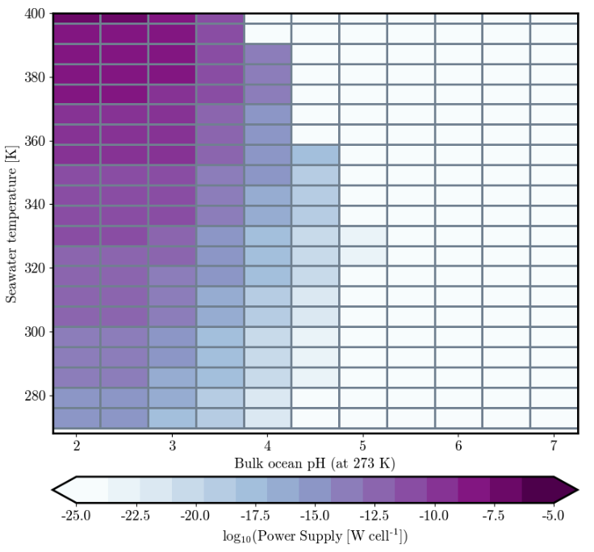
Power Supply in the Ocean of Europa
Cal Whyte
Faculty Advisor: Dr. Manasvi Lingam, Dept. of APSS, Florida Institute of Technology
Faculty Observer: Dr. Hamid K. Rassoul, Dept. of APSS, Florida Institute of Technology
Results and Outlook:
There is still much more work to be done before an accurate model of Europa is created. The results do not match what is expected. This is a result of the chemical composition not accurately resembling that of Europa’s ocean. Given more time this aspect is being implemented into the model. In the near future more simulations will be run which will provide more reliable results.
Background and Relevance:
Europa is seen by NASA as one of the most promising candidates in the search for life beyond Earth. Its global subsurface ocean likely provides the necessary conditions for the establishment and support of life. Using the Python package NutMEG, it is possible to model Europa’s environment to predict its habitability
Power Supply per Cell
Method:
Simulations were created using previous NutMEG code that modeled the environment of Enceladus, a similar icy moon. To adjust this model to fit Europa, initially the pH and temperature were changed. It is estimated that Europa’s ocean has a pH of about 2.6, so a range of 2 to 7 was used. A temperature range of 260 K to 400 K was used to match the habitable range. The majority of the ocean is likely close to the low end, but higher temperatures could be found at hydrothermal vents. These ranges were used to calculate the power supply available to typical methanogens in order to find what conditions would be ideal for life.
Above figure shows the pH and temperature values which allow for the most energy availability, with darker shading meaning more energy. For reference, the typical power supply required for methanogens on Earth is a minimum of ~10⁻²⁰ W cell⁻¹.

