Slide 1

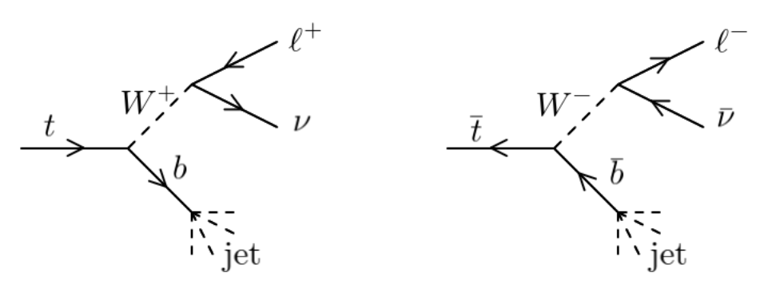
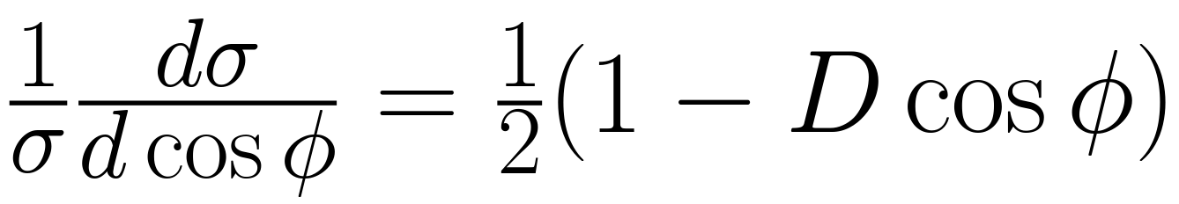
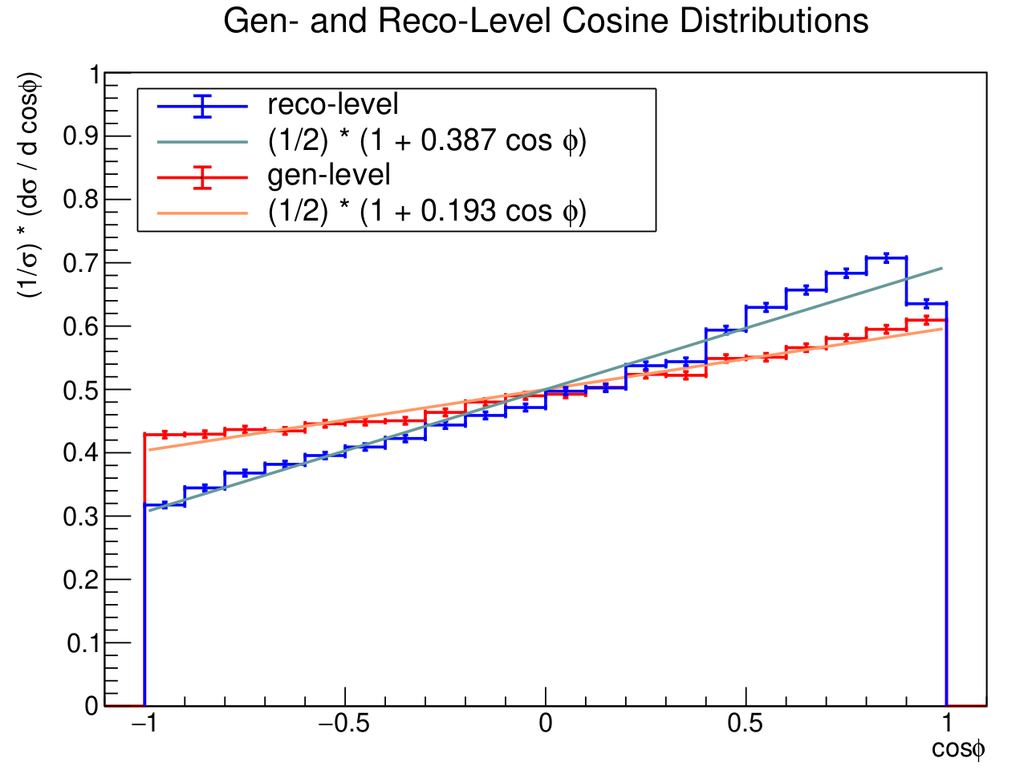
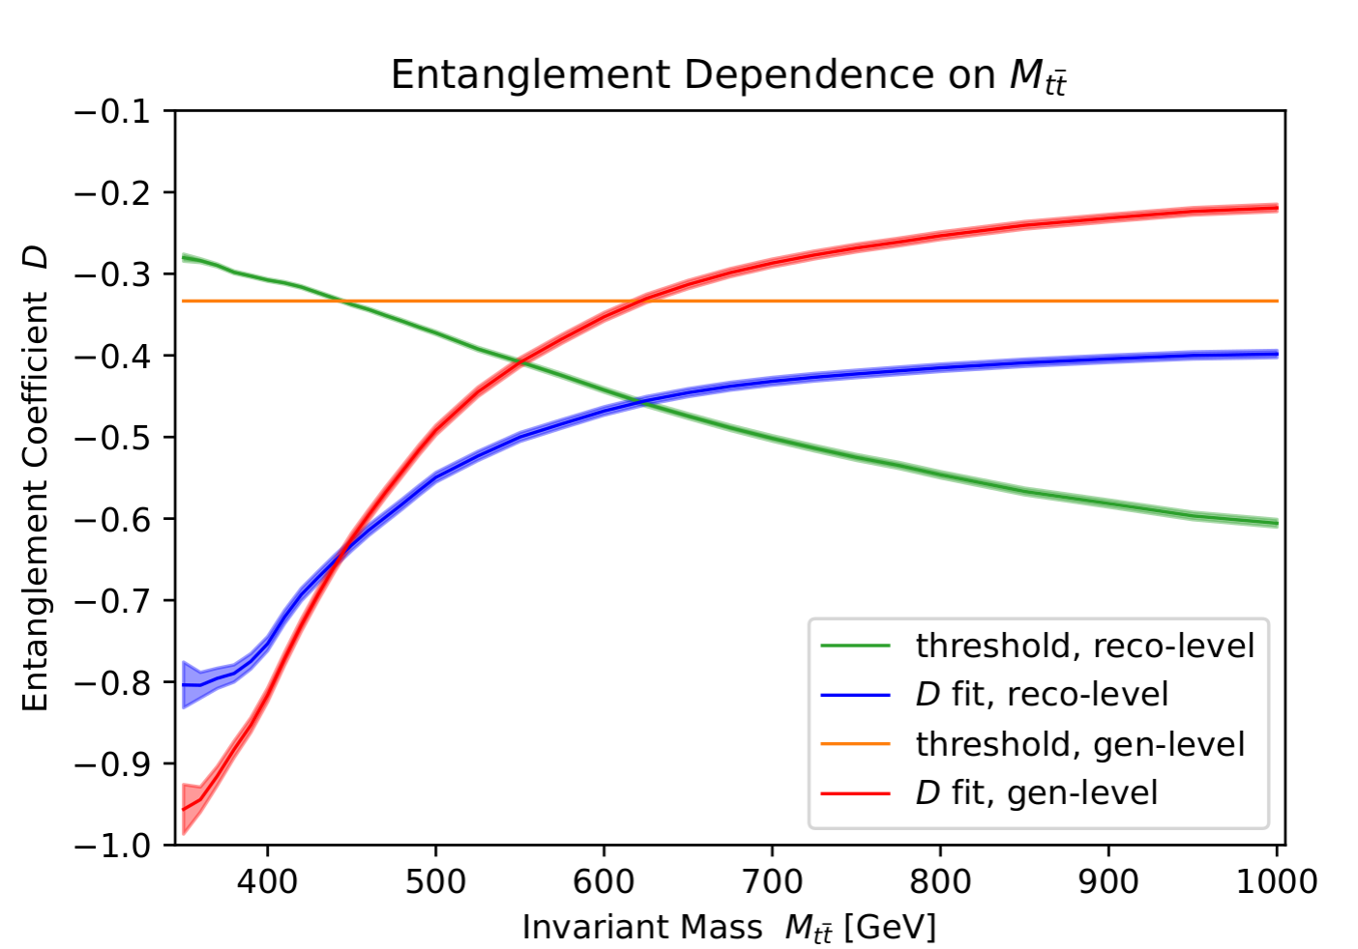
Quantum Entanglement of Top Quarks at CMS
Nico Braukman
Faculty Advisor: Dr. Marc M. Baarmand, Dept. of APSS, Florida Institute of Technology
Faculty Observer: Dr. Hamid K. Rassoul, Dept. of APSS, Florida Institute of Technology
INTRODUCTION
Top quarks are the most massive elementary particle in the Standard Model. They are produced in large quantities at the Large Hadron Collider (LHC) as a pair of quark and antiquark. The goal of this project is to determine the degree of quantum entanglement between the spins of the top quark and antiquark by measuring the angular distribution of the tops' decay products in the Compact Muon Solenoid (CMS) experiment at the LHC. This project complements previous low-energy entanglement experiments by making similar measurements on a high-energy system.
TOP QUARK PRODUCTION, DECAY, AND ENTANGLEMENT
Top quarks are produced in high-energy proton-proton collisions.
They decay on a time scale of ~10⁻²⁵ seconds by the below processes:
The time needed for the tops' spins to decorrelate is ~10⁻²³ seconds, which is longer than the decay time. So, the spin correlation and entanglement information is passed on to the daughter leptons in the form of their angular distribution [1].
The lepton angular distribution is given by the below differential cross section:
If D < –1/3 (for the theoretical/generator-level distribution), then there is entanglement [1]. For the reconstruction-level distribution, detector effects will change the entanglement threshold for D.
Detector effects will be accounted for in the future by an "unfolding" procedure [2] which compares the generator-level and reconstruction-level distributions.
DATA AND METHODS
Monte-Carlo simulated data of events with two electrons in the final state (ee events)
Top quark reconstruction was computed by collaborators at Purdue
A linear fit to the daughter electron angular (cosine) distribution is performed using the MIGRAD chi-squared minimization algorithm from ROOT's TMinuit class
RESULTS
Generator-level best fit (no invariant mass cuts): D = –0.193 ± 0.005
Reconstruction-level best fit (no invariant mass cuts): D = –0.387 ± 0.004
Unfolded distribution preliminary fit: D = –0.21 ± 0.01, agrees with results in [2]
The entanglement criterion is met for events with invariant mass ≲ 600 GeV. How does this distribution change when including eµ and µµ events? After accounting for detector effects through unfolding?
CONCLUSIONS AND FUTURE PLANS
The entanglement threshold is only met for events with sufficiently low invariant mass. In the future, these analysis methods will be applied to simulated eµ and µµ events in order to investigate a more inclusive simulated data sample. Finally, these methods will be applied to the full "Run 2" (years 2016, 2017, 2018) real dataset from CMS.
A more detailed unfolding procedure is required to determine how entanglement changes with cuts on invariant mass. Future analysis will incorporate unfolding as well as estimate systematic errors.
REFERENCES
[1] Y. Afik and J.R.M. de Nova. Entanglement and quantum tomography with top quarks at the LHC. Eur. Phys. J. Plus 136(9), 2021.
[2] A.M. Sirunyan et al. (CMS Collaboration). Measurement of the top quark polarization and tt̄ spin correlations using dilepton final states in proton-
proton collisions at √s=13 TeV. Phys. Rev. D 100, 2019.

