Slide 1
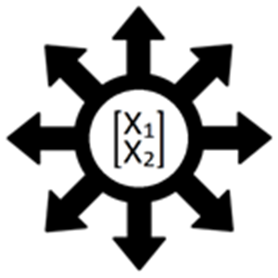


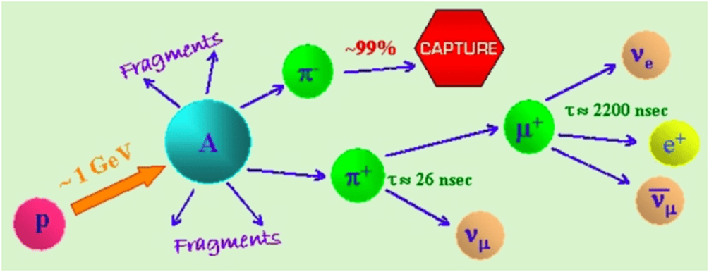
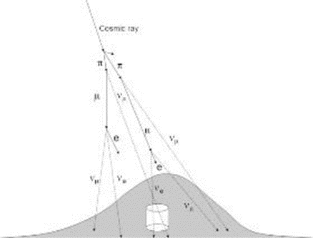
A Comprehensive Review of Neutrino Properties
Benjamin Frazier
Faculty Advisor and Observer: Dr. Hamid K. Rassoul, Dept. of APSS, Florida Institute of Technology
Background
Neutrinos are subatomic particles that have no electric charge and have very little mass; comparable to but less massive than an electron. The neutrino only interacts using the weak force and gravity which makes them hard to detect in most settings. A neutrino can be detected in one of three different mass states, the electron, tau, and muon neutrino. A neutrino can oscillate between these states and these oscillations are what point to the neutrino having a non-zero mass. They travel below the speed of light and can even experience time.
Figure 1: Meson decay into neutrino mass states in the atmosphere
Naturally, neutrinos are detected from collisions of cosmic rays and atmospheric particles. These collisions with the nucleus of a molecule create a meson which decays into a neutrino. Experimentally, beams of neutrinos are shot through detectors which can identify, through proton interaction, which type of neutrino is being observed.
Experiments
The introduction to the neutrino’s ghost-like nature began with the Project Poltergeist experiments in 1956. Frederick Reines and Clyde Cowan observed the first evidence of neutrinos, at Los Alamos National Laboratory in New Mexico, using a 10 ton detector and a fission reactor.
The detection of solar and atmospheric neutrinos came about in two critical experiments. In 1968, Ray Davis and his team at the Homestake gold mine detected these sun produced neutrinos. Later, in 1985, the Kamiokande experiment detected solar neutrinos in the atmosphere from cosmic rays. Both of these experiments showed a discrepancy between expected amounts of detectable neutrinos and what was actually observed. The discrepancy showed around one third of the postulated neutrinos were detected in these experiments. The follow up experiment to the Kamiokande experiment, the Super-Kamiokande experiment, showed that these atmospheric muon neutrinos would switch flavor as it entered the detector. This led to the evidence of neutrino oscillation.
Ongoing Study
The search for neutrinos and their properties continues today and into the future with more experiments and hypothesis. One such experiment is the Deep Underground Neutrino Experiment (DUNE). This experiment consists of two detectors 1300 km apart and a proton accelerator which produces neutrinos at both the front source detector and the secondary detector. The beam goes from the Fermi National Accelerator Laboratory in Illinois to the Stanford Underground Research Laboratory in South Dakota. The aim of this experiment is to answer questions like how neutrinos fit into the standard model based on their interactions with the fundamental forces. Another application that is being postulated with this experiment is the birth of black holes by detecting neutrinos found in newly formed neutron stars and supernovae remnants.
Other important experiments ongoing are the Collaboration with the LSND and MicroBooNE detectors.
References
Kajita T. (2010). Atmospheric neutrinos and discovery of neutrino oscillations. Proceedings of the Japan Academy. Series B, Physical and biological sciences, 86(4), 303–321.
Figure 2: Atmospheric Neutrino Production at 15 km

