Slide 1





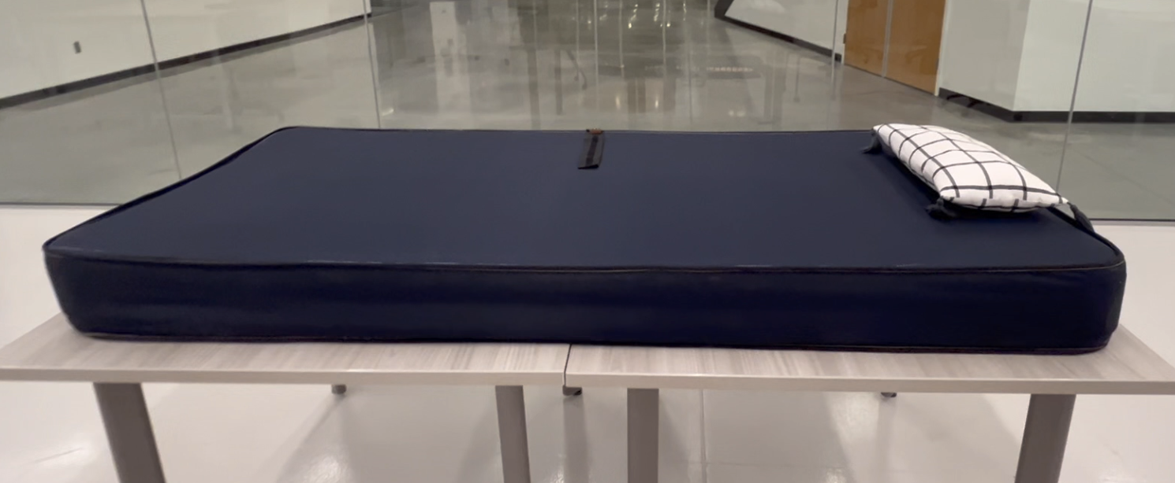
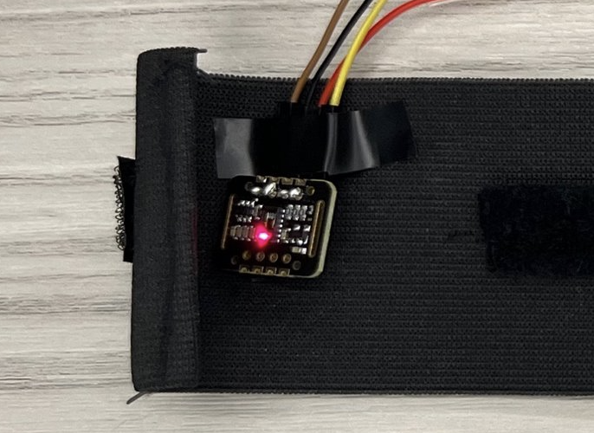
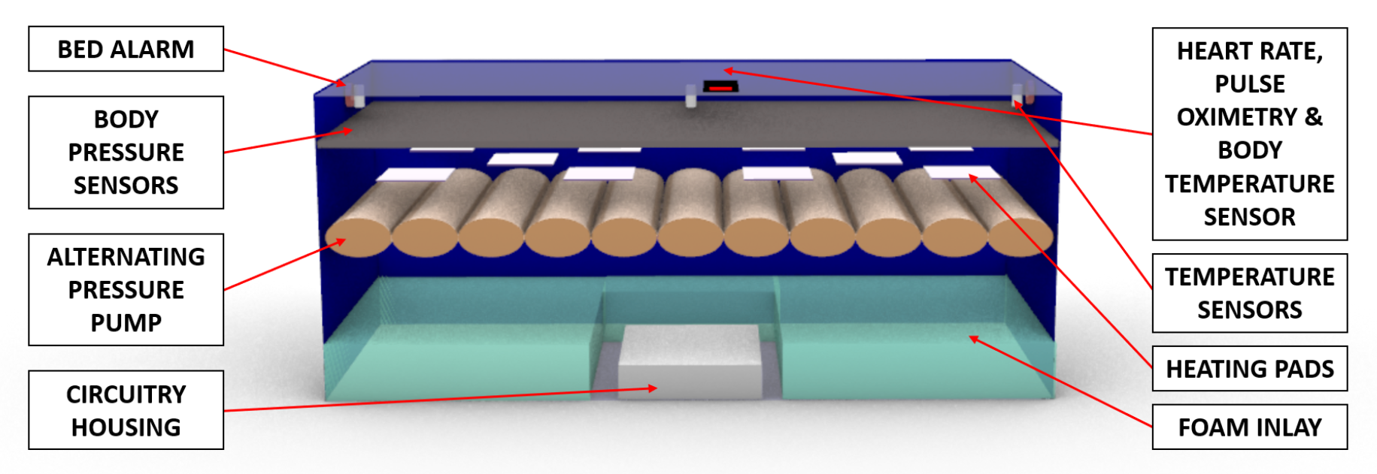
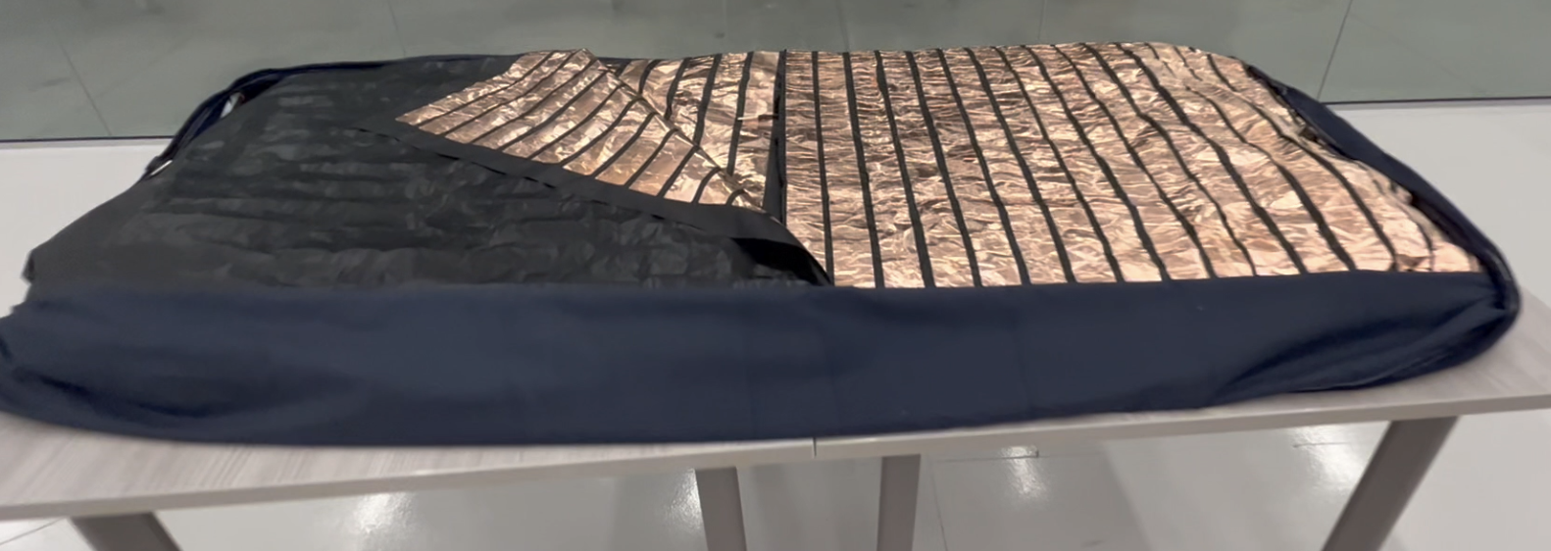
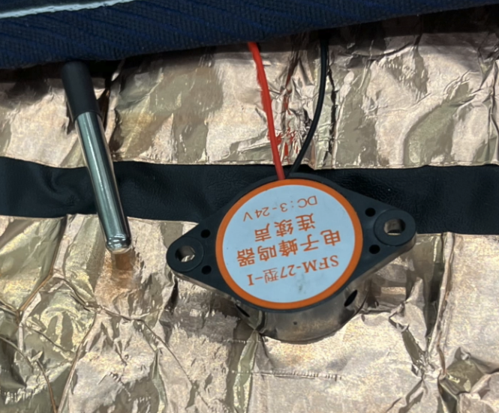
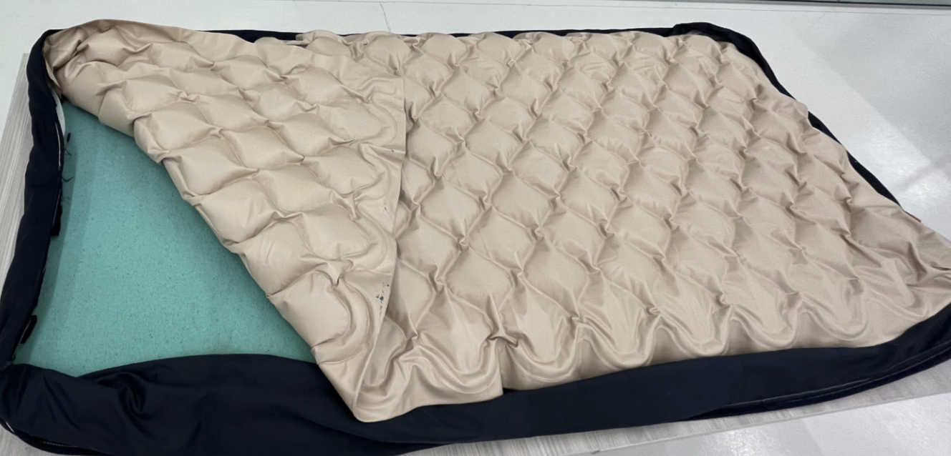
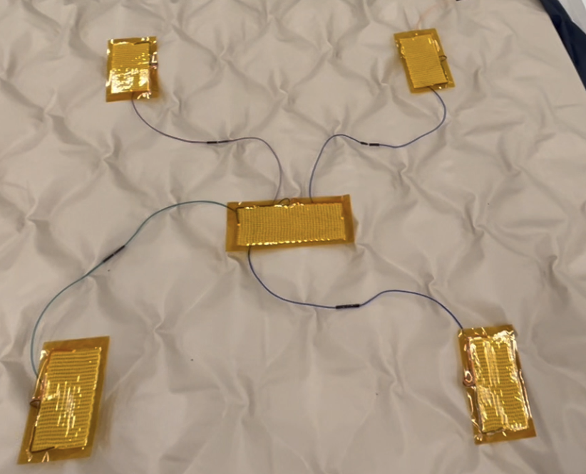
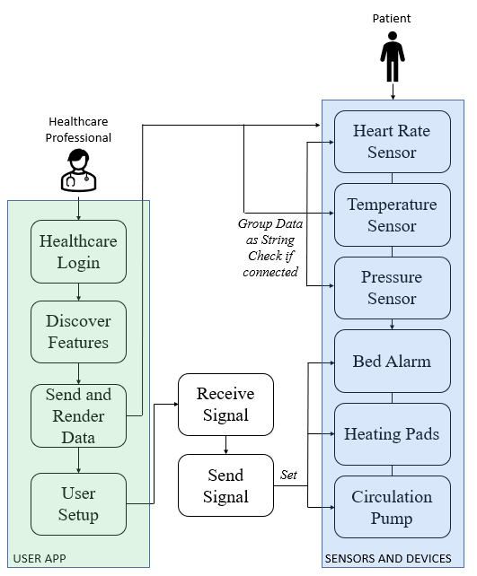
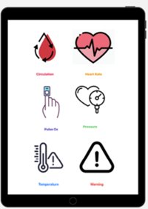

Smart Hospital Mattress for Improved Patient Care and Comfort
Katelyn Canedo, Alexis Haley, Aveisha Maharaj, Kayla Mastin, and Marko Vukasinovic
Faculty Advisor: Dr. Venkat K. Chivukula, Dept. Of Biomedical and Chemical Engineering and Sciences, Florida Institute of Technology
INTRODUCTION
DESIGN METHODS
RESULTS
The backbone of healthcare are nurses and their crucial role to patient care^{[1]}. Most mortality rates have been linked to the variation of nurse staff levels, especially in post operative care. A study in England found the probability of a surgical patient dying rises by 7% for every extra patient over four in a registered nurse's caseload^{[2]}.
HARDWARE
All sensors and devices were individually tested and compared to known sensing devices. Then, all components were placed within the mattress for final testing. The final test combined all previous validation forms to ensure sensors were working properly.
Sensor components were combined and connected to an Arduino Due. A 3D printed component houses the main circuitry at the base of the mattress. All sensors are located within the top layers of the mattress except for an elastic heart rate monitor with the option to be worn on the wrist and strapped onto the mattress.
A
D
1
2
B
E
Figure 1: Nursing staff shortages across the Unites States as of March 2022^{[3]}.
Figure 2: Schematic of expanded sensor layout within mattress.
Our proposal to solve this problem is the implementation of smart mattresses in the hospital. Here, we have designed a mattress with numerous sensors and devices incorporated for intensive care. This will assist nurses and CNAs and reduce the workload they face.
SOFTWARE
All components were tested initially with direct connections through Arduino code. One final code for all circuits operating at once was created and tested. Then, a Bluetooth module was added to allow for wireless communication between the mattress and IOS app.
C
F
Figure 4: (A) exterior of mattress with heart rate sensor, (B) interior of body pressure mapping sensors, (C) circulation pump and foam inlay, (D) heart rate sensor, (E) bed temperature and bed alarm devices, (F) one side of heating pads.
OBJECTIVES
CONCLUSION
To create a connected mattress capable of measuring and reporting patient vitals via a Bluetooth IOS application
To build a cost-effective smart mattress capable of measuring/modulating heart rate, pulse oximetry, body temperature, bed temperature, body pressure distributions, circulation pumps, heating pads, and bed alarms.
Here, we have demonstrated a connected mattress with the ability to monitor crucial patient vitals and improve the comfort of patients in intensive care.
Future improvements involve better regulated compression pumps, wireless heart rate monitor, and completed bed frame.
ACKNOWLEDGEMENTS AND REFERENCES
ECONOMICS
Thank you to Dr. Keshav Chivukula, our advisor, Ed Dallal, our Capstone Coach, and Felix Gabriel for their help and support in the creation of this product.
Materials Cost / Unit | $568.71
Projected Price Point | $15,000.00
Total Business Cost | $504,500.00
Break-Even Sales Point (in units) | 35
[1] Bergman, L., et al. Nurs Crit Care. (2021).
[2] Dall’Ora, C. et al. International Journal of Nursing Studies. (2022).
[3] Ochieng, P., et al. Kaiser. (2022).
Figure 3: Schematic of Software and Hardware Communication with App Layout.

