Slide 1


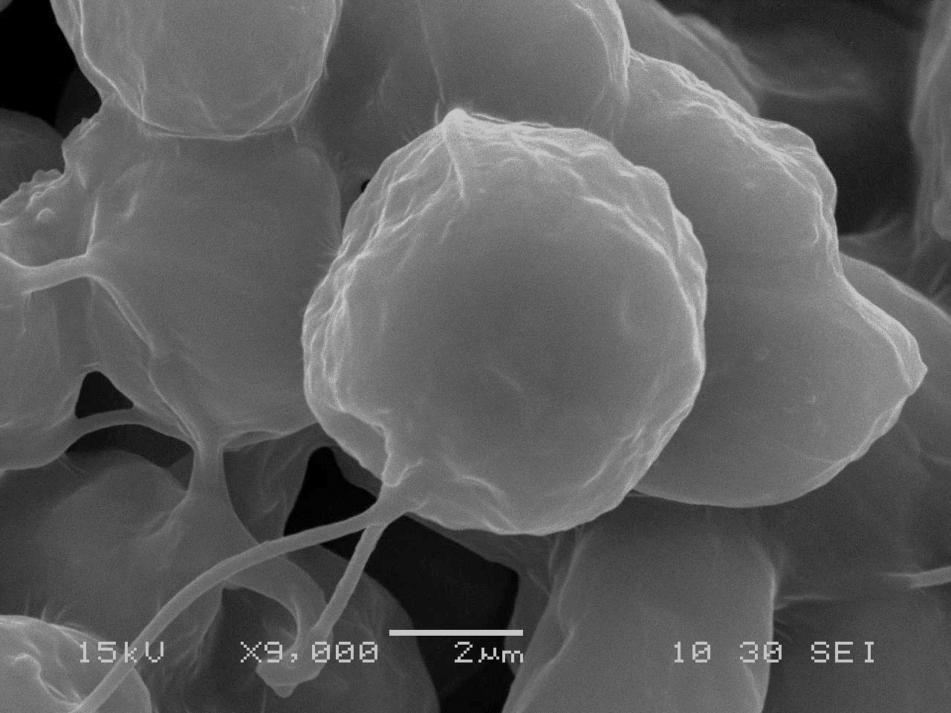
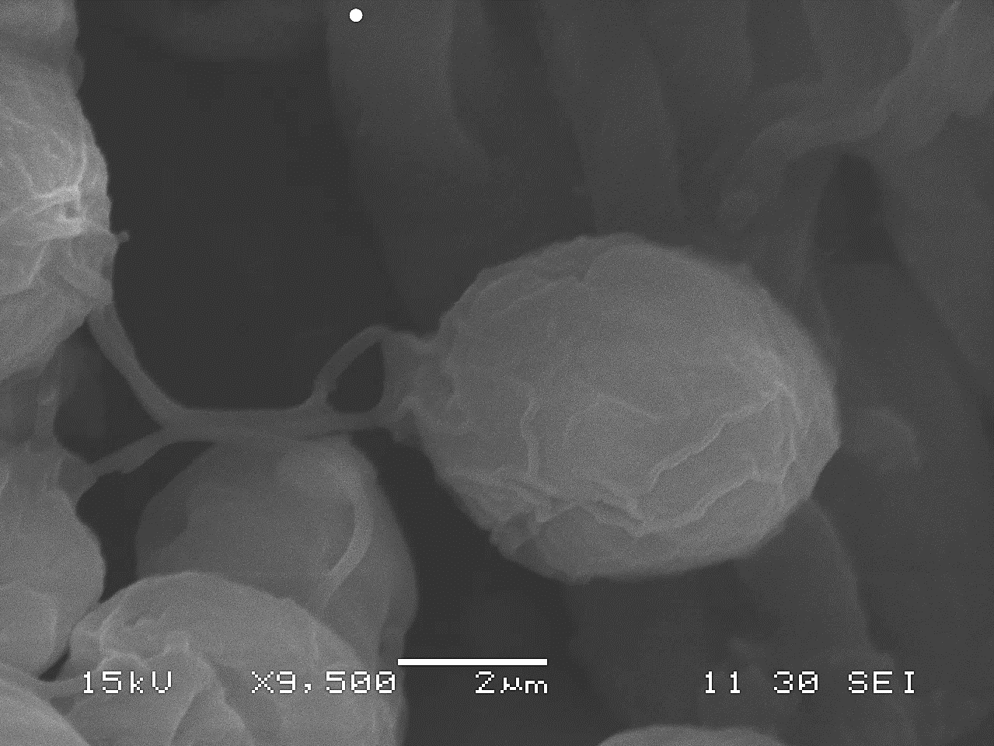
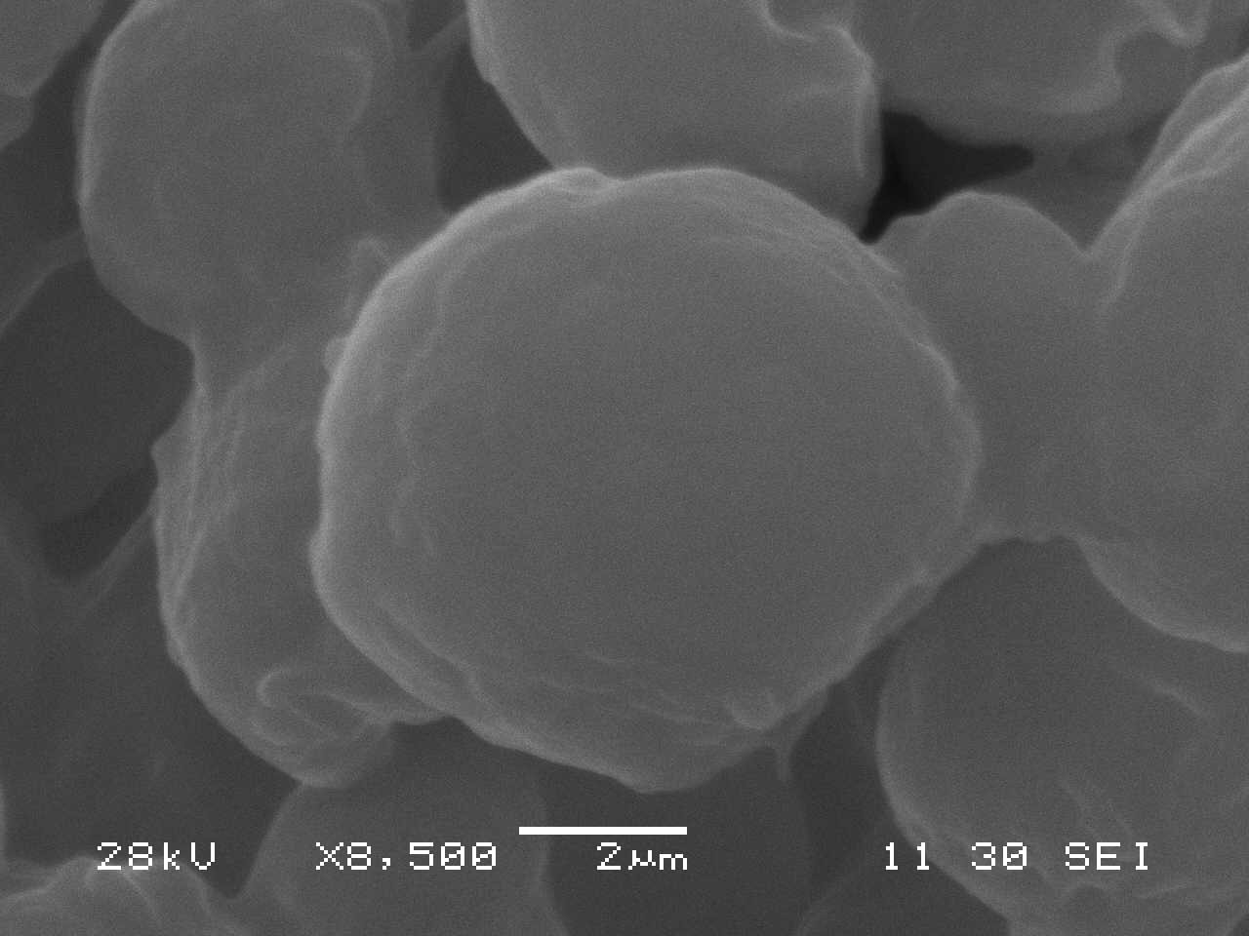
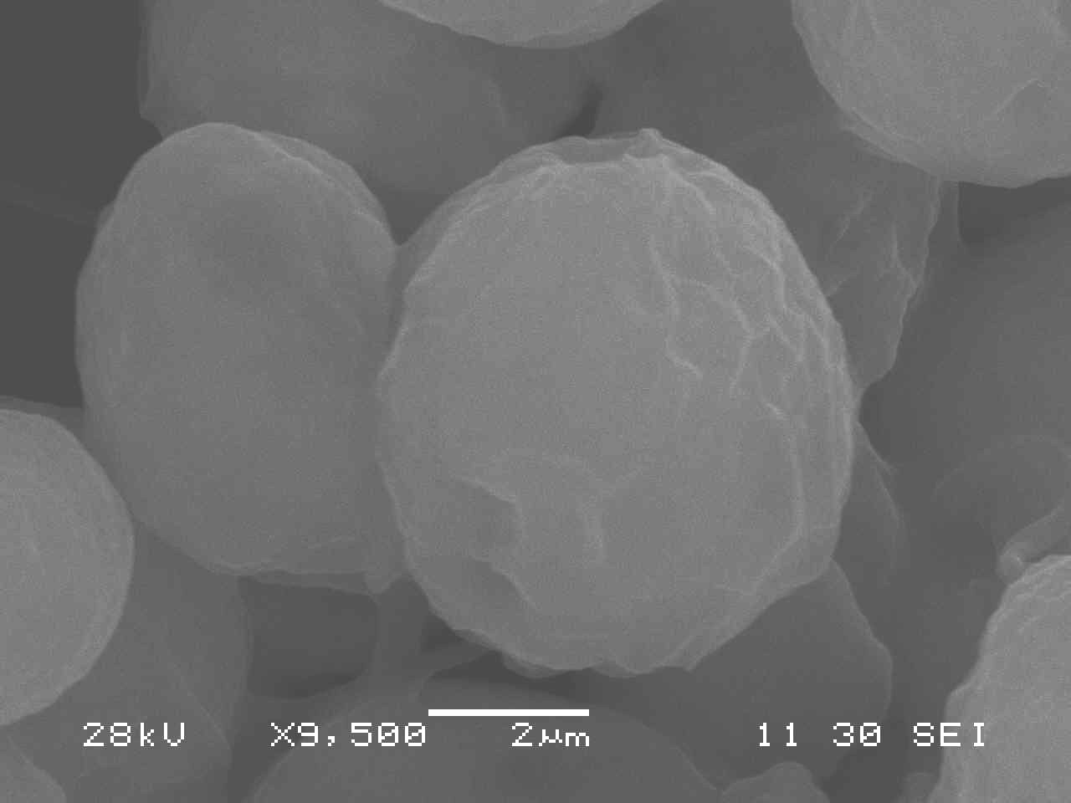
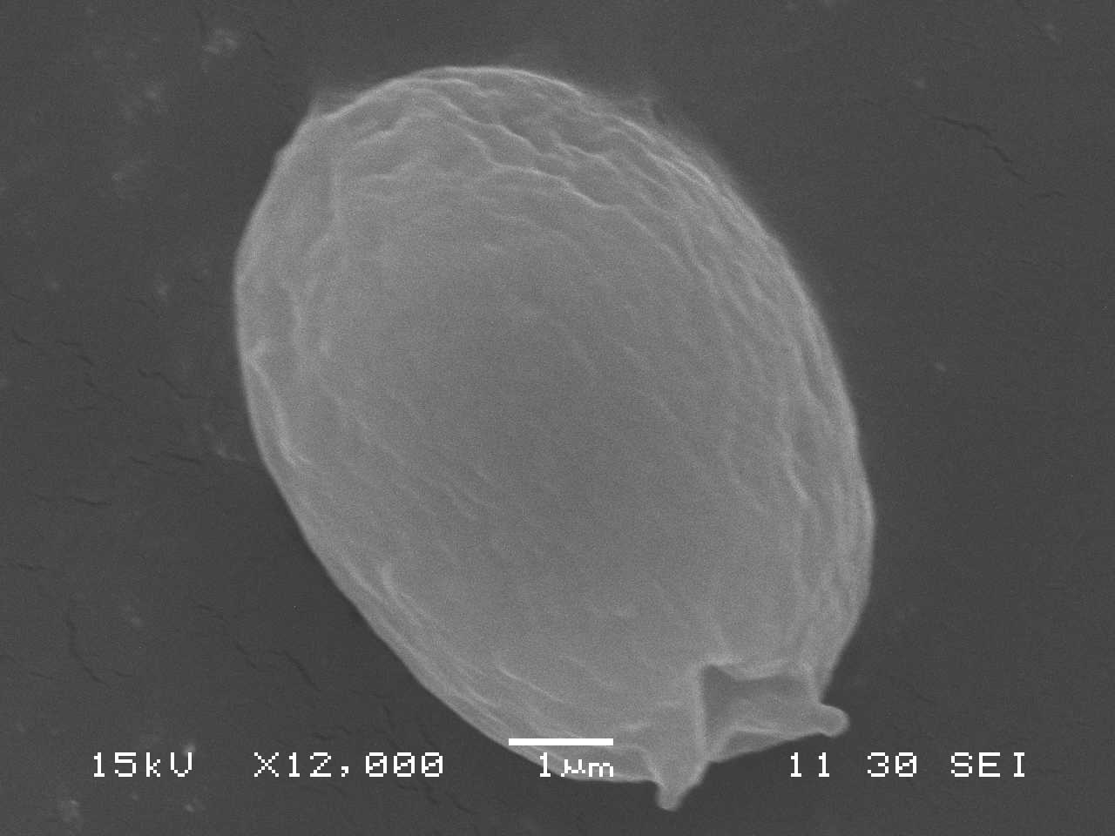
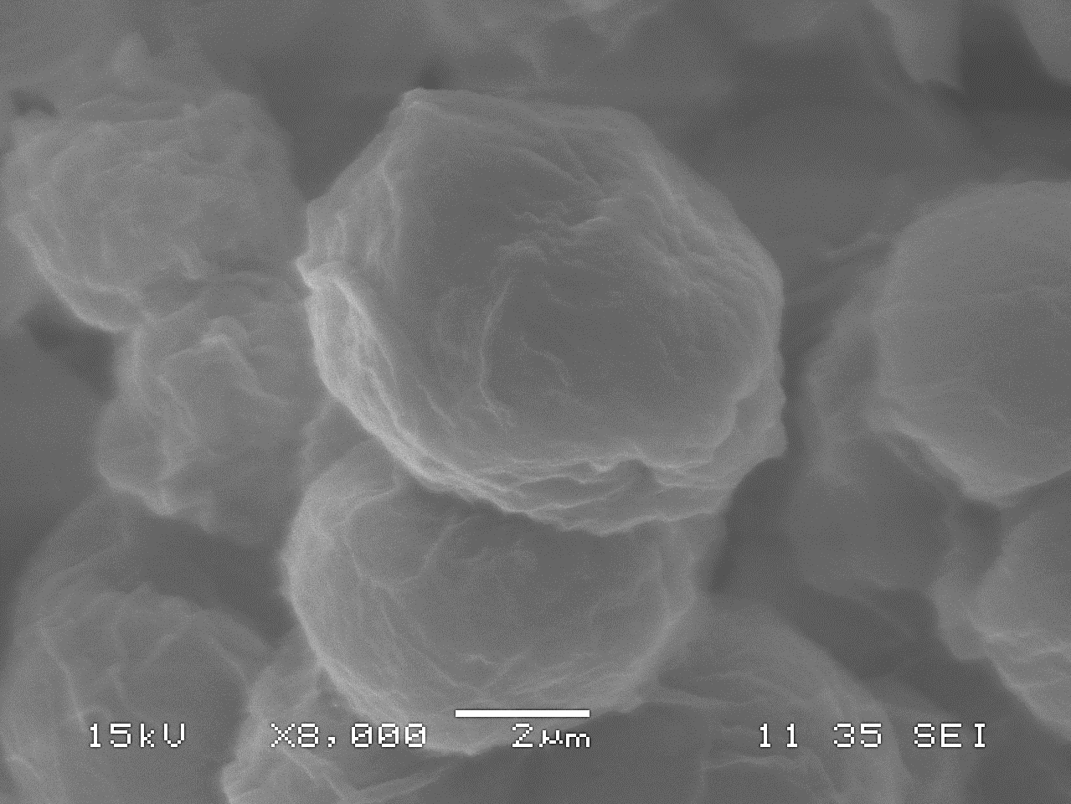
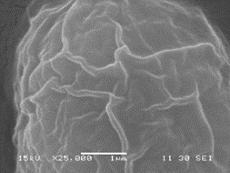
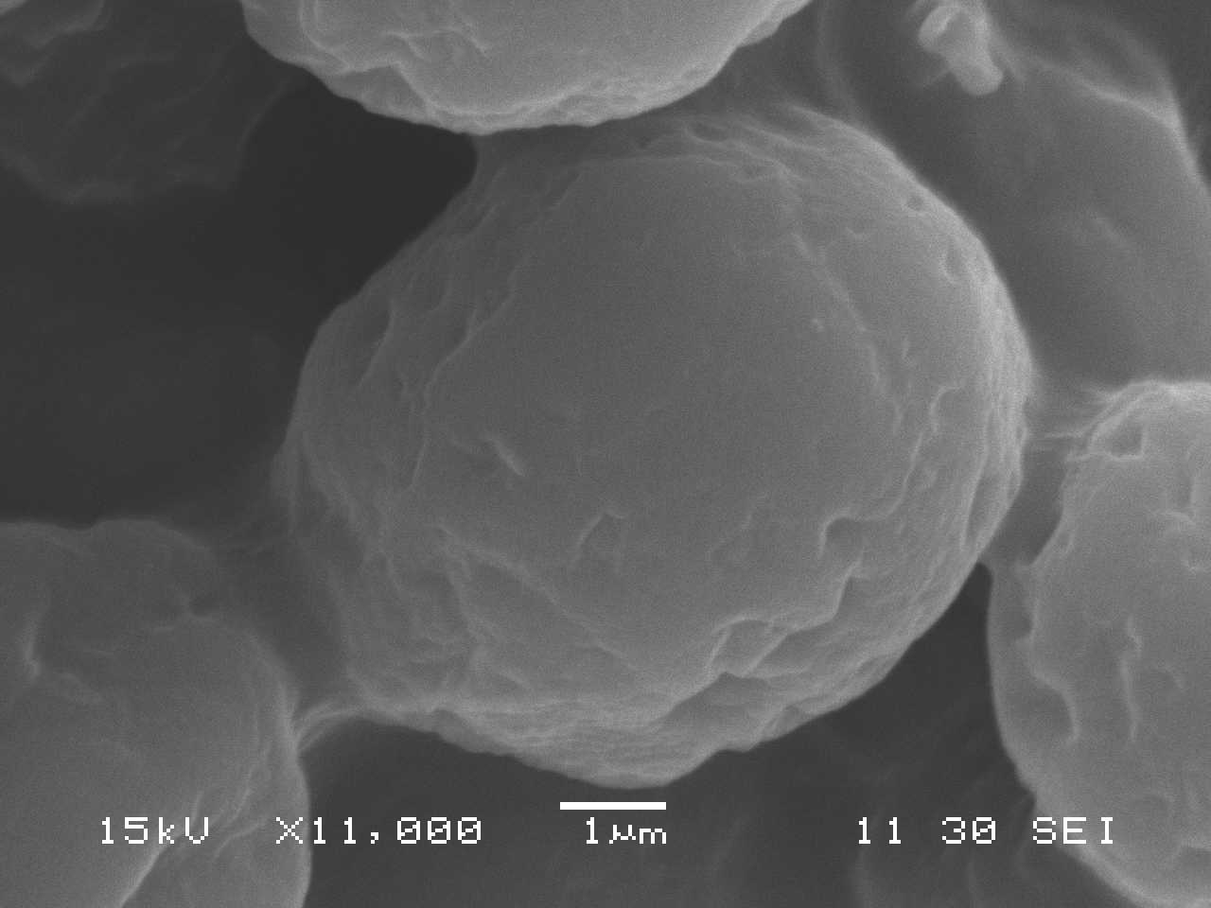
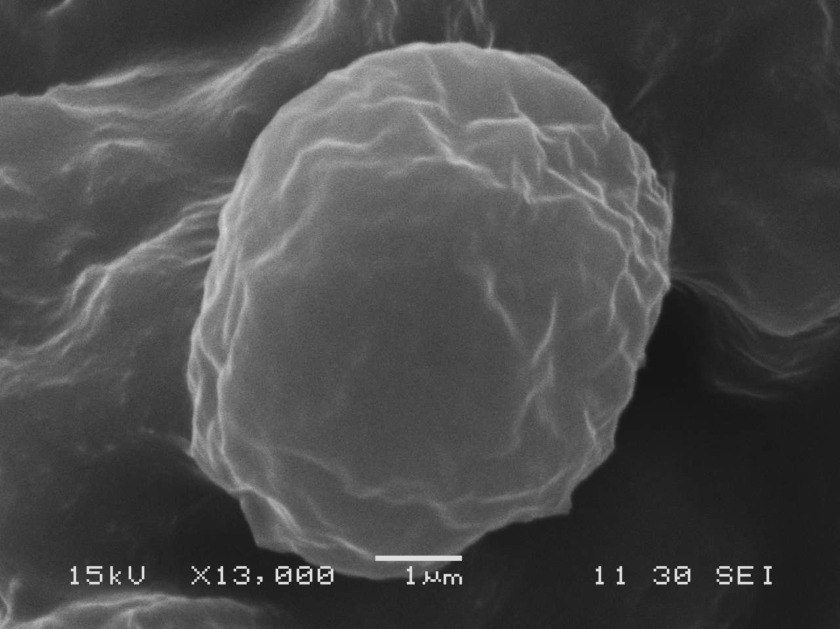
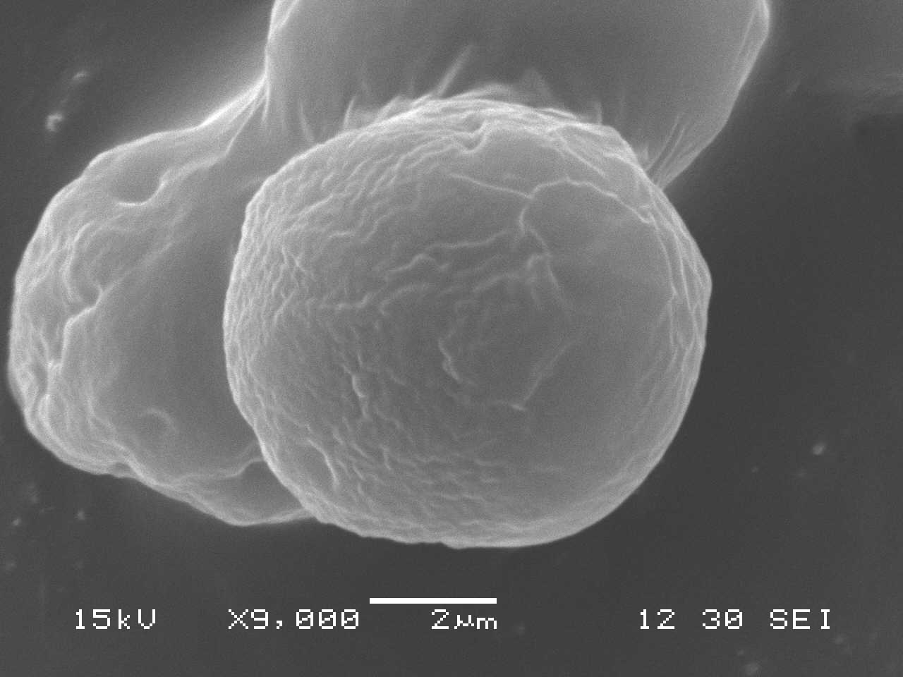
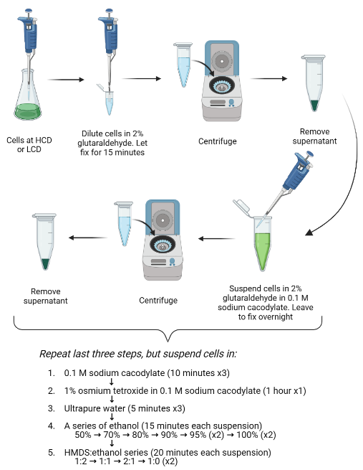
High-Resolution Microscopy Analysis of Quorum Sensing in Chlamydomonas reinhardtii
Kara Smoak
Faculty Advisor: Dr. Andrew G. Palmer, Department of Ocean Engineering and Marine Sciences, Florida Institute of Technology
Background
Results
Quorum Sensing (QS) enables unicellular organisms to exhibit phenotypic changes that positively correlate with cell density
We found that Chlamydomonas reinhardtii (cc-124), a model unicellular eukaryote, produces a quorum sensing molecule (QSM), dubbed the Chlamydomonas Swimming Speed Factor (CSSF), that triggers the phenotypic switch to a faster swimming speed
  Though it is unknown if there are any phenotypic variations between surface structures of cells at LCD or HCD, samples can be imaged using a Scanning Electron Microscope (SEM)
Analyzing images of LCD and HCD samples can highlight any potential phenotypic comparisons that appear on the surfaces
Viewing and comparing cells on an ultrastructural level will provide information regarding cell structure that will refine the understanding of how Chlamydomonas reinhardtii responds to QS
Figure 2: cc-124 (a) LCD (b) HCD
Figure 3: cc-1419 (a) LCD (b) HCD
(a)
(b)
(a)
(b)
Figure 4: cc-4414 (a) LCD (b, c) HCD
Figure 5: HCD extract experiment: LCD cc-124 culture with the addition of (a) HCD cc-124 extract (b) 1% DMSO (c) nothing
(a)
(b)
(c)
(a)
(b)
(c)
Table 1: average surface area and standard deviation of each strain at LCD and HCD, and the LCD culture with HCD extract. Surface area was measured with ImageJ
Experimental Design
Table 2: frequency at which surface 'wrinkles', in N cells, is observed for each strain and cell density
Figure 1: Flowchart depicting the fixation procedure used to prepare a sample of Chlamydomonas cells for the SEM
 |  | # cells (N) | # wrinkled cells | Frequency
cc-124 | HCD | 241 | 128 | 53%
 | LCD | 84 | 20 | 24%
cc-4414 | HCD | 93 | 42 | 45%
 | LCD | 36 | 7 | 19%
cc-1419 | HCD | 48 | 10 | 21%
 | LCD | 45 | 6 | 13%
LCD cc-124 + HCD extract |  | 40 | 11 | 28%
 |  | Avg. Area (um²) | Std. Deviation
cc-124 | HCD | 30.30 | 8.49
LCD124 | LCD | 30.74 | 7.28
cc-4414 | HCD | 27.21 | 4.52
LCD 1419 | LCD | 30.13 | 4.15
cc-1419 | HCD | 28.74 | 5.54
LCD 4414 | LCD | 31.96 | 6.35
LCD cc-124 + HCD extract |  | 32.12 | 6.29
Conclusions
Surface ‘wrinkles’ of the cell wall layer are not characteristic of QS in Chlamydomonas reinhardtii
There are no significant differences between the surface area of LCD and HCD cultures

