Slide 1



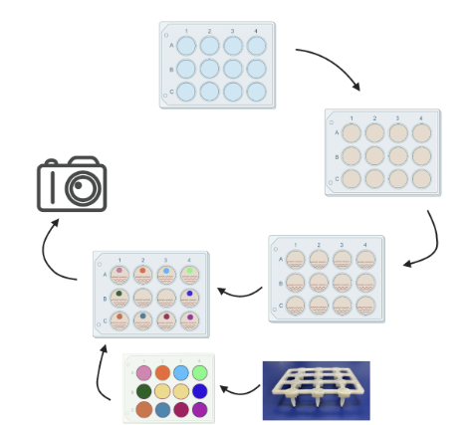
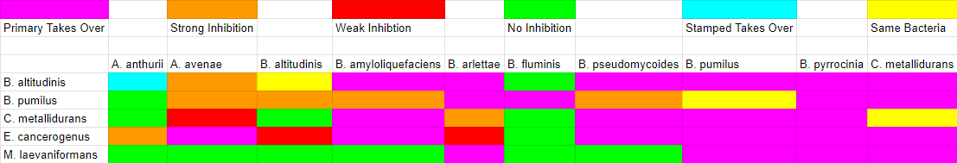
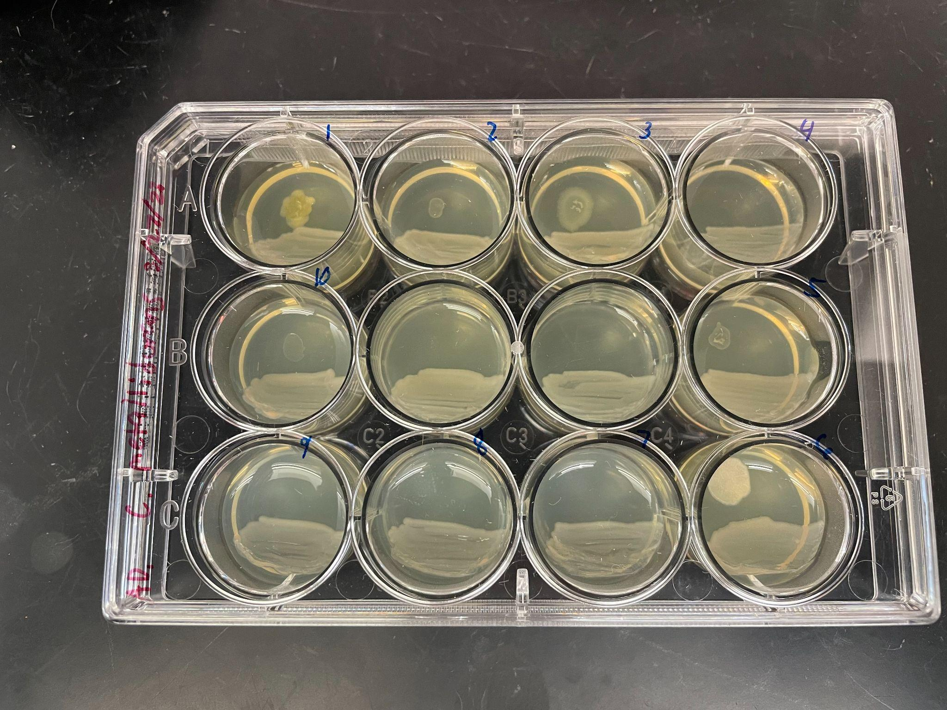
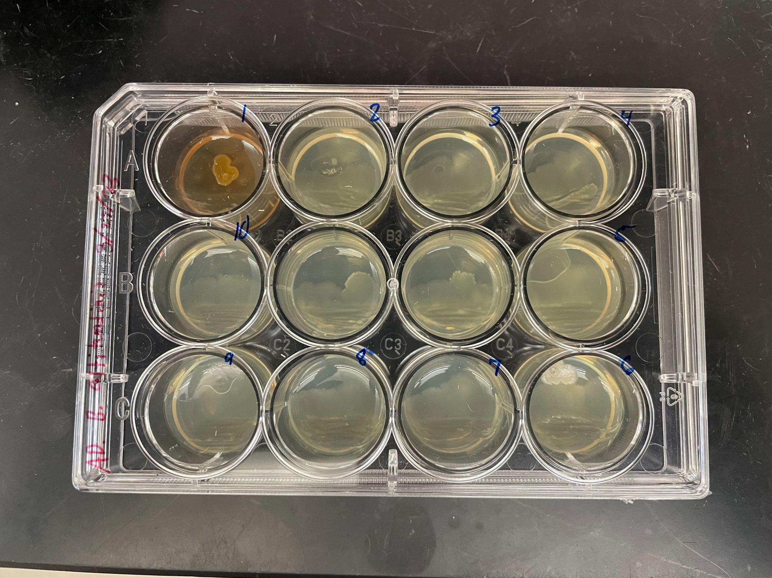
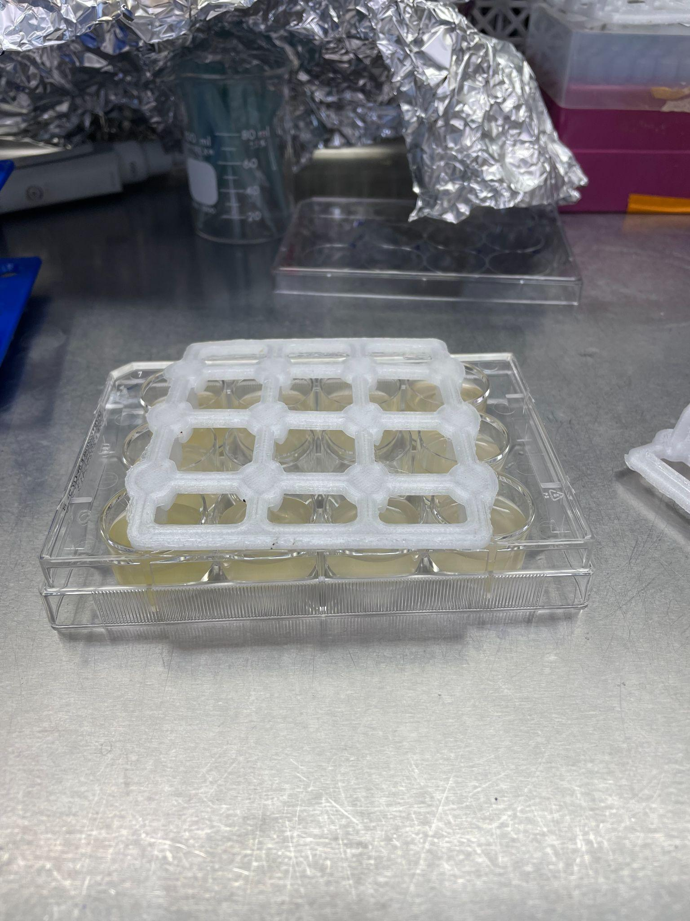
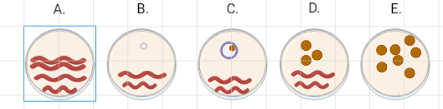
Evaluating Co-Culture Compatibility of Plant Growth Promoting Microorganisms with the Potential to Support Space Agriculture
Tom Wilson & Anthony DiGiovanni
Faculty Advisor: Dr. Andrew Palmer, Dept. of Biology, Florida Institute of Technology
Background
Amount of space for prepackaged within the spacecraft would be overbearing. Cost to resupply prepackaged food would also be too expensive to consistently fund
The need for nutrition during deep-space travel will have to come from grown food
The microgravity environment aboard the International Space Station (ISS) poses significant challenges that limit both plant growth and agricultural yields
Hypothesis: Plant growth promoting (PGP) microorganisms can be leveraged in space, to improve agricultural yields in the microgravity environment
Experiment: Co-culture various bacteria found within the microbiome of the ISS that may allow for the symbiotic growth of plants
Methods
Results:
Figure 4: An overview of the results for all the tested bacteria
Figure 1: Each well of the 12-well plate is loaded with 2.5 ml of LB agar. One bacterial species is plated in all wells, then the stamp is used to introduce ten different bacteria into the individual wells by dipping it into liquid cultures and then placing it on the previously streaked plate. Observations the effects of the potential co-culture are taken.
Figure 5: C. metallidurans co-cultured with the ten bacteria listed in the "List of Stamped Bacteria". Various inhibitions can be seen with this bacteria as the primary.
List of Stamped Bacteria:
Acidovorax anthurii (1)
Acidovorax avenae (2)
Bacillus altitundinis (3)
Bacillus amyloliquefaciens (4)
Bacillus arlettae (5)
Bacillus fluminis (6)
Bacillus pseudomycoides (7)
Bacillus pumilis (8)
Burkholderia pyrrocinia (9)
Cupriavidus metallidurans (10)
Figure 3: Representation of phenotypic scoring system: A) Primary Takes Over, B) String Inhibition, C) Weak Inhibition, D) No Inhibition, and E) Stamped Takes Over
Figure 6: B. altitudinis grown with the ten bacteria listed below. A. anthurii (1) took over the well as a stamped bacteria.
Figure 2: A polycarbonate 3D-printed stamp dipped into a 12-well plate consisting of ten different liquid cultures.
Discussion/Future Objectives
Analyze the phenotypes that produced the results
Examine bacteria growth within a Microgravity simulator
Begin analyzation of all bacteria retrieved from NASA
References
Temkin MI, Carlson CM, Stubbendieck AL, Currie CR, Stubbendieck RM. High Throughput Co-culture Assays for the Investigation of Microbial Interactions. J Vis Exp. 2019 Oct 15;

