Slide 1
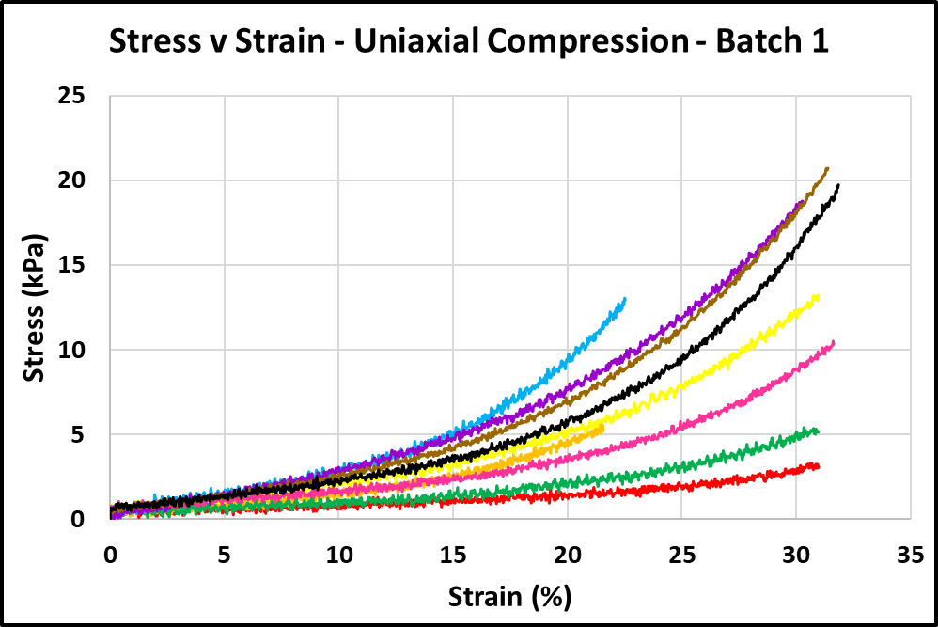
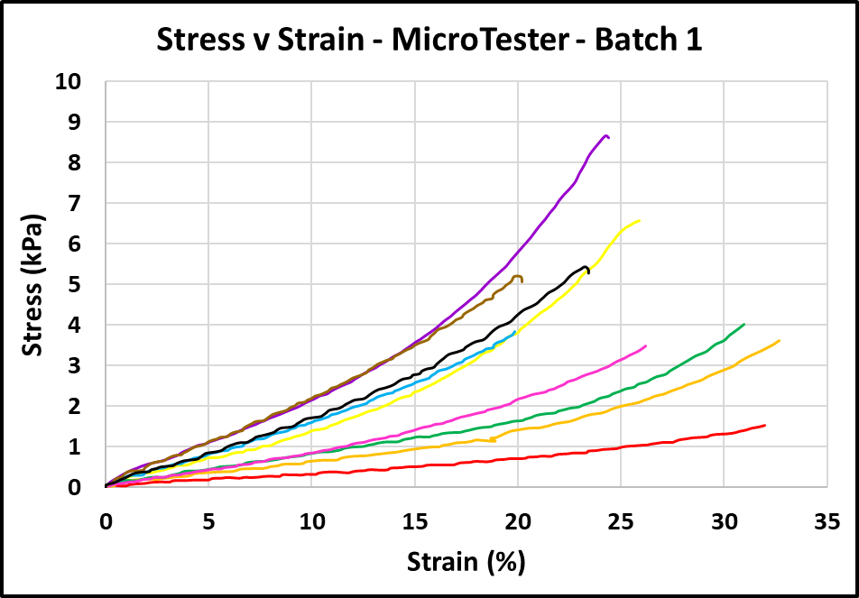
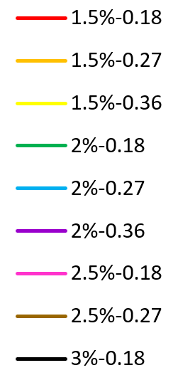
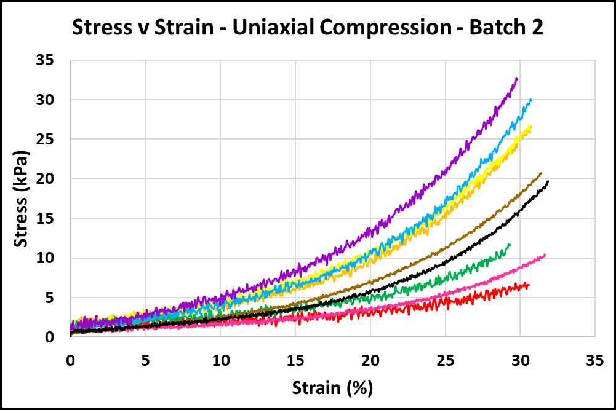
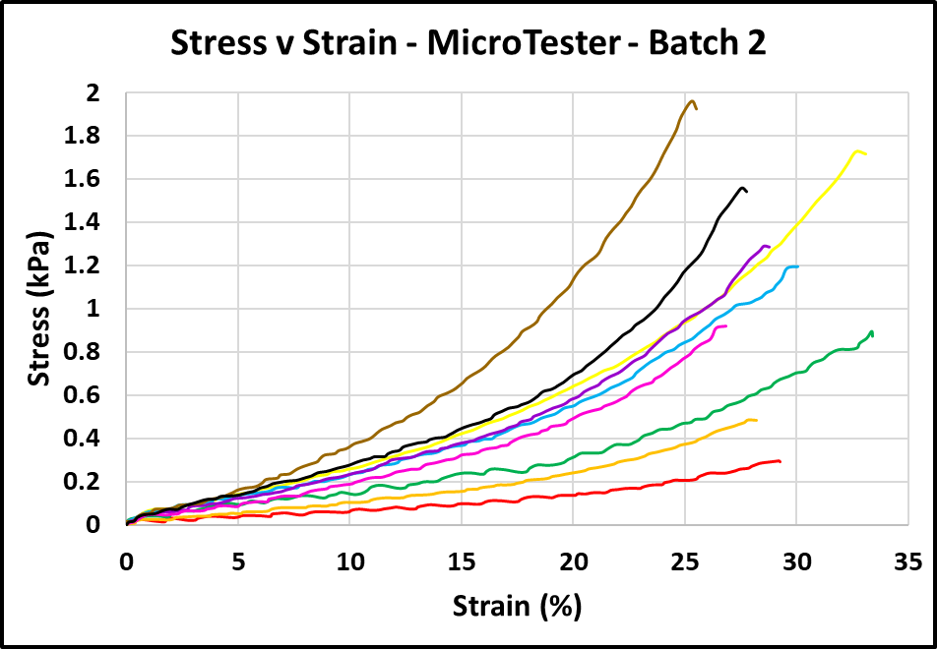
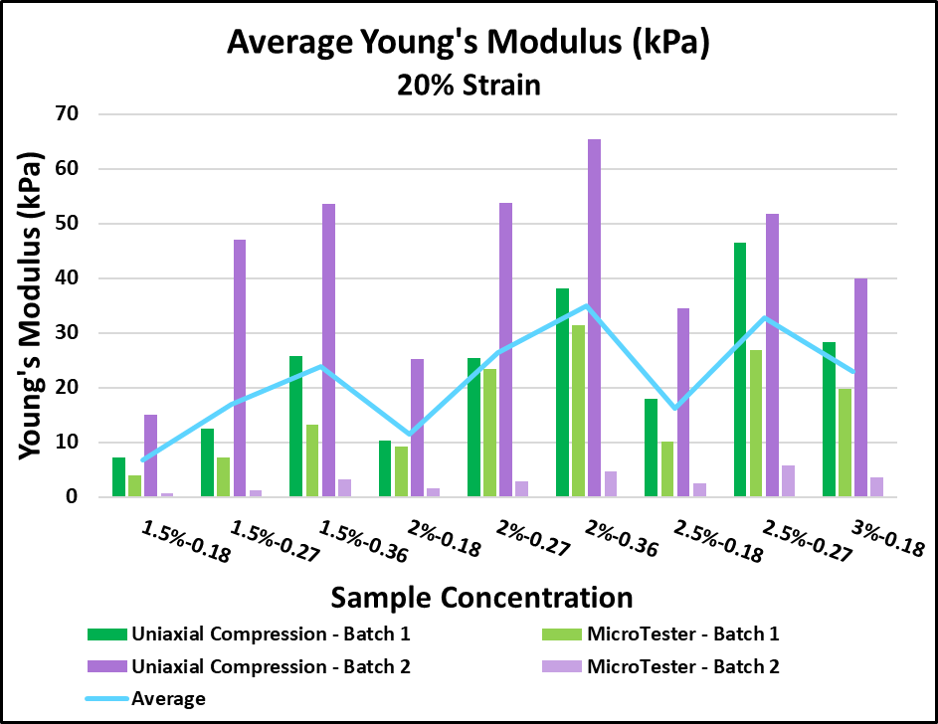
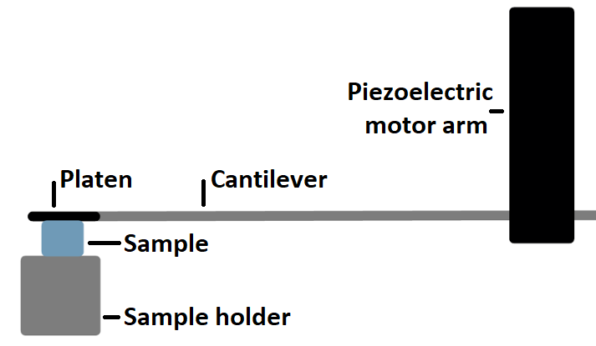
Compression Testing of Alginate Hydrogels
Genna Felder, Caitlin Streck, Seda Yilmaz, Yingnan Zhai, Xiangpeng Li (UCF)
Faculty Advisors: Dr. Linxia Gu, Dept. of Biomedical Engineering, Florida Institute of Technology; Dr. Jihua Gou, Dept. of Mechanical and Aerospace Engineering, University of Central Florida
Background
Results
The hydrogels used in this study were fabricated for use in wound healing, 3D printing, and tissue engineering applications.
They were tested via compression to compare stiffness of the hydrogels to the body’s native tissues.
9 different sample types were tested (6 samples each for compression and 8 samples each for Micro testing); composed of alginate hydrogels with concentrations of 1.5%, 2%, 2.5%, and 3%, crosslinked with +2 cation inclusions of 0.18, 0.27, and 0.36.
Hydrogels were fabricated in two separate batches for two rounds of testing.
Legend
Methods
Uniaxial Compression Testing
Each sample was uniformly cut using a 3D printed blade holder and compressed until failure.
Data Analysis: Stress and strain were given during testing and averages at 20% strain were used to calculate the Young’s modulus [1].
MicroTesting
The hydrogels were cut into small samples with a cross-sectional area of approximately 4mm² and compressed past 20% strain.
Figure 1. MicroTester sample and cantilever layout
Data Analysis: Stress was calculated by the bending moment of the beam multiplied by the length of the beam divided by the moment of inertia [2]. Strain was calculated by dividing the tip displacement of the platen by the initial height of the gel [3].
Figure 2. Stress vs. Strain of sample averages for each concentration
Discussion
Young’s modulus increases with increasing concentrations of both alginate and additives.
Young’s modulus range is approximately 3 - 50 kPa; matching the range for many native soft tissues including the brain, tongue, and esophagus.
Variation of Young’s modulus across samples and testing methods may be caused by batch variation and time sensitivity of samples, as Young’s modulus increases when the samples lose hydration.
Future work: Include larger sample populations for more consistent statistical and error analysis, as well as performing a study of the effect of cross-linking over time.
Figure 3. Trend comparison of average Young’s modulus across all batches at 20% strain

