Slide 1




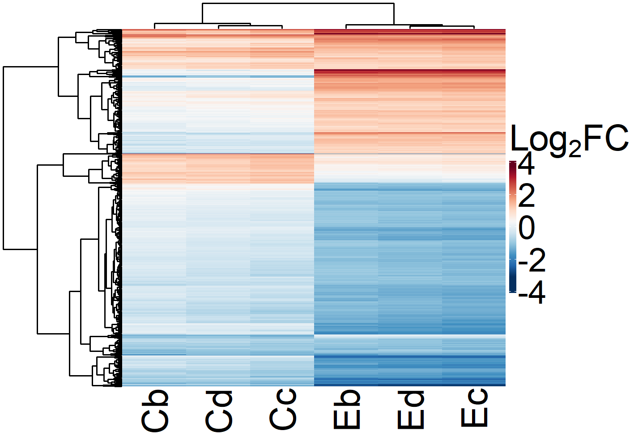
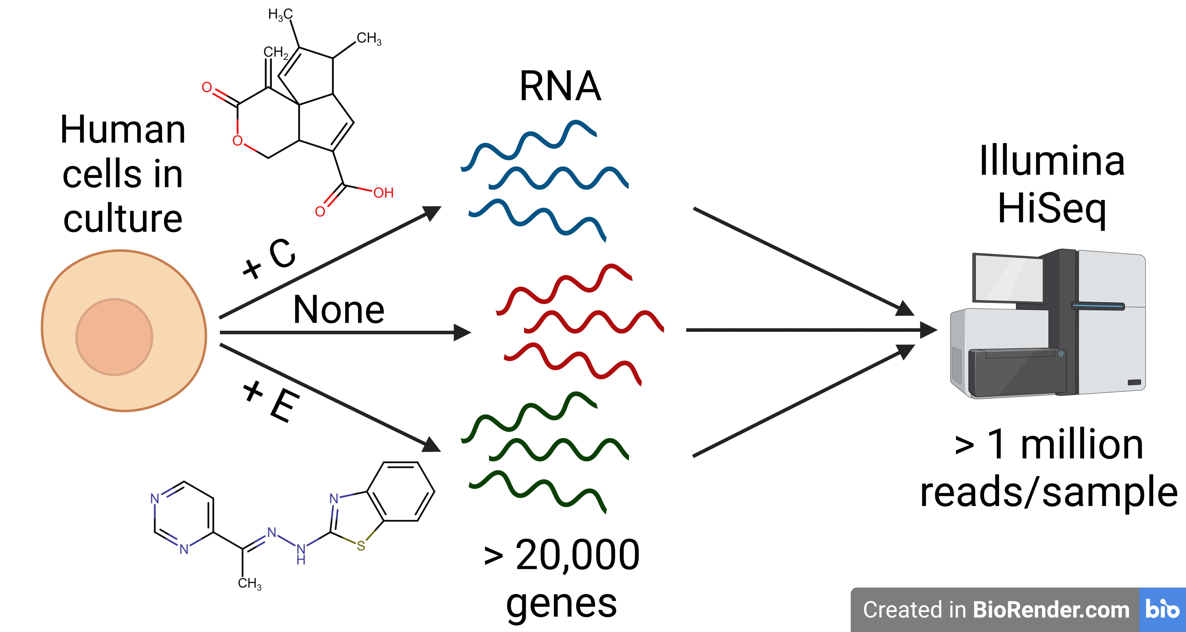
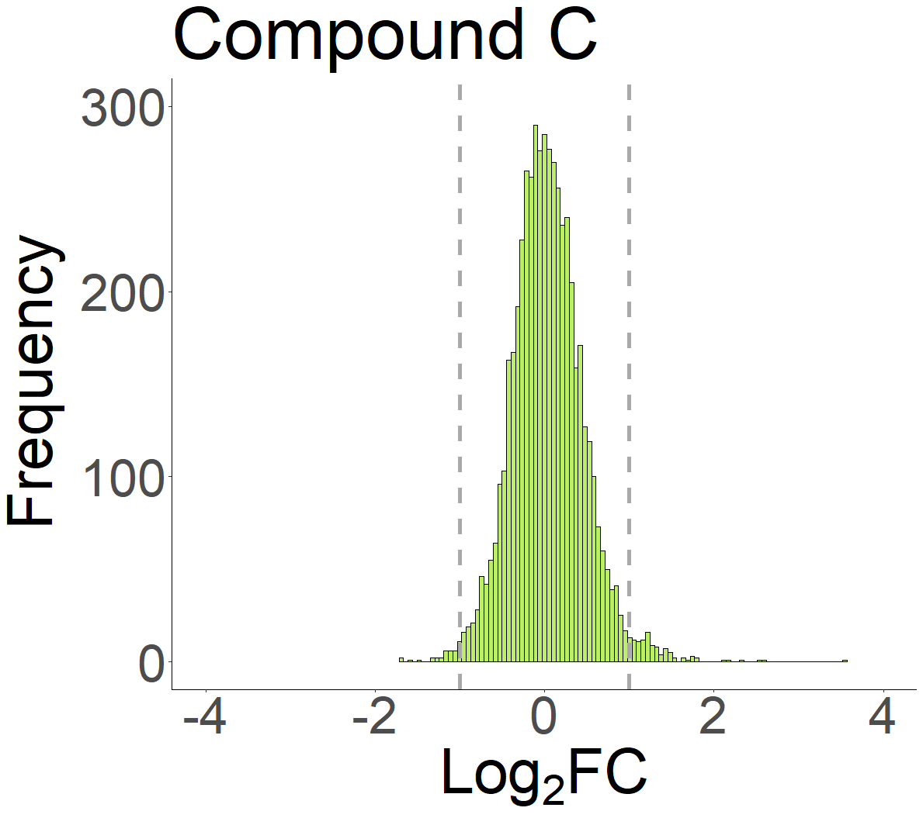
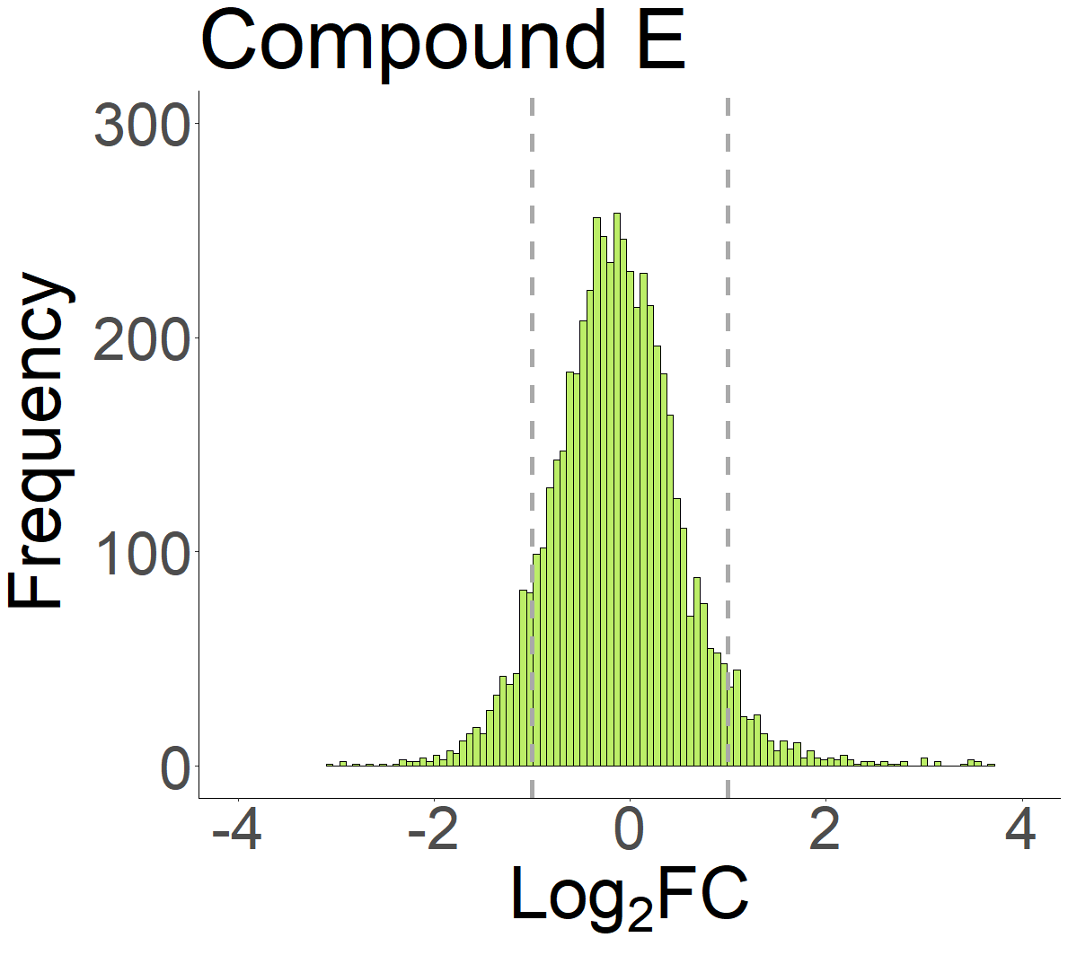
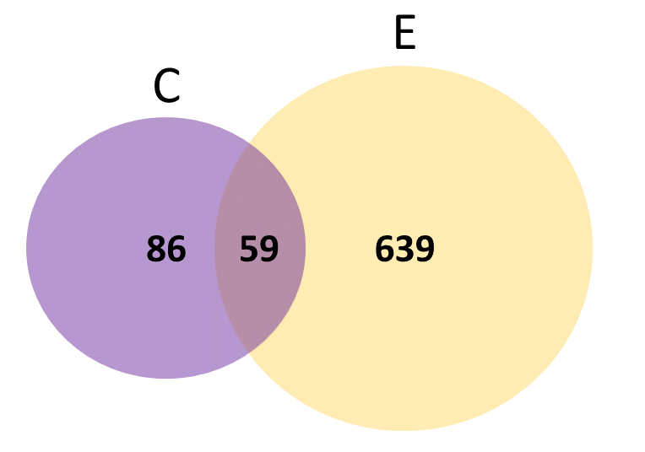
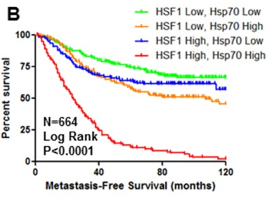
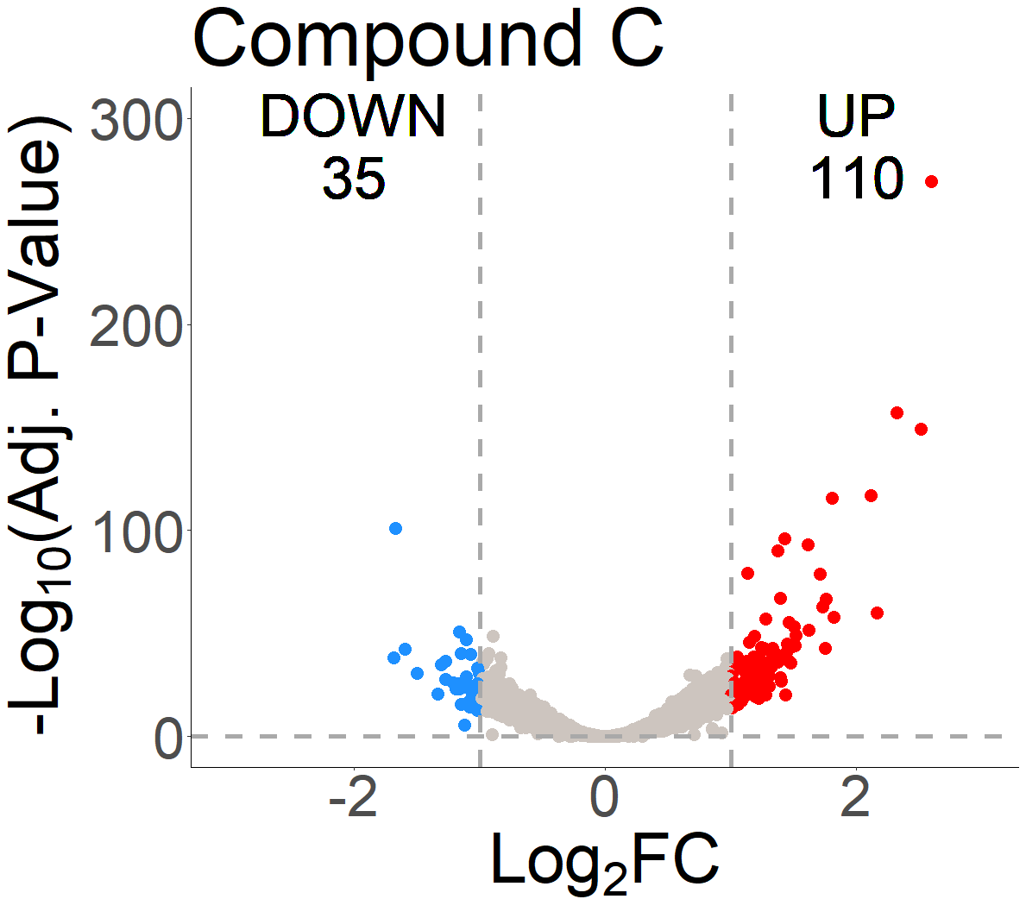
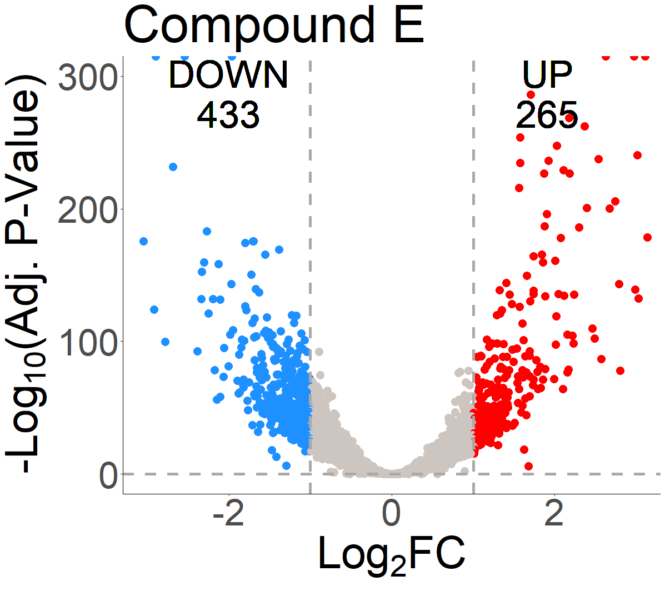
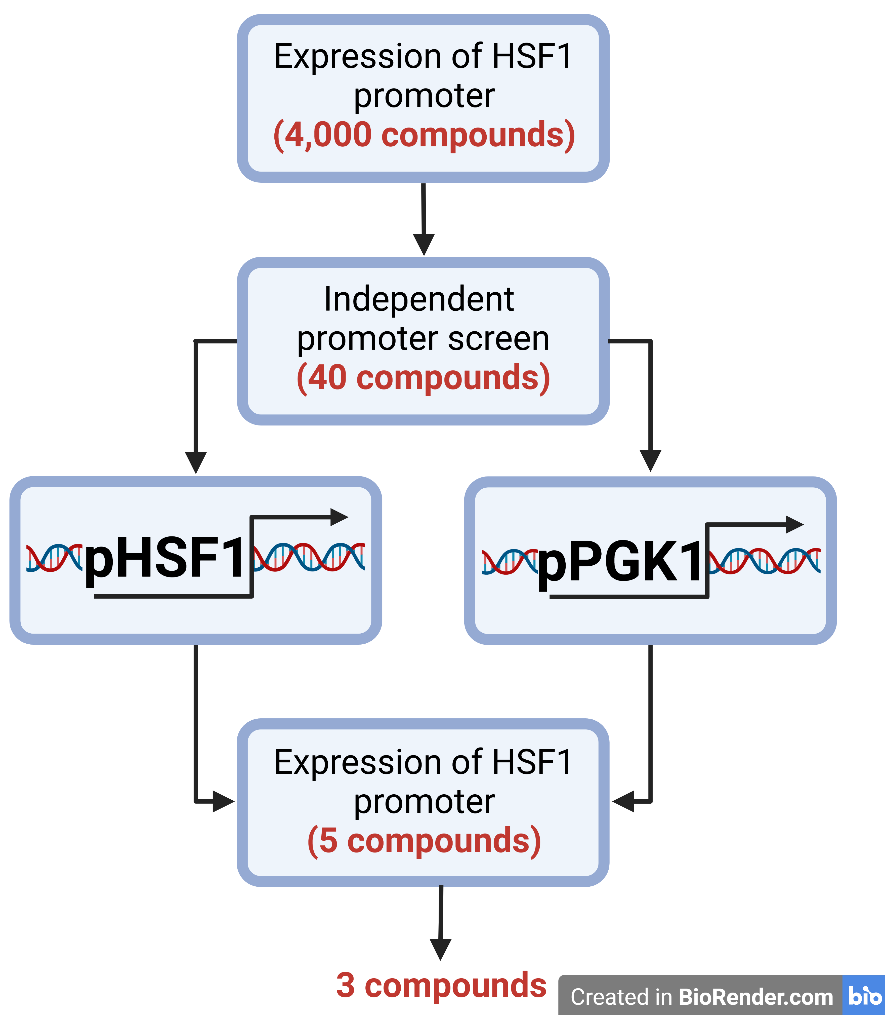
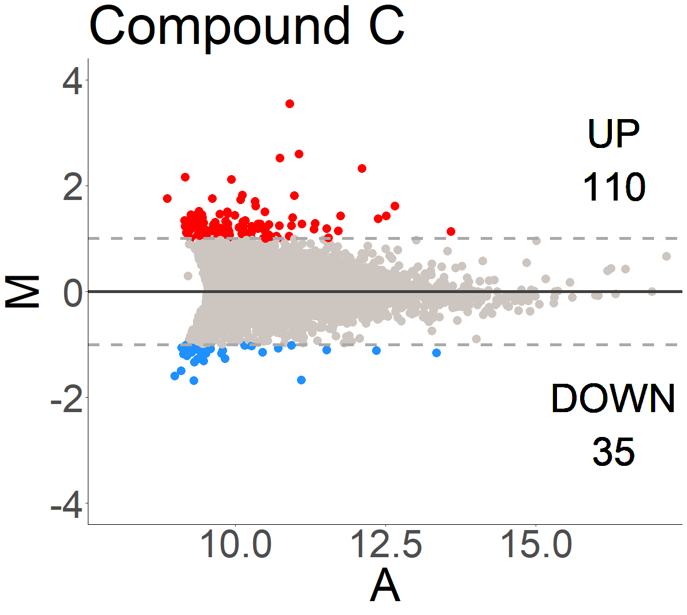
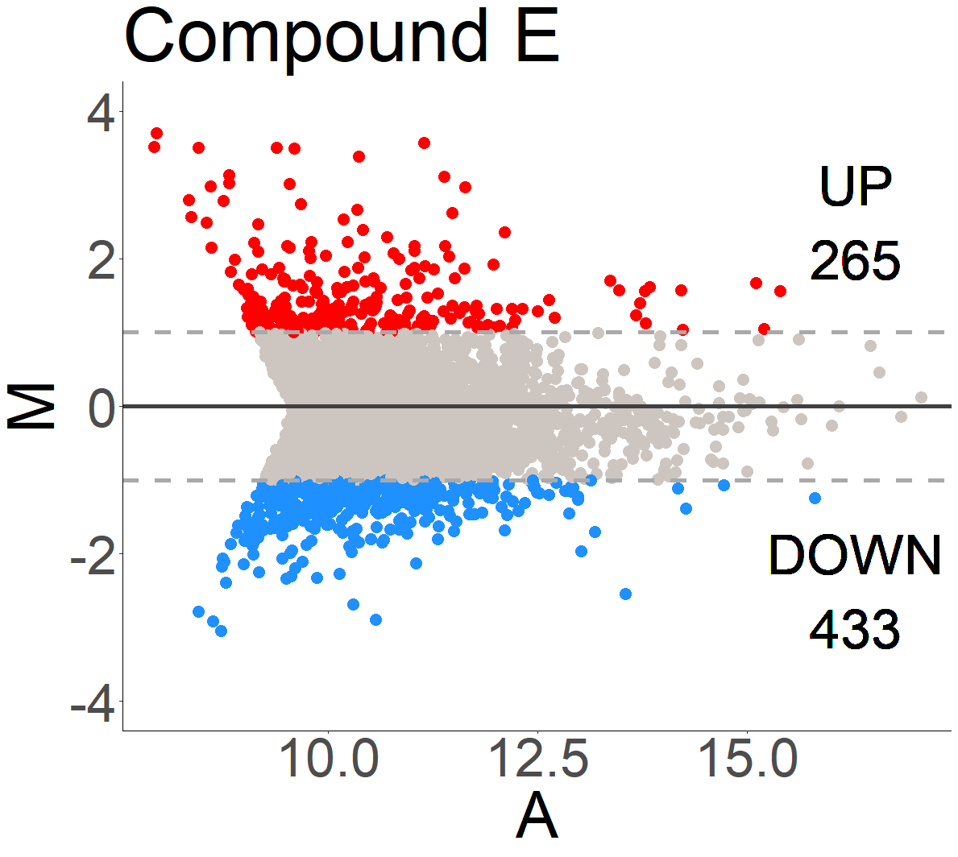
Development of an Anti-cancer Agent Targeting HSF1
Sarah Marsh
Faculty Advisor: Dr. Karen S Kim Guisbert, Dept. of BCES, Florida Institute of Technology
ABSTRACT
RESULTS
Of the approximately 250,000 new cases of breast cancer diagnosed every year, an estimated 80% will have increased levels of the HSF1 transcription factor. HSF1 is the master regulator of the heat shock response that functions to maintain cellular protein folding homeostasis. We have performed a cell-based screen and identified three small molecule inhibitors of HSF1 expression. Here, we characterize the response of HEK293T cells upon 16-hour exposure to the small molecules on a genome-wide level using RNA-sequencing technology. The goal is to identify the mechanism of action in order to further develop the potency of the small molecule and to minimize potential side effects.
Figure 3: Schema showing RNA sequencing of human cells exposed to compounds C and E.
Figure 5: Heatmap of C and E compounds showing patterns in differential gene expressions via color scale and dendrograms.
INTRODUCTION
Figure 6: Venn diagram of C and E compounds illustrating the relationship between their differentially expressed genes.
Figure 1: Levels and activity of HSF1 correlate with metastasis-free survival. Reprinted from Carpenter et al., 2017.
CONCLUSIONS
We have defined the transcriptomic response of HEK293T cells exposed to two compounds identified through a small molecule, cell-based screen to decrease HSF1 expression. The two compounds display substantially different responses in gene expression, indicating that the mechanism of action is likely to be unique for each drug.
Figure 2: Flow chart visualizing the identification of three compounds out of 4,000 that specifically decrease HSF1 expression. Image designed by Michaela Foley using Biorender.
FUTURE DIRECTIONS
Figure 4: Statistical tests to identify differentially expressed genes from cells exposed to C and E. Row 1, histograms, showing frequency distribution. Row 2, volcano plots, with statistical significance versus magnitude of change. Row 3, MA plots, with magnitude of change, M, versus average log intensity, A.
Future work will define specific pathways and genes that contribute to the compounds’ responses, and their connections to the down-regulation of HSF1. The long-term goal is to identify the interaction partners to improve potency and complete preclinical studies.

