Slide 1
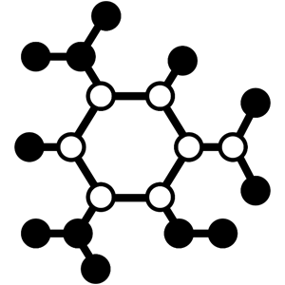
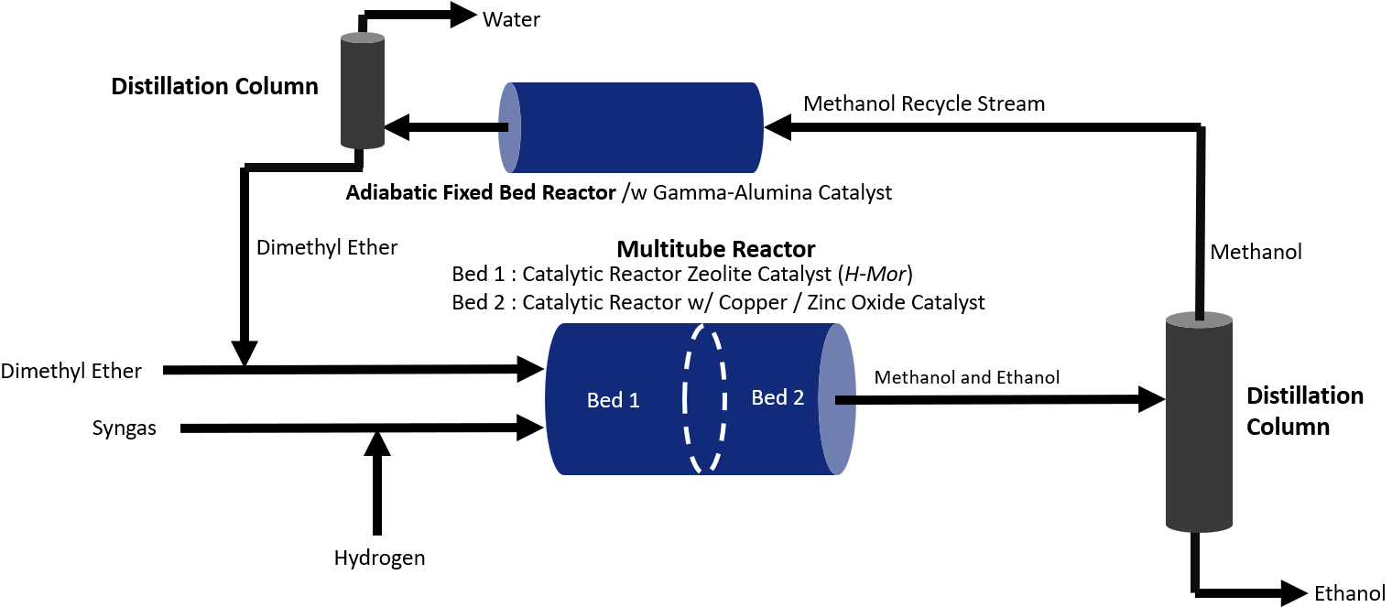
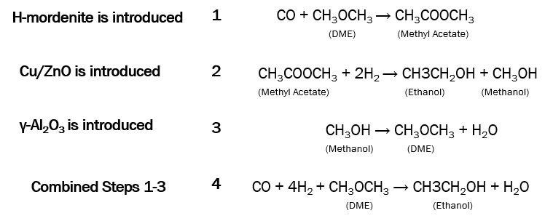
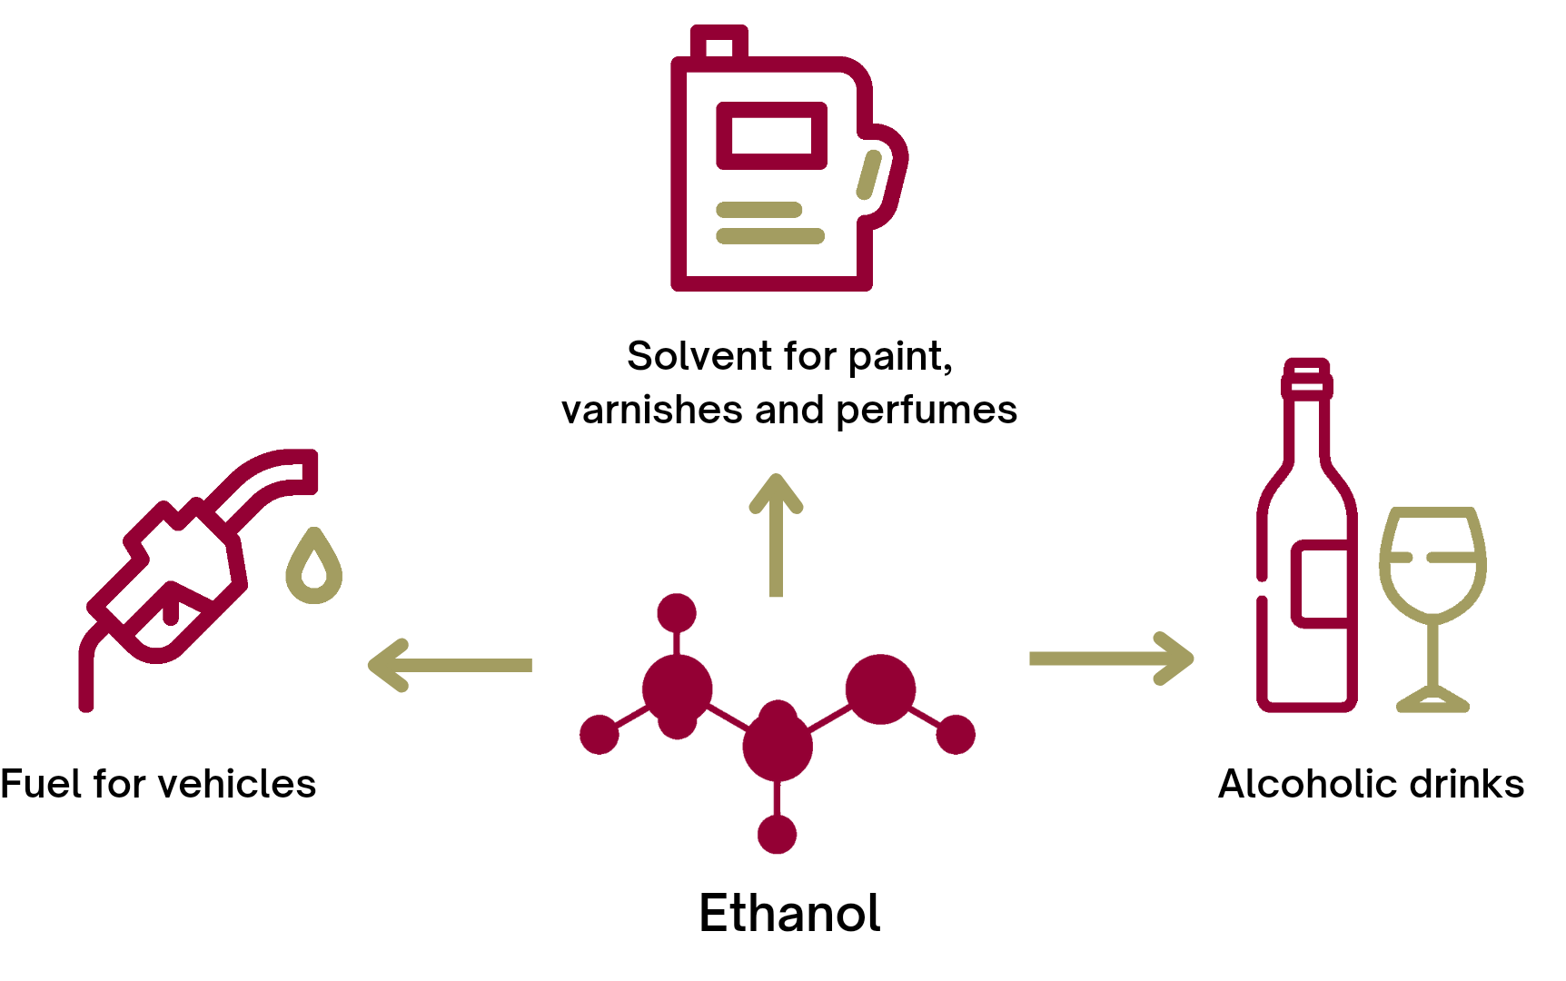
Synergizing Zeolite and Metallic Catalysts for Improved Ethanol Synthesis via a Dimethyl Ether-based Method
David Small, Alexia Barnett, and Gia Marquez
Faculty Advisor(s): Dr. Jonathan E. Whitlow, Dept. Of Biomedical and Chemical Engineering and Sciences, Florida Institute of Technology
Abstract
The project aims to explore a cost-effective and sustainable method for ethanol production, using carbon monoxide, hydrogen, and dimethyl ether instead of food crops. It will analyze the annual and hourly production rate and compare it with Poet Biorefining's output, the largest US-based ethanol producer. This project is significant due to the increasing demand for ethanol as a fuel blend for automobiles and the need to discover novel production techniques. This plant can produce up to 45 million gallons of ethanol annually.
Block Flow Diagram
Project Design Methodology
The ethanol manufacturing process was simulated using Aspen Plus software. There, the multi-tube dual-bed reactor was modeled as two heat exchangers to simulate each bed. During the utilization of the Aspen Plus software, it is important to note that certain limitations may arise. One such limitation includes the intermittent cooling process within the reactor. However, this obstacle was successfully addressed by breaking down the reactor into multiple sections and implementing suitable cooling techniques within each section. Moreover, certain heuristics were applied to ensure the safety of the reactor.
Project Novelty
This innovative process utilizes a dual-catalyst system consisting of H-mordenite and copper-zinc oxide to effectively convert dimethyl ether to ethanol. The specifics of this process’s novelty includes the following:
                Use of two novel catalysts which result in approximately 100% conversion of dimethyl ether
              Recycle stream of dimethyl ether produced from the process’ methanol stream
Chemical Reactions
Process Considerations
              A multitube reactor will be used to mitigate the risks associated with a carbon monoxide leak
              All process wastewater will be sent to a treatment facility
              Steam and water are used for cooling and heating as needed
              DME will be re-added to the process after separating and recycling
Motivation
The increasing demand for ethanol as a fuel additive has brought concerns about traditional production methods, which primarily rely on food crops such as corn and sugarcane. These methods have been associated with environmental degradation and economic implications. Alternative production methods such as using carbon monoxide, hydrogen, and dimethyl ether have gained attention as they can eliminate the need for food crops and significantly reduce production costs.
Commercial Uses
Catalyst Combination Comparison

