Slide 1
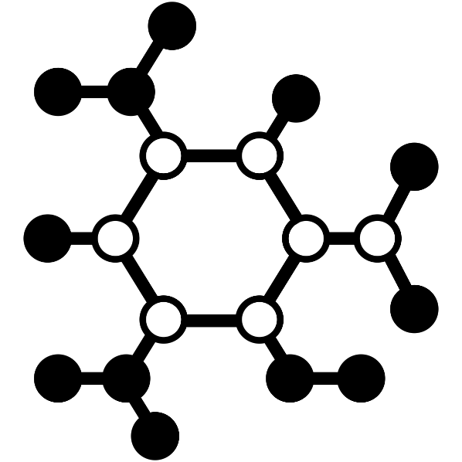
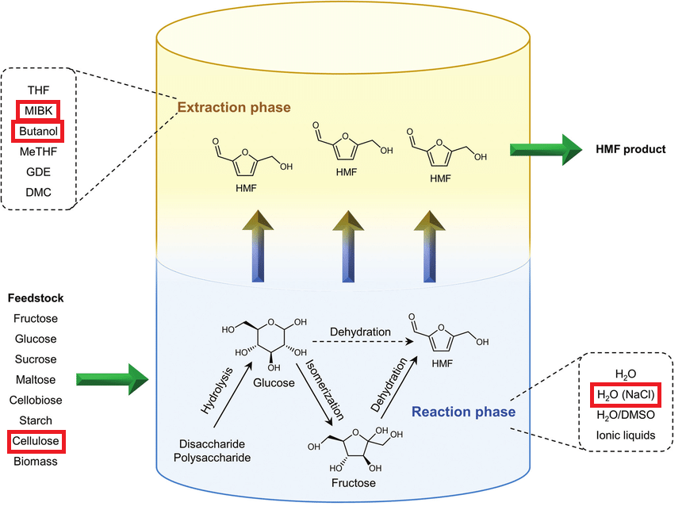
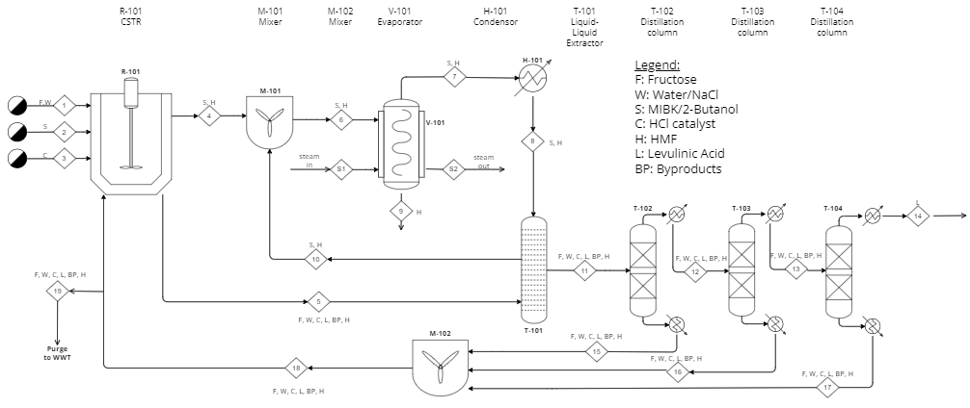
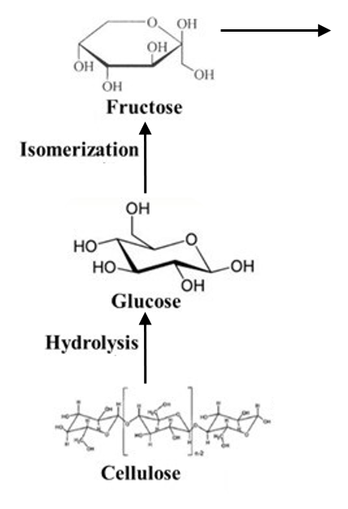
Synthesis of HMF from Waste Paper
Alex Kidd, Jasmine Lalonde, and Krystal Lemaster
Faculty Advisor: Dr. Jonathan E. Whitlow, Dept. of Biomedical and Chemical Engineering and Sciences, Florida Institute of Technology
Abstract
Motivation
Producing hydroxymethylfurfural (HMF) from waste paper;
Involves the conversion of cellulose from waste paper to fructose by isomerization;
Environmental and economic benefits:
  Lowering greenhouse gas emissions from waste paper disposal;
  Creating a multi-use compound from waste material;
  Reducing cost by switching to a cellulose based feedstock.
Fossil fuel reserves are dwindling and prices are rising creating a demand for other more renewable options;
HMF is a key chemical intermediate for many petroleum product substitutes such as polymers and biofuels.
Process in CSTR
Novelty
Aqueous Phase
Reaction phase containing NaCl, HCl, water and fructose.
Organic Phase
Extraction phase containing 2-butanol,MIBK, and HMF.
Waste paper feedstock:
Low-cost, abundant, and renewable source of cellulose;
Eliminates the need for costly and energy-intensive pre-treatments;
Helps address environmental concerns ;
In just the U.S alone, almost 1 billion trees worth of paper is trashed each year.
Process Flow Diagram

