Slide 1

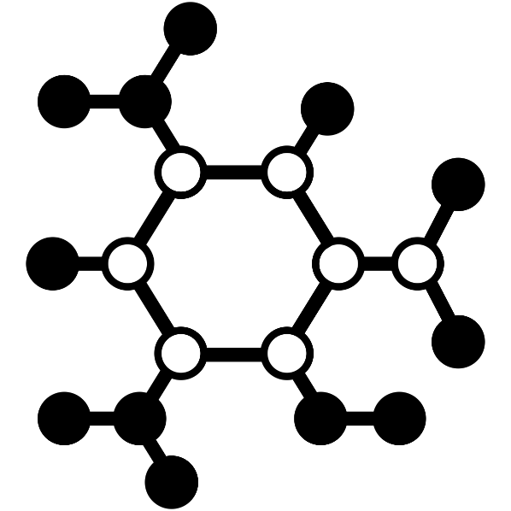
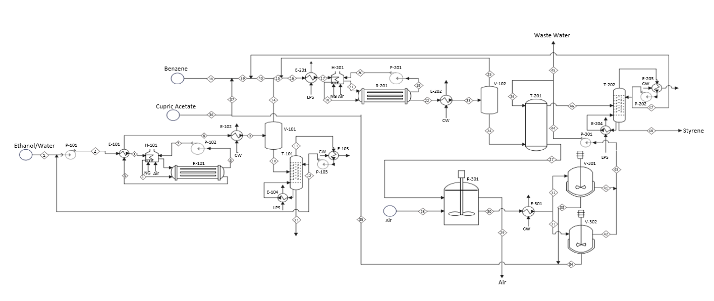
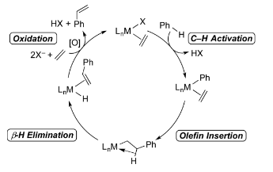
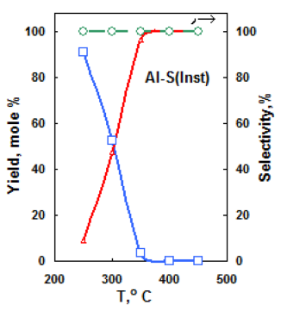
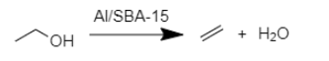
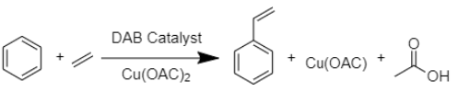
Styrene Production using Bioethanol and Benzene
Hunter Smith, Phillip Nader, Abdulrahman Sumailan, Waleed Al Daraai
Faculty Advisor: Dr. Whitlow, Dept. of Chemical Engineering, Florida Institute of Technology
Abstract
Process Flow Diagram
Styrene is the main precursor for polystyrene which is one of the 7 major plastic groups and is used in the production of many common consumer packaging for insulation. Modern styrene production is typically derived from petrochemicals. The design presented here limits the reliance on petrochemicals through the use of bio-derived ethanol as one of the feedstocks
The process is composed of
two main stages, in which first
ethylene is produced via dehydration
of ethanol and then the second stage,
In which styrene is produced by
oxidative phenylation of styrene using a
copper oxidizing agent and a rhodium
based catalyst.
Production
99,000 tonne/yr Styrene at 99.9% Purity
Waste Water
Motivations
PFD Table Index
Novelty
Unit Type | Equipment
Pumps | P-101, P-102, P-103,P-201, P-202, P-301
Heat Exchangers | E-101, E-102, E-103, E-104, E-201, E-202, E-203, E-204 E-301
Tubular Reactors | R-101, R-201
CSTRs | R-301
Flash Vessels | V-101, V-201
Heaters | H-101, H-201
Crystallizers | V-301, V-302
Extractors | T-201
Distillation Columns | T-101, T-202
The styrene industry is worth $52.3 billion and has a CAGR of 6.0% based on increasing consumer goods and population growth. With current trends focusing on sustainability, developing a bio-based alternative to the typical petrochemical-based method is an important objective for the environmental benefits. Furthermore, biologically based feedstocks are less likely to be effected by the volatility of the petrochemical market.
The major novelty of the project is through the use of two major catalysts in the reactors. The first catalyst is an Al/SBA-15 based catalyst, which is a significant improvement to other catalyst due to the 100% selectivity for ethylene and up to 99% yield. The second catalyst is a rhodium based catalyst that catalyzes the oxidative phenylation of benzene into styrene. Unlike most styrene production processes, this catalyst allows for direct production of styrene from benzene and ethylene in a single step, with the use of a copper oxidizing agent that can be regenerated via oxidation.
Capital Cost
Manufacturing Cost
Reactions

