Slide 1




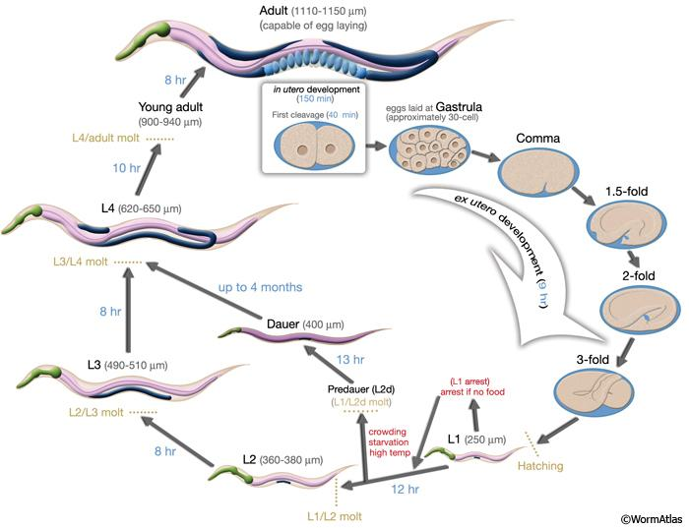
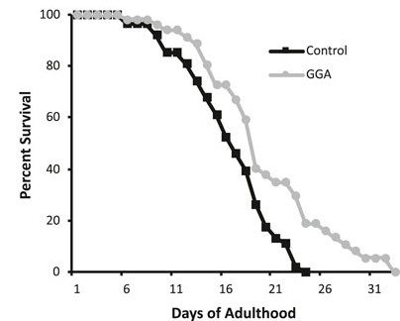
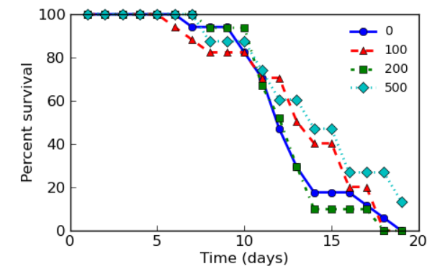

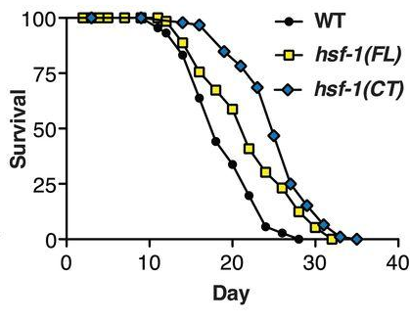
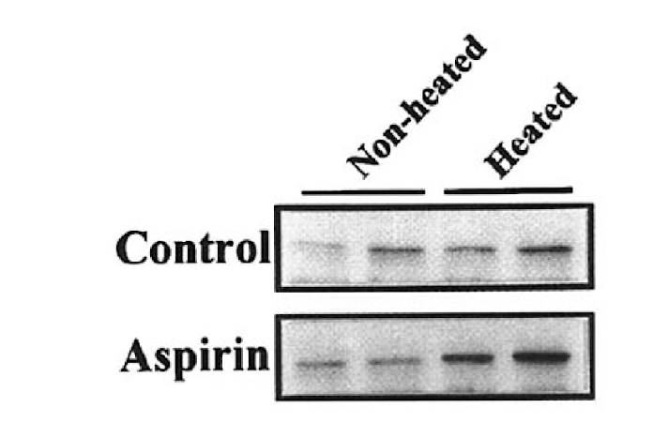
An aspirin a day keeps the doctor away –
acetylsalicylic acid and lifespan
Marco Zavala
Advisor: Dr. Eric Guisbert, Department of Biomedical and Chemical Engineering and Sciences, Florida Institute of Technology
Abstract
Aging is the most significant risk factor for most human diseases. Several genetic pathways demonstrate the capacity to regulate aging, including the Heat Shock Response (HSR) controlled by heat shock transcription factor 1 (HSF1). Acetylsalicylic acid (aspirin) is an anti-inflammatory drug often used to reduce pain, fever, and the formation of blood clots. Aspirin is known to partially activate HSF1. Here, we test whether aspirin can affect lifespan using the model nematode Caenorhabditis elegans.
μM
μM
μM
μM
Figure 1: Introduction to C. elegans (wormatlas.com)
Figure 3: Chemicals that activate HSF1 enhance lifespan (Mossiah et al. 2022)
Figure 5: Aspirin affects lifespan in worms
Summary:
We have shown that aspirin can positively affect lifespan in C. elegans.
Future Directions:
Test whether this effect requires HSF1 using RNAi inhibition and genetic mutations and test the effects of aspirin on neurodegenerative disease models.
anti-HSP70
Figure 2: HSF1 activation can affect lifespan in worms (Baird et al. 2014)
Figure 4: Aspirin can partially activate HSF1 in mammals (Fawcett et al. 1997)
Notes:
Why we use C.elegans - say what figure 1 is
Break on HSF1 and refer back to figure one

