Slide 1
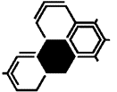
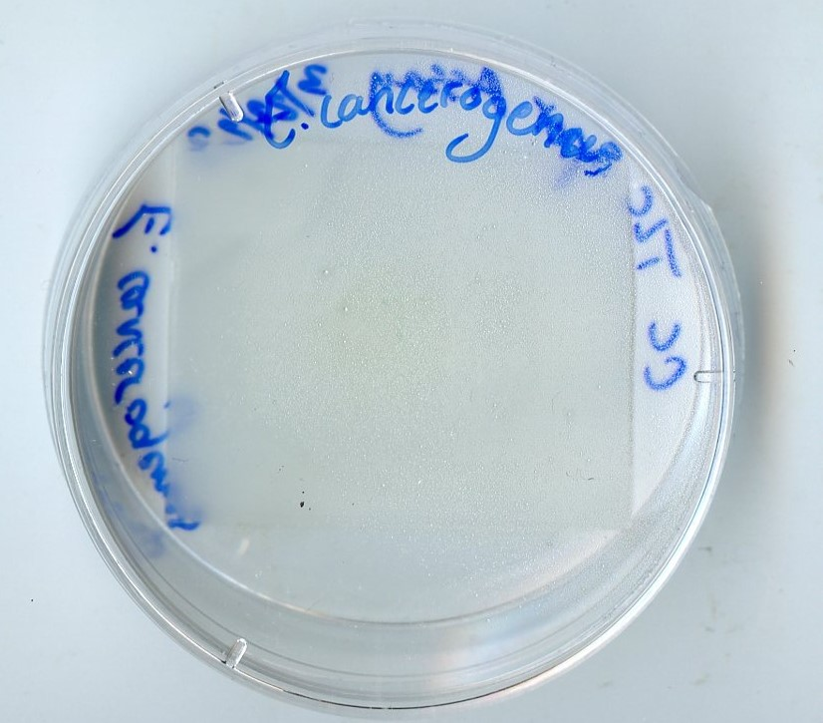
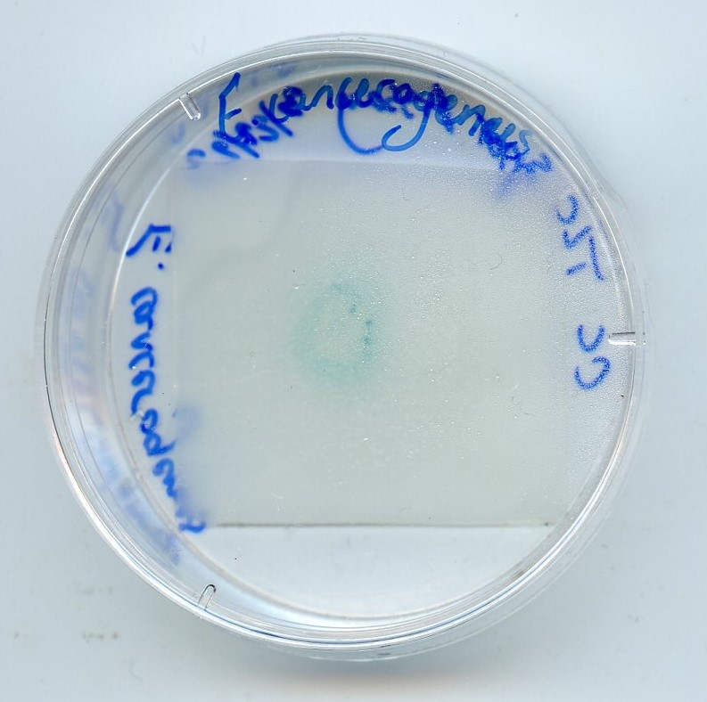
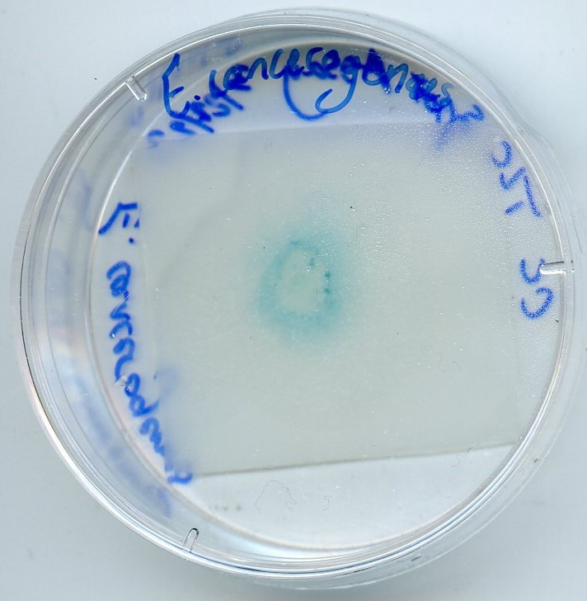
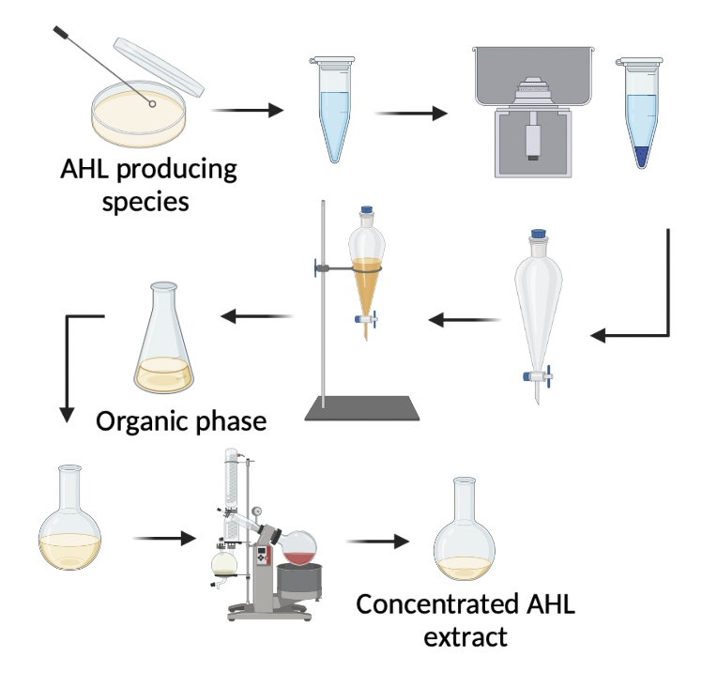
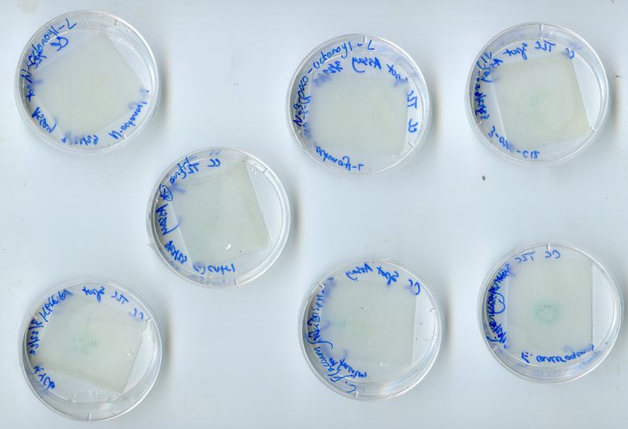
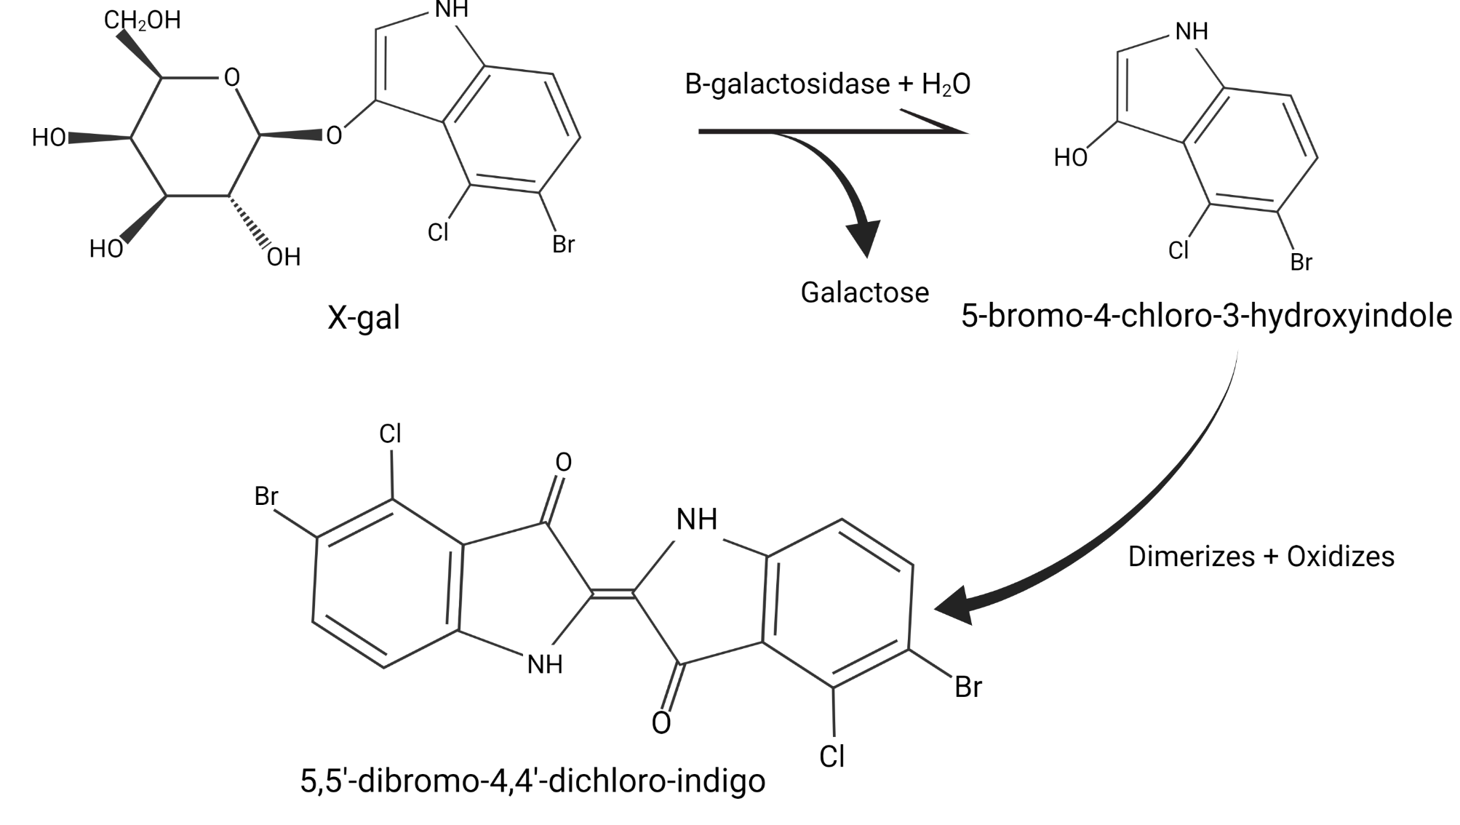
Extraction of Quorum Sensing Molecules from Microorganisms
Identified Aboard the ISS
Alyssa Carson, Conner Cadenhead, Tyler DeScenza
Faculty Advisor: Dr. Andrew G. Palmer, Department of Ocean Engineering and Marine Science, Florida Institute of Technology
Faculty Observer: Dr. Hamid K. Rassoul, Department of APSS, Florida Institute of Technology
Background
Plant growth-promoting bacteria could help improve edible biomass yield and supplement life support for future Mars missions.
Some biological responses can be regulated by cell density, a phenomenon known as quorum sensing (QS). In Gram-negative bacteria, the most common QS signals are N-acyl-L-homoserine lactones (AHLs).
Bacteria taken from the ISS that produce AHLs were identified prior using Agrobacterium tumefaciens KYC55, which produces β-gal in the presence of AHLs.
Thin-layer chromatography (TLC) is used to study solutes by weight. TLC allows the AHLs to migrate up the plate and therefore distinguish the identity of which AHL is present.
Ongoing: Modifying a spot extract assay to better apply TLC to determine the identity of AHLs present.
Detected ISS Bacteria that use AHLs
Burkholderia multivorans
Burkholderia pyrrocinia
Cupriavidus metallidurans
Curtobacterium flaccumfaciens
Enterobacter cancerogenus
Methylobacterium luistanum
Pantoea agglomerans
Figure 4: Spot assay workflow, to support extract viability. Created with BioRender.com
Results
Experimental Design
Figure 5: Images of the E. cancerogenus plate at the 2 h, 4 h, and 6 h mark showing the evolution of blue (X-Gal) over time.
Figure 2: Workflow for AHL extraction and concentration the AHLs from the different species samples. These species were previously identified as AHL producing. Created with BioRender.com
Figure 6: TLC spot assay at the 4 hour mark, showing the first signs of enzyme activity. Plates shown above include extracts from 2 species: E.cancerogenus and C. flaccumfaciens. Stock AHLs: N-C8, N-3-oxo-C8, and N-3-oxo-C12. KYC6 (+) control, and no AHL (-) control.
Summary and Future Studies
Figure 1: X-gal reaction as a substrate for the enzyme β-galactosidase. Product dimerization, followed by oxidation, yields the insoluble dark blue color, 5,5’-dibromo-4,4’-dichloro-indigo. Created with ChemDraw
Known AHLs (stock) were compared with extracts in the spot assay. AHLs were detected, not identified
Future studies will use high-performance liquid chromatography (HPLC) and more TLC tests
HPLC would yield results with fewer variables
Figure 3: TLC assay workflow. A ladder of stock AHLs are used to determine the identity of each extracted AHL. Created with BioRender.com

