Slide 1

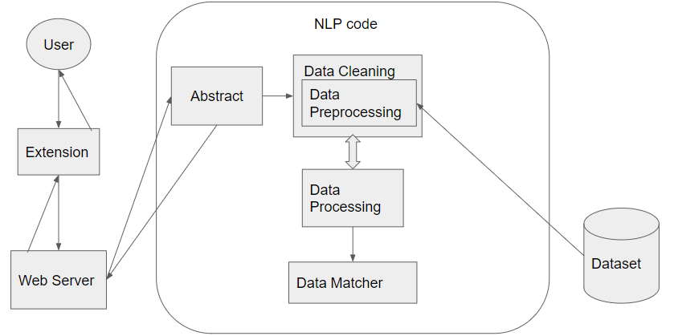
Fake News Detector
Victor Pinto, Joseph Bigelow
Faculty Advisor: Dr. Nasheen Nur, Dept. of Computer Engineering and Sciences, Florida Institute of Technology
Abstract:
In the modern age, social media has become a common aspect of society. Social media has opened new possibilities for access to information and easy communication between users, but also presents a very real threat. Fake news, defined as information that is misleading or inaccurate to the facts to manipulate the reader, is a problematic issue. Social media is a popular platform for misinformation to be spread at a quick rate. Due to the massive amount of information available through the internet, finding credible sources can be challenging for users. The solution proposed is a tool that will allow users to authenticate information on social media. The proposed system integrates an NLP based detection tool to communicate with a web browser extension through a web server.
Proposed Approach: System Architecture
Our Tool and Implementation
Tool removes symbols and punctuation from both text from the user and news articles
Tool then takes the data and converts it to vectors for analysis
Cosine score, matching score, and word appearance are generated
Web server in Javascript
An extension that uses HTML, Javascript, and Chrom’s API tools. The styling of the extension was done with CSS
Tool is created with python
SQL databases to store news articles and Twitter posts
Description
Extension: a chrome web extension that sends text to the web server and displays the result for the user
Web Server: the server handles HTTP request from both the server and the NLP tool
Abstract: the abstract is part of the NLP tool made by us. it acts as a interface for a webserver between the tool and the server.
NLP tool: the tool has multiple steps. the tool takes the text sent to the server and articles from the database to calculate similarity scores, which are sent back through the server to the extension
Database: The database stroes multiple news articles from both Fox and CNN. The text is extracted when new text is going to be analysed
Discussion of Limitations
Tool is not cross-platform compatible
  Tool is limited to only running on a Windows computer
  Would like to improve the tool so it can run independently on other systems
  have tool run on linux and mac machines
The backend NLP tool is very basic.
  Had only three values generated.
  Prevented the advancement and diversity of visualization features for extension
Requirement Analysis and Research gaps
The reason for requirement analysis is to continue improving the current detection tool. One requirement we incorporated into the design of our extension was visual explainability for the model’s detection result. Future research can be expanded to address current challenges such as:
Lack of trust from users to algorithm based results
Lack of diverse databases with both real and fake news
Detection models that can perform with different types of media
Detection models for different languages
Future Direction
Making the tool accessible to other platforms such as Mac and Linux operating systems
Improving the scope of the NLP tool
Incorporating visual explanation for the user through features and text comparison
Submitting the survey paper and a user study paper on an improved version of the tool

