Slide 1
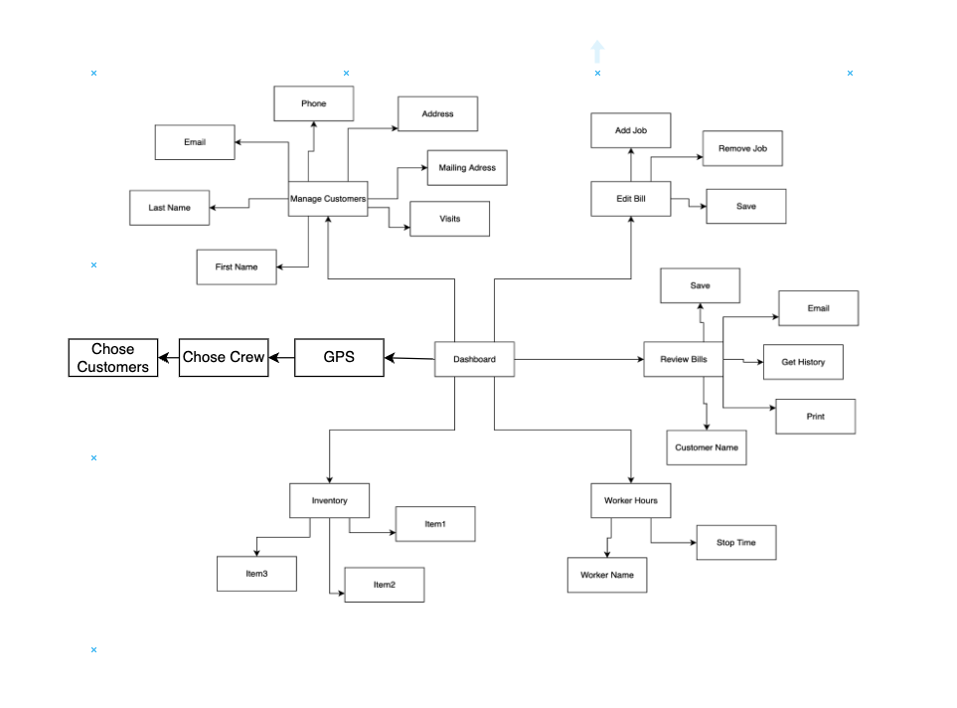
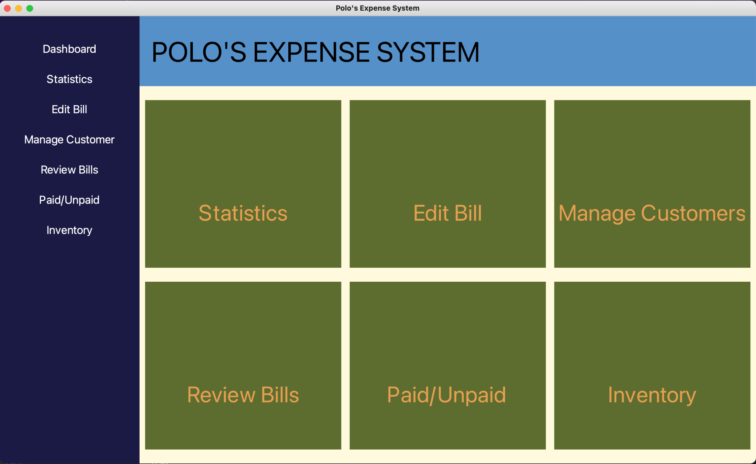
Polo’s Expense System
Matthew Brown and Nicholas Velasquez
Faculty Advisor: Dr. Fitzroy D. Nembhard, Dept. of Computer Science, Florida Institute of Technology
Motivation
- Our client has a landscaping business that have an outdated billing system
- Most of the billing system is done on paper and they would like to move forward to an online system that works for them
- Their Customer information is also not organized and they would like a place to have all their information easily accessible
Goals
- Allow the creation of bills for customers that are editable and have different methods of sending
- Create a well developed customer database that will allow the user to add and delete customers as well as store all of their billing and contact information
- Allow the user to mark specific bills that are paid for
- Create an inventory system to keep track of goods the company is stocked with
- Create a statistics page that will present the company with key stats to help with productivity and efficiency
Architecture
Features
Manage Customers
- Connected to customer database
- Allows for updates on new or existing customers
Statistics
- Displays company statistics
- Connected to customer, billing, and inventory databases
Edit Bill
- Edit existing bills to have new jobs
- Can add job items from the inventory page
Paid / Unpaid
- Bills can be marked as paid or unpaid
- Displays all sent bills
Inventory
- Keeps track of the company’s inventory items
- Item quantity, cost per, and description are editable
Review Bill
- Allows for the user to save bills manageably as pdfs for printing
- Allows emailed bills to go to the correct email address

