Slide 1
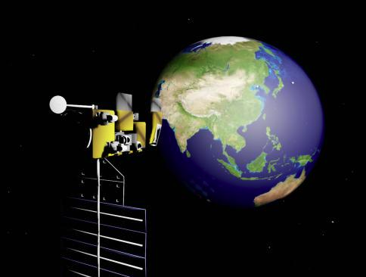
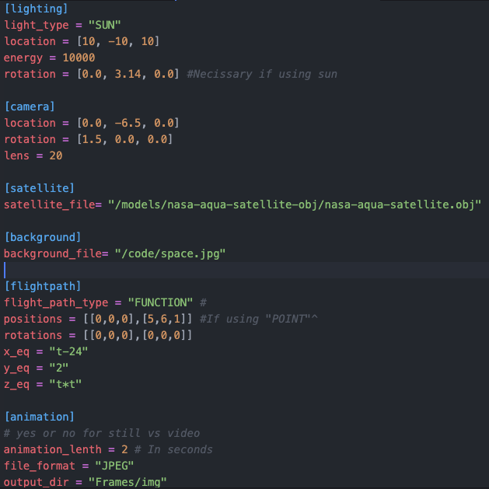
Synthetic Data Pipeline for Satellite Pose Estimation
Nathan Pichette, William Stern, Stephane Baruch, Hanibal Alazar
Faculty Advisor(s): Dr. Ryan White, Dept. of Computer Science, Florida Institute of Technology
Motivation
Rendered Image
Tools Used
The currently there is no simple way to create synthetic satellite motion data. Currently users need to animate a single clip for every use case needed. We seek to create an easy-to-use pipeline for generating large amounts of synthetic data for use in satellite pose estimation.
Blender - 3D environment
BPY - Python library to control 3D space and objects in Blender
TOML - Configuration file
Github - Project housing and version control
TQDM - Progress bars
Goal
Limitations and Improvement
Create an automated system that can render footage of a satellite in motion
Enable the user to upload their models and backgrounds
Allow for adjustable the path of motion and lighting features
Allow users to easily adjust settings
Configuration
It can be difficult to estimate the flight path and speed of objects without running the program. Potential improvements include creating a visualization tool to help the user create good flight paths.
Currently the program requires admin access on some operating systems
Features
Custom .obj model and .jpg background selection
Satellite and Camera motion based onreceived functions or interpolated from point values
Lighting from a point or grid sun lighting from specified direction
The program can generate a 3D star background or use a static JPEG image.
Evaluation/ future work
The data pipeline was evaluded for ease of use and received positive feedback. Researchers will utilize the project to generate data for the purpose of training machine learning models, which will enable the prediction of satellite movement and rotation.

