Slide 1
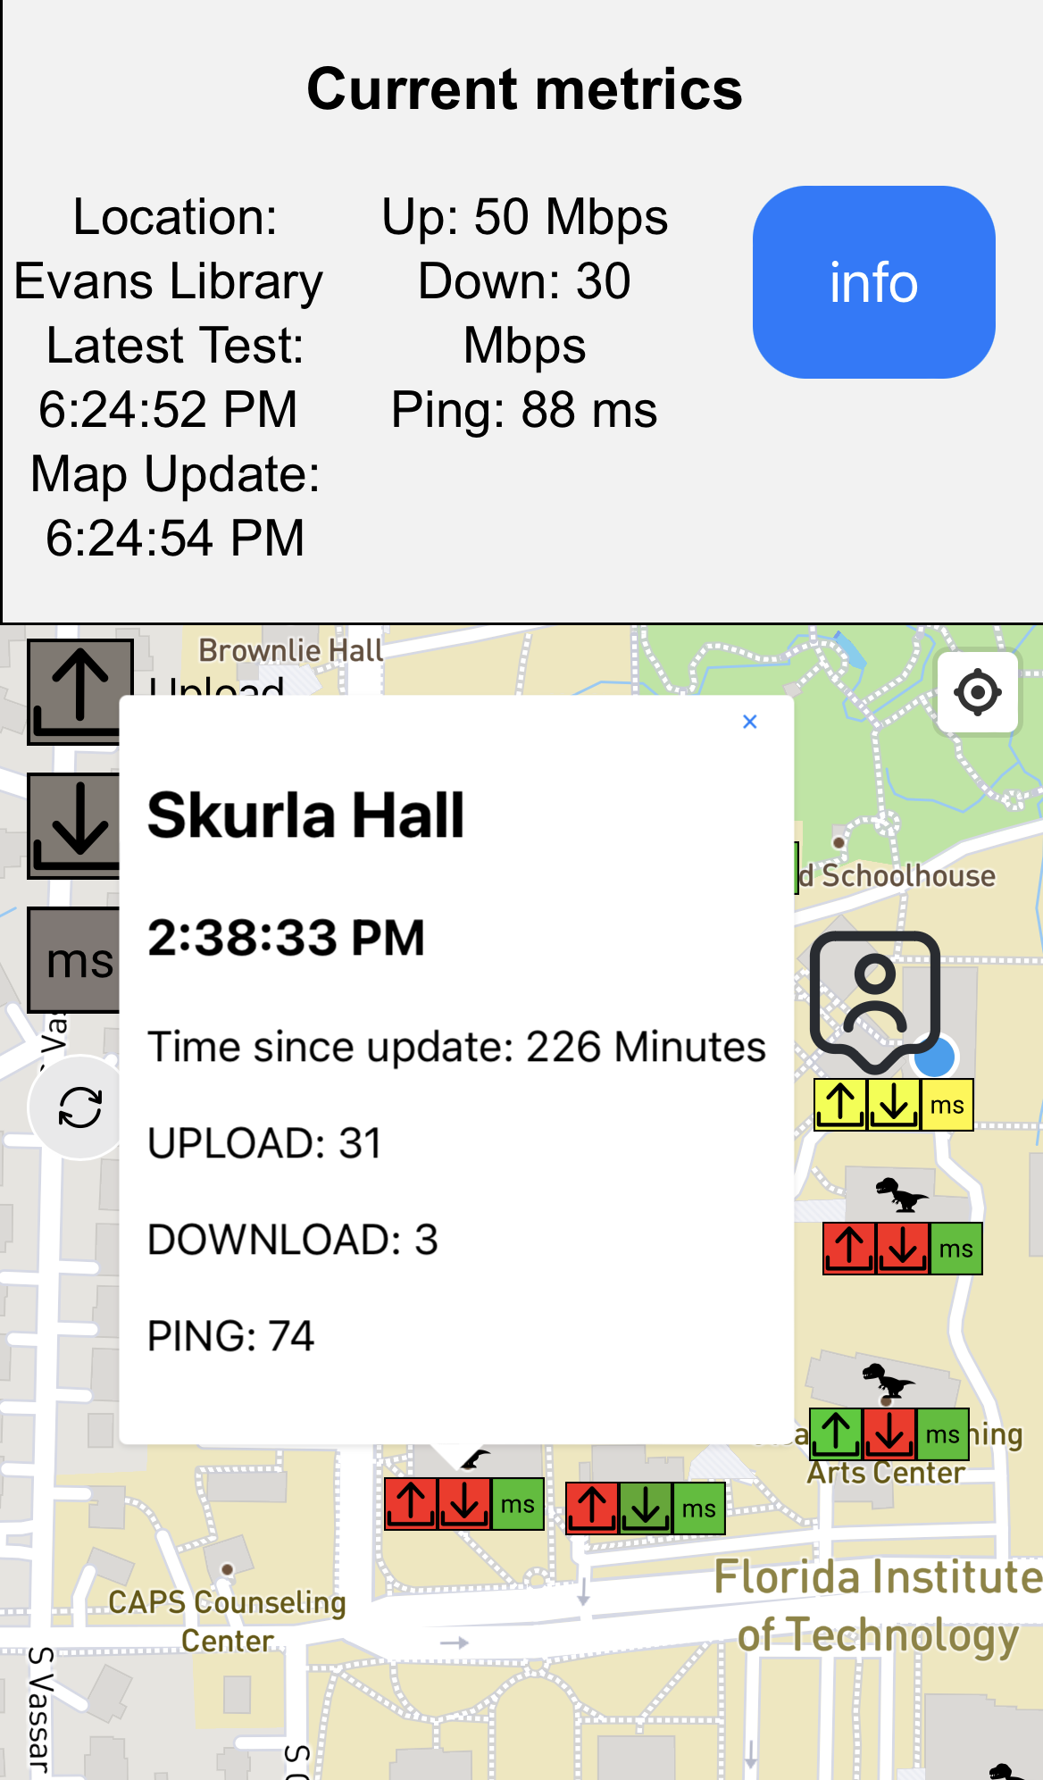
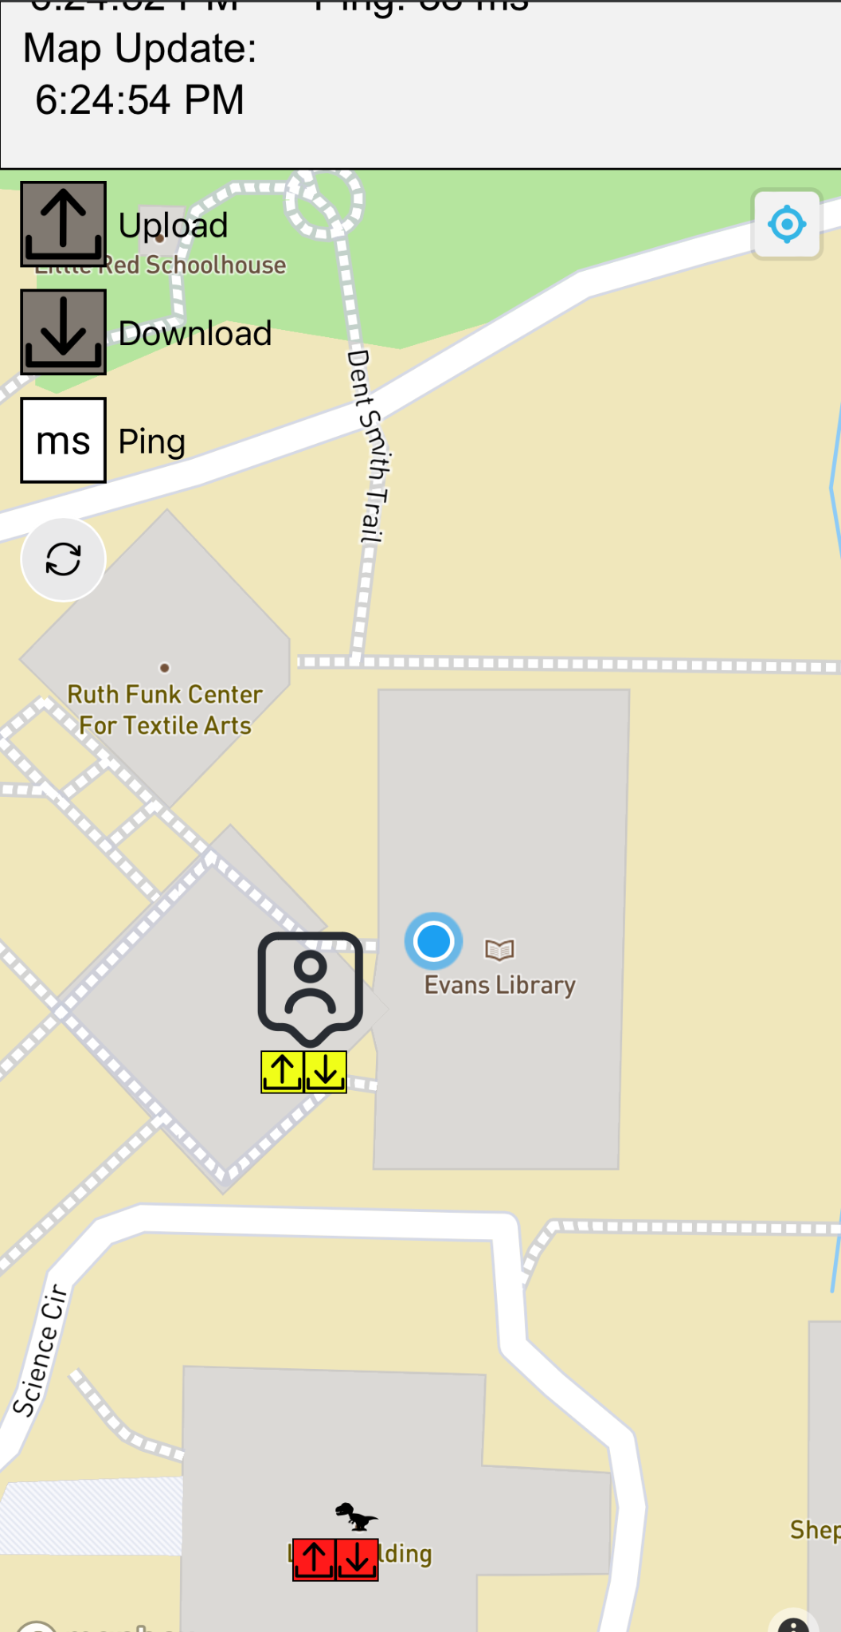
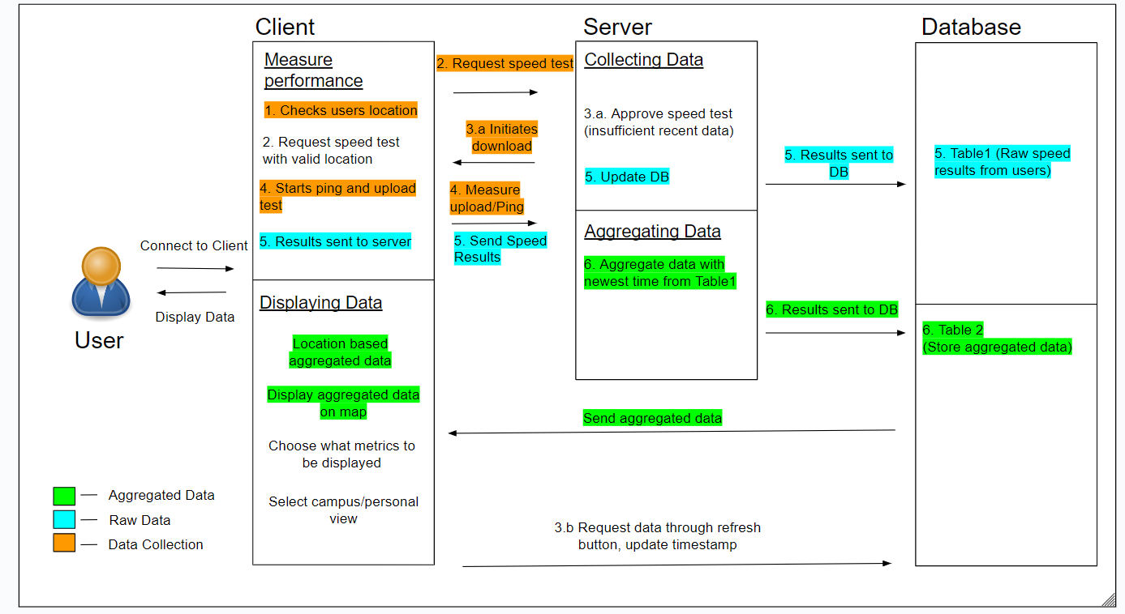
Wifi Performance Map
Devon Resendes, Ankur Dhadoti, Aaron Glenore
Faculty Advisor(s): Dr Philip Chan, Dept. of Computer Science,
Florida Institute of Technology
Motivation
Give users the ability to monitor wifi performance metrics over eduroam network without system administrator involvement and guiding them to locations that have better wifi metrics
Website
Features
Choose which performance metrics to be displayed on the map such as upload speed, download speed, and ping
Campus view which will have the user’s location with respect to the entire campus map
Personal view which will allow the user’s location to appear in the center of the map while the map moves.
Periodically update users Ping, upload, download and GPS data to the central server.
Goal
Create a web application to help users find better wifi metrics on eduroam.
Automatically gather wifi performance data such as ping, upload and download speed from users devices periodically
Generate a performance map
Directing users to a location that has a better connection
Evaluation
Feedback from 8 users
Users were given a task, and they were evaluated on if they were able to complete the task
Tasks was incomplete because location couldn’t be retrieved and speed test was not ran
Design
Complete Task | Not Complete Task
7 | 1
Reducing Network Traffic
1. Check user’s location is within geofence
2. Client requests speed test from server. Server can approve/ deny
3. Server aggregates 3 data points into an average for any building
4. Refresh button, user pulls newest data from server
Future work
Divide buildings into four parts
Ask nearby devices to run a speed test to update metrics
Be able to show depth of points from buildings with multiple levels

