Slide 1
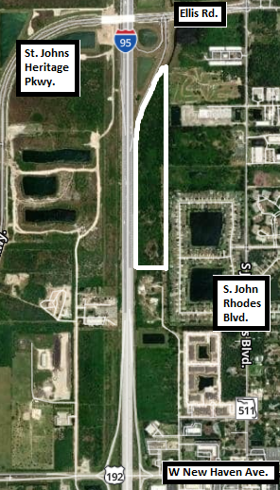
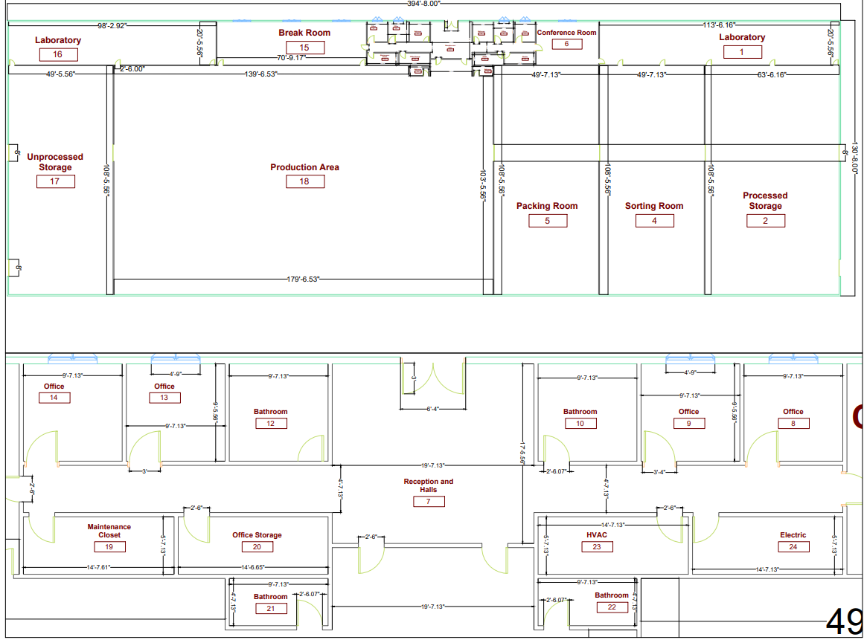
Plastic Recycling Plant
Kaelen Childers, Eric Davidson JayZe Elysee, Alaina Pistininzi, Stephan Heinrichs
Faculty Advisor: Dr. Troy V. Nguyen, Dept. of Mechanical and Civil Engineering, Florida Institute of Technology
PROJECT OBJECTIVE
TEAM ORGANIZATION
CURRENT CONDITIONS
Florida has seen a gradual decrease in the percentage of waste recycled. (Source: FDEP)
Increase the quantity of materials recycled in Brevard County by building a recycling plant.
Minimize construction waste generation.
The Garbage Garage LLC
Located in Melbourne, FL
Close to Exit 182
Entrance from US-192 off I-95
25 acres, heavily forested.
New utility lines will be required
DESIGN FEATURES
FLOOR PLAN/REVIT MODEL
52,000 square feet.
4 offices, 4 restrooms, 2 labs, maintenance closet, HVAC system room, electrical room, conference room, break room, reception desk.
Five Main Rooms: Dirty Storage, Production Line, Packing, Sorting, and Processed Storage.
Truck parking/loading on both the South and North ends of the building.
CONSTRUCTION FEATURES
Retention Pond to the North.
150’ by 300’, 10’ depth.
5’ x 5’ Footings, 6” Foundation.
Metal roof set at a 15 degree angle, 6” overhangs.
Rooftop mounted solar panel array.
Recycled crushed concrete mixed with hot asphalt.
Prefabricated interior/exterior walls
COST ESTIMATE/SCHEDULE
PROJECT IMPACT
Construction cost estimate: $9 million
Construction cost: $5 million.
Land cost: $4.5 million.
Construction schedule estimate:
7 months.
Plant capable of recycling a minimum of 11 million pounds of plastic per year.
Will increase Brevard County’s recycling capacity and help manage Florida’s increasing waste production.
Designed to have enough room to expand, ensuring the longevity of the project.

