Slide 1




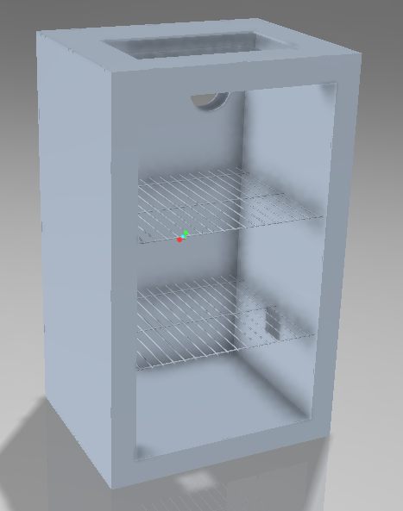
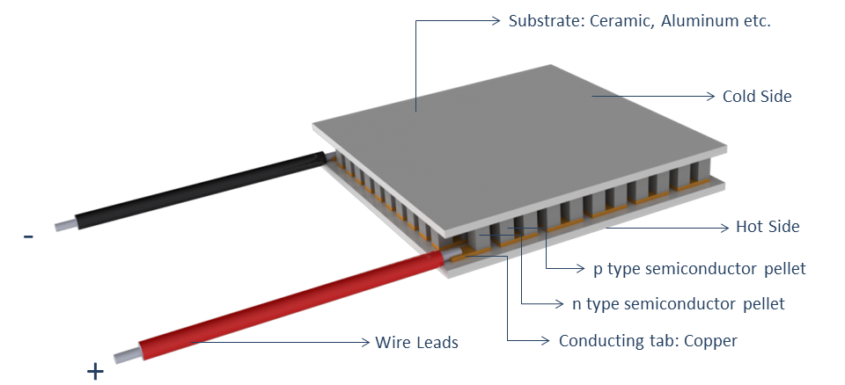
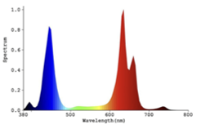
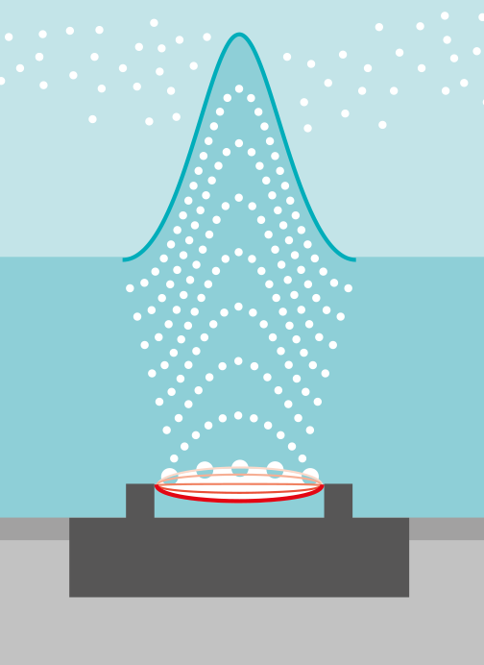
Environmental Growth Chamber
Alexander Hohensee, Shamar Clement, and Jessica Dean
Dr. Douglas E. Willard, Dept. of Mechanical and Civil Engineering, Florida Institute of Technology
Motivation
Structural Design
Peltier Modules
Environmental chambers currently on the market cost thousands of dollars, making research expensive
Most models are built for large-scale research, not small-scale research or commercial sale
Our project aims to be a cost-effective solution to biology research costs, as well as provide an affordable option for personal use
Structure Materials:
0.2 in. Acrylic casing
2 in. EPS Insulation for temp. regulation
Aluminum mounting for thermo-electric (TE) module ports
Figure 2: The TE modules take advantage of valence electrons in p and n type semiconductors to generate and move electricity. This creates a temperature difference and controlled heat transfer
Objectives
Design and build a working environmental growth chamber prototype.
Design chamber interior to accommodate different-sized plants.
Design and build chamber structure with cheap and durable materials.
Incorporate lighting, temperature, and humidity control from a central, user-friendly interface.
Regulate temperature between 5°C - 40°C, relative humidity between 40% and 90%, and lighting through a day-night cycle
Additional Features
Figure 1: Creo model of the chamber’s structural casing
Design Results
Due to the use of Thermoelectric modules to regulate temperature within the environmental chamber, all chemicals were eliminated from the design creating an eco-friendly, sustainable chamber.
Rusting and corrosion were successfully eliminated from the structure.
Budget
Figure 3: Spectrum Percent of Relative Energy.
The chamber operates in full spectrum lighting (IR, red, blue, UV) with a day/night cycle.
Total Allotted Budget | $2,000.00
Budget Used | $643.55
Cost of Unit Production | $744.53
Excess Budget | $1,255.47
Figure 4: Ultrasonic mist modules operate by using a piezoelectric transducer to vibrate at a high frequency under water. Doing so creates water droplets about the size of 5 microns and launches them into the air creating fog/mist.
Future Work
This project was able to stay well under budget, spending the least of any senior design team.
Conduct further research around the dew point and its affects on the TE modules (frosting over due to humidity)
Continue work on system interface and controls
Incorporate maintenance ports into final structure design
Acknowledgements
Thank you to Ethan Bair, Felix Gabriel, Faraz Ege, Adam Georgevich, and Dr. Andrew Palmer.

