Slide 1
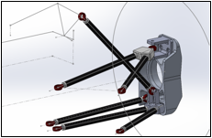
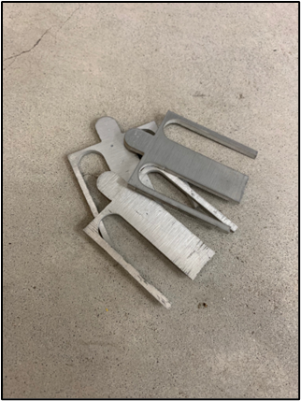
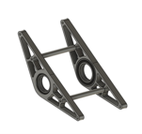
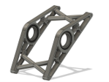
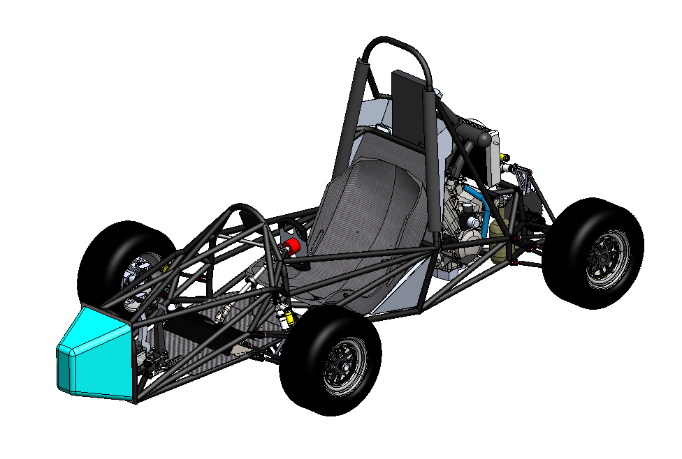
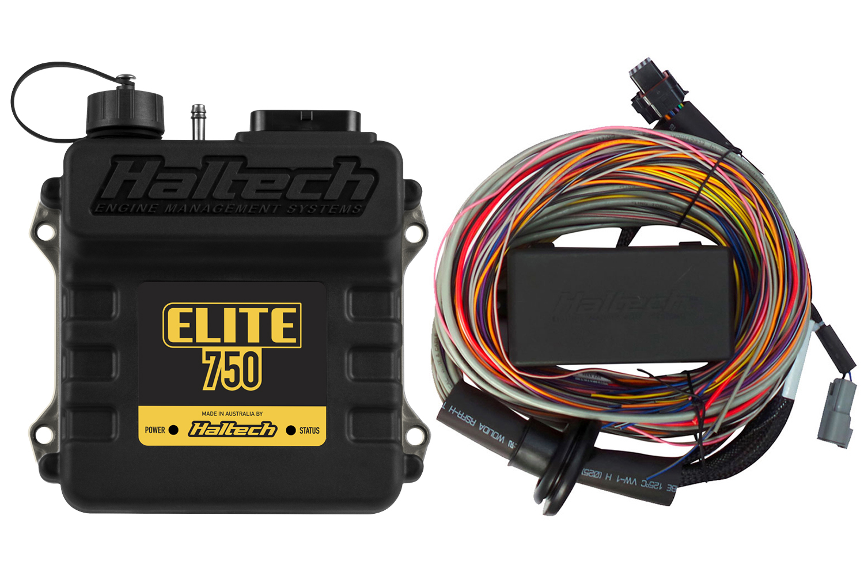
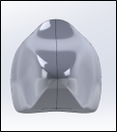
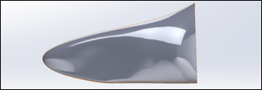
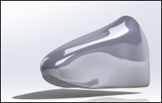
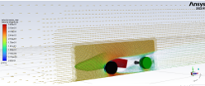
Formula SAE
Sander Sorok, Mason Yaskovic, Shawn Nobles, Trishaa Mahesh, David Dacosta, Caden Englehart, Hamed Al Subhi, Michael Fleckenstein, Terna Chagu, Luis Maiz
Faculty Advisor(s): Darshan Pahinkar, Dept. of Mechanical Engineering, Florida Institute of Technology
Performance
Project Goals
Reliability
Control Arms
Design and build a new Formula SAE racecar based off the last car built in 2019. The team must make meaningful improvements to the 2019 design that will enhance performance, reliability, and safety of the car to compete in Michigan this Spring.
Differential Mounting
Decrease bumpsteer: From suspension full compression to extension there is 0.175 degrees of toe change on the front and 0.02 degrees of tow change on the rear
Maintain camber gain: From suspension full compression to full extension, there is 2.7 degrees of camber increase in the front and 2.52 degrees of camber increase in the rear
Raise suspension roll center: The front is 5.9 inches from the ground surface and the rear is 2.3 inches from the ground surface
Aluminum rods were made to prevent shearing failure seen in the carbon fiber rod inserts. Loads applied were 1.1 G's of cornering with 1.5 factor of safety
Shims manufactured to easily change camber front and rear
The old design was prone to failure
Maximum chain tension found to be 282 lbs
The old design's factor of safety was 1.93 and the new design is 6.34
ECU & Wiring Harness
Wiring harness had to be completely redone due to communication failures between sensors, poor craftsmanship, etc.
Manifold air pressure, Air temperature sensors, O2 Exhaust sensor, and cam sensors used to tune the 2007 Honda CBR 600rr
Aerodynamics
Simple yet effective aerodynamics package
No rear or front wings to minimize cost and weight
Nose cone easy to install and remove for quick driver foot pedal adjustments
CFD analysis to optimize efficiency and downforce

