Slide 1



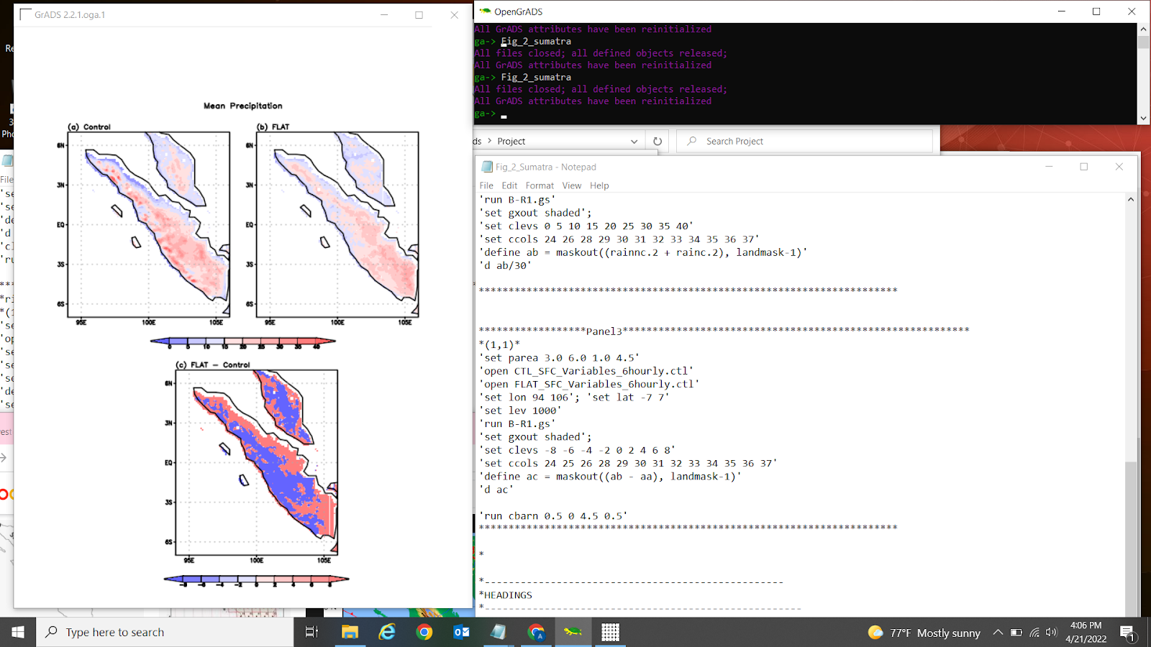
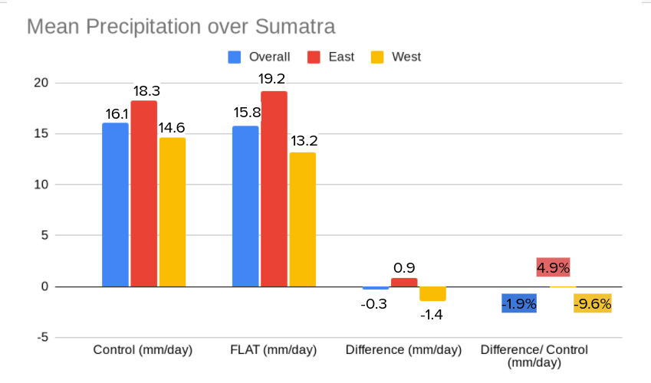
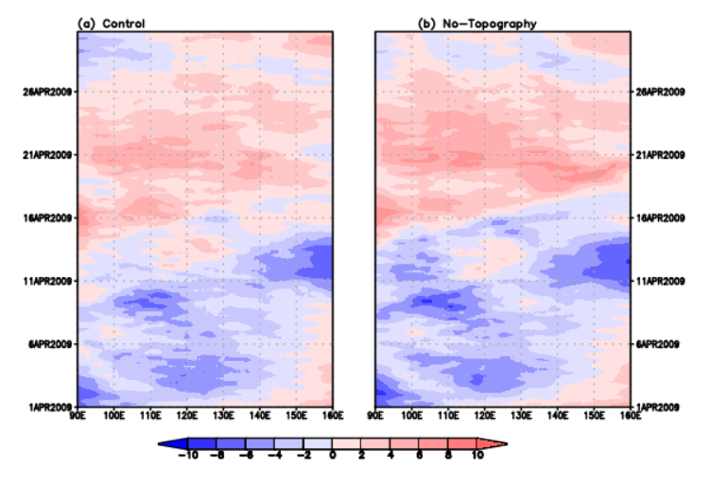
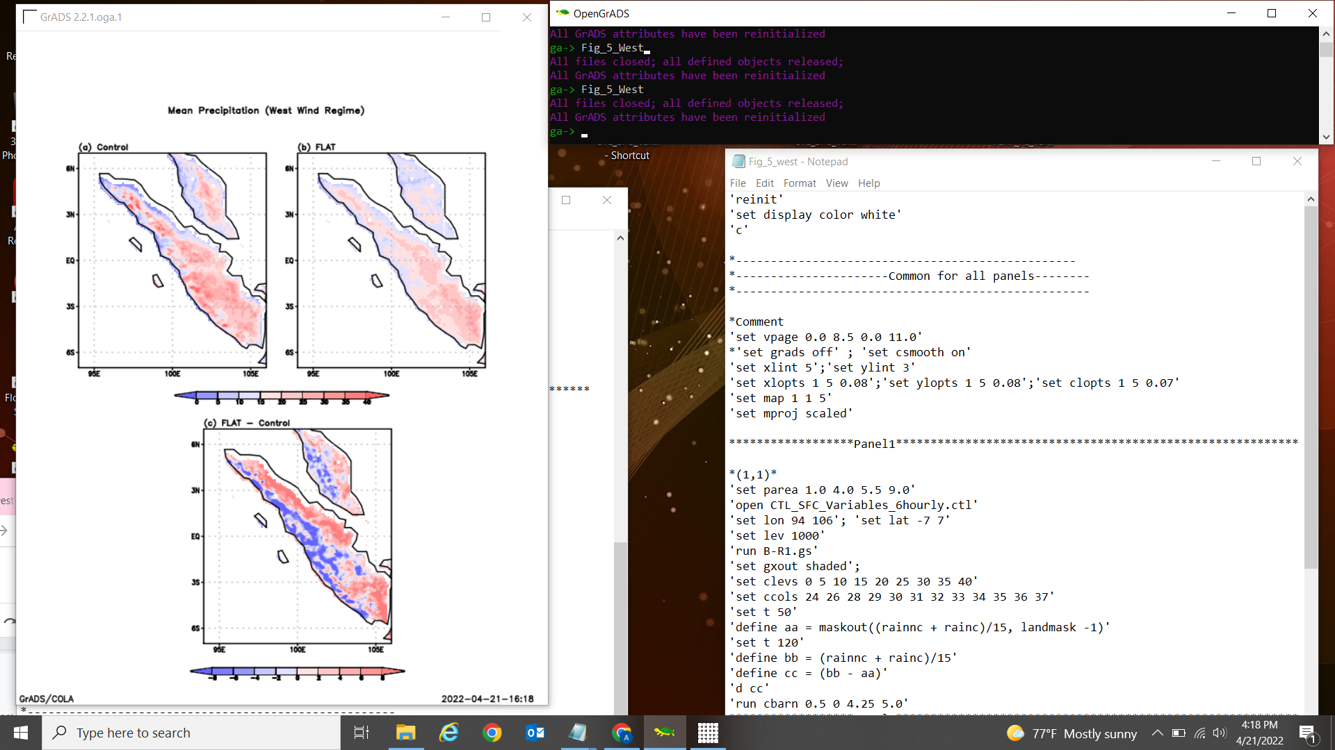
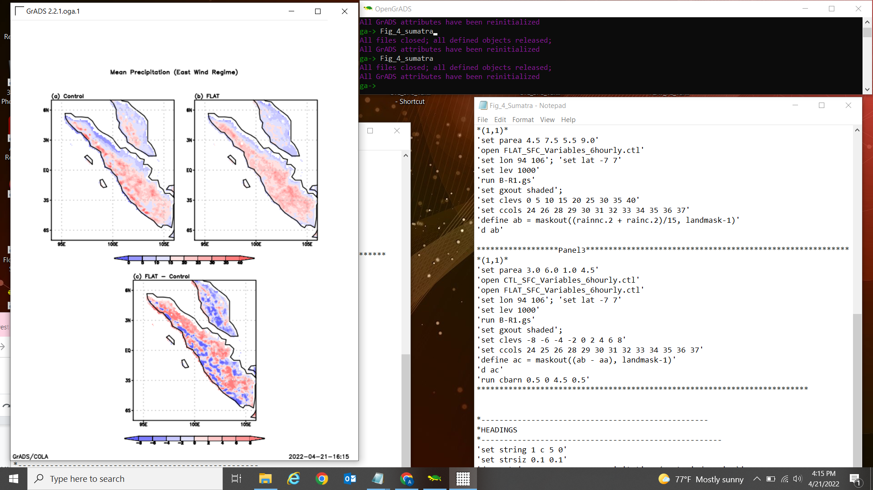
The effect of Topography on Precipitation over Sumatra during an MJO event in the Maritime Continent
Ally Jaime
Faculty Advisor: Pallav Ray, Dept. of Ocean Engineering and Marine Sciences,
Florida Institute of Technology
Introduction
The focus of this research is the Maritime Continent (MC), but more specifically the island of Sumatra. The MC is located in southeast Asia along the equator. This unique area on the globe proposes an extremely difficult challenge for scientists to model. There is a wide variety of topography including islands, mountains and narrow peninsulas. There is also ocean and shallow seas surrounding the 25,000 islands in this region. It is very important to have the MC represented correctly in models because it has a major effect on regional climatology and the global circulation of the earth’s atmosphere. Therefore, to better understand this area, we need to understand the changes in the intra-seasonal variation attributed to the MC. This region typically experiences wet winters and dry summers. While also having typical easterly winds and westerly anomalies. The westerly winds are strongest in winter, occurring during Madden Julian Oscillations (MJOs), and produce the most convection.
Mean Precipitation
Mean Precipitation for the 30 days differ by -0.3 mm/day.
Results and Discussion
The difference between the FLAT and Control mean precipitation over the 30 day time span was only -0.3 mm/day. Although I had hypothesized that Control precipitation would be larger than FLAT, I was expecting a more significant difference. However, after creating a Hovmoller diagram to differentiate between easterly and westerly winds, I was able to create mean precipitation figures for the respective winds. With these figures, I realized the there were substantial differences between the FLAT and Control. The easterly winds had a difference of 0.9 mm/day, while westerly produced -1.4 mm/day. The amount of rain and moisture experienced has a significant impact on the convection that takes place. Since the MC is one of the most important heat sources for global atmospheric circulation, this is critical. Convection creates surplus energy that can be exported to the rest of the globe. This emphasizes the importance of having precipitation represented correctly in general circulation models.
Hovmoller Diagram
Easterly winds are represented in blue and Westerly in red.
Data and Methods
To analyze the way topography affects precipitation over the island of Sumatra in the Maritime Continent, I used data from a time period when a strong MJO passed over the MC in April 2009. The MJO event was similar in nature to typical MJOs that appear in this area during spring. The model output is composed of 120 data points from every 6 hours over the 30 day span of the month of April 2009. The topography for the model was taken from a global multi-resolution terrain evaluation. In an attempt to alienate the role of topography, two simulations were conducted. One uses high-resolution data of the topography and is labeled ‘Control’ (CTL). The other simulation was conducted without any topography over 2 meters on the island and labeled ‘FLAT’. Figures and graphs produced will be made using GrADS software.
Future Possibilities
For this project, I removed topography throughout the entire Maritime Continent. For a future project, I plan to remove topography only over specific islands or areas within the MC.
Mean Precipitation - Westerly Winds
Mean precipitation for westerly winds differ by -1.4 mm/day.
References
Strachan, J. (2007): Understanding and modeling the climate of the Maritime Continent,
Tan, H., P. Ray, B. S. Barrett, M. Tewari, and M. W. Moncrieff, 2020: Role of topography on the MJO in the Maritime Continent
Mean Precipitation - Easterly Winds
Mean precipitation for easterly winds differ by 0.9 mm/day.
Acknowledgements
Dr. Pallav Ray, Meteorology, Florida Insitute of Technology

