Slide 1
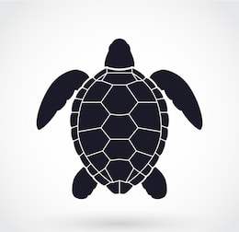
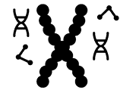

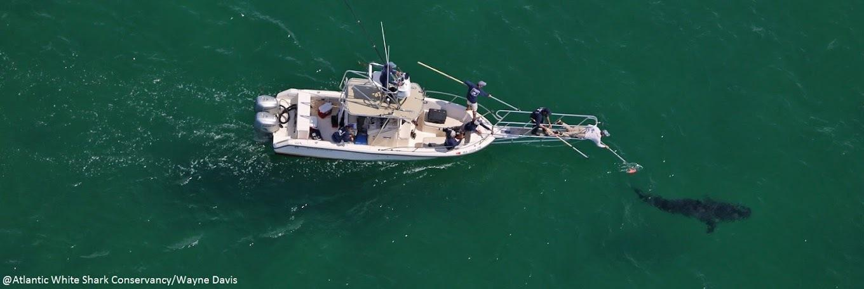
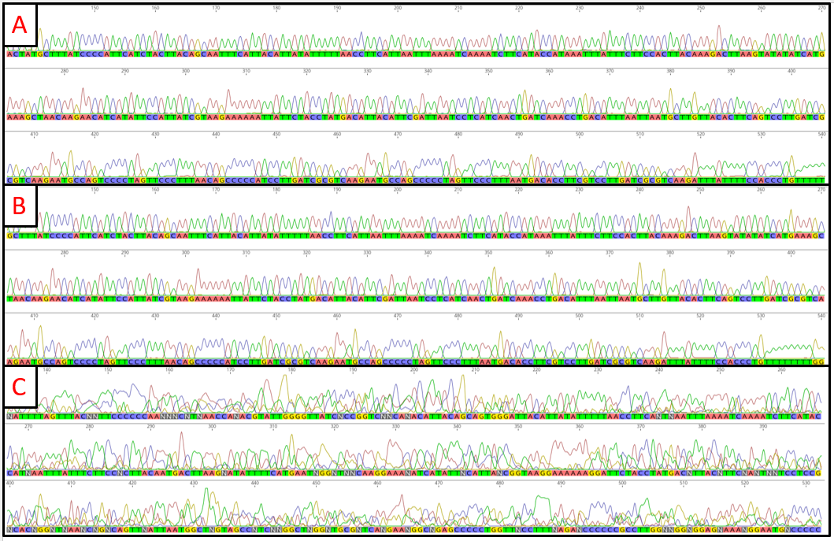
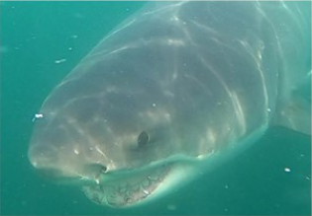
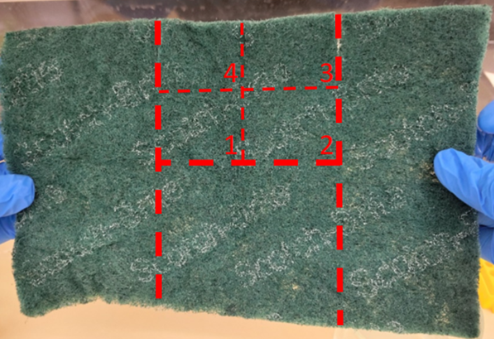
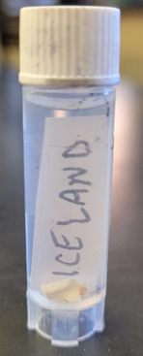
Collecting DNA from Sharks using Non-Invasive Skin Sampling
Lila Xenakis, Megan Winton, Greg Skomal, Toby Daly-Engel
Faculty Advisor: Dr. Toby Daly-Engel, Dept. of Ocean Engineering and Marine Sciences, Florida Institute of Technology
Introduction
Elasmobranchs (sharks, skates, and rays) are ecologically important predators, with >35% of all species currently under threat of extinction¹. Using molecular tools to examine population dynamics can improve conservation by pinpointing high-diversity “hotspots,” but sampling tissue for DNA analysis from large, elusive elasmobranchs remains logistically difficult². This is especially true for rare species like the white shark (Carcharodon carcharias; Fig. 1), which is considered Vulnerable to Extinction by the International Union for the Conservation of Nature⁴.
Fin clips taken during tagging or biopsy samples taken by speargun are traditionally used to collect DNA from white sharks, but these methods are potentially traumatic and pose a risk to both the animals and the researchers⁵. DNA collection using an abrasive surface to swab the skin of an animal has long been done on marine mammals, but this technique has never been used on sharks⁶. In collaboration with the Atlantic White Shark Conservancy (AWSC), we developed and tested a novel, non-invasive method of collecting and extracting DNA from white sharks to enable both individual and population-level genetic testing.
Materials and Methods
Skin swabs were collected from four white sharks with a scouring pad secured to an extendable pole (Fig. 2). Each animal’s dorsum was swabbed while they fed on a dead whale at the surface, and tissue plugs were taken from three of the sharks by biopsy-tipped pole spear. Samples were stored in 70% ethanol.
Sponges were cut into segments (Fig. 3A) and DNA was extracted from one segment at a time using a modified EZNA Tissue DNA Kit (Omega Bio-Tek, Norcross GA) with high fidelity Phusion polymerase. Biopsy samples (Fig. 3B) were processed similarly and quantified on a Qubit fluorometer.
800 base pairs of the mitochondrial control region were amplified using Polymerase Chain Reaction (PCR) and sequenced by the University of Arizona Genetics Core. Sequences were cleaned and aligned using the software Geneious (Biomatters Inc., Boston MA).
Results
PCR reactions using Phusion High Fidelity polymerase worked most consistently for both DNA collection types. Sponge samples produced consistently clean sequences, despite low initial concentrations. Sequence quality did not differ between sampling methods (Fig. 4).
Figure 1. White shark sample WS3 (photo credit: AWSC).
Figure 2. AWSC staff collecting a skin swab from a white shark.
Figure 4. D-loop of the mitochondrial control region chromatogram from Geneious. (A) clean sponge sample, (B) clean tissue sample, (C) failed sequencing sample.
Conclusion
This study shows that DNA can be collected using a non-invasive technique from free swimming white sharks and produce usable data for genetic analyses. These data are crucial for conservation, as white sharks’ low abundance, slow growth, and low reproductive potential hinder their ability to recover from depletion⁽³⁾. With this new method, researchers can collect DNA from white sharks and other threatened species using sponge swabs, ensuring that the animal is less impacted without sacrificing DNA quality.
Citations:
Dulvy, N. K. et al. 2021, Overfishing drives over one-third of all sharks and rays toward a global extinction crisis. 31(21), 4773-4787.
Reed, D. H., & Frankham, R. 2003, Correlation between fitness and genetic diversity 230-237
Huveneers, C. et al. 2018, Future research directions on the “elusive” white shark 455
Rigby, C.L. et al. 2022, Carcharodon carcharias (amended version of 2019 assessment). The IUCN Red List of Threatened Species 2022: e.T3855A212629880.
McClain et al. 2022, Age-Dependent Dispersal and Relatedness in Tiger Sharks (Galeocerdo cuvier) 1221
Thode, A. et al. 2005, Sperm whale and longline fisheries interactions in the Gulf of Alaska—Passive acoustic component 412, 57
Figure 3A. Scouring pad used to collect skin tissues from white shark WS3. Red lines indicate where cuts were made.
Figure 3B. Tissue sample from white shark WS3.
Acknowledgements: Thank you to the staff at AWSC, and all the members of the Daly-Engel Shark Conservation Lab for their work and support for this project. Funding was provided by the AWSC.

